Slide 1
SARCASM DETECTION IN PRODUCT REVIEW FOR SENTIMENT ANALYSIS

Slide 2
INTRODUCTION
Sentiment Analysis is the process of analyzing product reviews to determine the sentiment or opinion expressed by customers.
It involves examining the text of reviews to classify them as positive, negative, or neutral.
Sarcasm detection in product reviews is a specialized aspect of sentiment analysis.
The detection of sarcasm in product reviews contributes to a better understanding of customer sentiments and preferences.
By identifying sarcasm, it ensures a more comprehensive and accurate analysis of customer opinions.

Slide 3
OBJECTIVES
Improve accuracy.
Identify Sarcastic Comments.
It aims to identify sarcastic comments or reviews where the writer's true sentiment contradicts their expressed opinion.
The goal is to enhance the accuracy of sentiment analysis.
To develop a platform for analyzing the sentiment in product reviews

Slide 4
PROBLEM STATEMENT
The issue with sarcasm detection is that it can lead to inaccurate analysis and understanding of the intended meaning of the communication
The challenge is to develop techniques and models to detect sarcasm in product reviews accurately, to ensure the sentiment analysis of product reviews is reliable and reflects the true opinion of customers.

Slide 5
METHODOLOGY
Data Collection
Model Evaluation
Model Deployment
Data Pre-Processing
Feature Extraction
Model Training

Slide 6
EXPECTED OUTCOME
To improve accuracy.
To Identify Sarcastic Comments.
Help businesses understand their customers' needs and preferences
Classify the sentiment as either positive or negative depending on the overall sentiment

Slide 7
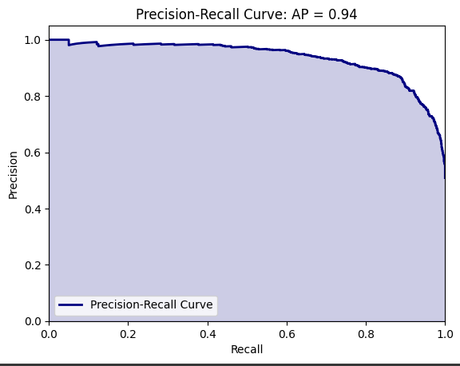
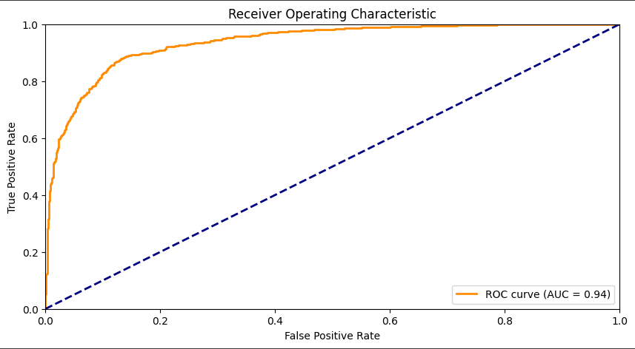
LOGISTIC REGRESSION

Slide 8
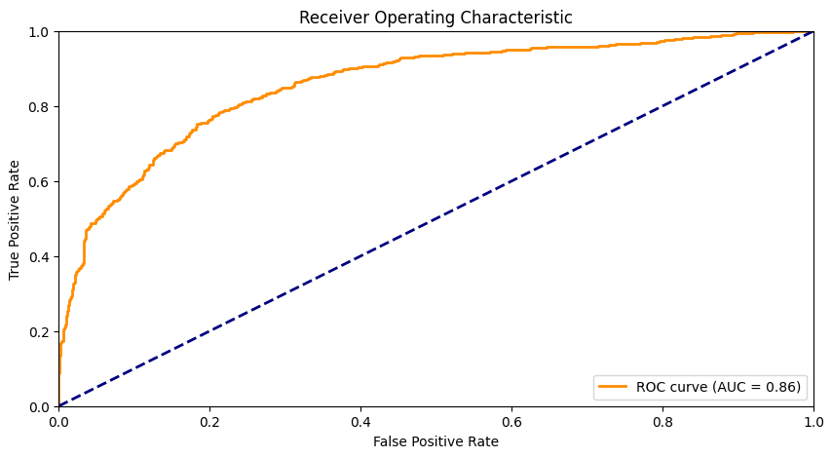
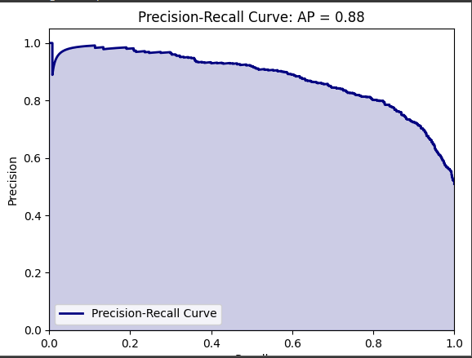
SUPPORT VECTOR MACHINE

Slide 9
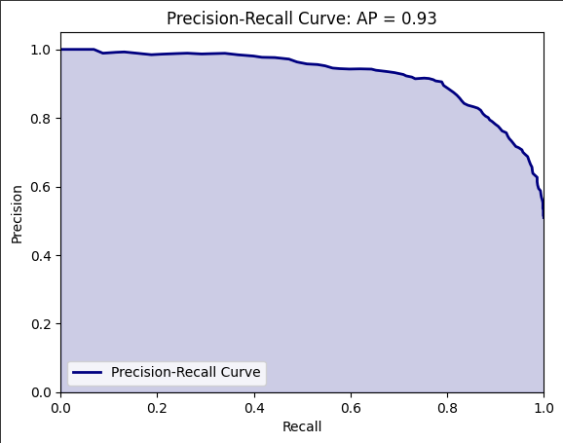
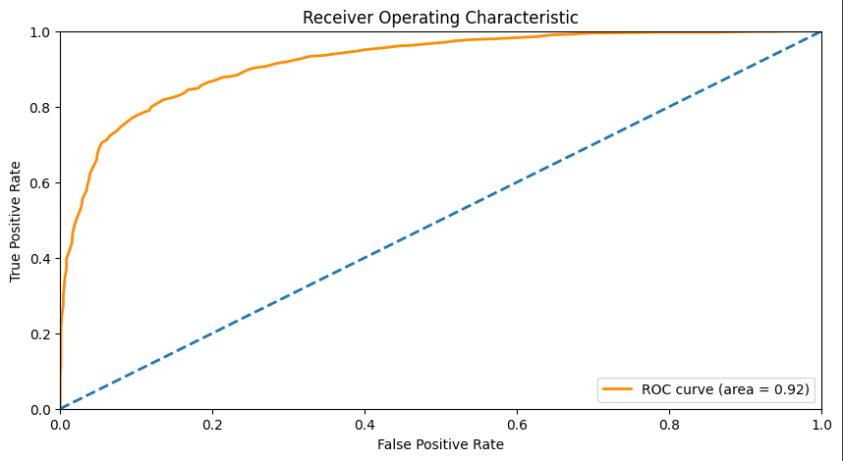
RANDOM FOREST

Slide 10
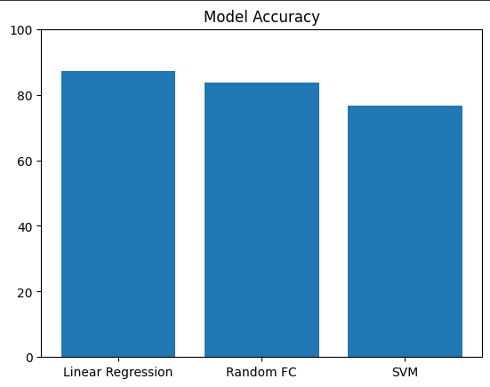
MODELS ACCURACY

Slide 11
CONCLUSION
Sarcasm detection is an important aspect of sentiment analysis in product reviews as it can significantly affect the overall sentiment of the review. However, detecting sarcasm in text can be challenging due to its implicit nature, making it necessary to develop advanced machine learning models that can accurately identify sarcastic language in product reviews.

Slide 12
REFERENCE
[1] Sentiment Analysis Challenges: A Review by Chandrashekhar Tople and P. B. Dhumne International Journal of Recent Technology and Engineering (IJRTE) ISSN: 2277-3878 (Online), Volume-11 Issue-6, March 2023
[2]E-COMMERCE PRODUCT REVIEWS USING SENTIMENTAL ANALYSIS by 1S.Devi , 2S.Bharath Kumar, 3S.Keerthivel ,4S.Ranjith ISSN: 2320-2882[6] S.R. Srividhya and S. Sangeetha, A Methodology to Detect Fraud Apps Using Sentiment Analysis.
[3]https://towardsdatascience.com/a-step-by-step-tutorial-for-conducting-sentiment-analysis-a7190a444366

Slide 13
THANK YOU

