Slide 1














Xin chào
VIETNAM

Slide 2










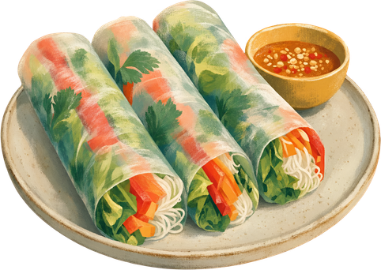

VIETNAM

Slide 3

















