Slide 1


IDEATION CHALLENGE - SEASON 2
Problem Theme : Grid Optimization and Control: AR/VR-Enabled Control Centers
Idea Title : $ATURDAY
Team Name : MEGATRON PRIME
Institute Name: Chennai Institute of Technology

Slide 2
TEAM DETAILS
Team Name: MEGATRON PRIME
Name | Course (B.Tech/ M.Tech/ Ph.D etc.) / Designation | Stream (EEE,CSE, etc.) | Year (I,II,III,IV,V) | Role (Team Leader/ Team Member/ Mentor)
Dikashma shree Selvakumaran | B.E | CSE(AIML) | II | Team Leader
Jashwanth N | B.E | EE-VLSI | II | Team Member
Sanjay G | B.E | EEE | II | Team Member
MENTOR : Dr.R.M.Bommi Maruthi raj (HOD OF EE-VLSI)

Slide 3
IDEA PITCH
Our $ATURDAY solves grid instability and inefficiency problems,it helps to lead with standardised test programs and allowing the employees to gain operational experience over the leading operating complexity and also, helping GIS power grid operators by using DRL and XGBoost while also simulating the grid path allocation in VR and the the operation in AR.
Innovating real-time smart grid management.
Problem and existing alternatives | Proposed Solution | Company Knowledge | Customer Segments
Inefficient simulation space,high fault rates,high transmission loss,operational complexity. | P2P node communication,real-time grid control and simulation using AR/VR, DRL, XGboost. | Expertise in AI, FPGA acceleration,Unity app development and GIS HVDC monitoring system. | Power grid operators, smart city planners, Renewable energy sectors.
Unique value propositions |  | Channels/Touch points
AI-driven fault prediction, real-time AR/VR visualization, ultra-low latency response. |  | Web dashboard, AR/VR control centers and monitoring systems.
Our AI-Enhanced Smart Grid System solves grid inefficiencies and fault prediction problem,
helping power grid operators by reducing downtime and optimizing load distribution.
Innovating The $ATURDAY.

Slide 4
PROBLEM STATEMENT
Problems in power sector: Transmission loss, Path optimisation, lack of operational experience and standardized testing for HVDC GIS(AC).
Customers and End users: PGCIL,TANGEDCO,MRE,CEA. the end users are the individuals, businesses, and industries that ultimately use the electricity transmitted through the HVDC grid.
Relevant Insights: 30 – 40% of total energy loss occurs due to transmission and distribution (T&D) inefficiencies, Mumbai secured about 10k-15k Cr for the power transmission unit in GIS,Major grid failures affected 620 people due to outbreaks.

Slide 5
PROPOSED SOLUTION / IDEA
Brief Explanation: We create a virtual 3D version of the power grid where operators can see live data and simulate and experience it and test solutions. AI helps in optimizing the power flow (XGBoost) automatically.
Problem Overview: It tackles the optimization of load between the 3-phases optimizing load (DRL), and offering immersive operator tools (AR/VR) for rapid decision-making this enhances the resilience and also reduces the downtime.
Innovation: This project integrates AI-driven digital twin, AR control centers, and predictive AI to optimize smart grids, enhancing fault detection, power distribution, and maintenance, while ensuring real-time, Multi-node access, and self-automated grid operations.

Slide 6
IMPACT AND BENEFITS
Benefits: AR can overlay real-time data (voltage, current, power flow) on PLC panels that operate on SCADA. Operators can visualize the entire power grid in AR (real-time) with P2P-communication, detecting faults instantly and optimise path.
Potential Impact: $aturday will have a direct positive impact on power companies, engineers, regulatory bodies, and consumers, while also supporting renewable energy and academic research. It’s long-term scalability makes it a potential industry standard for modern grid management.
Commercial viability: One-Time Licensing & Setup Fees (making use of customised deployment for their network), A strategic partnership with power companies and hardware providers will accelerate its adoption, making it a scalable and profitable venture.

Slide 7
MARKET ANALYSIS
Market Insights: Renewable Energy Expansion and Renewable integration on Spark-HECSTM, digitalization and decarbonization projects in United States and the development of bi-directional EV Charging leads to huge spike for grid management in the Market as per the current analysis.
Competitors: Siemens AG has been the leading the competitor for this project as their annual growth rate has reached (CAGR) 8.06%, ABB, Hitachi Energy, GE Vernova, HD Hyundai Electric, Mitsubishi Electric.
Uniqueness: Decentralisation of grid monitoring and management system while changing the idea of operational experience but simulating the system in AR/VR by reducing it’s complexity and proving much accurate predictions and analysis to reduce transmission loss by using our path optimisation for the best outcome.

Slide 8
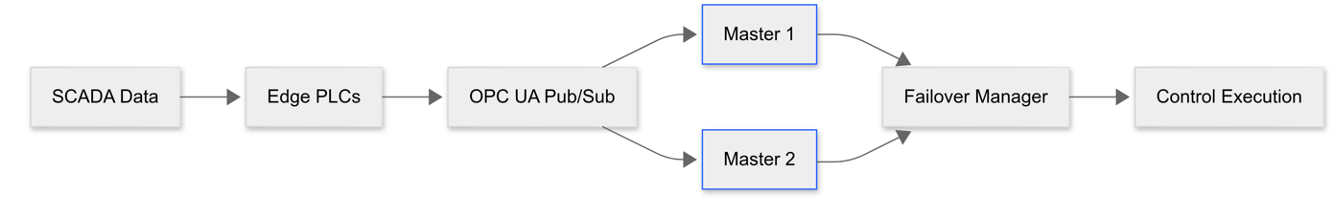
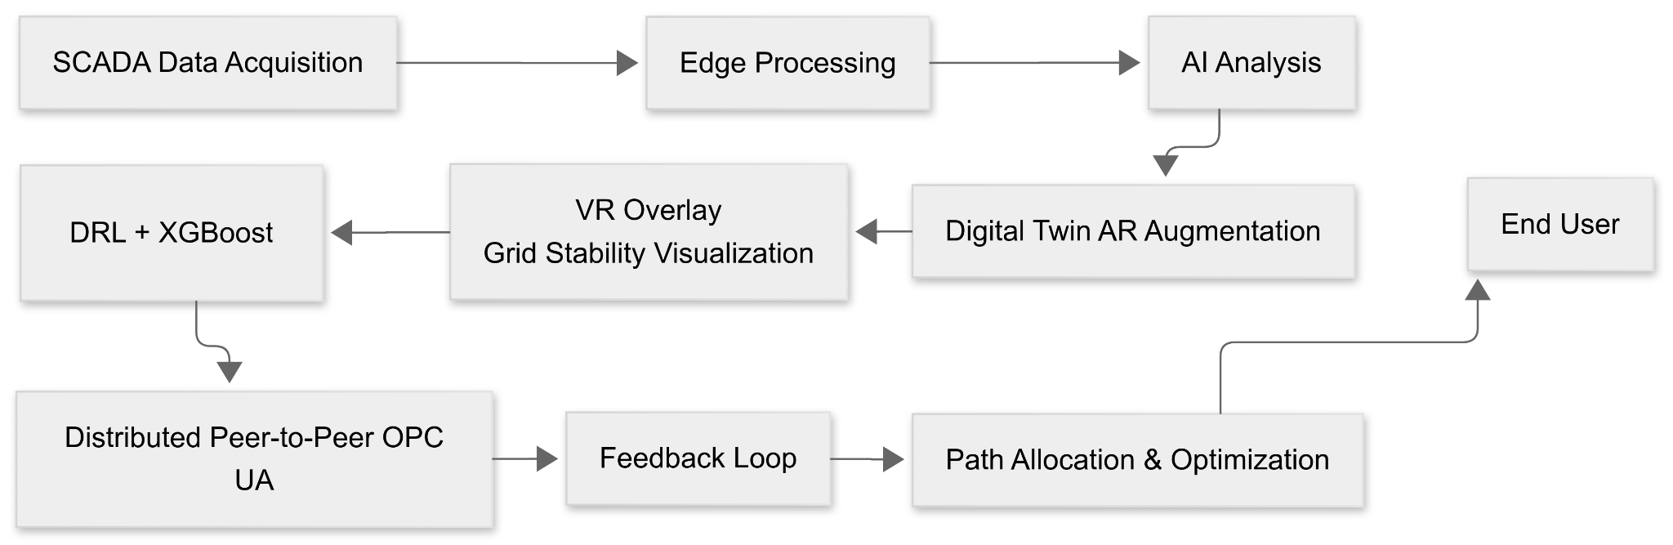
TECHNICAL APPROACH
P2P-Communication:
WORKFLOW:
$aturday provides decentralization and lesser complex operation on the power grid with real time VR visualisation and AR digital twins.

Slide 9
OUTCOMES
Grid Stability: We use Peer to Peer communication with (IEC 61850 Compatibility) between nodes to bring the decentralization of the SCADA architecture that works on the PLC control section of the grid (feasible).
Path optimisation: Models like XGboost and deep reinforcement learning are used to simulate simple physics through the system and interact with the simulated data that’s acquired from iVisionmax in CSVs and the right path is queued to start.
Digital-operation(Tool): The Entire control system(Master) is augmented in AR and the grid stability is simulated in VR ensuring the digital twin can be be accessed and can be used to run test by the employees for operational experience (a simulation tool simpler than running COMSOL multiphysics and lesser load).
User friendly: it is feasible and viable for any systems as it’s made by Unity.

Slide 10
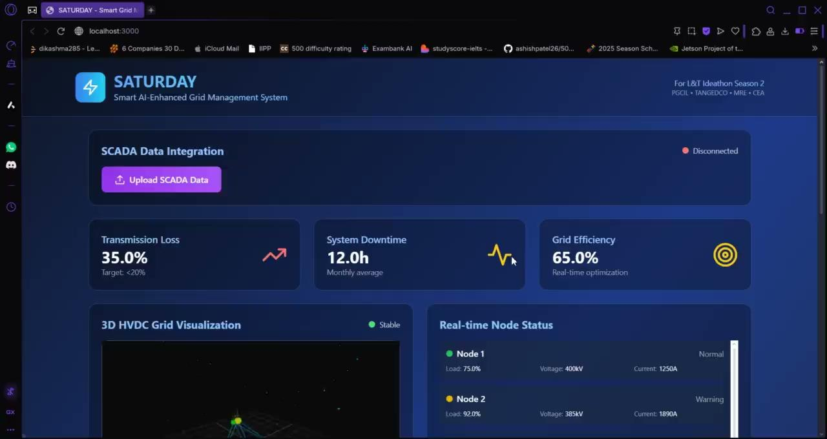
RESULTS
Checklist: - Synthetic SCADA data - Dashboard (Simulation) Under-Development: - AR/VR

Slide 11
FEASIBILITY AND VIABILITY
Feasibility: $aturday is technically feasible , needs strong software, hardware, and data security measures & Economically, it has long-term potential, especially in training and real-time monitoring while Operationally, it requires training and cybersecurity focus.
The “Challenging” Part: There’s a need to develop a middleware layer to extract and visualize data and Any new control system must comply with IEC 61850 (Smart Grid Standard) and national power grid regulations.
The “Resolve” Part: We use IOT gateways and P2P node access for seamless communication and there’s a need to Work closely with regulatory bodies from the start.

Slide 12
RESEARCH AND REFERENCES
https://www.mdpi.com/1424-8220/22/22/8980
https://www.researchgate.net/publication/388837864_Edge_AI-Based_Fraud_Detection_System_for_Smart_Grid_Power_Monitoring
https://www.mdpi.com/2076-3417/14/23/10933#:~:text=Digital%20Twin%20technology%20represents%20a,physical%20aspects%20of%20electrical%20grids.
https://www.researchgate.net/publication/367972661_A_Review_on_Digital_Twin_Technology_in_Smart_Grid_Transportation_System_and_Smart_City_Challenges_and_Future
https://www.larsentoubro.com/pressreleases/2024-09-30-lt-makes-new-strides-in-digital-energy-solutions-business/
https://www.larsentoubro.com/pressreleases/2024-05-08-key-order-wins-in-renewables-and-grid-systems-reflect-lt-s-dominance-in-clean-energy-space/

Slide 13
GitHub Link: (demo-version)
Thank You!

