Slide 1
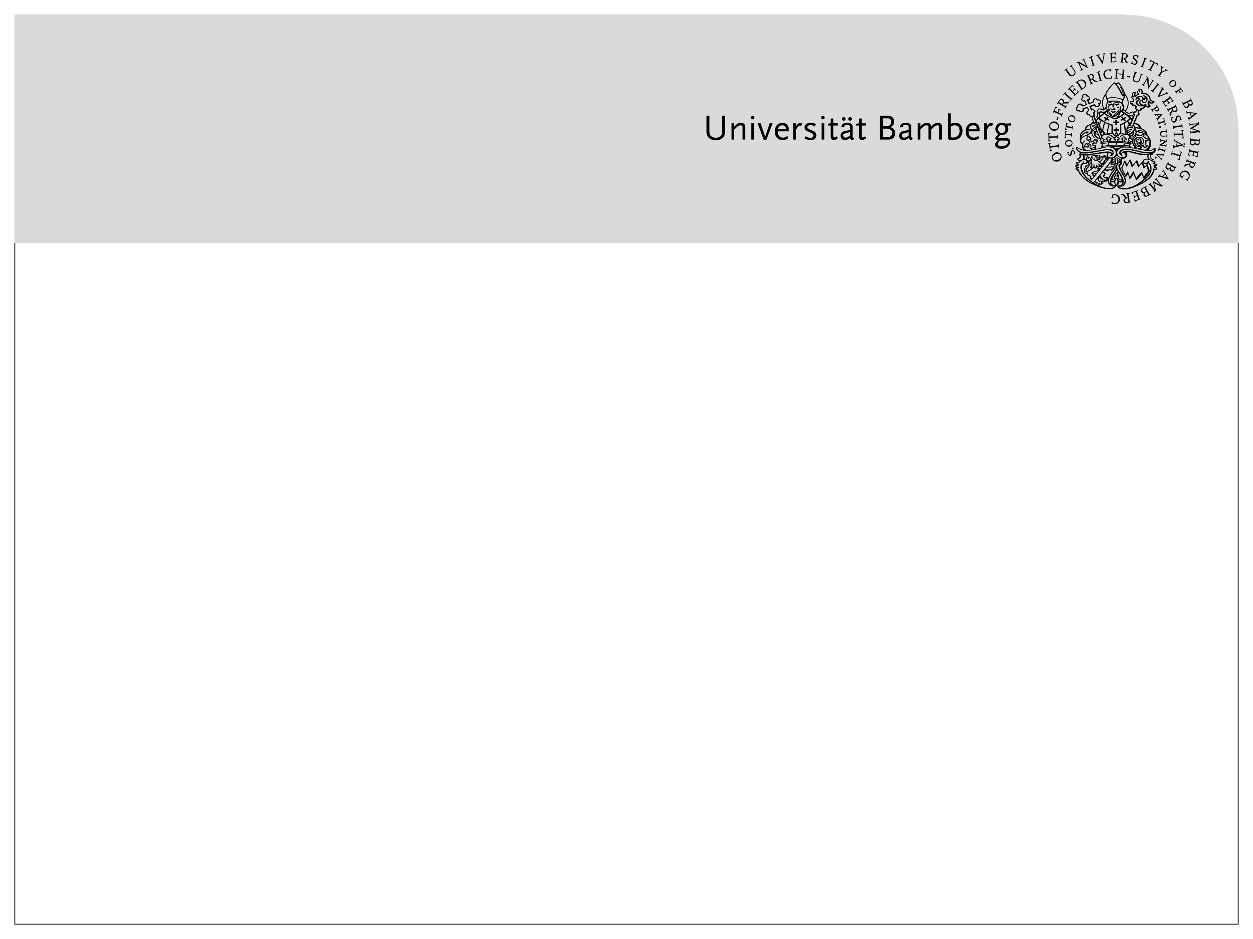
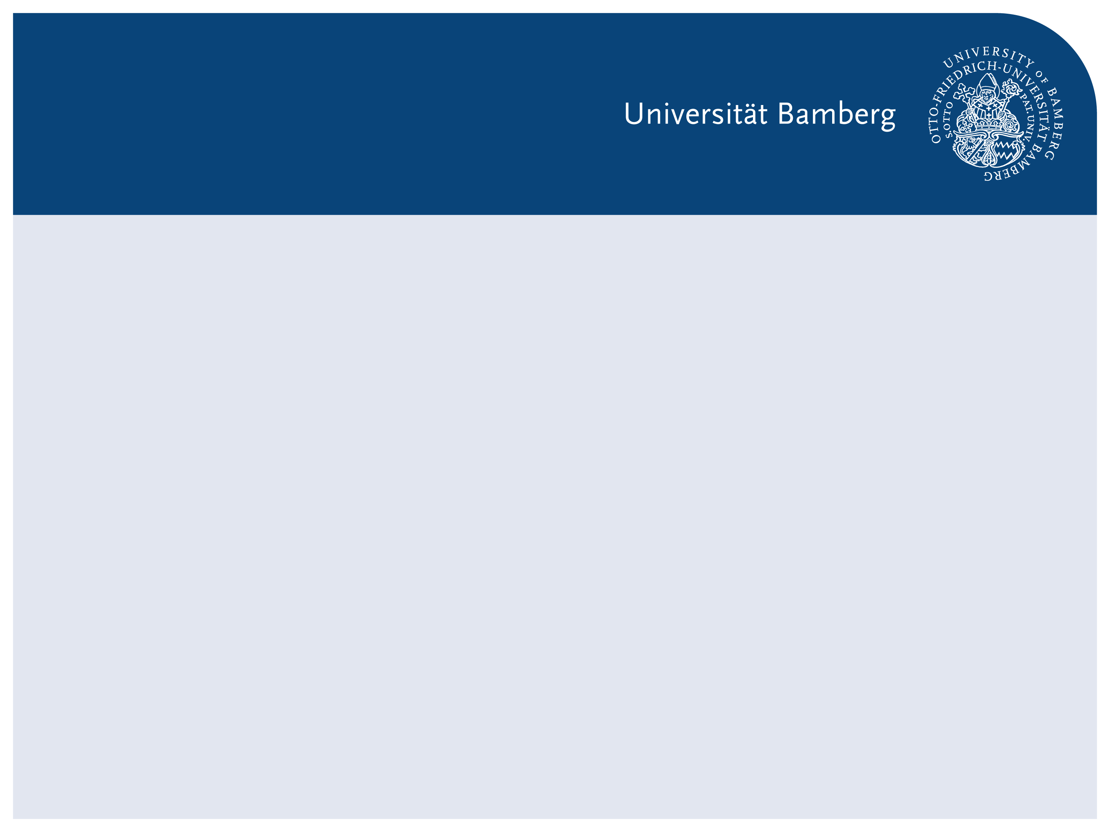
From Accuracy to Explainability: Understanding CNN Errors with xAI
xAI-Proj-B Course Project – CNN-based Image Classification

Slide 2
Course Context & Motivation
Context
Explainable AI course
All teams: first CNN + xAI project
Motivation
CNN accuracy can look convincing
But:
Are errors random?
Can we trust confident predictions?

Slide 3
CNN Basics (Learner Perspective)
CNN Intuition
CNNs learn hierarchical visual features
Early layers: edges, textures
Deeper layers: shapes, object parts
Why CNNs
Designed for image data
Widely used in object classification

Slide 4
Model Choice & Baselines
Our Setup
Backbone: ResNet18
10-class image classification
Baseline Design
Different pretraining sources
Different training strategies

Slide 5
Research Question & Red Thread
Research Question
What kinds of errors does a CNN make?
How confident is it when it is wrong?
Can xAI help us understand these errors?
Red Thread
Build → Observe → Question → Explain

Slide 6
Initial Results: Accuracy Is Not Enough
Observation
Models reach reasonable accuracy
Model B performs best overall
But
Accuracy alone does not show:
Error structure
Confidence behavior

Slide 7
Why Sample-Level Analysis?
Limitation of Aggregate Metrics
Accuracy averages over samples
Risky errors are hidden
Our Idea
Look at individual predictions
Combine:
correctness
confidence
loss

Slide 8
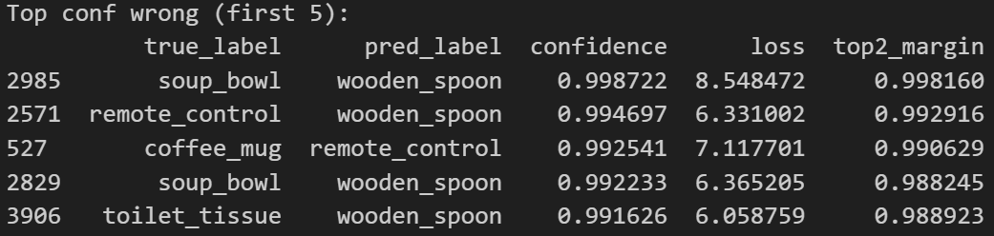
Difficulty Table & Error Subsets
Per-sample Metrics
Prediction & true label
Confidence
Loss
Defined Subsets
Easiest correct
Hardest correct
Low-confidence correct
High-confidence wrong

Slide 9
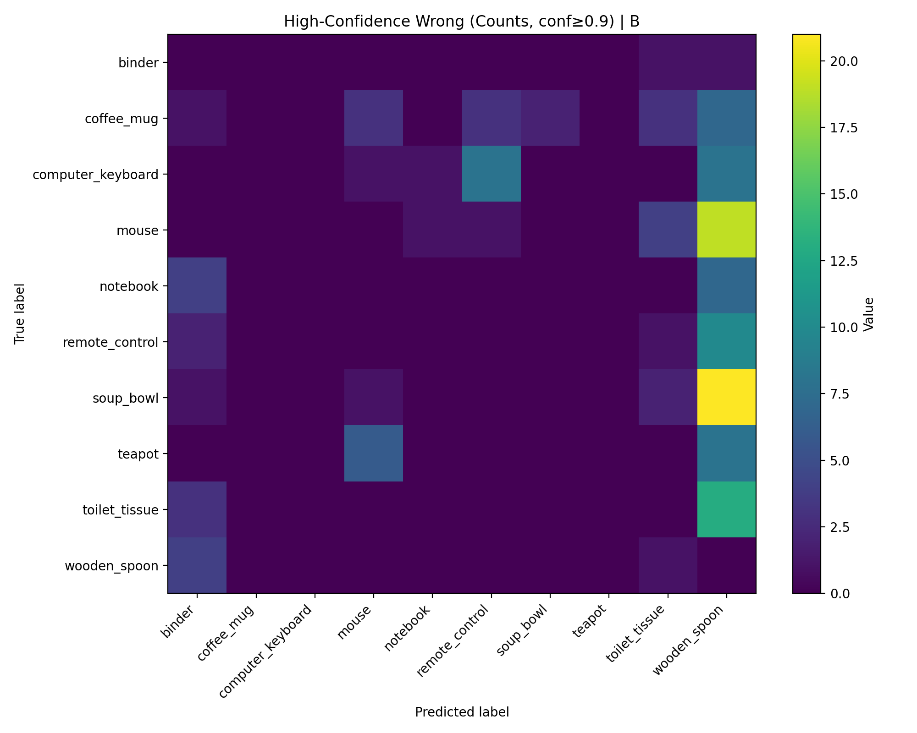
Focused confusion on high-confidence wrong

Slide 10
Interim Summary: What We Learned So Far
So Far
Errors are not random
Confidence does not guarantee correctness
Some classes dominate errors

Slide 11
Why Explainable AI?
What is Grad-CAM?
A visual explanation method for CNNs
Highlights image regions that contribute most to a specific prediction
Produces a heatmap over the input image
Method (Our Use Case)
Apply Grad-CAM to high-confidence wrong samples
Analyze whether the model focuses on object regions or spurious cues

Slide 12
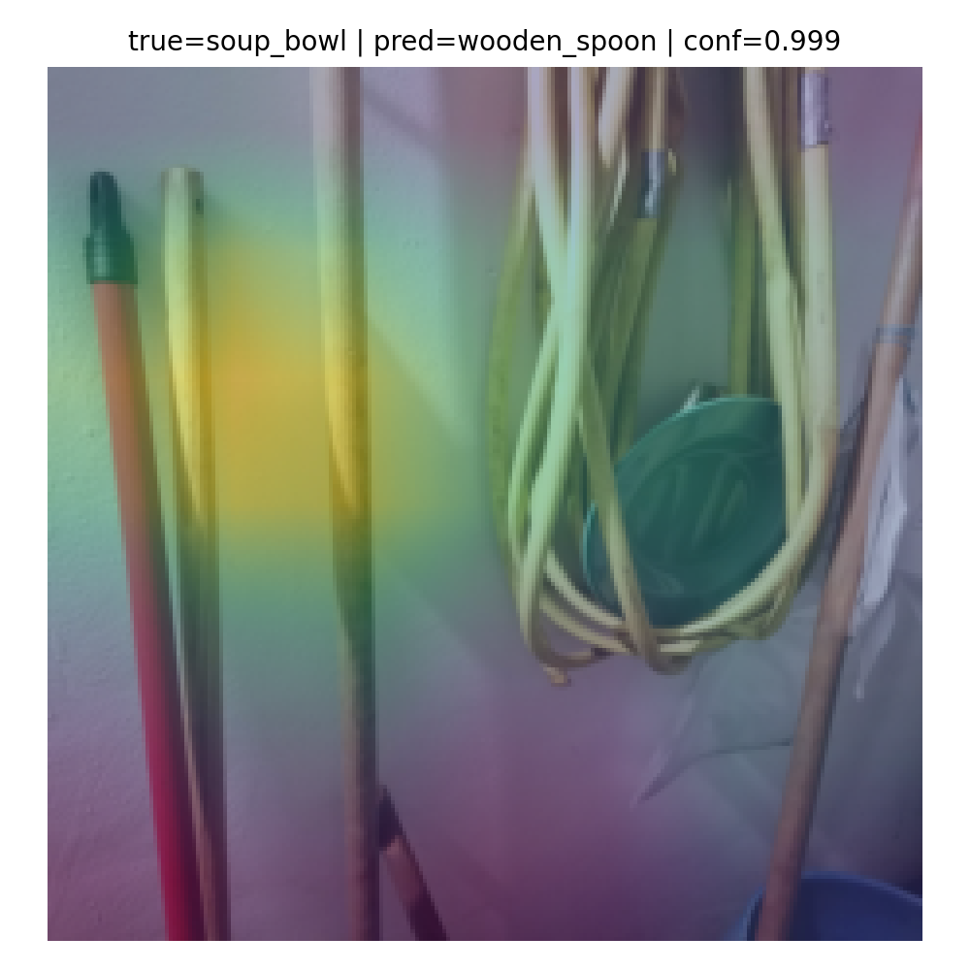
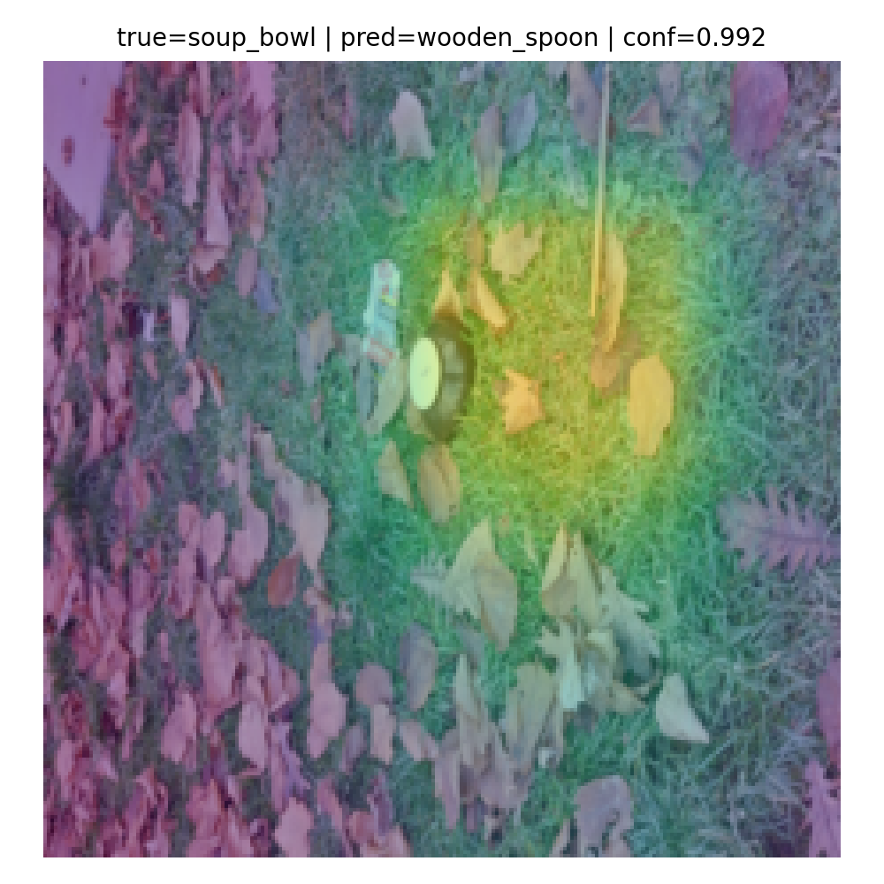
Grad-CAM Examples (1): soup_bowl → wooden_spoon

Slide 13
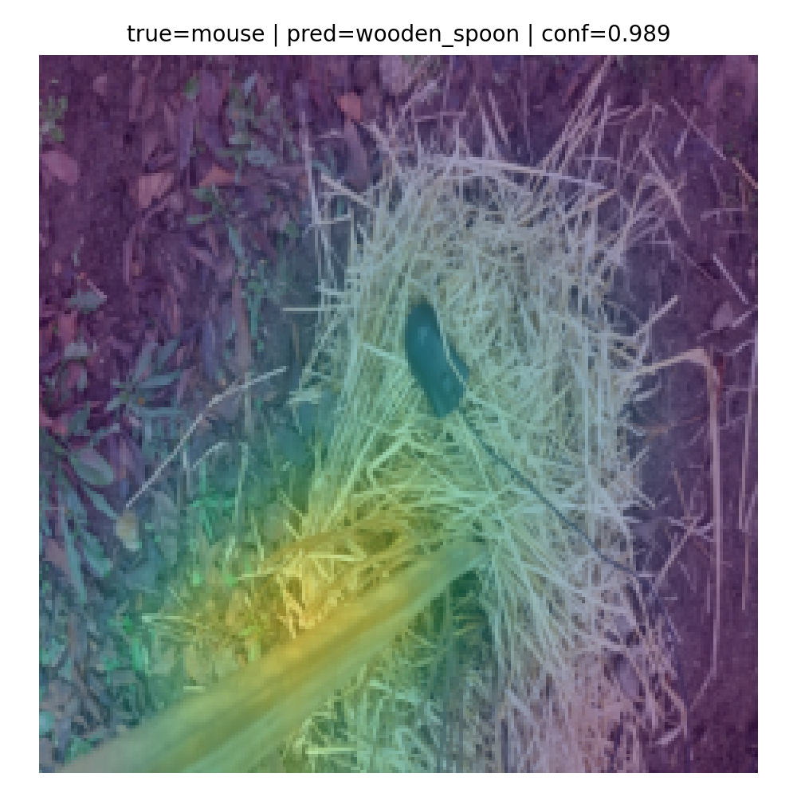
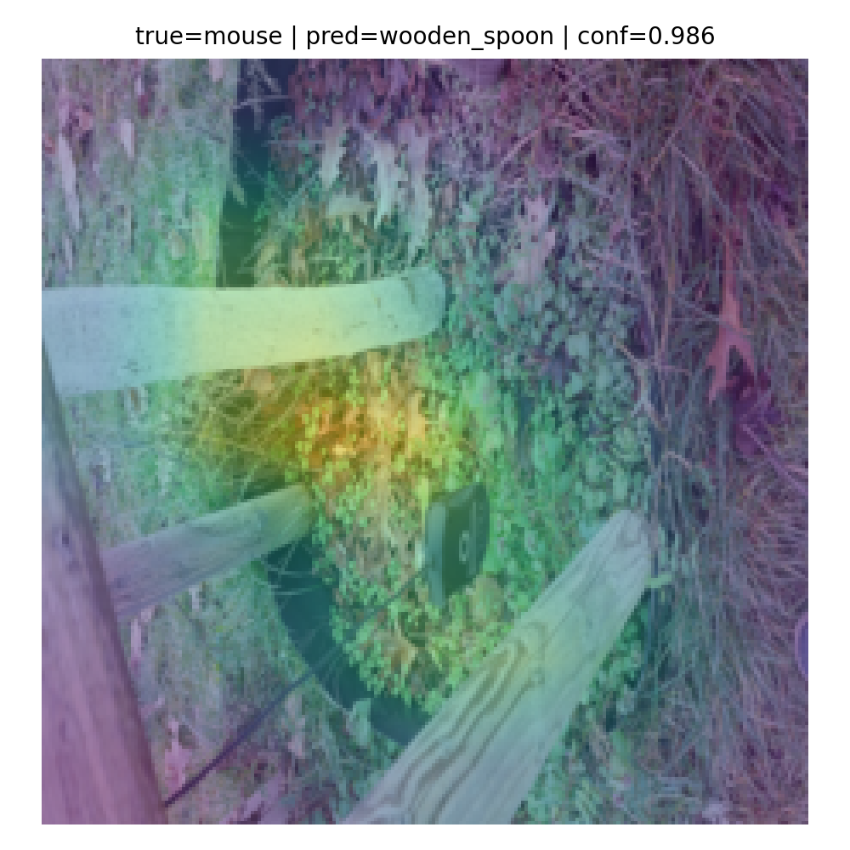
Grad-CAM Examples (2): mouse → wooden_spoon

Slide 14
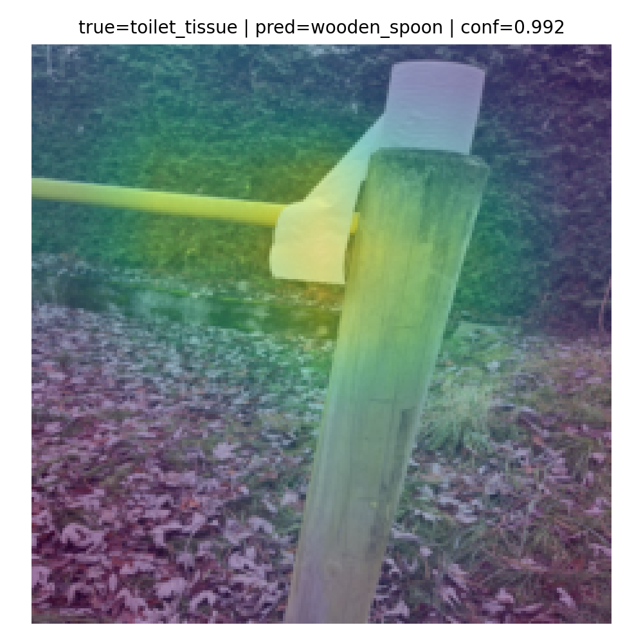
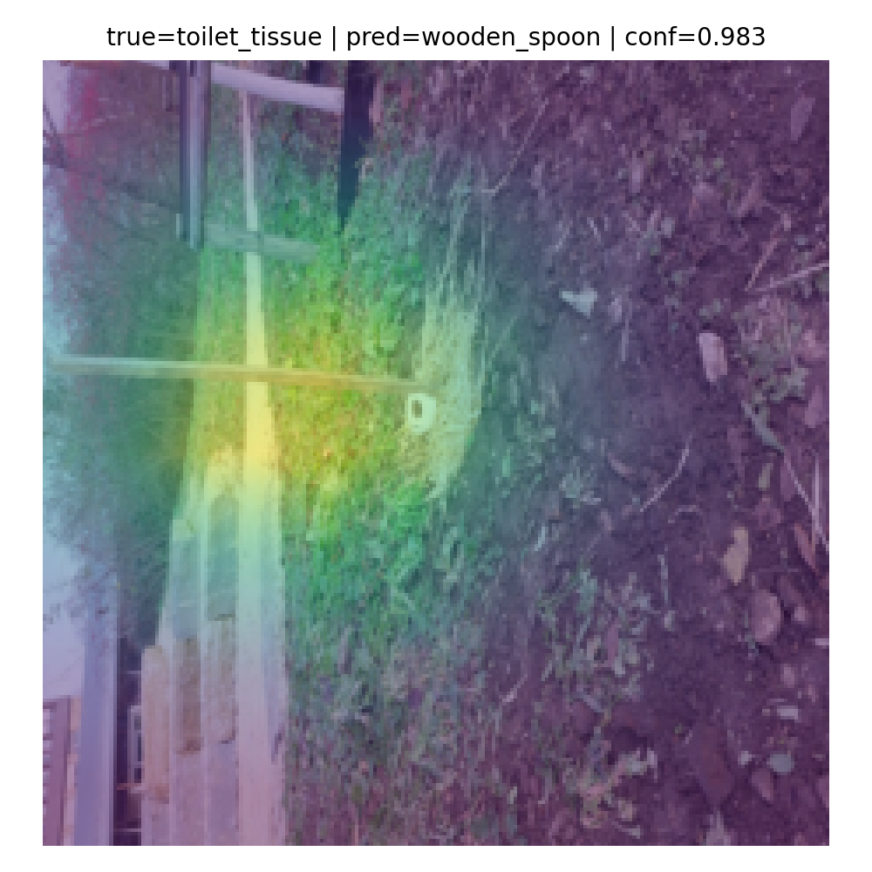
Grad-CAM Examples (3): toilet-tissue → wooden_spoon

Slide 15
Grad-CAM Insights
Observation
Attention focuses on:
wooden textures
elongated shapes
background regions
Interpretation
Shortcut / texture bias
Overgeneralization of wooden_spoon features

Slide 16
Reflection, Trust & Next Steps
Reflection
Accuracy ≠ reliability
Explainability changes how we trust models
Next Steps
Cross-model comparison
Calibration checks
Data diversity

