Slide 1


Online Recruitment System
IGATE is now a part of Capgemini
Notes:
Copyright © 2011 IGATE Corporation (a part of Capegemini Group). All rights reserved.
No part of this publication shall be reproduced in any way, including but not limited to photocopy, photographic, magnetic, or other record, without the prior written permission of IGATE Corporation (a part of Capegemini Group).
IGATE Corporation (a part of Capegemini Group) considers information included in this document to be confidential and proprietary.

Slide 2

Team Members
Nishant Mhatre
Vinay Gupta
Vishal Gupta
Diksha Gupta
Shraddha Surve
Priyanka More

Slide 3
Project Details
The Online Recruitment System is developed to enhance the Recruitment which work fully online.
Online Recruitment System allows a job seeker (fresher or a working professional) to log into the application and submit his resume with other academic information.
The job seeker can search for a job with the many given categories.
An employer can also sign up and provide the employment details and search for fresher or working professional with the corresponding details.
Such sites also make it possible for recruiters and companies to post their staffing requirements and view profiles of interested candidates.

Slide 4
Diagram Depicting Entire Project

Slide 5
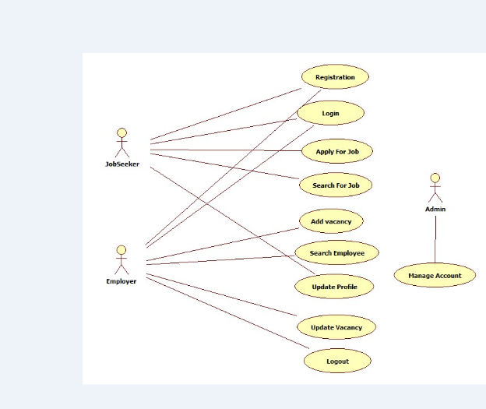
Use Case Diagram

Slide 6
Class Diagram

Slide 7
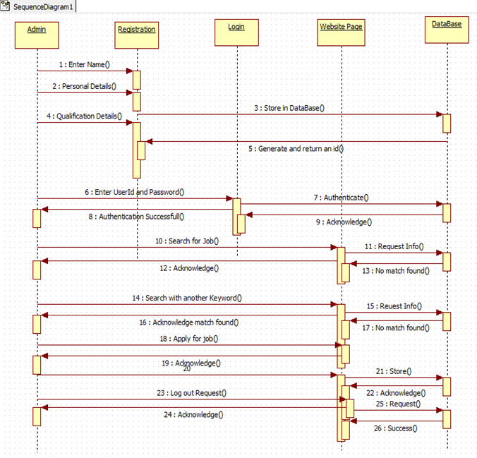
Sequence Diagram

Slide 8
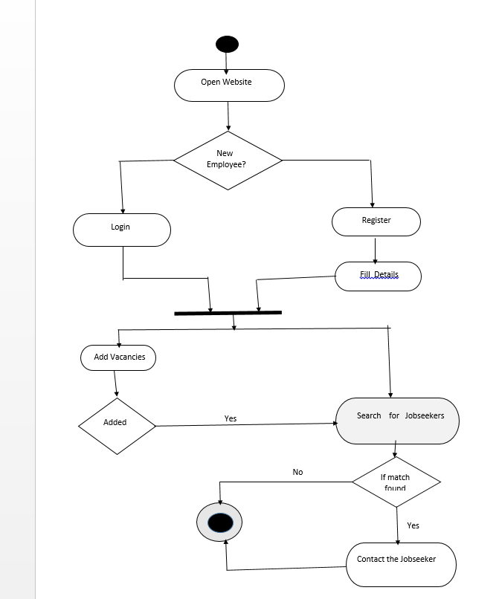
Activity Diagram

Slide 9
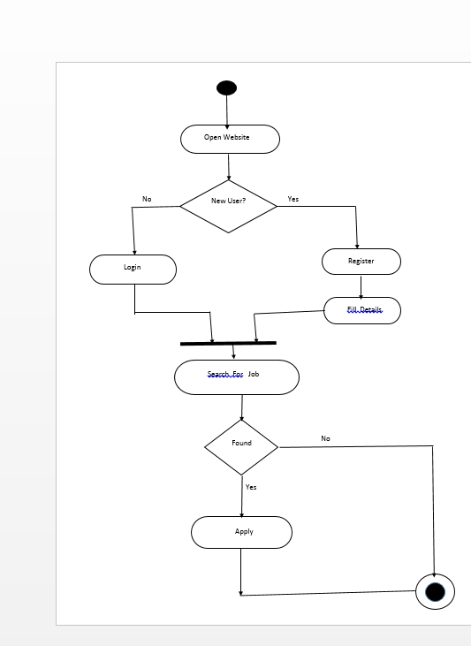
Activity Diagram

Slide 10
Screen shots

Slide 11
Screen shots

Slide 12
Future Enhancements
The three macro economics trends that are seen as fuelling the growth of this industry are:
Shorter employment tenures
Shrinking labor pools
Need for technology workers
In wake of the new and related trends.
It is imperative for frequent upgrades to a company’s software or web applications to make it easier for clients and employees to address new business needs.

Slide 13

Thank You
Any Queries

