Slide 1
Agentic AI Health Symptom Checker
IBM HACKATHON PROJECT
Presented By: Arti Sunil Dikole

Slide 2
OUTLINE
Problem Statement
Technology used
Wow factor
End users
Result
Conclusion
Git-hub Link
Future scope
IBM Certifications

Slide 3
Problem Statement
Millions rely on internet searches for health concerns, leading to misdiagnosis and unnecessary panic.
Healthcare access is limited in remote and underserved areas.
Doctors are overwhelmed with minor cases that could be self-managed with proper guidance.
Current online symptom checkers are static and lack contextual, personalized reasoning.
There is no proactive AI-driven tool that can:
Understand natural language descriptions of symptoms.
Ask intelligent follow-up questions.
Suggest safe, reliable next steps.

Slide 4
Technology used
Cloud & AI Services
IBM Cloud Lite – Cloud platform for scalable AI deployment.
Natural Language Processing (NLP) – Understands medical symptom descriptions in plain language.
Retrieval Augmented Generation (RAG) – Fetches relevant medical knowledge for accurate answers.
IBM Granite Model – Advanced large language model for reasoning and contextual understanding.
Supporting Tools & Frameworks

Slide 5
IBM cloud services used
IBM Watson Natural Language Understanding (NLU)
Extracts entities, keywords, symptoms, and sentiment from patient text input.
Helps classify medical intent.
IBM Watson Assistant
Powers conversational chatbot flow for patient symptom discussions.
Integrates with the backend AI reasoning engine.
IBM Cloud Object Storage
Stores anonymized patient data, medical reference documents, and AI training datasets.
IBM Watson Discovery (for RAG)
Enables Retrieval Augmented Generation (RAG) to pull relevant medical knowledge from trusted datasets.
IBM Granite Model
IBM’s foundation LLM is used for contextual understanding and reasoning.
IBM API Gateway & App ID
Secures APIs and manages authentication/authorization for patient access.
IBM Cloud Databases for PostgreSQL / MongoDB
Secure, scalable storage for structured and semi-structured health records.

Slide 6
Wow factors
Agentic AI Reasoning – Goes beyond Q&A to proactively guide users toward better decisions.
Dynamic Follow-up Questions – Adapts based on user’s responses for accurate triage.
RAG (Retrieval Augmented Generation) – Pulls trusted medical knowledge in real-time for reliable suggestions.
IBM Granite LLM Integration – Enterprise-grade AI for contextual understanding & safe health guidance.
Multi-Language Support – Accessible for non-English speakers in rural and global contexts.
Emergency Detection – Flags critical symptoms and advises immediate action.
Privacy First – HIPAA-compliant data handling with encryption.
Continuous Learning – Improves with every interaction using anonymized feedback loops.

Slide 7
End users
General Public
Anyone seeking quick, reliable health guidance.
Self-check symptoms before visiting a doctor.
Patients in Remote / Rural Areas
Limited access to healthcare facilities.
Need trusted AI guidance in local languages.
Elderly & Chronic Disease Patients
Continuous monitoring for recurring symptoms.
Early alerts for health deterioration.
Healthcare Professionals
Doctors get pre-assessed patient cases.
Reduced time spent on minor cases.
Telemedicine Platforms
Integrates as a pre-consultation triage tool.
Helps prioritize urgent patients.

Slide 8
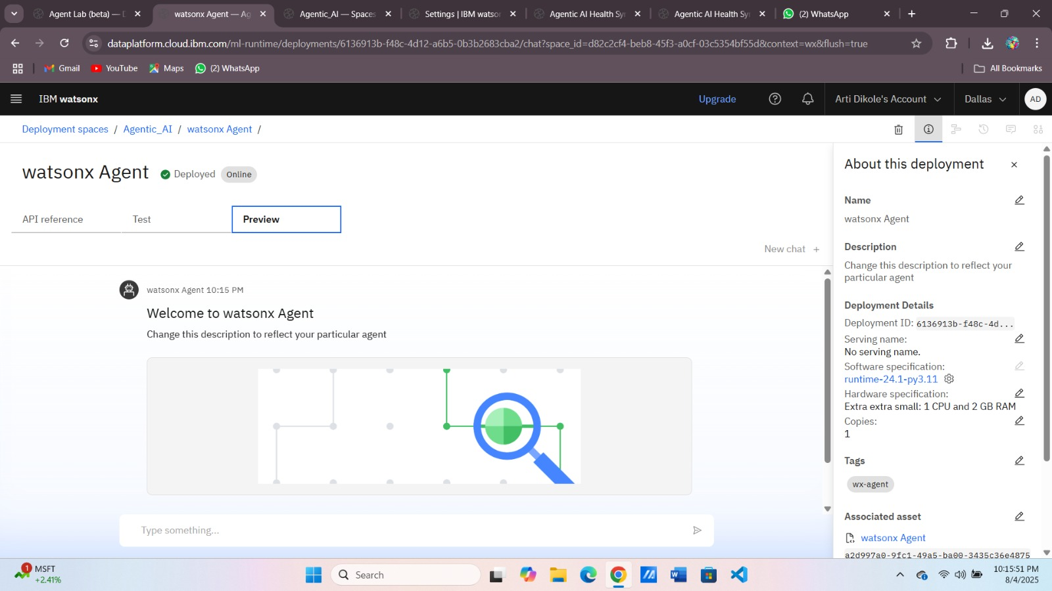
Results

Slide 9
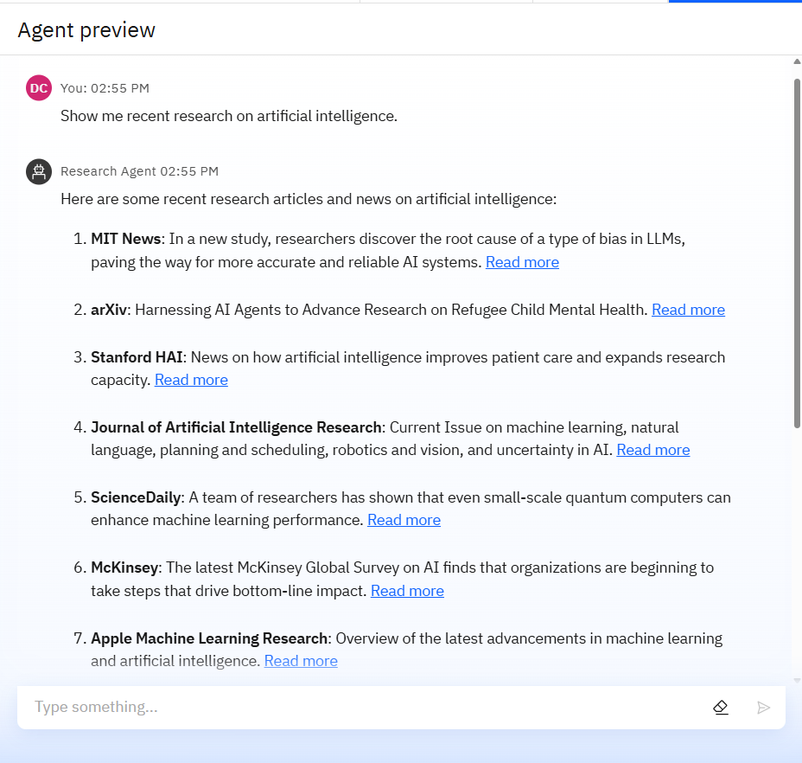
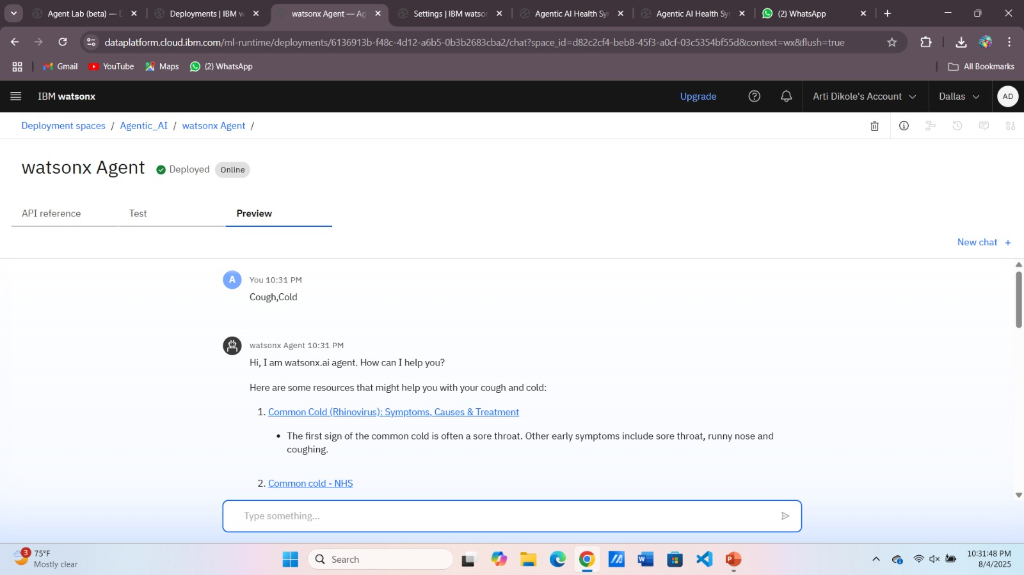
Results

Slide 10
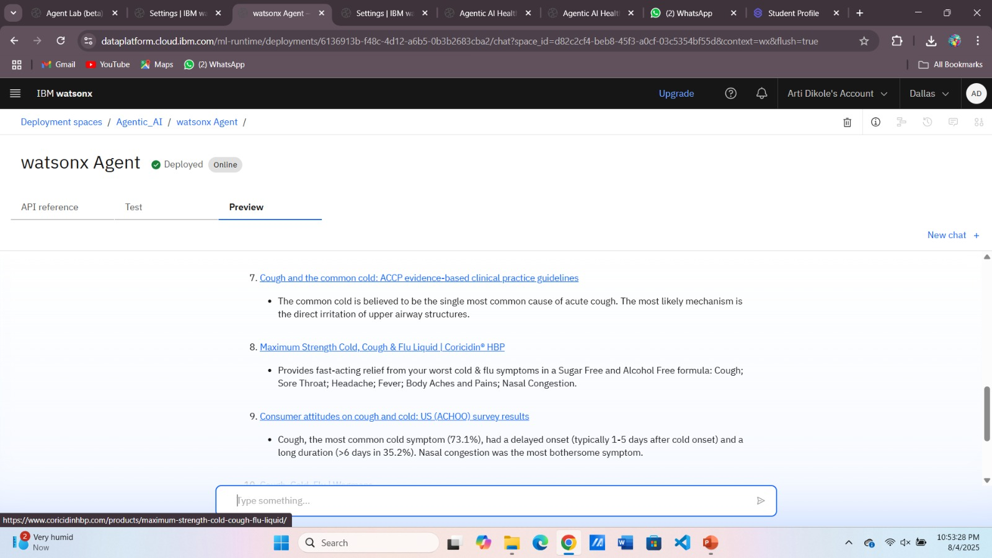
Results

Slide 11
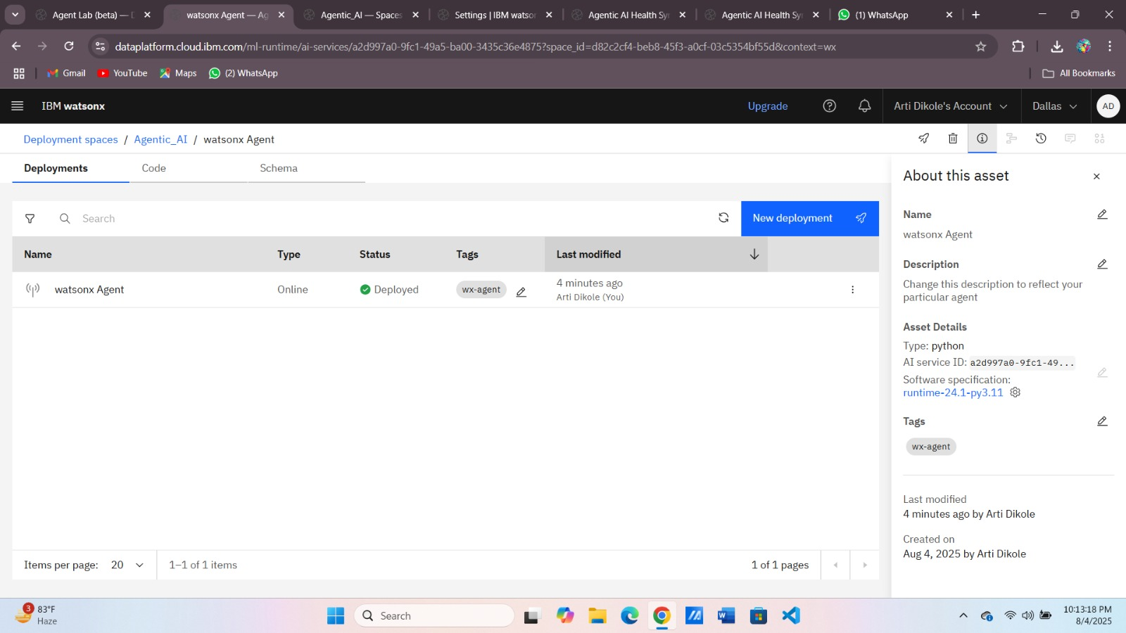
Results
Deployed AI Agent

Slide 12
Conclusion
Provides accurate, personalized, and proactive health guidance.
Bridging the gap between patients and healthcare using Agentic AI.
Leverages IBM Cloud, NLP, RAG, and IBM Granite model for safe and reliable recommendations.
Empowers users with early detection and informed decisions.
Potential to reduce healthcare burden and improve access globally.

Slide 13
GitHub Link
https://github.com/DikoleArti/Agentic-AI-Health-Symptom-Checker

Slide 14
Future scope
Wearable Device Integration – Real-time health monitoring via smartwatches & IoT devices.
Telemedicine Integration – Direct booking with doctors from within the app.
Multi-modal Input – Voice, image, and video-based symptom analysis (e.g., rash detection via photo).
Preventive Healthcare Alerts – AI-powered reminders for health checkups & vaccinations.
Global Language Expansion – Support for multiple regional & international languages.
AI-driven Predictive Health Analytics – Early detection of chronic diseases through pattern recognition.
Integration with EHR Systems – Seamless sharing of patient data with hospitals & clinics (with consent).
Offline Mode for Rural Areas – Limited-function AI triage without internet connectivity.

Slide 15
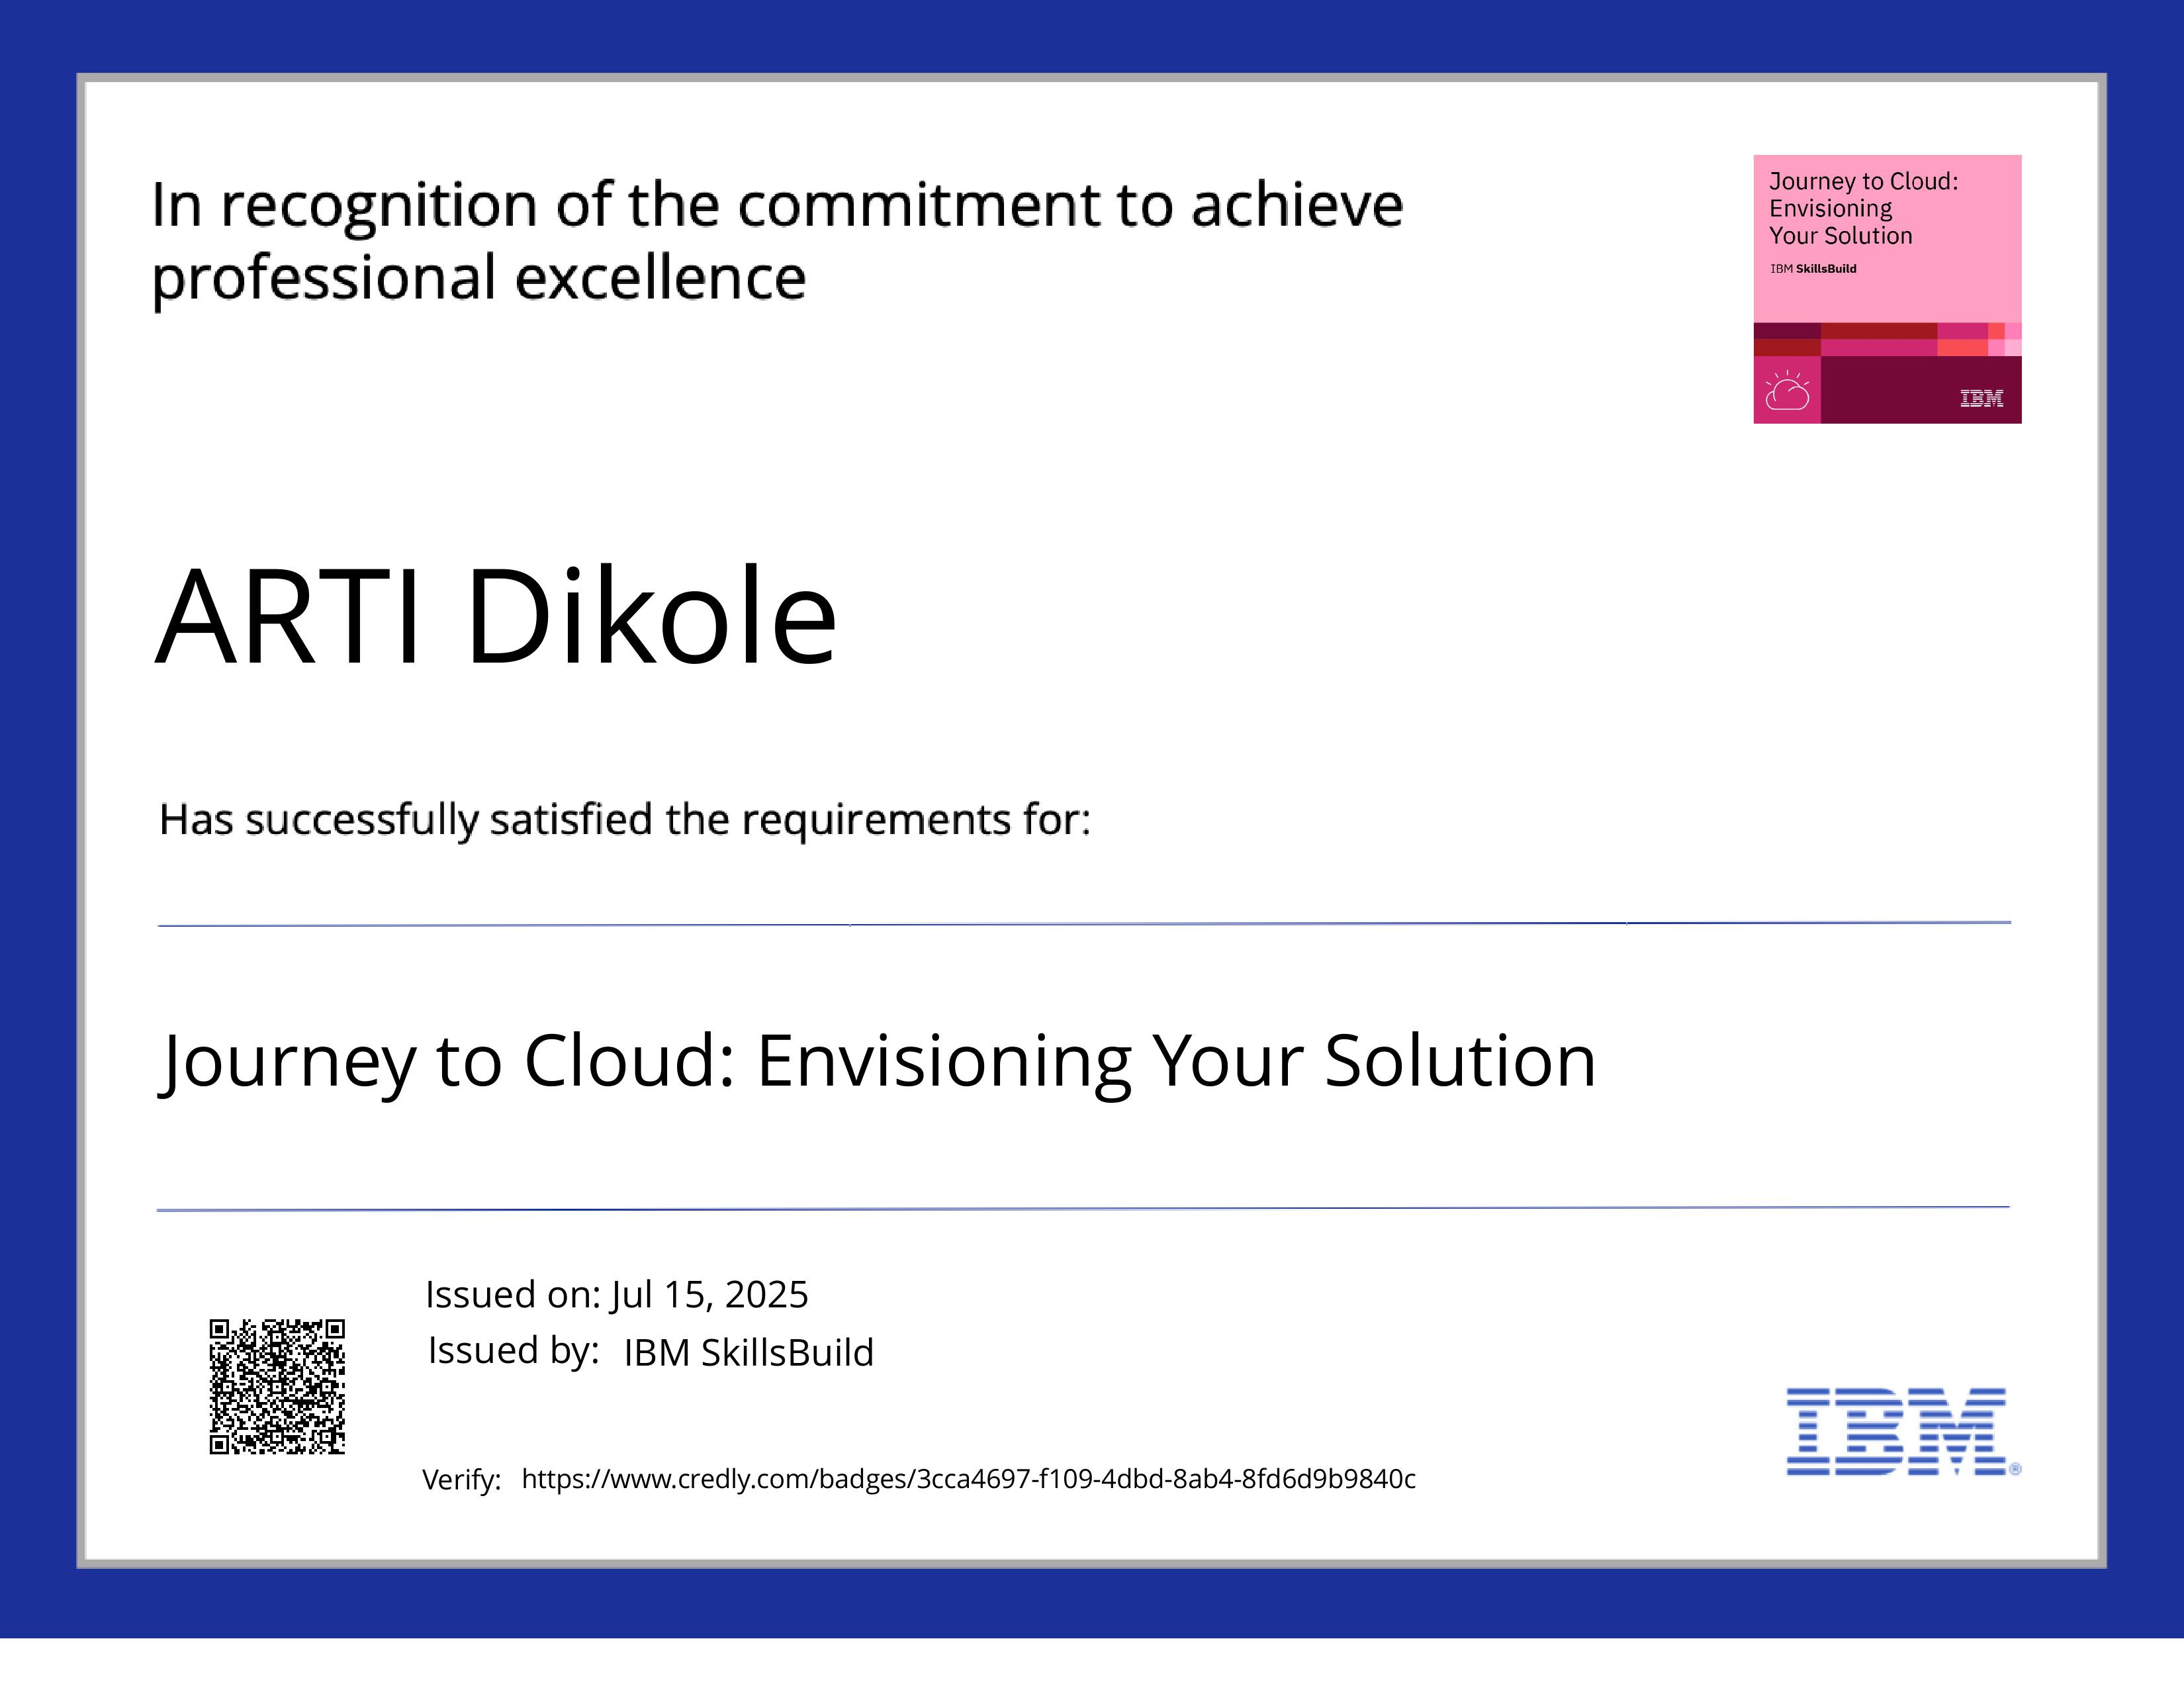
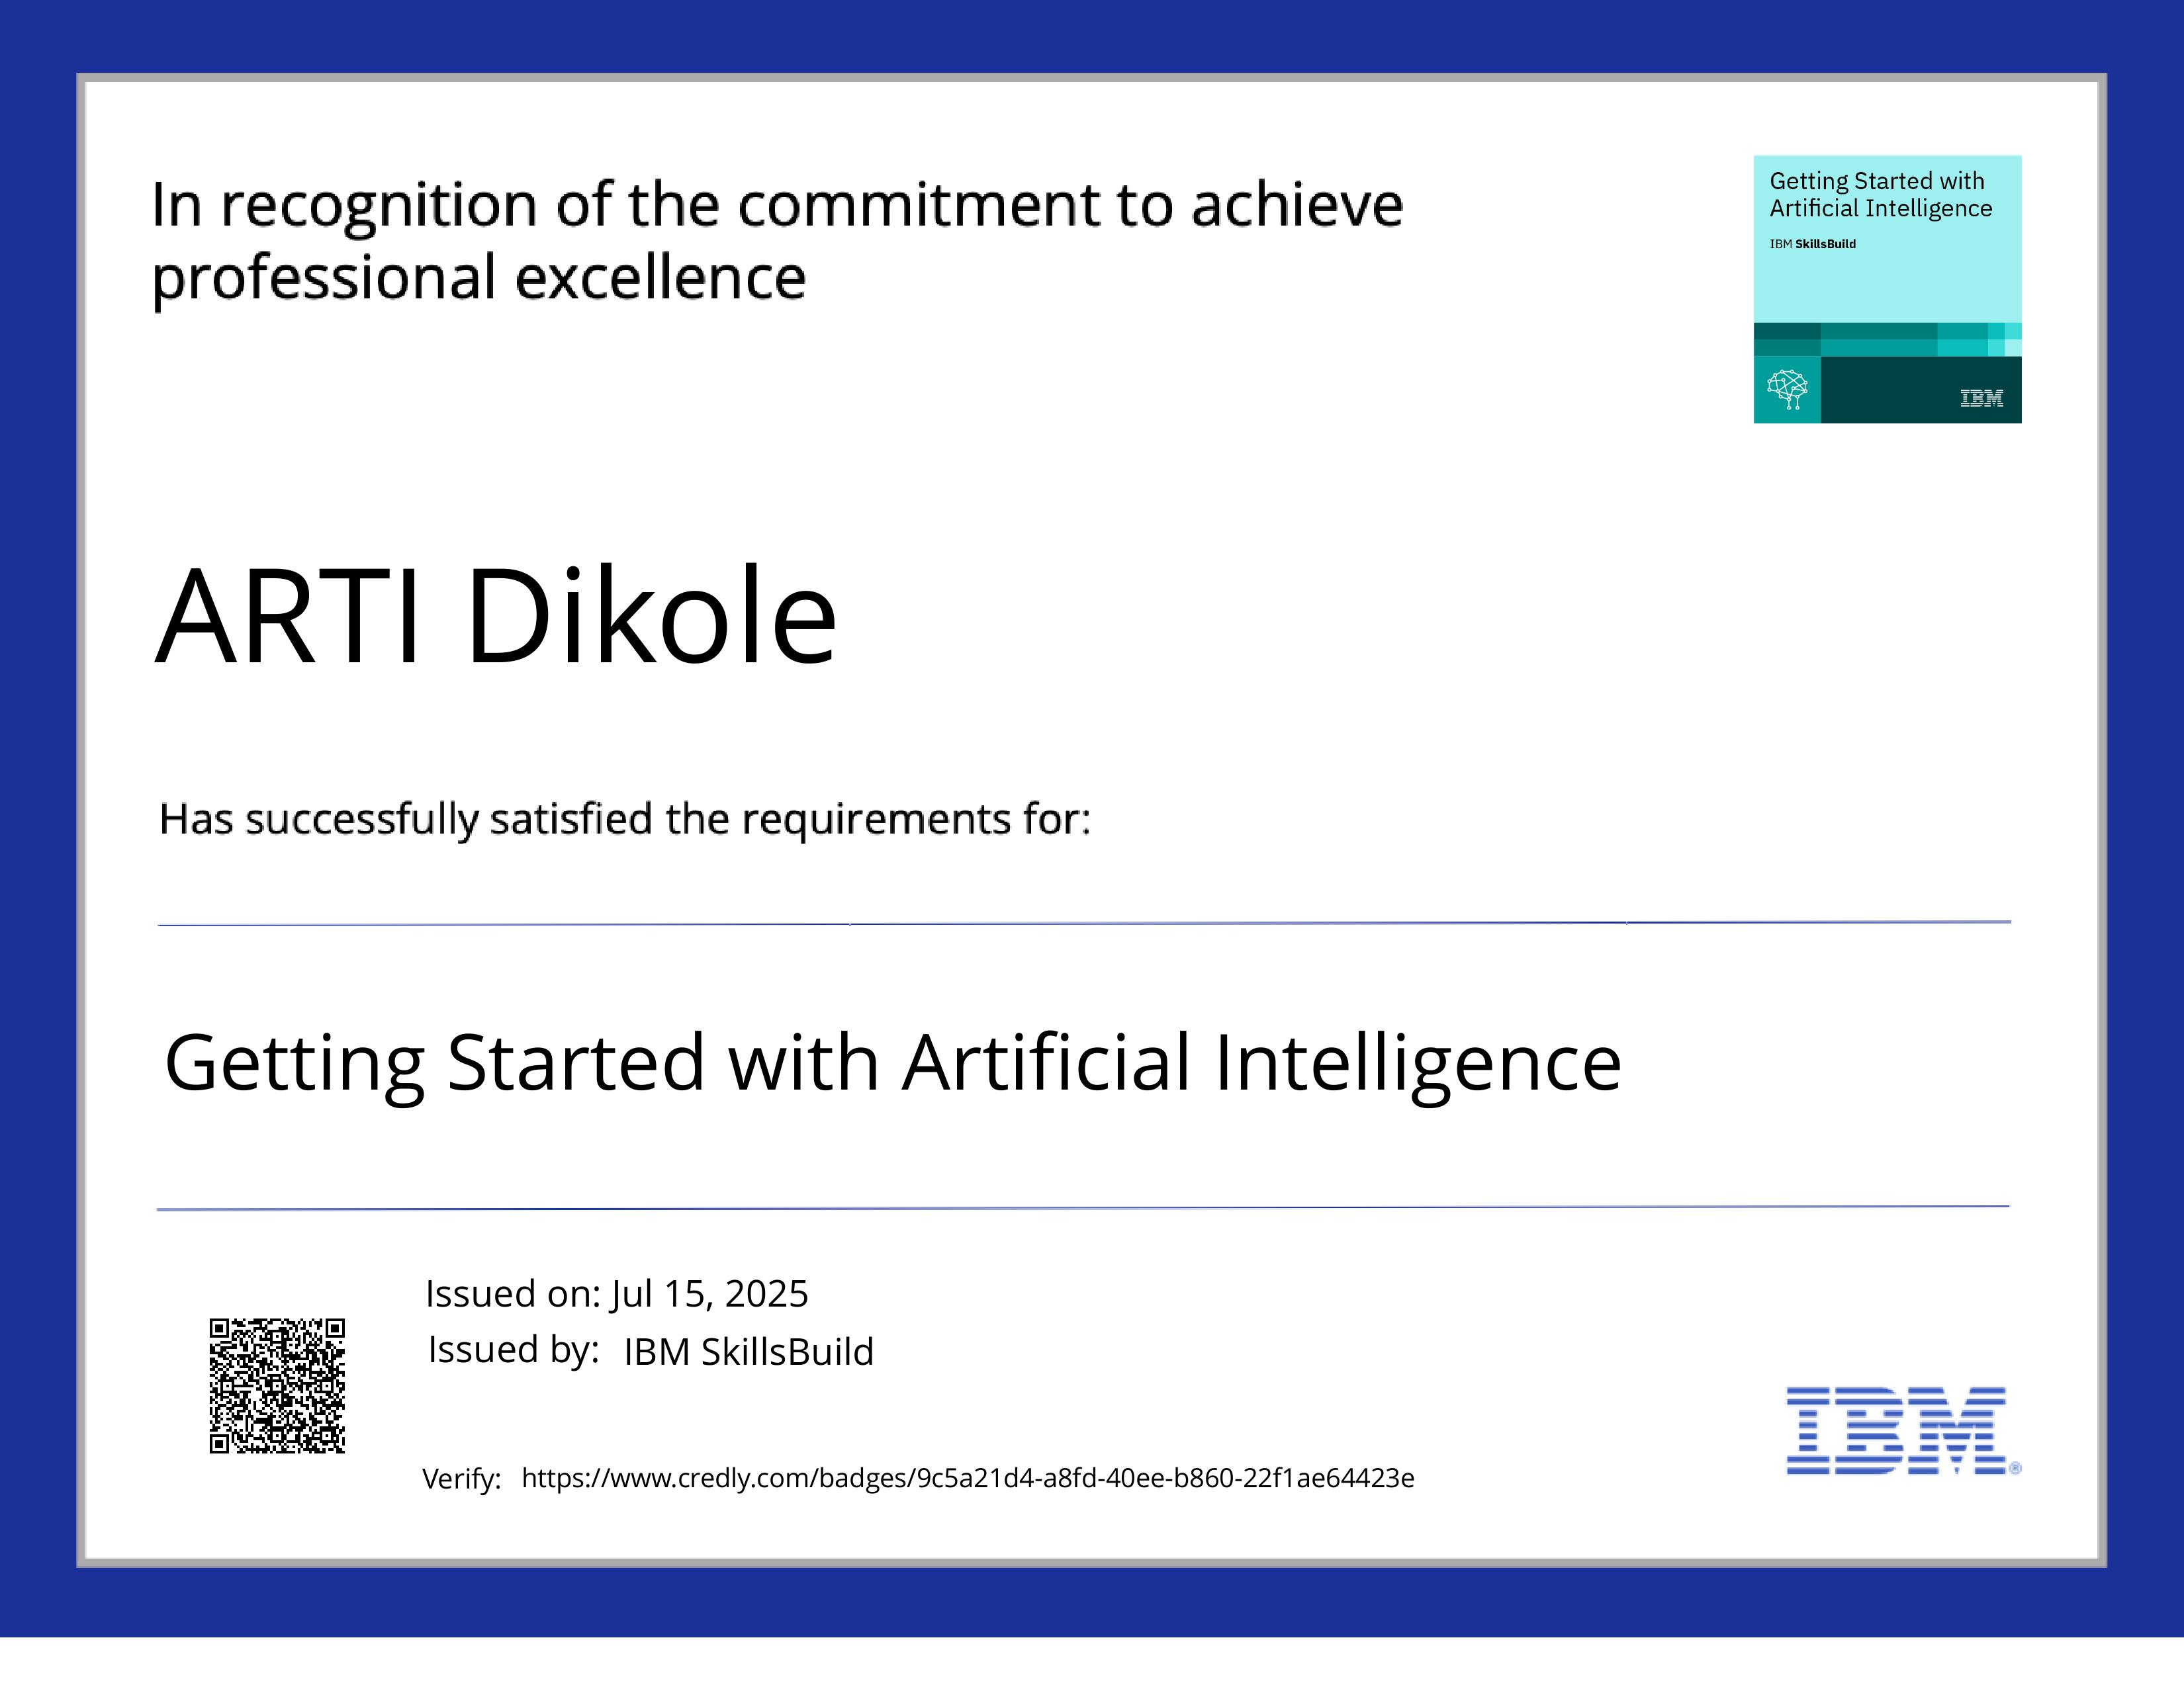
IBM Certifications
Screenshot/ credly certificate( getting started with AI)

Slide 16
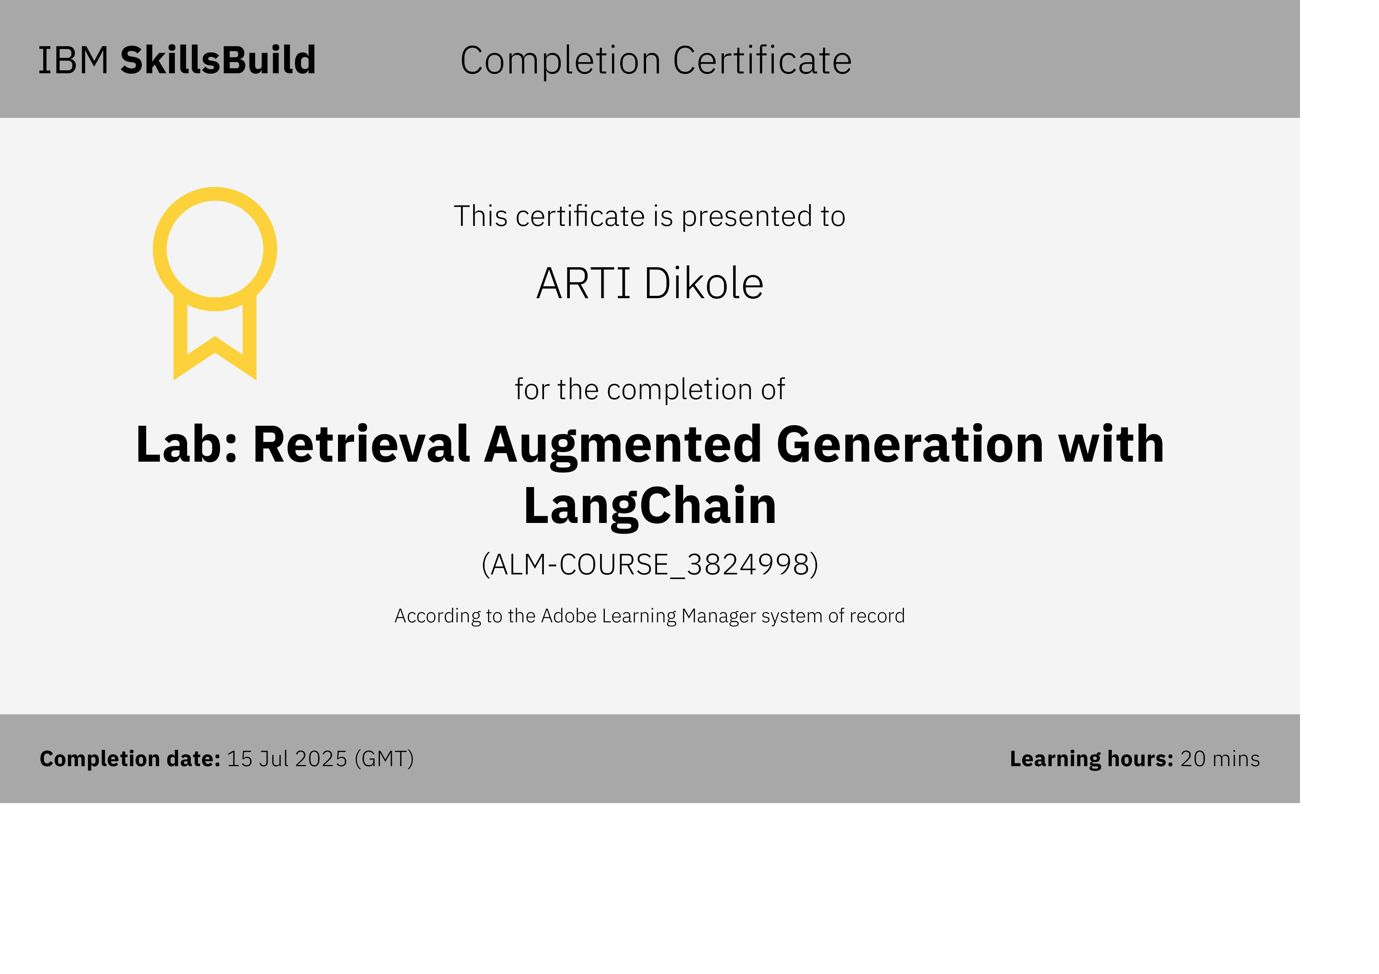
IBM Certifications
Screenshot/ credly certificate( getting started with AI)

Slide 17
THANK YOU

