Slide 1
RETAILSMART
Stock Analytics
Dashboard
Retail inventory insights for smarter stock decisions
PROJECT PRESENTATION
Presented by: Diksha Suryawanshi
B.Tech – Computer Science & Engineering

Slide 2
Project Overview
A visual dashboard for understanding retail inventory and product pricing.
RetailSmart Stock Analytics converts inventory data into a set of visual summaries that can support day-to-day retail decisions.
INVENTORY MONITORING
PRODUCT PRICING
REORDER AWARENESS
Compare stock size and review opening versus closing stock.
Compare retail prices across products and spot price differences.
View retail price and reorder-point measures by product category.
Main purpose: make stock information easier to interpret at a glance.
RetailSmart Stock Analytics
02

Slide 3
Problem Statement
Why a stock analytics dashboard is useful.
• Retailers manage many products, categories and stock quantities at the same time.
• Reading raw spreadsheet rows makes it difficult to compare products quickly.
• Low stock may be overlooked when reorder information is not easy to see.
• Opening and closing stock need to be compared to understand inventory movement.
• Managers need a quick visual summary to support replenishment and pricing decisions.
Project response: consolidate key inventory measures into one interactive-style visual report.
RetailSmart Stock Analytics
03

Slide 4
Project Objectives
The dashboard is designed to answer practical stock-management questions.
01
Monitor stock
Compare available stock across stock-status groups.
02
Compare prices
Review retail price differences between products.
03
Track inventory
Compare opening stock and closing stock.
04
Review categories
Summarize retail price and reorder-point measures by category.
05
Support decisions
Help users identify where more investigation or replenishment may be needed.
RetailSmart Stock Analytics
04

Slide 5
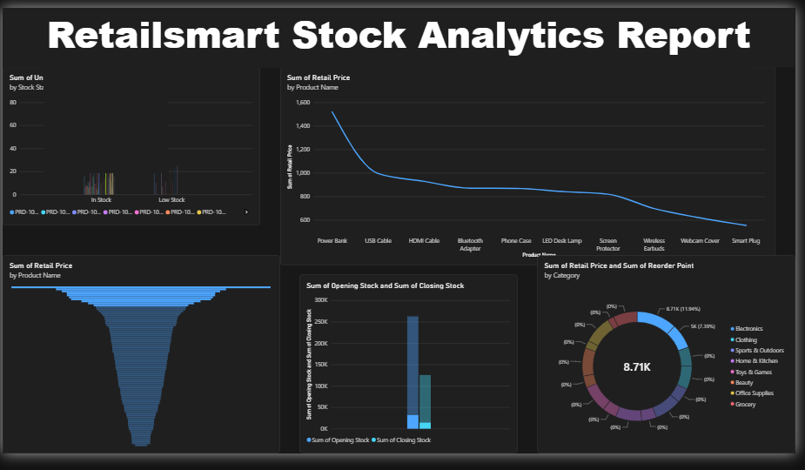
Dashboard at a Glance
The supplied dashboard contains five main visual areas.
Source: dashboard screenshot provided for this project.
RetailSmart Stock Analytics
05

Slide 6
Dashboard Analysis
What each visual appears to communicate.
STOCK STATUS
RETAIL PRICE BY PRODUCT
PRICE DISTRIBUTION
A column chart compares stock-size groups such as in-stock and low-stock items. Product labels are crowded.
The line chart ranks or displays retail-price totals by product; Power Bank appears highest in this view.
The horizontal bar chart shows a strongly uneven distribution, but product labels and aggregation should be reviewed.
OPENING VS CLOSING
CATEGORY / REORDER
The column chart compares the summed opening and closing stock measures.
The donut chart summarizes category-level retail price and reorder-point measures; the center shows 8.71K.
RetailSmart Stock Analytics
06

Slide 7
Key Insights from the Current View
Observations are based only on the visible dashboard; validate them against the source data.
• Power Bank has the highest visible retail-price value in the product line chart.
• The line chart trends downward across the displayed product sequence, ending near Smart Plug.
• The stock-status chart has many small bars and crowded product labels, which makes comparison difficult.
• Opening stock and closing stock are not shown on a comparable scale clearly enough to infer a stock-change percentage.
• The donut chart center displays 8.71K; confirm whether this is retail price, reorder-point total, or another aggregated measure.
Important: these are visual observations, not verified business conclusions.
RetailSmart Stock Analytics
07

Slide 8
Tools & Data Workflow
Technology labels should be updated to match the software actually used.
Source Data
Data Preparation
Analytics
Visualization
Decision Support
→
→
→
→
Product, category,
price and stock fields
Clean names, types,
missing values
Aggregate stock,
price and reorder data
Charts, labels,
category legend
Review low stock
and replenishment
Visible from the screenshot: a dark-themed dashboard with multiple chart types. The exact BI tool and dataset schema were not provided.
Suggested documentation: list the actual tool (for example, Power BI or Excel), data source, columns and refresh method.
RetailSmart Stock Analytics
08

Slide 9
Strengths & Areas to Improve
A balanced review of the current dashboard design.
STRENGTHS
IMPROVEMENTS
• Dark, consistent visual theme
• Multiple chart types in one view
• Product-level price comparison
• Stock and category measures shown together
• Useful starting point for inventory review
• Increase chart title and axis-label sizes
• Reduce crowded legends and truncated names
• Use currency and quantity units consistently
• Clarify whether charts show Sum, Average or Count
• Show reorder status and low-stock alerts explicitly
RetailSmart Stock Analytics
09

Slide 10
Recommendations
Practical improvements to make the report more actionable.
Add KPI cards
Create a low-stock table
Total SKUs, total stock, low-stock items, stock value.
Product, current stock, reorder point, shortage and suggested reorder quantity.
Improve chart readability
Check aggregations
Sort bars, shorten labels, use tooltips and limit unnecessary legends.
Avoid summing unit prices if average price or individual price is more meaningful.
Add filters
Validate calculations
Category, product, stock status and supplier.
Confirm units, blank values, duplicates and category totals.
RetailSmart Stock Analytics
10

Slide 11
Future Scope
How RetailSmart can evolve beyond descriptive analytics.
• Demand forecasting using historical sales and seasonal patterns.
• Automated alerts when stock falls below a reorder point.
• Supplier lead-time analysis and recommended order quantities.
• Sales, returns and profit-margin analysis alongside stock data.
• Scheduled data refresh and exportable management reports.
• Role-based views for store staff, inventory managers and administrators.
Future target: move from “what is in stock?” to “what should we reorder, and when?”
RetailSmart Stock Analytics
11

Slide 12
CONCLUSION
Better visibility.
Smarter stock decisions.
RetailSmart brings product pricing, stock levels, opening/closing inventory and category-level measures into one visual report. With clearer labels, validated calculations and low-stock alerts, it can become a stronger decision-support tool for retail inventory management.
VISUALIZE
VALIDATE
ACT
Turn rows into patterns.
Trust the numbers.
Reorder at the right time.
Thank you

Slide 13
References & Presentation Notes
Project-specific details to confirm before submission.
• Primary visual reference: RetailSmart Stock Analytics Report dashboard image supplied by the project owner.
• No source dataset, formulas, data dictionary or BI-tool file was supplied; numerical findings should be validated against the original data.
• Add the actual software name, dataset source, project duration and team/member details if required by your college format.
• Suggested references for methodology: the official documentation for the BI tool used and the source dataset documentation.
Questions?
Thank you for your time.
RetailSmart Stock Analytics
13

