Slide 1
Professional File Management System
Operating System Project
Java-based GUI application for file and folder management
Presented by: Diksha Suryawanshi

Slide 2
Project Introduction
A GUI-based File Management System developed using Java.
Demonstrates practical Operating System concepts related to files, folders and storage.
Provides a simple interface to perform common file operations.
Designed to make file-system concepts easier to understand through an interactive application.
2

Slide 3
Objectives
Understand file and directory management concepts.
Implement file operations using Java.
Provide an interactive and user-friendly GUI.
Demonstrate file attributes, file access and storage management.
Connect theoretical OS concepts with a working software application.
3

Slide 4
Technologies Used
☕ Java
🖥️ Java Swing / GUI
📁 Java File Handling
🧩 Object-Oriented Programming
⚙️ Operating System Concepts
4

Slide 5
Main Modules
🔐 Login System
📊 Dashboard
📁 File Management
📂 Folder Management
⚙️ File Operations
🔎 Search
📋 File Details
🗑️ Recycle Bin
5

Slide 6
File Operations
Open and Close File
Read and Write File
Start File
Copy and Move File
Truncate File
Set File Attribute
6

Slide 7
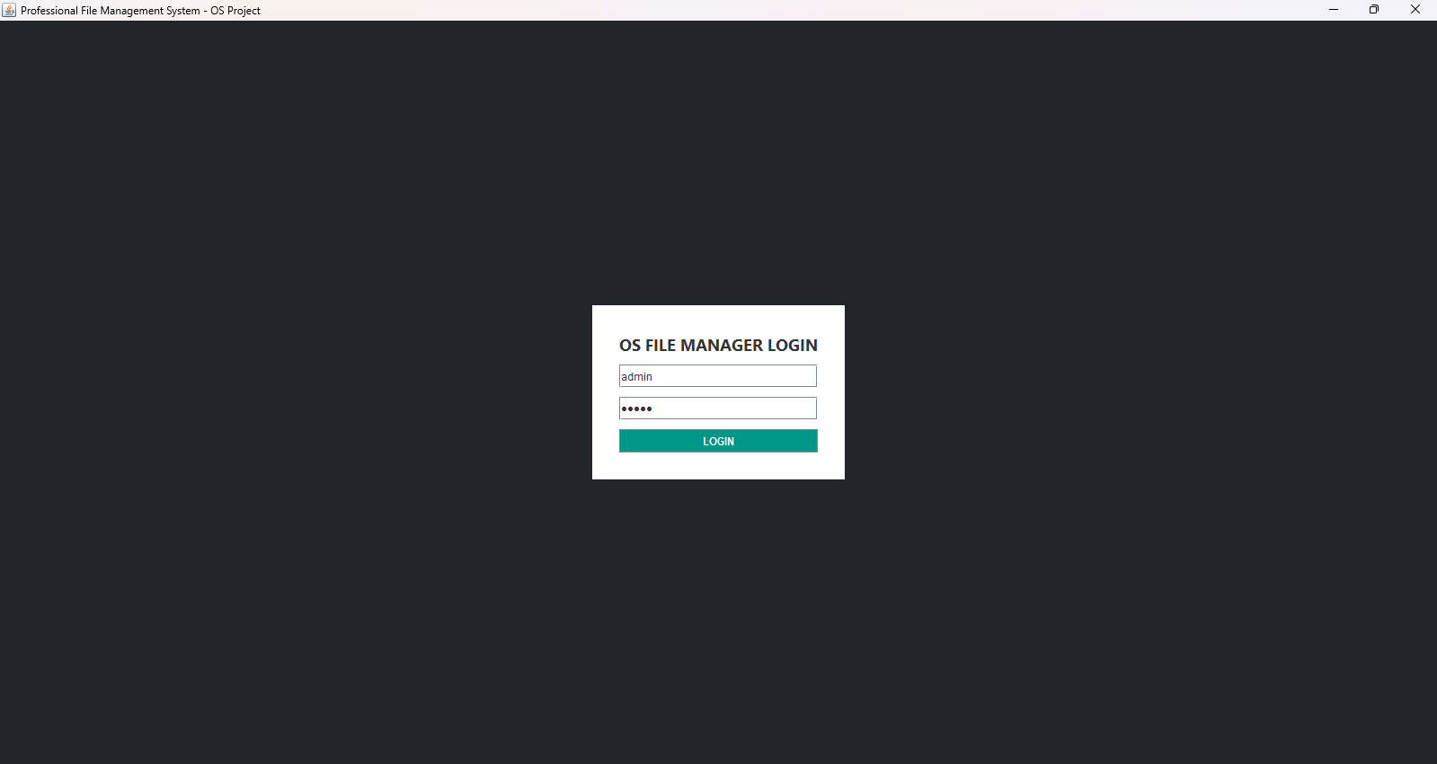
Dashboard
7

Slide 8
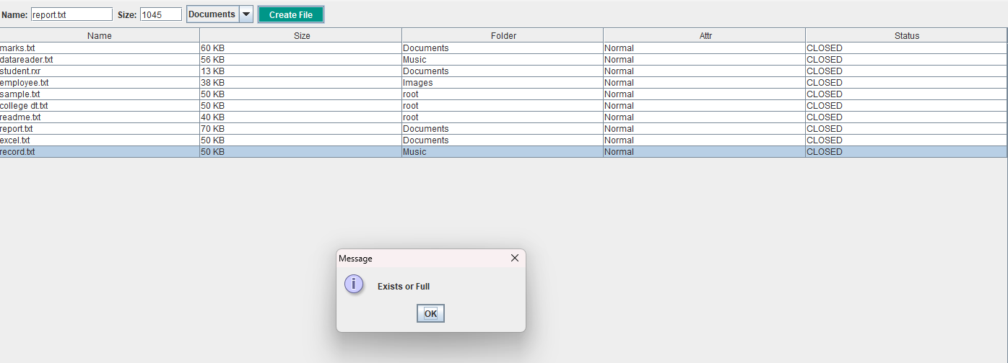
File Operations Interface
8

Slide 9
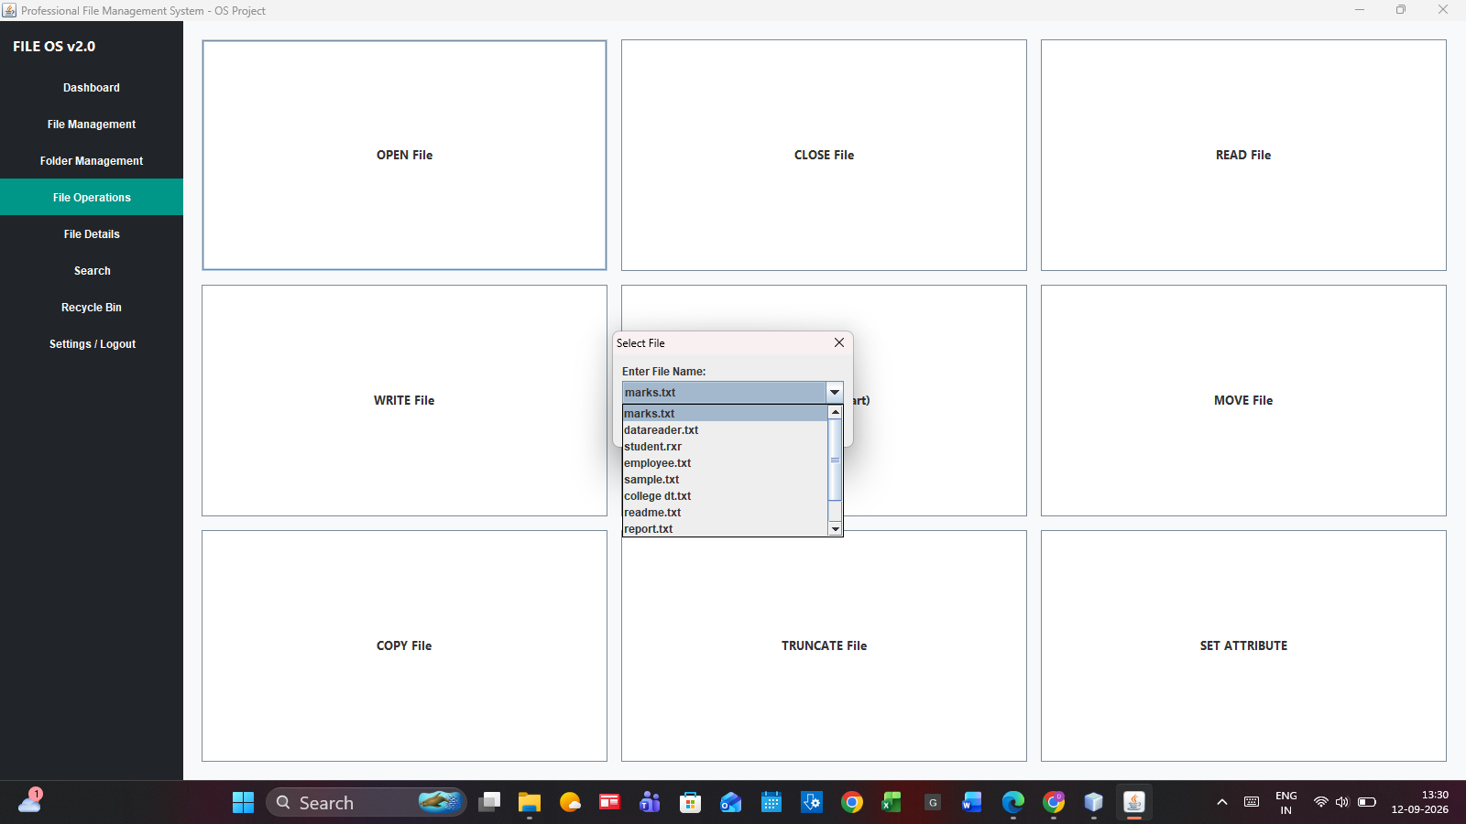
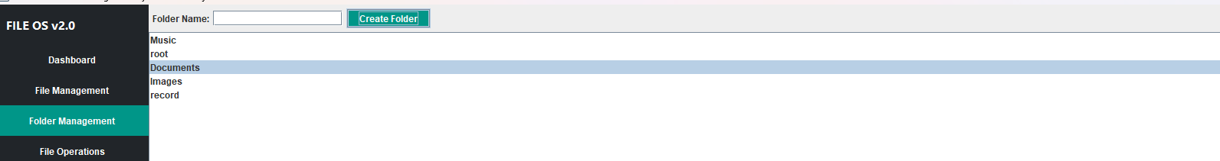
Search & File Details
9

Slide 10
Conclusion
The project provides a practical demonstration of OS file-management concepts.
It combines Java GUI development with file and folder operations.
The system improves understanding of how files, directories and storage operations can be managed.
Future scope: database integration, role-based access, improved security and advanced file analytics.
Thank You
10

