Slide 1
Web Security & Vulnerability Testing
VAPT Basics: SQL Injection, XSS and Automated Scanning
Week 6 Technical Lab Report
Diksha Uma Shankar Raul
DG Cyber Security Internship | October 2026

Slide 2
What is VAPT?
Vulnerability Assessment finds and lists weaknesses. Penetration Testing exploits them to prove real impact, so they can be fixed before an attacker finds them.
OWASP Top 10 categories studied
SQL Injection
XSS
Broken Authentication
Security Misconfiguration
Untrusted input changes the SQL query
Attacker script runs in a victim's browser
Weak login or session handling
Insecure defaults, missing headers

Slide 3
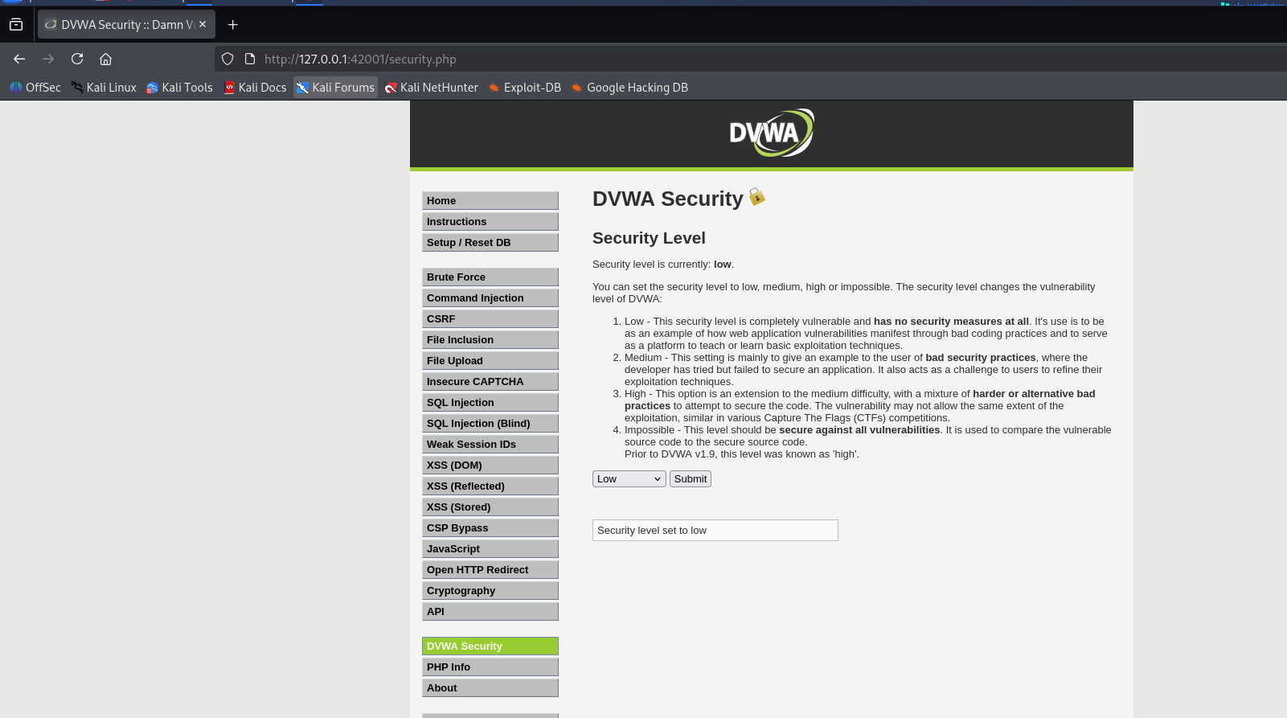
Tools & Lab Setup
Attacker machine: Kali Linux
Target: DVWA (Damn Vulnerable Web Application), run locally
Burp Suite Community: intercept and inspect requests
OWASP ZAP: automated vulnerability scan
DVWA security level set to Low
Figure 3.2: DVWA Security level set to Low

Slide 4
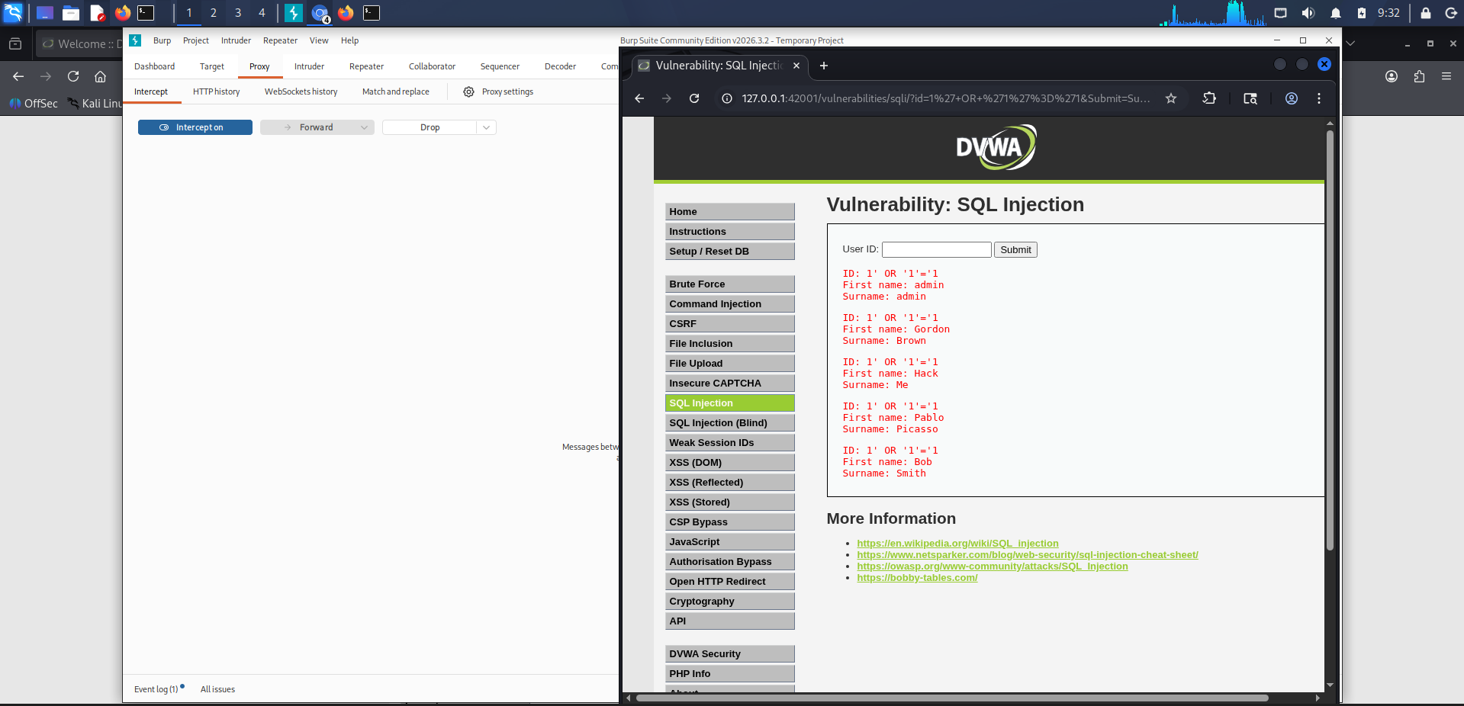
SQL Injection
Payload used
1' OR '1'='1
Entered in the User ID field of the DVWA SQL Injection module
Result: every row of the users table was returned
Input is joined directly into the SQL query without sanitisation
Figure 4.4: All user records returned

Slide 5
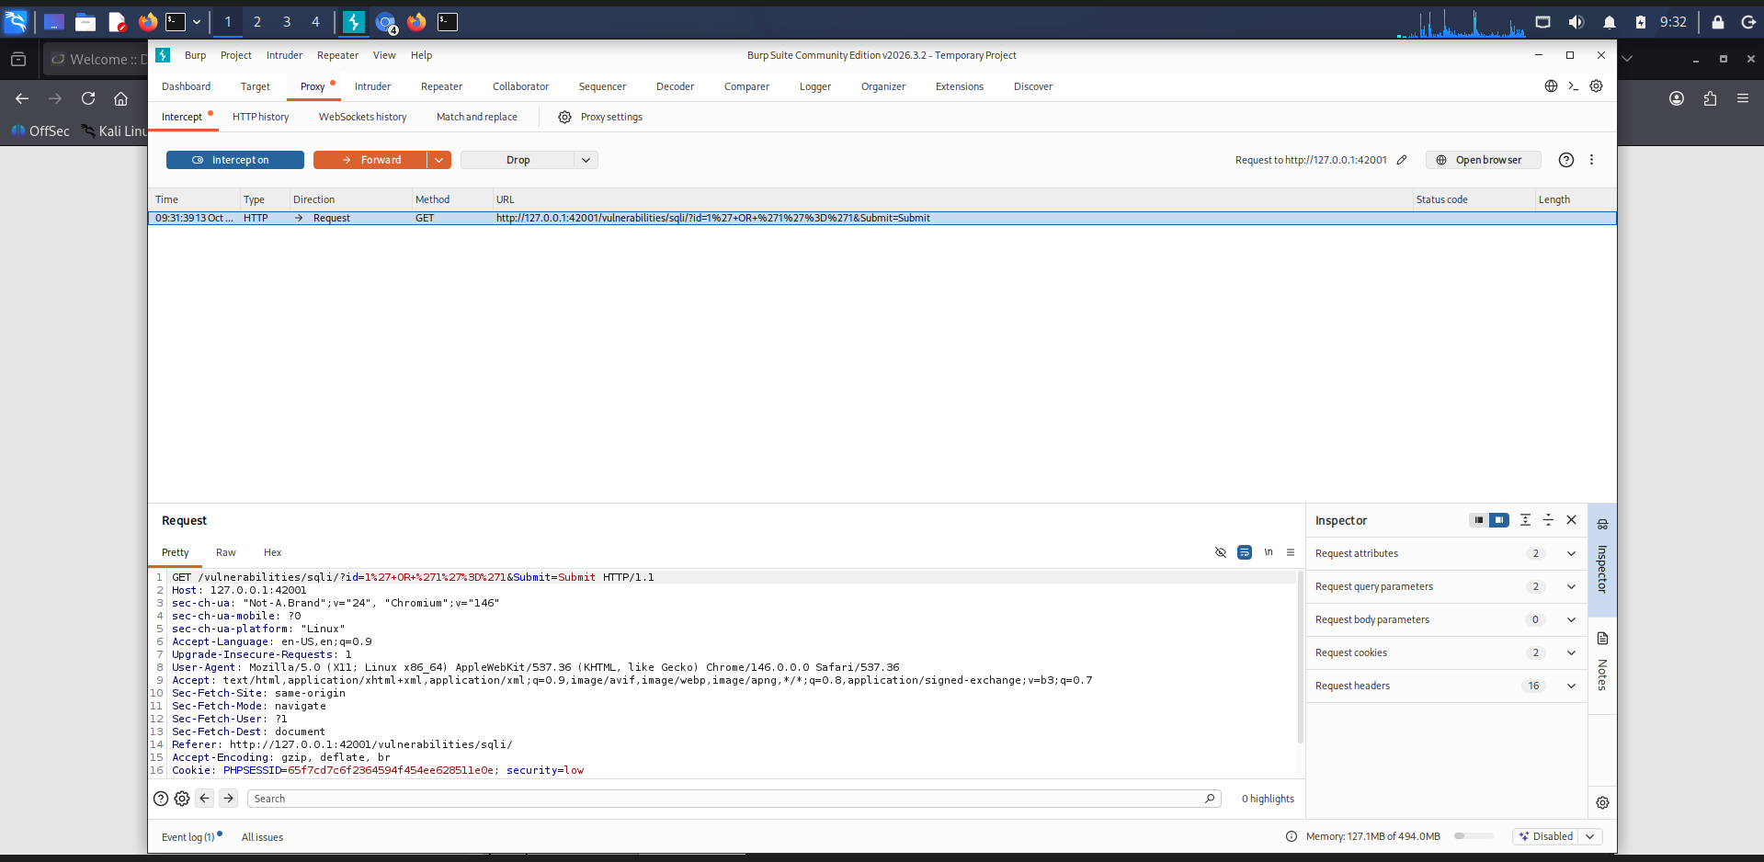
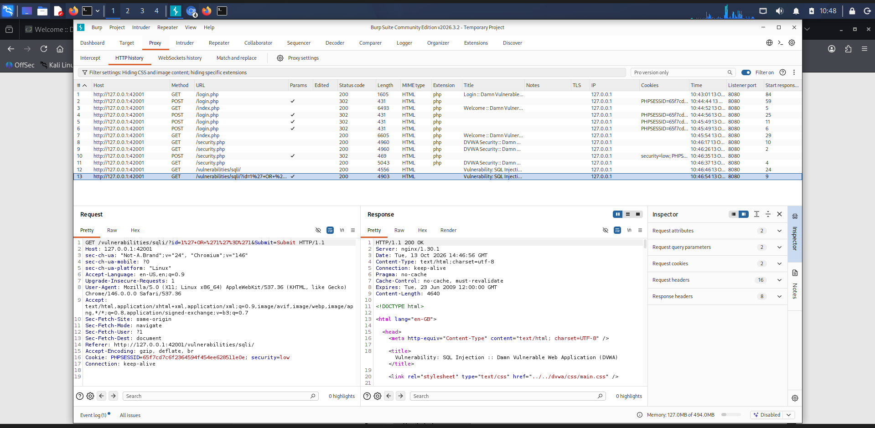
Capturing the Request in Burp Suite
Figure 4.3: Payload captured in Burp Proxy
Figure 4.5: HTTP history, request and 200 OK response
Burp Suite sat between the browser and DVWA, so the injected GET request and the server response could be inspected.

Slide 6
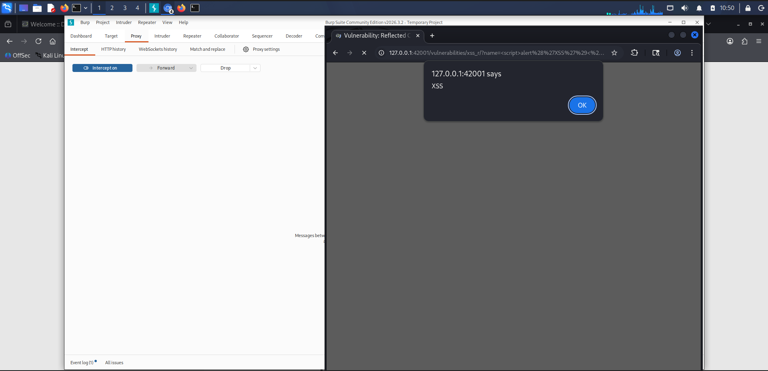
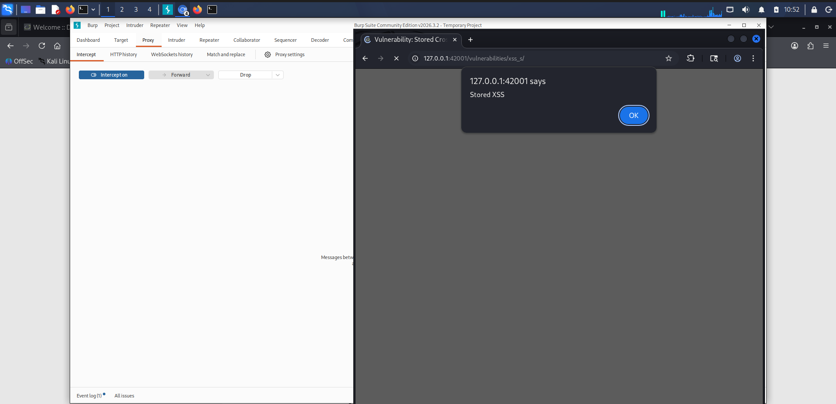
Cross-Site Scripting (XSS)
Reflected XSS
Stored XSS
<script>alert('XSS')</script>
<script>alert('Stored XSS')</script>
Figure 5.2: Alert confirms execution
Figure 5.3: Alert fired from the guestbook
Stored XSS fired again on page refresh, proving the script is saved in the database.

Slide 7
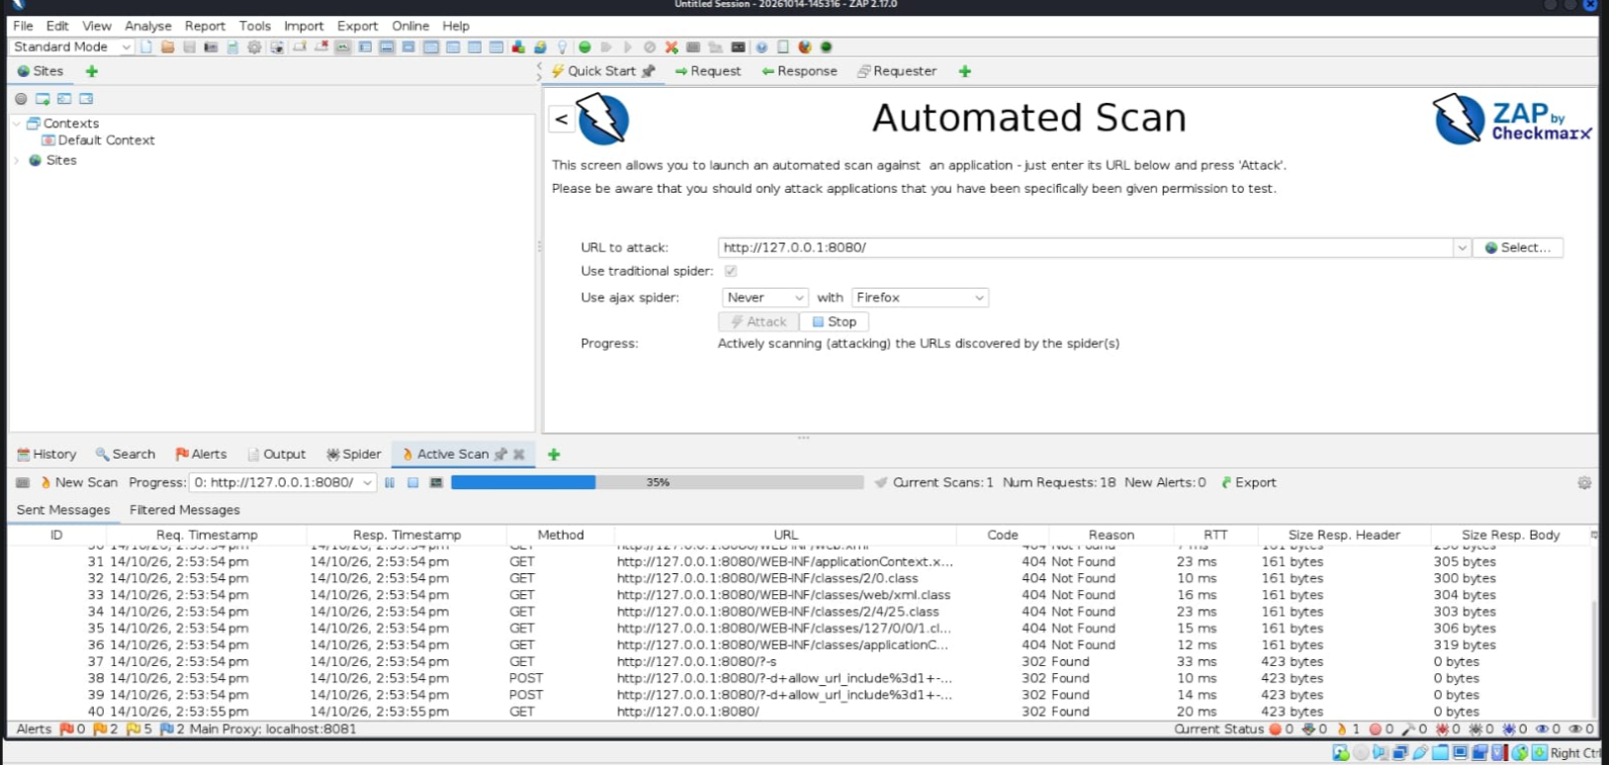
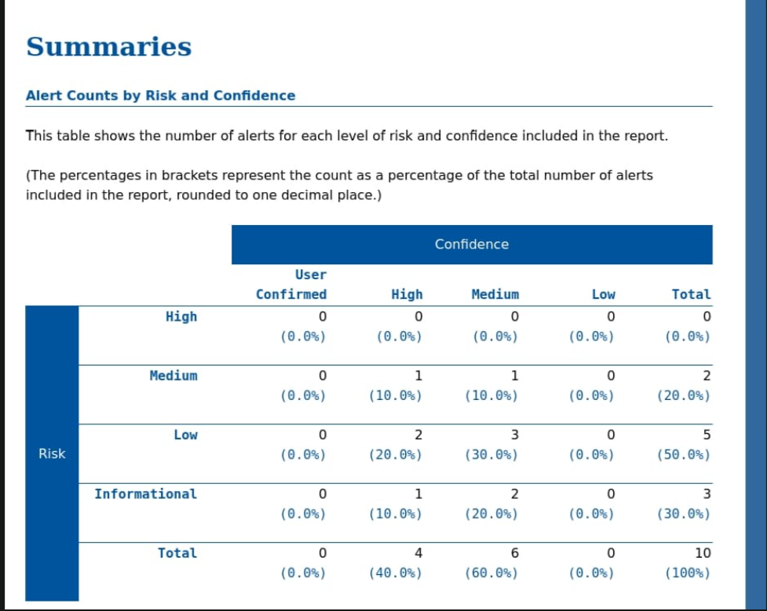
Automated Scan with OWASP ZAP
Figure 6.1: Active scan in progress
Figure 6.4: Alerts by risk and confidence
9 distinct alerts (10 instances) found
2 Medium, 5 Low, 3 Informational
Examples: Missing Anti-Clickjacking Header, CSP Header Not Set

Slide 8
Findings & Risk Levels
Vulnerability | Risk | Tool | Impact
SQL Injection | High | DVWA + Burp Suite | Full user table dumped
Stored XSS | High | DVWA | Script runs for every visitor
Reflected XSS | Medium | DVWA | Script runs from crafted input
Missing Anti-Clickjacking Header | Medium | OWASP ZAP | Page can be framed
CSP Header Not Set | Medium | OWASP ZAP | No browser-level XSS defence
Cookie without SameSite / info leak | Low | OWASP ZAP | Minor disclosure, CSRF exposure

Slide 9
Prevention & Mitigation
SQL Injection: parameterised queries, input validation, least-privilege DB accounts
XSS: encode all output, validate input on the server, set a Content-Security-Policy
Clickjacking: X-Frame-Options (SAMEORIGIN) or CSP frame-ancestors
Missing CSP: define and enforce allowed script, style and frame sources
General: keep training or debug settings out of production

Slide 10
Conclusion
Set up a safe lab with DVWA, Burp Suite and OWASP ZAP
Exploited SQL Injection, Reflected XSS and Stored XSS
Manual testing and automated scanning complement each other
Input validation, output encoding and secure headers are key defences
Thank you

