Slide 1

DR. BABASAHEB AMBEDKAR TECHNOLOGICAL UNIVERSITY, LONERE, RAIGAD
Department of ELECTRONICS AND TELECOMMUNICATION ENGGINERING
Mini Project Presentation on
UNDERWATER WIRELESS COMMUNICATION SYSTEM
Under guidance of:
Dr. Pallavi Ingle
Presented By :
RAHUL NARENDRA IPTE (2130331372503)
DIKSHA PUNDLIK KHARVLKAR (2130331372505)

Slide 2
CONTENT
Introduction​
Block Diagram
Arduino UNO
IR LED
TSOP 1738
Circuit Diagram
Working
Advantages
Applications
Conclusion

Slide 3
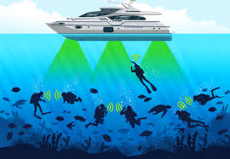
INTRODUCTION
Underwater wireless communication is essential for a range of applications, including environmental monitoring, underwater exploration, and surveillance. However, the harsh underwater environment presents several challenges to wireless communication, including attenuation, multipath propagation, and interference. Traditional wireless communication methods such as acoustic or radio frequency suffer from limited range and low bandwidth. Therefore, there is a need for an effective and efficient method for underwater wireless communication.

Slide 4
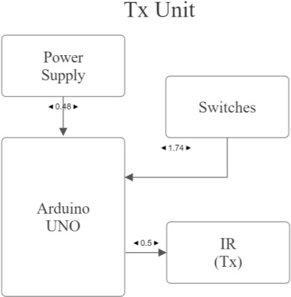
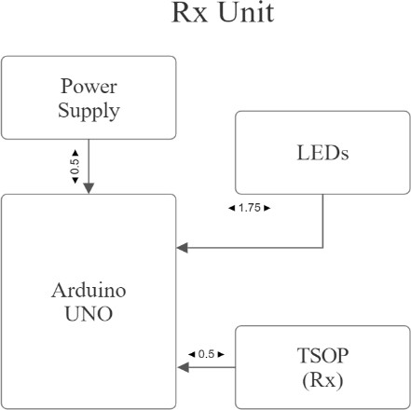
BLOCK DIAGRAM
BLOCK DIAGRAM DESCRIPTION
• Power Supply
• Arduino UNO R3
• Slide Switches
• IR LED (Tx)
• LED’s
• TSOP 1738 (Rx)

Slide 5
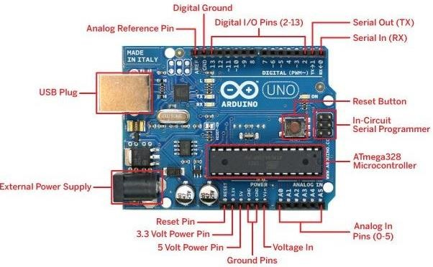
ARDUINO UNO
An Arduino is an open-source microcontroller development board. Arduino consists of both a physical programmable circuit board and a piece of software, or IDE (Integrated Development Environment) that runs on computer, used to write, and upload computer code to the physical board.

Slide 6
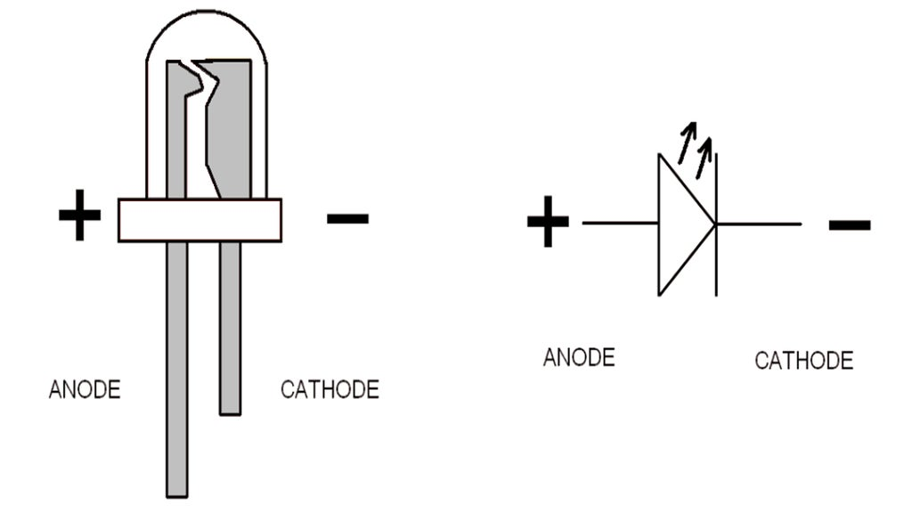
IR LED
An Infrared light-emitting diode (IR LED) is a special-purpose LED that emits infrared rays ranging from 700 nm to 1 mm wavelength

Slide 7
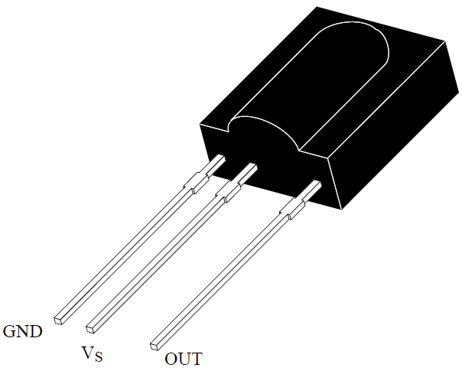
TSOP 1738
TSOP1738 is an IR receiver with an amplifier that acts as a switch and converter within a circuit. It has a single input and output that only reacts to the input IR signal. The TSOP1738's main function is to convert IR impulses to electric signals. Every IR receiver operates on a specific frequency. TSOP1738 operates on a 38 kHz IR frequency.

Slide 8
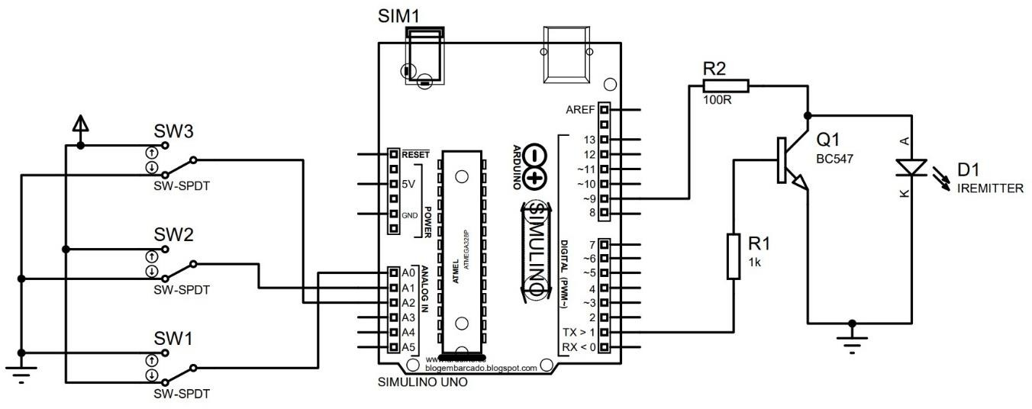
CIRCUIT DIAGRAM
CIRCUIT DIAGRAM OF TRANSMITTER PART
IR led which is controlled by using Arduino and BC547 transistor.
To controlling the led at receiver side we are using the slide switch

Slide 9
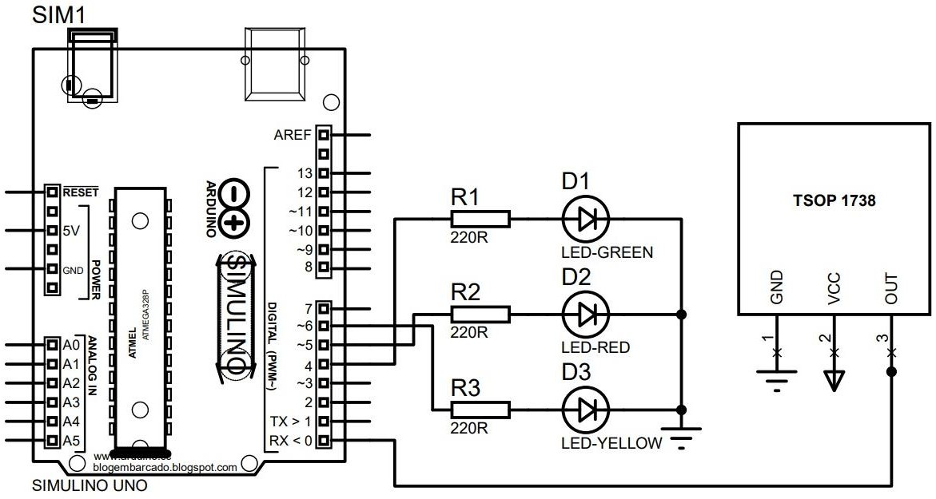
CONTINUE …..
CIRCUIT DIAGRAM OF RECEIVER PART
The TSOP 1738 receiver IC
The LEDs are connected to the Arduino UNO

Slide 10
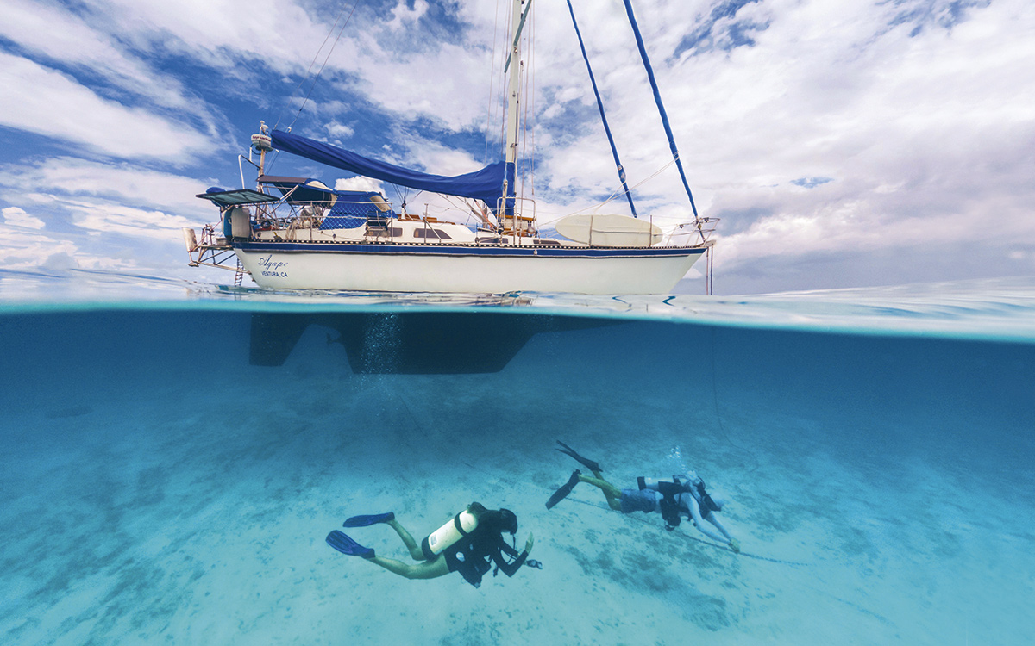
WORKING
Transmitter circuit and Receiver circuit.
Both transmitter circuit and receiver circuit are connected to the separate power supply and separate Arduino.
Transmitter : three switches named as S1, S2, and S3
Receiver : three LEDs named as L1 for Green, L2 for Red, and L3
When switch is pressed, Arduino reacts to it by sending digital pulse to transistor sends this pulse to IR diode which emits the IR wave.
IR wave are received by TSOP 1738.
This TSOP 1738 received pulse to Arduino
Arduino checks pulses and compare it with store information
If pulses are matched the respective LED glows and indicate the message.

Slide 11
ADVANTAGES
low cost
Low maintenance
easy to make
Easy to use

Slide 12
APPLICATIONS
It is additionally utilized in pollution management and climate recording.
It also has the application in the detection of the objects on the ocean floor.
Environmental monitoring and collecting of oceanographic information.
It is the applying in underwater archaeology, search and rescue machines and defense.
It is also used in seismic monitoring, pollution monitoring and ocean currents monitoring.
The underwater wireless communication is used in the equipment monitoring and control and in the autonomous underwater vehicles (AUV).

Slide 13
CONCLUSION
The use of an IR sensor in an underwater wireless communication system offers several advantages, including low power consumption, low cost, and ease of implementation. The IR sensor allows for data transmission through the water using light waves, which can travel a considerable distance with minimal attenuation. Furthermore, the IR sensor can be integrated with other underwater sensors and devices to create a comprehensive underwater communication network. further research and development are needed to improve the reliability and performance of this technology for practical applications in underwater communication systems.

Slide 14
REFERENCES
[1] Ritik Patil, Yash Yennewar, Tanmay Kawase, Rushikesh Tetwar, Prof. Suhas D. Kakde, “Underwater Wireless Communication System Using IR Sensor”, International Research Journal of Modernization in Engineering Technology and Science (IRJMETS), ISSN: 2582-5208, Published By, www.irjmets.com – 2023.
[2] Prof. Ranjith Rajan, Ms. Elizabeth P.T, Ms. Amala Susan Roy, Ms. Aiswarya K.S, Ms. Christymol Bousally, “Underwater Wireless Communication System”, International Journal of Engineering Research & Technology (IJERT) ISSN: 2278-0181, Published By, http://www.ijert.org – 2020.
[3] Mr. K. Rajesh Kumar, K. Mohanraj, A. S. Murugan, K. Naveen, K. Prakash, “IR Wireless Underwater Communication System”, International Research Journal of Engineering and Technology (IRJET) ISSN: 2395-0056, Publish By, www.irjet.net – 2021.

Slide 15
THANK YOU

