Slide 1
Resort Management System
Presented by:
Sangita Marri
Nishant Carvalho
Diksha Nikore

Slide 2
ABSTRACT
The main objective of our website is to provide a platform for an efficient and hassle free booking of room.
A website where customers are allowed to subscribe to our promotional offers.
A website where customer can book the room of his/her choice and enjoy the services provided by our resort

Slide 3
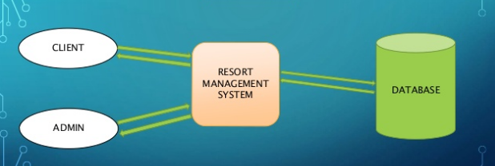
ARCHITECTURE OF THE SYSTEM

Slide 4
Userlogin
Home
Check Availability if not available
if available
User login
Book Now
Booking Details Userlogout

Slide 5
Admin Login
Admin
admin login
Log
Booking database Roomdb Review Feedback out
Update/Delete Add/Update/ Add/Delete Show
Delete

Slide 6
FEATURES
The customer can view different types of rooms.
The customer can book rooms of his/her own choice.
After successfully booking email will send at particular users mail id
User can also give a valuable feedback.
Admin has the full control over the website and database.
Admin can view/delete the customer bookings.

Slide 7
SYSTEM REQUIREMENTS
USER INTERFACE REQUIREMENTS: HTML, JavaScript, Jquery, Bootstrap, CSS.
DATABASE REQUIREMENTS: PHP, MongoDB, Xampp.
HARDWARE: 4 GB RAM, Intel core i5 8th gen, AMD graphics/ NVIDIA
SOFTWARE: Google chrome for page display, Git used for project collaboration

Slide 8
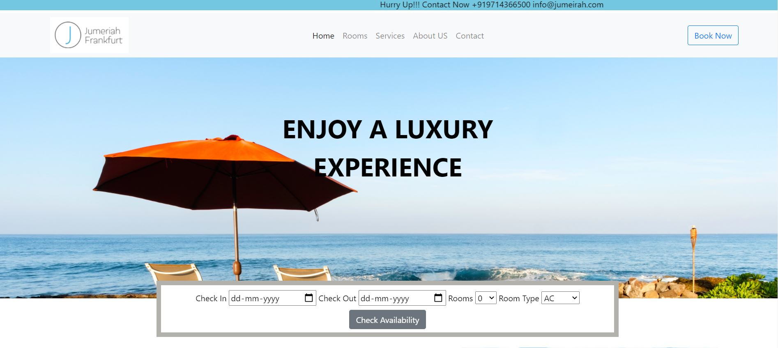
Work Flow Home page

Slide 9
Facilities/Services
Indoor Games
1.Chess
2. Pool
3.Table Tennis
Gym
Restaurant

Slide 10
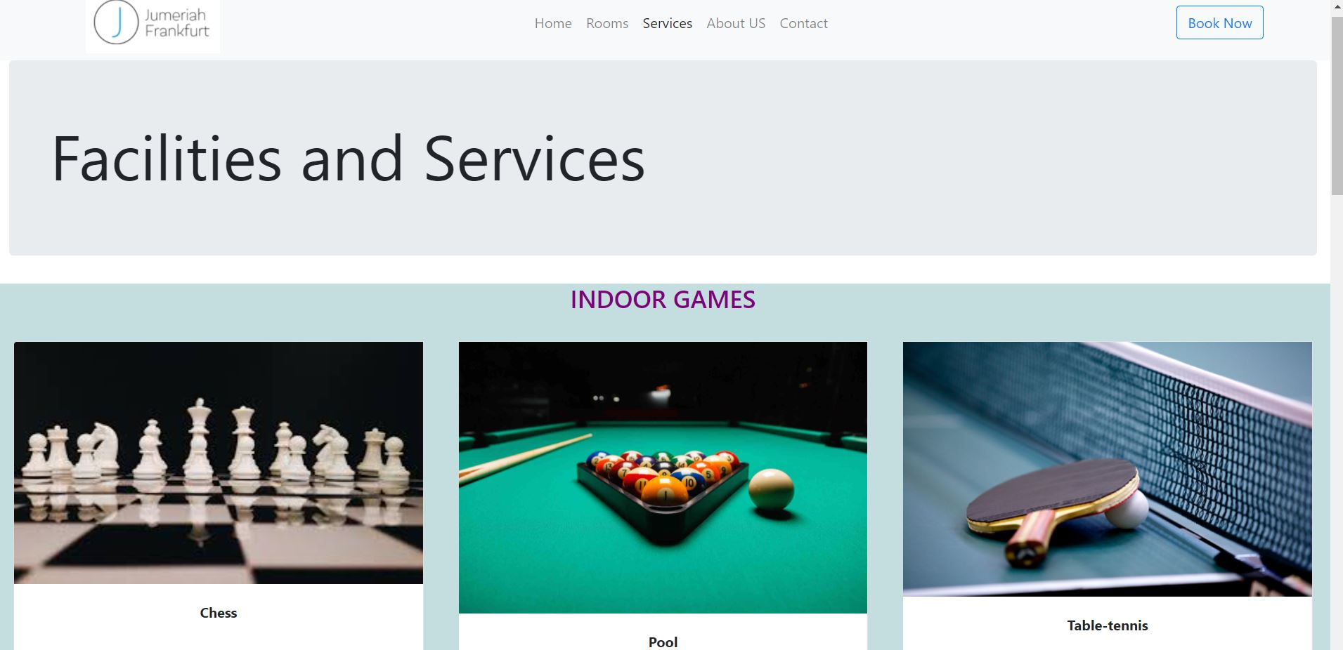
Services page

Slide 11
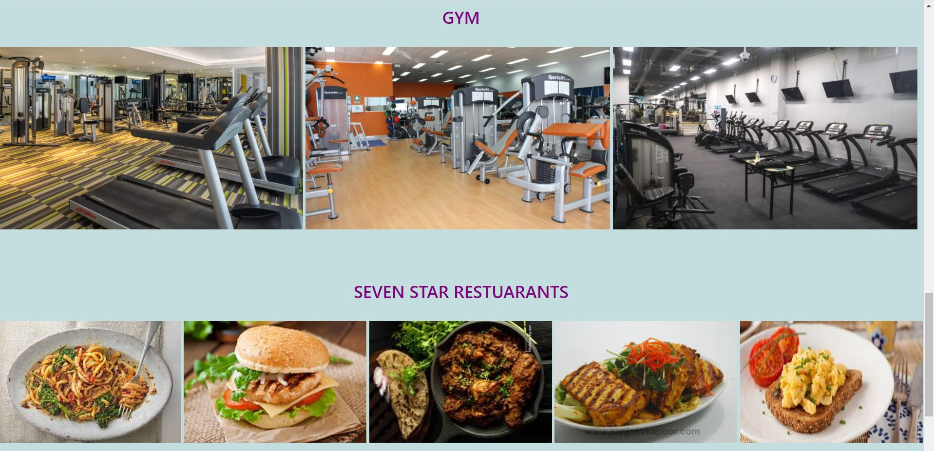

Slide 12
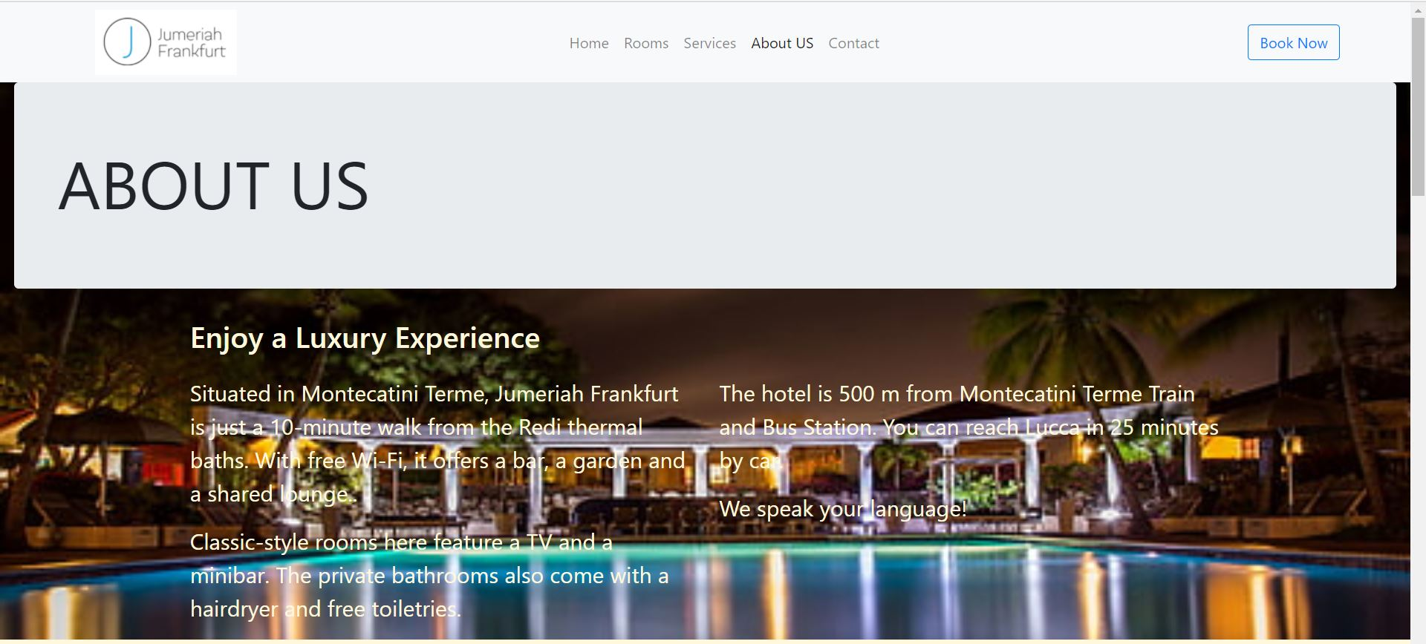
About Us

Slide 13
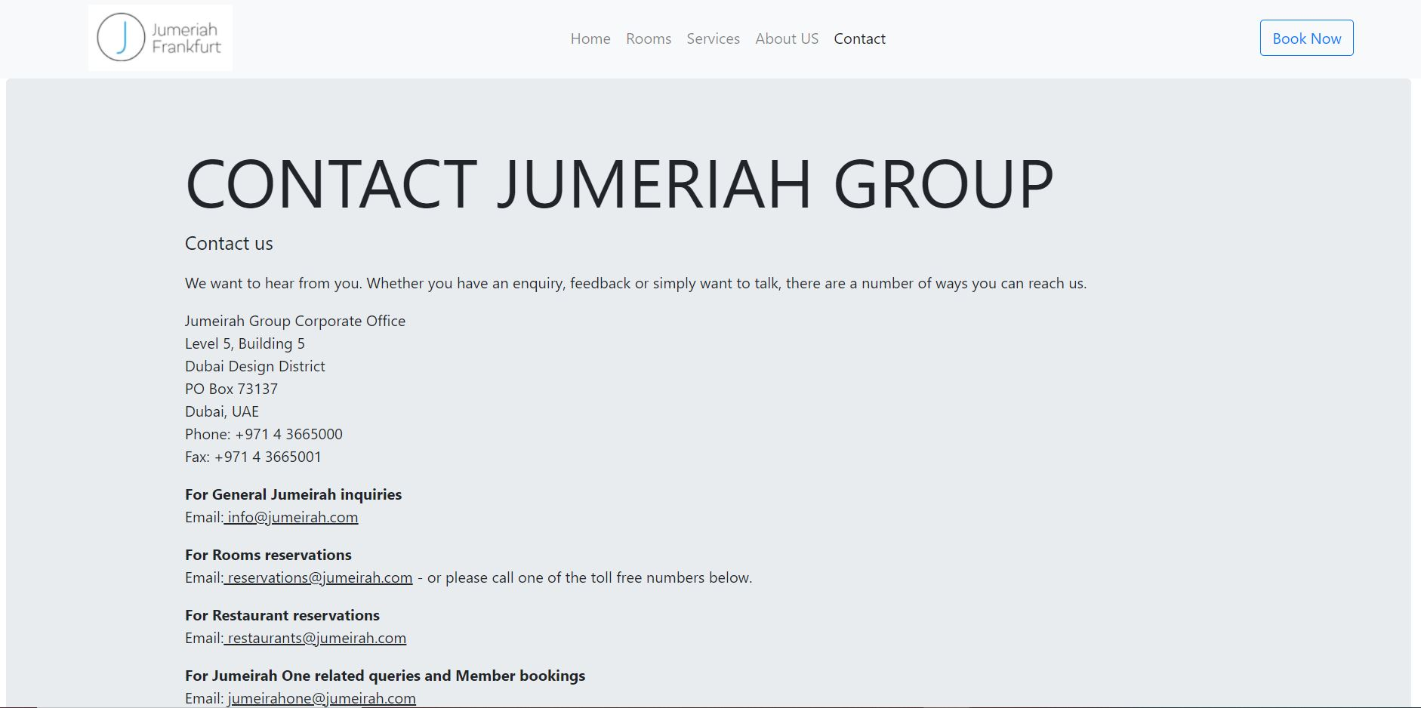
Contact Us

Slide 14
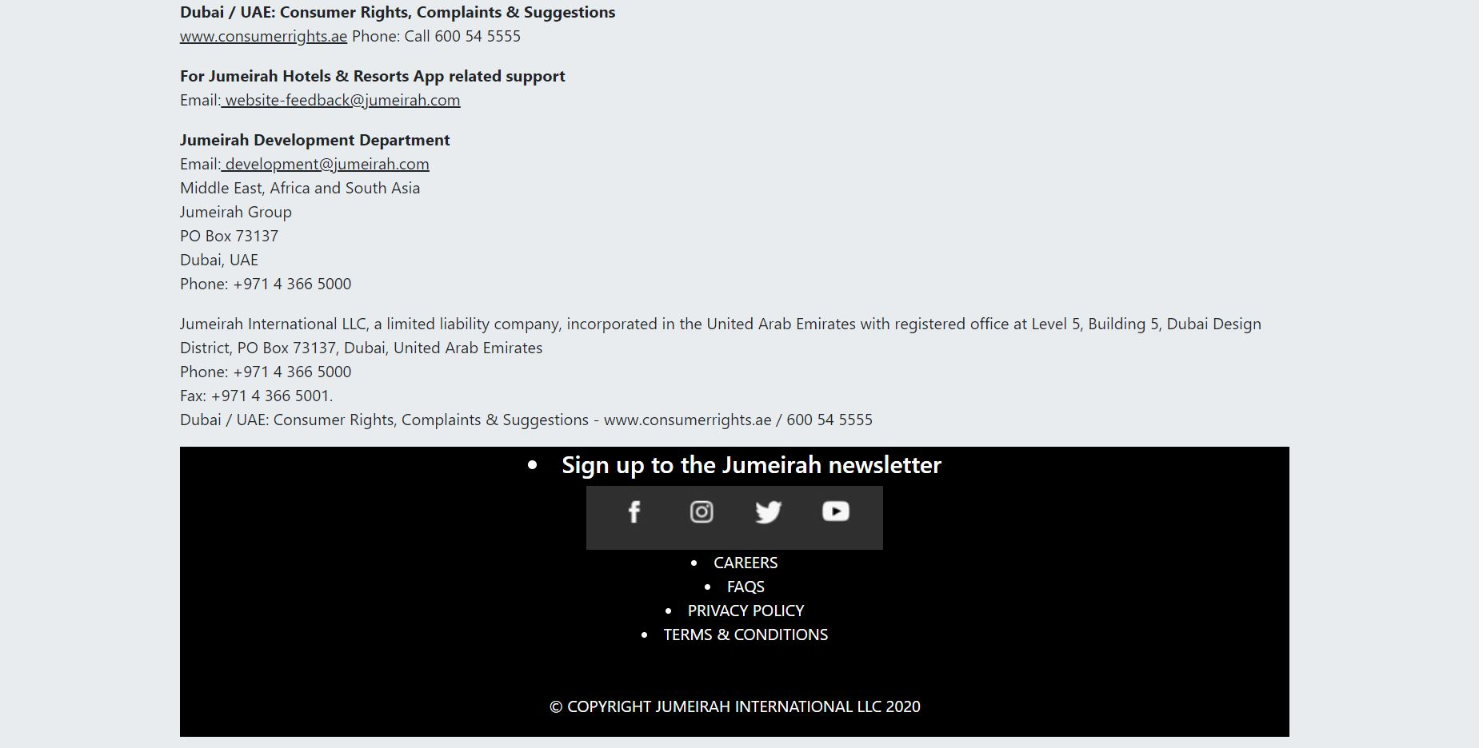

Slide 15
ADVANTAGES
Accessible in every area where internet is present.
Easy to use and Simple to understand.
Quick and save lots of time.
Very secure and requires less resources.
No need use the 3rd party platforms.

Slide 16
DISADVANTAGES
Requires data or Internet to access.
Failure of machine or servers.
Heavy traffic leads to failure or long wait issues.

Slide 17
FUTURE SCOPE
Expanding the project in different location around the globe.
Keep on changing UI- Design (User Interface) to make it look attractive.
Making servers more powerful.
Expanding the databases for storing more customers information.
Transforming this to the mobile application for better portability and making it more reliable.

Slide 18
CONCLUSION
After doing this project we got a deep understanding of how an actual real life website works.
This software aims at reducing paper work & provide multiple facilities to user with less efforts and Accessing the Portal according to choice & availability.
We learnt how database is integrated with the front-end and how all the validations are done.
We also learnt how to make the website user friendly and responsive so that it works on each device.

Slide 19
Thank You!!!

