Slide 1


APPLIED MACHINE LEARNING FOR TEXT ANALYTICS (24ALT3101)
HACKATHON
Title
AI-Powered Emotion Analysis of Social Media Text
Team No-11
Roll No. Name
2420030001 DIKSHA YADAV
2420030445 LALITHA
2420030631 T.SHREEJA
KONERU LAKSHMAIAH EDUCATION FOUNDATION

Slide 2
OUTLINE
Introduction
Objectives
Literature Survey
Proposed Method
Conclusion

Slide 3
Introduction
Why Emotion Analysis?
Every day, millions of people post tweets, comments, and reviews that show how they feel.
Understanding these feelings helps companies improve service, helps researchers study public opinion, and helps spot signs of stress early.
Normal sentiment analysis only says positive, negative, or neutral. It cannot tell if someone is happy, sad, angry, or scared.
Our project is an AI-powered system that reads a social media post and tells which emotion it shows.
It uses a pretrained AI language model (BERT / DistilBERT) trained on emotion-labeled posts, so it understands the meaning of the whole sentence.

Slide 4
Objectives
What Our System Aims to Do
Detect emotions — identify Joy, Sadness, Anger, Fear, Surprise, and Love in a post, not just positive or negative.
Use AI language models — train a ready-made model like BERT or DistilBERT on emotion data so it learns our task.
Clean the social media text — remove links, symbols, and noise so the model gets clear, simple text.
Check how well it works — measure accuracy, precision, recall, and F1-score to show the results are reliable.
Give instant results — a simple web page where the user types a post and sees the emotion with a confidence score.

Slide 5
Literature Survey
Traditional Sentiment Analysis: Early methods used word lists and simple ML (Naive Bayes, SVM) to label text as positive, negative, or neutral. They missed context and sarcasm.
Deep Learning (RNN/LSTM/CNN): Learned word order in a sentence, but struggled with long sentences and long-range meaning.
Transformer Models (BERT, 2018): Reads the whole sentence in both directions, so it understands context well. DistilBERT is a lighter, faster version and RoBERTa is a stronger version.
GoEmotions Dataset (2020): A large dataset of Reddit comments labeled by humans with 27 emotions, helping research go beyond simple sentiment.
Research Gap: Many systems still show only positive or negative. Our project fills this gap by training an AI model to detect specific emotions in social media posts.

Slide 6
Methodology
Approach – From Text to Emotion
Data Collection: Collect social media posts from public datasets such as GoEmotions or the Kaggle Emotion Dataset.
Data Preprocessing: Clean the text: remove links, symbols, and extra noise, and convert everything to lowercase.
Feature Extraction: Turn the cleaned words into numbers that the AI model can understand (tokenization).
Model Training: Train a pretrained model (BERT or DistilBERT) on emotion-labeled posts.
Emotion Classification: For any new post, predict Joy, Sadness, Anger, Fear, Surprise, Love, or Neutral with a confidence score.
Model Evaluation: Test the model using Accuracy, Precision, Recall, F1-Score, and Confusion Matrix.
Result Visualization: Show the result on a simple web page with charts of how emotions are spread across posts.

Slide 7
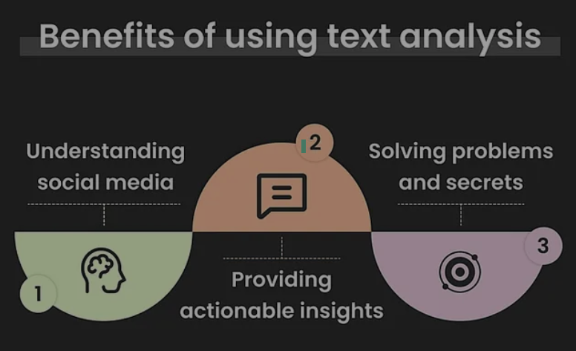
Conclusion
Understanding How People Feel
Our AI-powered system reads social media text and detects specific emotions, going beyond simple positive or negative sentiment.
It is useful for brand monitoring, customer feedback, mental health awareness, and understanding public opinion.
Future work: support more languages, understand sarcasm and mixed emotions, and make the model lighter for mobile use.

Slide 8
THANK YOU

