Slide 1
GRAMMARFIX
IF
Dangling-Else Resolver
An interactive Compiler Design tool that detects dangling-else ambiguity,
shows both interpretations, and resolves the grammar deterministically.
Team:
Diksha Yadav 2420030001
G. Bhavya Sree 2420030116
I. Keerthana 2420030186
B. Anupama 2420030575
ELSE
?
AMBIGUITY → RESOLUTION
01

Slide 2
Problem & Motivation
Why the dangling-else problem matters in compiler design
The ambiguity
Classic example
• In nested if-else statements, one else may match more than one if.
• This creates two possible parse-tree interpretations.
• A compiler needs a deterministic rule to choose the correct association.
if (A)
if (B)
S1;
else
S2;
Why GrammarFix?
It converts a textbook grammar problem into a visual, interactive learning and demonstration tool.
Which if owns the else?
02

Slide 3
Objectives & Core Features
Everything needed for a complete hackathon demonstration
01
Detect
02
Explain
03
Resolve
Identify nested-if patterns that can create dangling-else ambiguity.
Show the two possible interpretations in a clear visual form.
Apply the nearest-unmatched-if rule using matched/unmatched grammar.
04
Visualize
05
Test
Display before-and-after parse trees using simple HTML/CSS.
Support built-in test cases plus custom nested-if programs.
Simple • Fast • Beginner-friendly
03

Slide 4
Proposed Solution & System Architecture
Minimal stack: Flask + HTML + CSS + JavaScript
Browser UI
Flask Backend
Analyzer
Grammar Resolver
Tree Renderer
→
→
→
→
HTML • CSS • JS
Python
Token + nesting logic
Matched / unmatched
HTML/CSS nodes
INPUT
→
DETECT
→
INTERPRET
→
RESOLVE
→
VISUALIZE
Custom input → analysis → grammar resolution → parse-tree output
No database • No React • No Node.js • No Graphviz • Only Flask installation required
04

Slide 5
Algorithm & Grammar Resolution
The key idea: attach ELSE to the nearest unmatched IF
Detection workflow
Grammar transformation
• Read the custom nested-if program.
• Track IF/ELSE nesting and possible associations.
• Flag an ELSE when more than one IF can own it.
• Build the two possible interpretations.
• Resolve using the nearest unmatched IF rule.
Original grammar
S → if E then S
| if E then S else S
| other
Resolved grammar
M → if E then M else M | other
U → if E then S
| if E then M else U
Rule: ELSE → nearest unmatched IF
05

Slide 6
Demo Flow & Parse-Tree Visualization
A simple live demo from input to resolved output
1 Custom input
3 Before → After
Ambiguous
Resolved
if (A) { if (B) { S1; } else { S2; } }
IF
IF
IF
ELSE
IF
ELSE
AMBIGUITY DETECTED
S1
S2
S1
S2
2 Two possible interpretations
• ELSE → inner IF
The tree updates from the user's actual input — not hardcoded output.
• ELSE → outer IF
Paste → Detect → Compare → Resolve
06

Slide 7
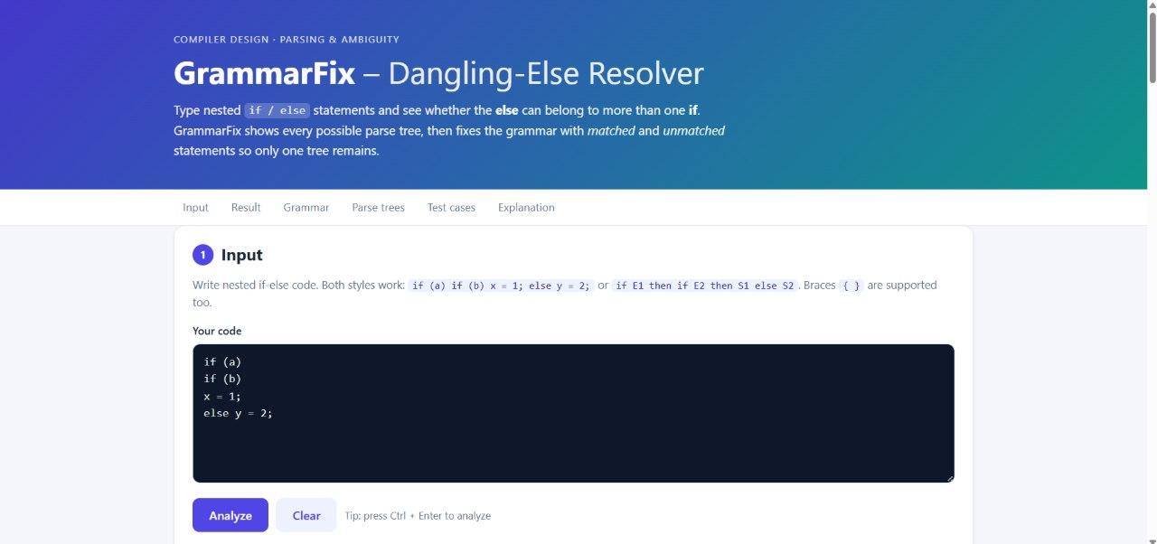
Implementation live demonstration
07

Slide 8
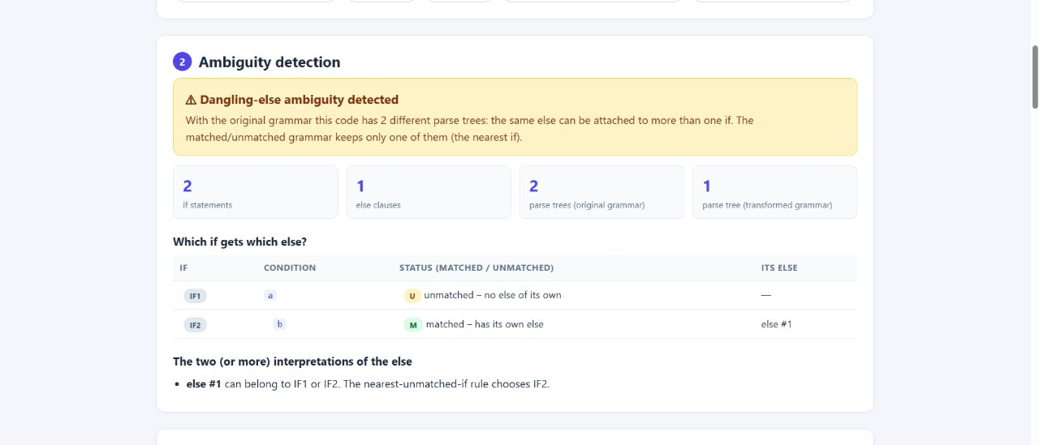
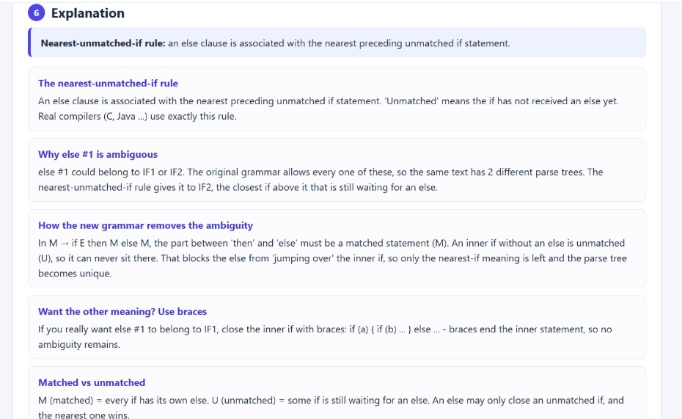
08

Slide 9
Results, Advantages & Future Scope
A compact educational compiler-design demonstrator
Results
Advantages
Future
• Detects nested-if ambiguity
• Explains two interpretations
• Shows grammar transformation
• Visualizes before/after trees
• Supports 5+ tests + custom input
• No database or heavy libraries
• Runs locally with Flask
• Clean responsive dashboard
• Beginner-friendly source code
• Strong visual demo for viva/hackathon
• Full tokenizer/parser
• More CFG ambiguity patterns
• Step-by-step parse animation
• Export trees and reports
• Syntax highlighting + larger test suite
Limitation: pattern-based educational analysis, not a complete production compiler parser.
09

Slide 10
THANK YOU
IF
GrammarFix
Dangling-Else Resolver
ELSE
↓
nearest unmatched IF
Questions / Demo
Turning grammar ambiguity into something you can see, test, and understand.
10

