Slide 1
INTELLIGENT HEALTHCARE
ANALYTICS & DEVOPS PLATFORM
Adaptive Software Engineering — Review 2
Team Members
2420030001 – Diksha Yadav
2420030384 – Karishma Suthar
2420030023 – Dhanya Sri
2420030463 – Darishma
Guide: K.Bhavya

Slide 2
1. Problem Statement
2
What problem are we solving?
Core Problem
Hospitals generate large volumes of operational data, but it is often distributed across systems or analyzed manually. This makes it difficult to monitor operations, identify bottlenecks, predict workload and make timely decisions.
Data
Manual Reporting
Limited Intelligence
Patient, appointment, admission, bed and department information can exist in separate sources.
Periodic report preparation takes time and limits quick access to operational insights.
Conventional systems mainly support record keeping, with limited prediction and AI-based recommendations.

Slide 3
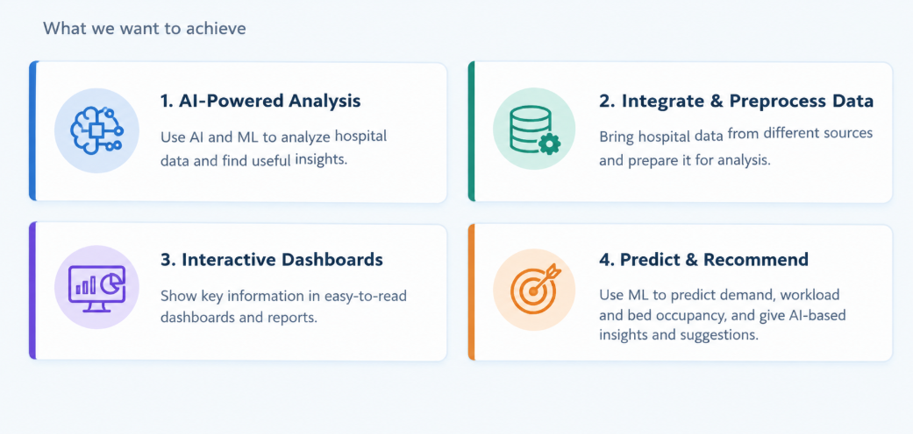
2. Objectives
3
What we want to achieve

Slide 4
3. Existing System
4
Current method and its limitations
Current Method
Limitations
• Separate systems/data sources
• Manual or periodic report generation
• Basic record keeping and transaction processing
• Limited analytics and forecasting
• Mostly reactive decision-making
• Time-consuming reporting
• Limited real-time visibility
• Difficult demand prediction
• Delayed detection of unusual trends
• No unified AI recommendation layer

Slide 5
4. Proposed System
5
Our solution and its benefits
Proposed Solution
A unified healthcare analytics platform that integrates hospital data, preprocesses it, performs analytics, applies ML/AI, and presents dashboards, reports and AI-assisted recommendations through one interface.
Centralized
Predictive
Intelligent
Multiple hospital datasets in one platform
Demand, workload and bed forecasting
AI trends and recommendations
Visual
Actionable
Deployable
Interactive dashboards
Supports planning and faster decisions
REST API, PostgreSQL, Docker and cloud options

Slide 6
5. Technology Used
6
Languages, tools, database and frameworks
Frontend
Backend
AI / ML
AI Assistant
React.js • TypeScript • Tailwind CSS
Spring Boot • Java • REST API
Python • Pandas • NumPy • Scikit-learn
OpenAI API / Ollama • LangChain / LLM
Database
Visualization
DevOps
PostgreSQL
Chart.js / Recharts • Power BI • Matplotlib
Docker • Git • GitHub

Slide 7
6. Workflow
7
Simple flowchart showing how the system works
Hospital Data
Data Preprocessing
Data Analysis
CSV / Database / HMS
Cleaning • validation • transformation
Trends • patient flow • utilization
ML Prediction
AI Insights
Dashboard & Reports
Demand • workload • bed occupancy
Anomalies • bottlenecks • recommendations
KPIs • charts • reports • AI assistant
Hospital Administrators receive centralized, predictive and AI-assisted insights

Slide 8
7. Modules
8
Main modules / features
Patient Management
Appointment Analytics
Bed Management
Department Analytics
Patient records, admissions and discharge analysis
Appointment trends and waiting-time analysis
Bed occupancy, availability and forecasting
Department-wise load and performance
Resource Utilization
AI Insights
Reports
AI Analytics Assistant
Staff, equipment and service utilization
Trends, anomalies and recommendations
Hospital and department analytical reports
Natural-language questions over analytics

Slide 9
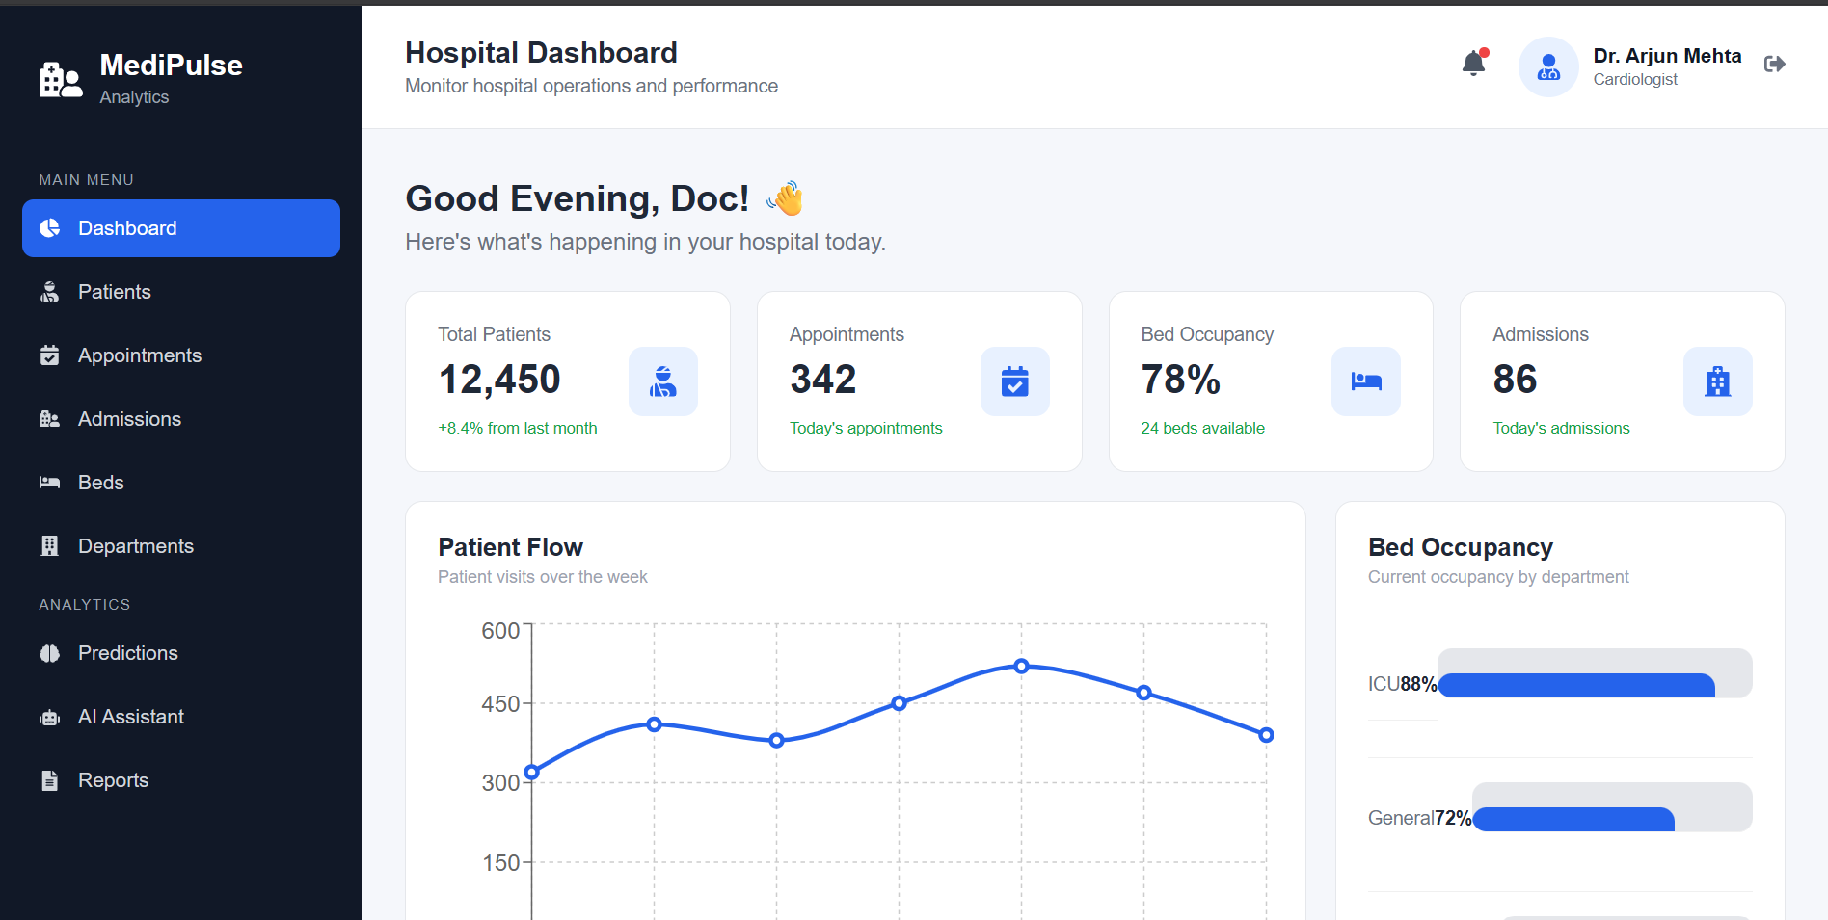
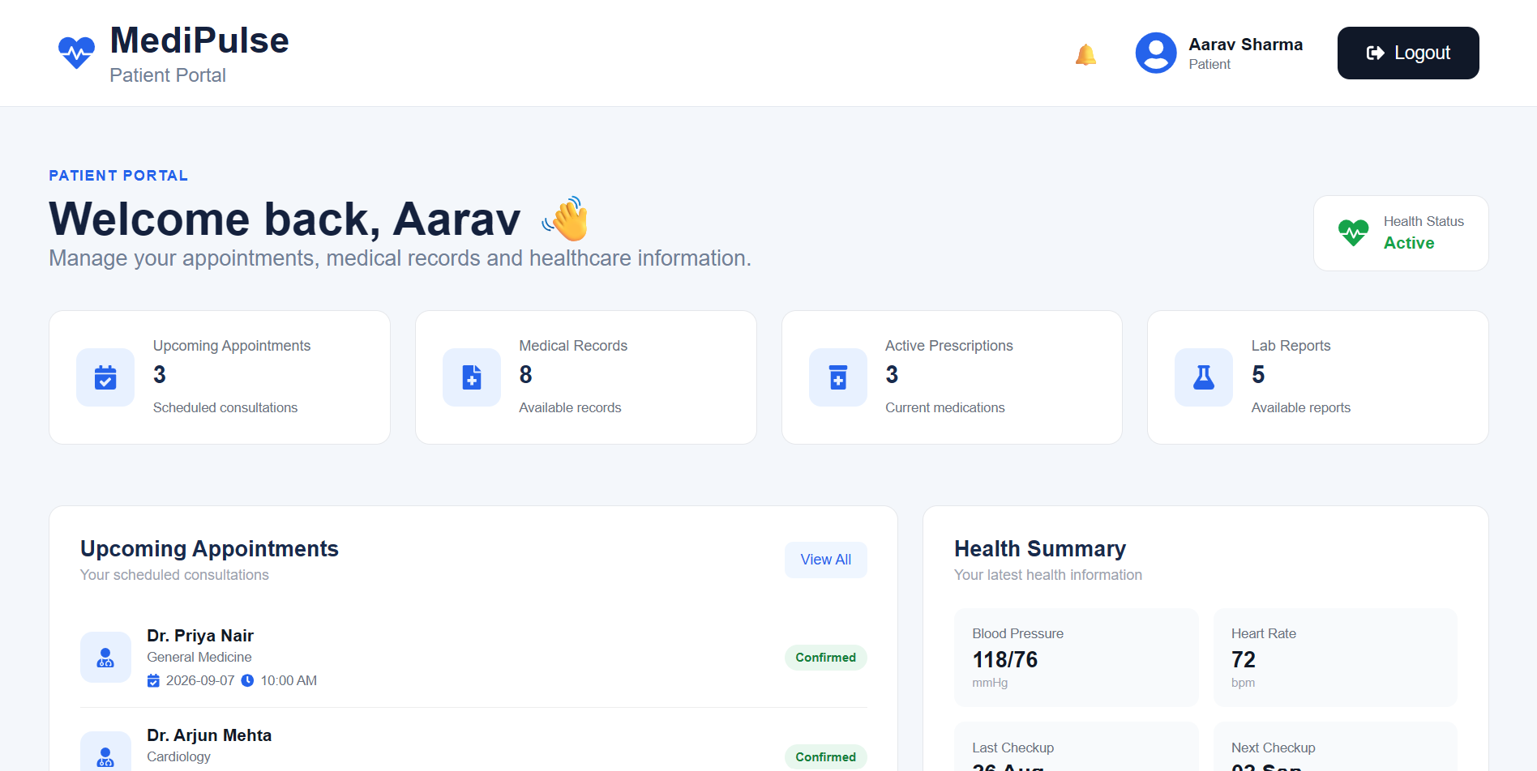
8.Implementation
Admin Side
Patient Side
Thank You!

