Slide 1
Quiz Making Project Presentation
Overview of quiz making system by our team members
Group Members:
58 Rajanandini Shankar Musale
59 Diksha Santosh Nikam
72 Siddhi Balasaheb Patil
74 Preeti Nishikant Sonule
75 Tejal Navnath Powar

Slide 2

Introduction to Quiz Making
Purpose
Target Audience
Significance
Design interactive quizzes for knowledge assessment
Students and instructors in varied academic fields
Enhances learning retention with immediate feedback

Slide 3

Objectives of Quiz Making
User-Friendly Design
Easy navigation and responsive layout
Dynamic Question Bank
Variety of question types and topics
Real-time Evaluation
Instant score calculation and feedback
Robust Performance
Efficient handling of multiple users

Slide 4
System Architecture of Quiz Making
System Flow:
1. User Interaction: - The user launches the quiz application and interacts with the GUI.
The user selects answers to questions, and the GUI sends the responses to the Java program.
2 Question Display : - The Java program processes the user's responses, checks answers, and updates the score.
The program retrieves questions and options from the data storage component.
3. Data Storage : - The Java program stores and retrieves quiz data, including questions, options, and answers.
4. Result Display : - After completing the quiz, the Java program displays the user's final score and results.

Slide 5
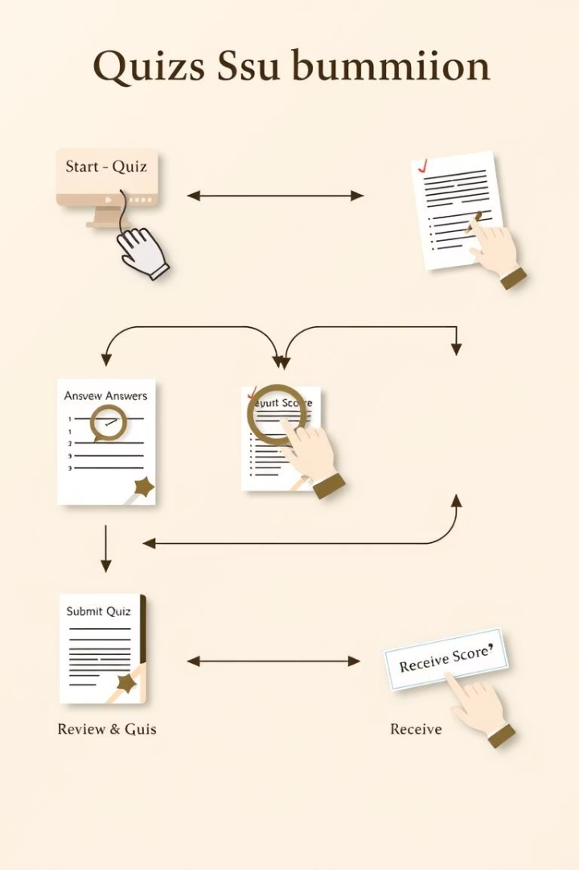




Working of the Quiz Making System
Question Display
User authentication to access system
Attempt Questions
Choose subject and difficulty level
Choose Answer
Submit answers within given time
Receive Results
Instant feedback and score display

Slide 6
Java Concepts Used in Quiz Making
Object-Oriented Programming
Exception Handling
Collections Framework
Classes and Objects for quiz data
Managing input errors
Dynamic question storage
Encapsulation of quiz logic
Ensuring program stability
Efficient data retrieval

Slide 7
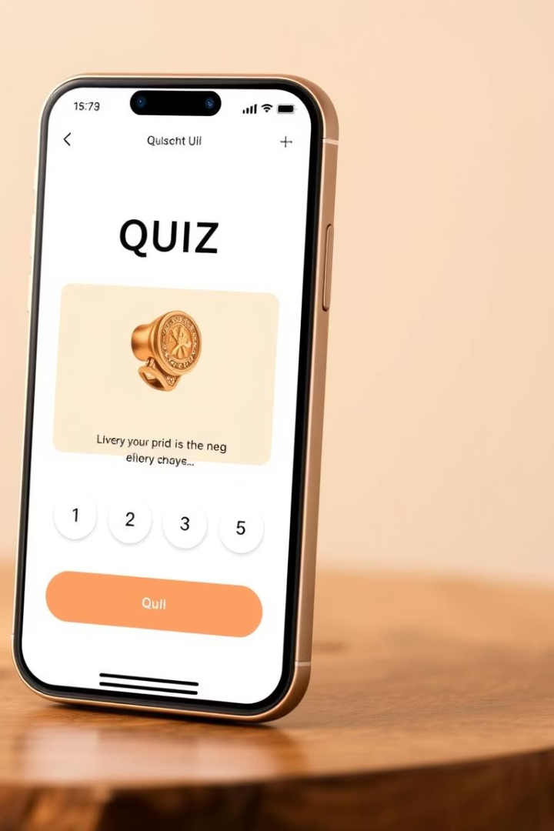
User Interface Design Highlights
Responsive Layout
Interactive Elements
Accessible on multiple devices and resolutions
Buttons, timers, and progress indicators
Accessibility Features
Keyboard navigation and screen reader support

Slide 8

Key Takeaways & Future Directions
Efficient Quiz System
Supports diverse educational needs
Scalability
Ready for larger user bases
Future Enhancements
Incorporate AI-based question generation
Mobile App Development
Extend accessibility and usability

