Slide 1

SCHEDULE PLANNER · WALKTHROUGH
Amazon Schedule Planner
Portfolio Schedule Balancing & Allocation — Preview → Dashboard
A single planner that ingests raw physical e‑tags, aggregates them by location, auto‑balances Product A / B against a 150 MW cap, and links every tag to its purchase and sale deals — from draft to committed schedule.
5
150 MW
24 HE
Interactive tabs
Global allocation cap
Hourly profile per tag
Proprietary and confidential. Do not copy without permission from OATI. © 2026 Open Access Technology International, Inc.

Slide 2


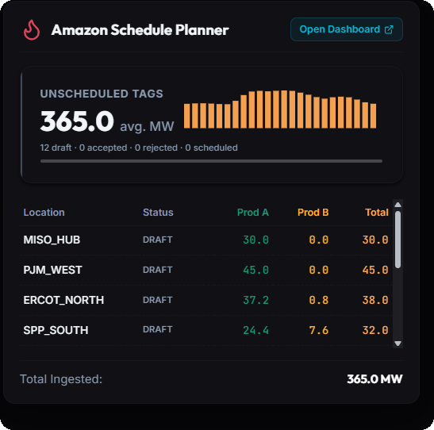
The Preview Card
A glanceable entry point before the full planner
A compact summary card that surfaces portfolio health at a glance — no need to open the full dashboard first.
Unscheduled Tags KPI — 365.0 avg MW across 12 draft tags with a live hourly sparkline.
Per‑location table — Prod A / Prod B / Total for every source (MISO_HUB, PJM_WEST, ERCOT_NORTH…).
Total Ingested — One line rolls up every location — 365.0 MW.
Open Dashboard — One click launches the full Schedule Planner to act.
Why it matters: catches imbalance early — you see what’s unscheduled before diving into the workflow.
Proprietary and confidential. Do not copy without permission from OATI. © 2026 Open Access Technology International, Inc.

Slide 3

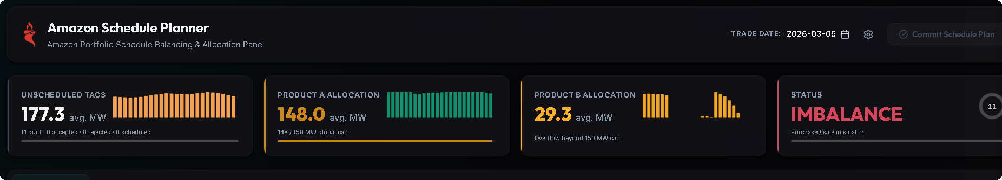
Command Center — The KPI Top Panel
Real‑time portfolio health, always on screen
UNSCHEDULED TAGS
PRODUCT A ALLOCATION
PRODUCT B SPILLOVER
STATUS
177.3 avg MW
148.0 / 150 MW
29.3 avg MW
IMBALANCE
11 draft tags awaiting a home
Filling toward the global cap
Overflow beyond the 150 MW cap
Purchase / sale mismatch, flagged live
Trade date + Commit Schedule Plan — the single action that finalizes the whole plan.
Proprietary and confidential. Do not copy without permission from OATI. © 2026 Open Access Technology International, Inc.

Slide 4


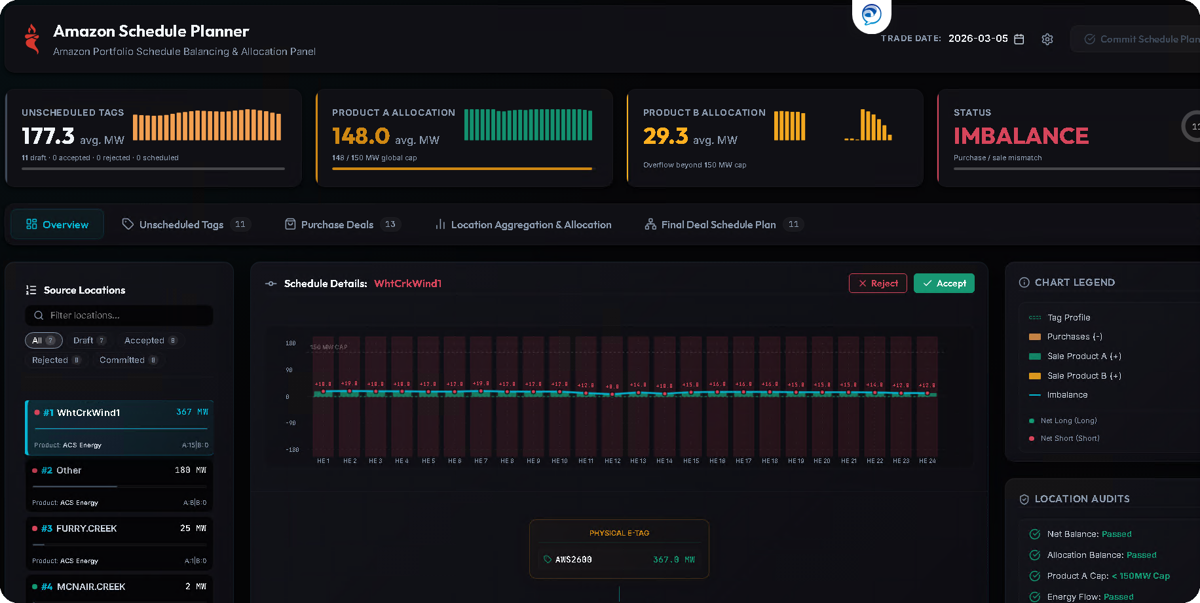
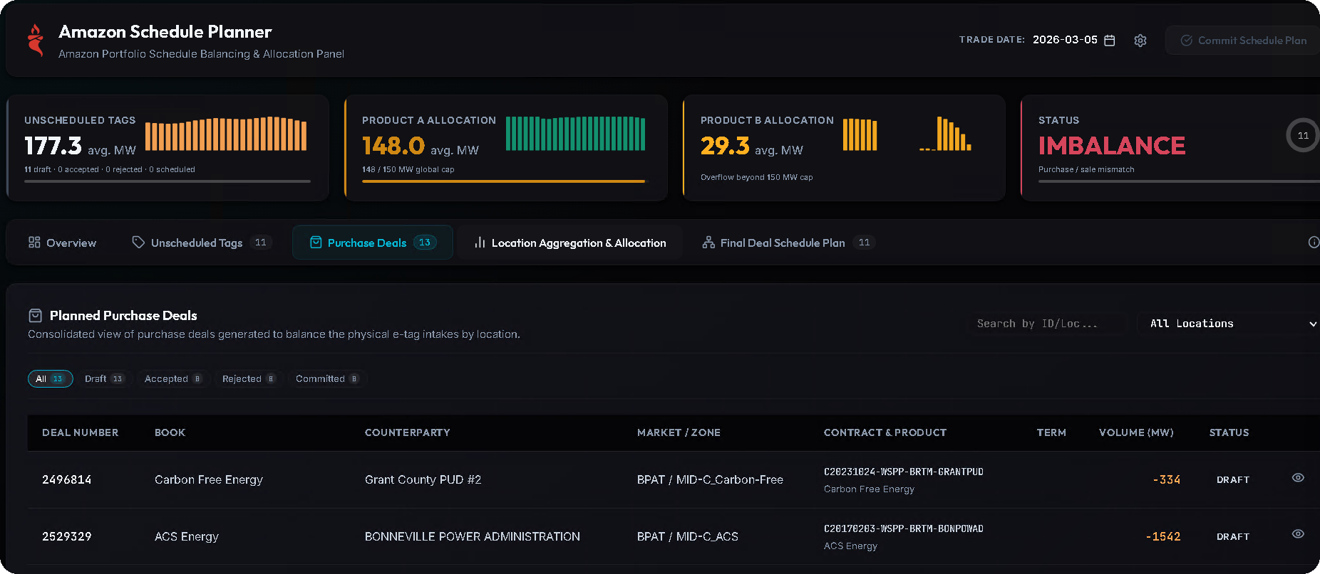
Overview & Purchase Deals
Inspect a schedule, then see the deals that balance it
OVERVIEW TAB
PURCHASE DEALS TAB
Source Locations — filter by All / Draft / Accepted / Committed.
Auto‑generated deals that balance physical e‑tag intake by location.
Schedule Details chart per tag with inline Accept / Reject.
Full ledger — Deal #, Counterparty, Market/Zone, Contract, Volume.
Location Audits — Net Balance, Allocation, Cap, Energy Flow: Passed.
Every deal DRAFT e.g. ACS Energy / BPA − 1,542 MW.
Proprietary and confidential. Do not copy without permission from OATI. © 2026 Open Access Technology International, Inc.

Slide 5



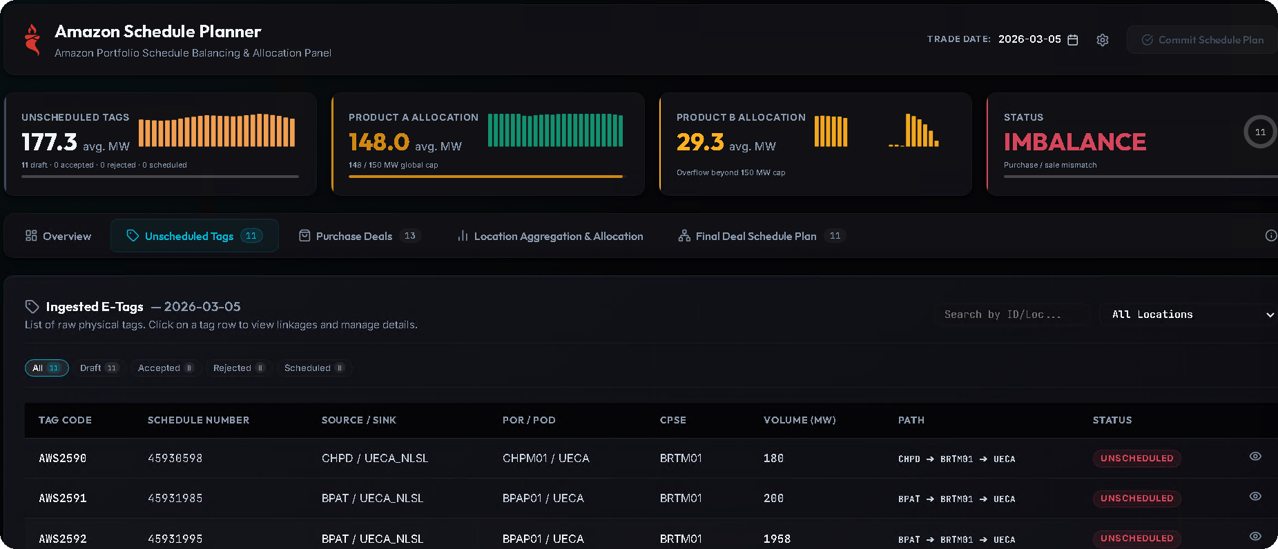
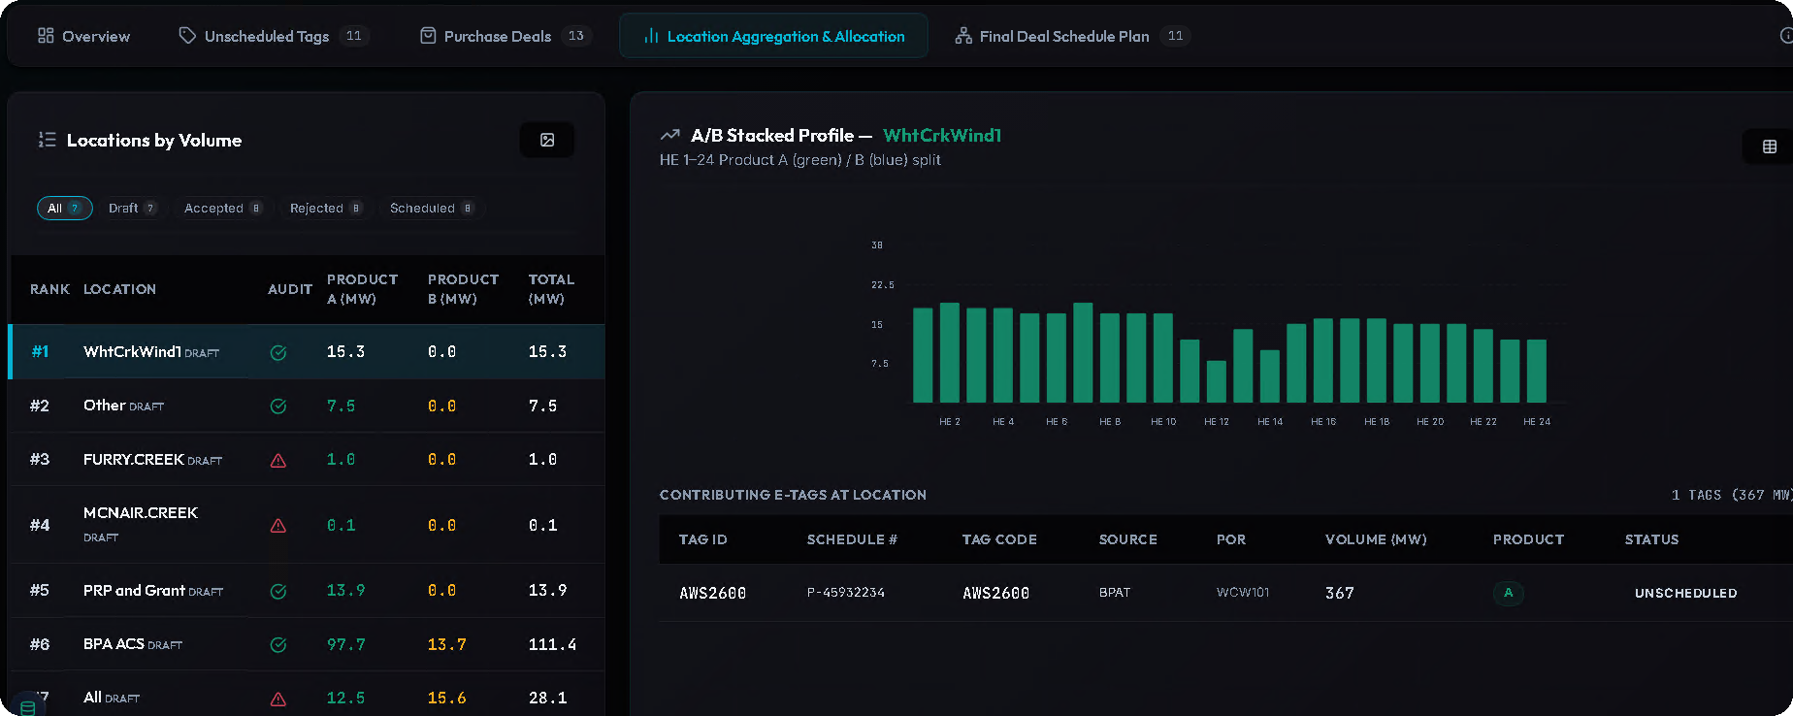
Unscheduled Tags & Location Aggregation
From raw physical tags to ranked, allocated buckets
UNSCHEDULED TAGS
LOCATION AGGREGATION
Ingested E‑Tags — raw physical tags for the trade date.
Ranked by volume with a ✓ / ⚠ audit on every location.
Full detail — Tag Code, Schedule #, Source/Sink, POR/POD, Volume, Path.
A caps at 150 MW per source; Product B absorbs the spillover.
All UNSCHEDULED — click a row to view linkages & manage details.
A/B Stacked Profile — HE 1–24, with contributing e‑tags per location.
Proprietary and confidential. Do not copy without permission from OATI. © 2026 Open Access Technology International, Inc.

Slide 6

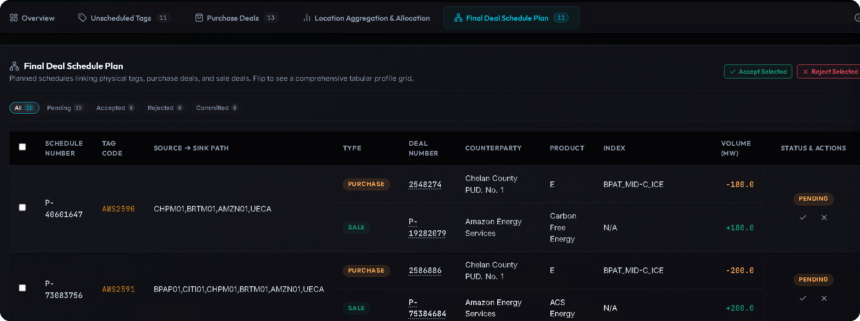
Final Deal Schedule Plan
Where physical tags, purchase deals & sale deals converge
Links every object — physical e‑tag ↔ balancing purchase ↔ matching sale.
Paired rows — a PURCHASE (−MW) and a SALE (+MW) share one schedule.
Traceable columns — Schedule #, Tag Code, Source→Sink Path, Type, Deal #, Product, Volume.
Bulk actions — Accept / Reject Selected; each row Pending until actioned.
The payoff: one auditable chain from a raw tag to committed buy / sell positions.
Proprietary and confidential. Do not copy without permission from OATI. © 2026 Open Access Technology International, Inc.

Slide 7
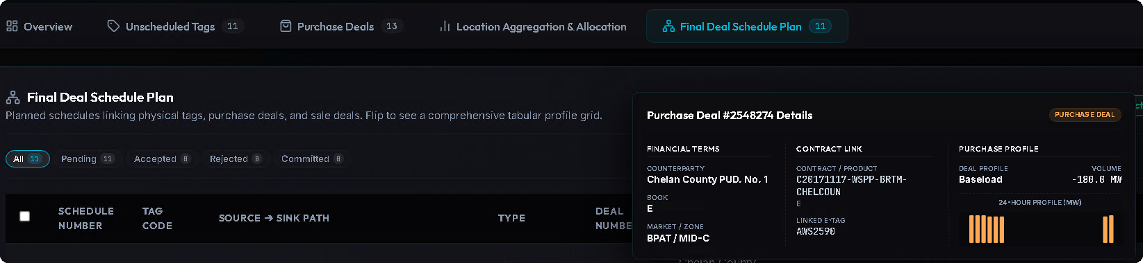
Final Deal Schedule Plan — Detail View
Flip any schedule into a full profile grid
FINANCIAL TERMS
CONTRACT LINK
PURCHASE PROFILE
Counterparty, Book & Market / Zone (e.g. Chelan County PUD No. 1 · BPAT / MID‑C).
Contract / Product tied back to its linked e‑Tag (AWS2590) — full lineage.
Baseload shape, −180 MW, rendered as a 24‑hour MW bar profile.
Proprietary and confidential. Do not copy without permission from OATI. © 2026 Open Access Technology International, Inc.

Slide 8

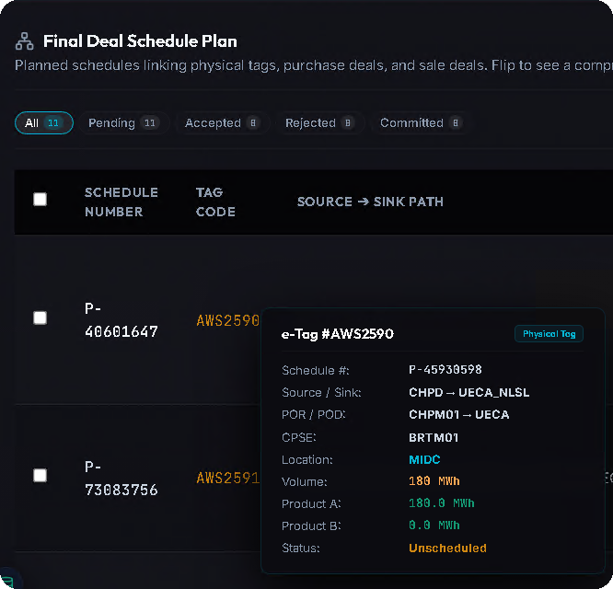
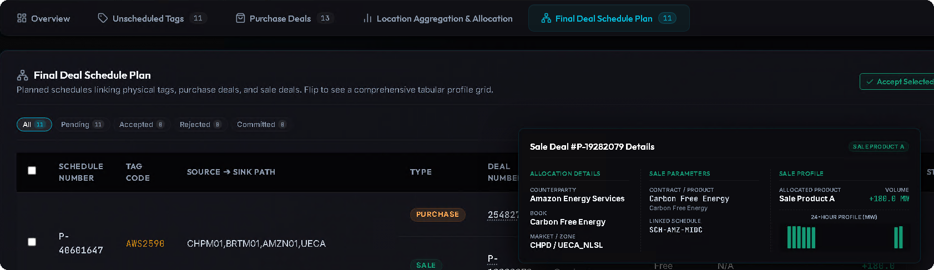
Interaction Model — Hover & Click
Progressive disclosure keeps a dense grid readable
HOVER → QUICK PEEK
CLICK → FULL DETAIL
Hover a Tag Code → an instant Physical e‑Tag tooltip.
Click a row / deal # → a full detail panel slides in.
At‑a‑glance Source/Sink, POR/POD, Location, A/B split, Status.
Deal deep‑dive Allocation, Sale Parameters & 24‑hr profile; Accept / Reject inline.
Proprietary and confidential. Do not copy without permission from OATI. © 2026 Open Access Technology International, Inc.

