Slide 1
E-Commerce Data Analysis
Project Guide: Dr. Pallavi G B
By:
Battula Pragati
Chandana Kolli
Diksha Jain

Slide 2
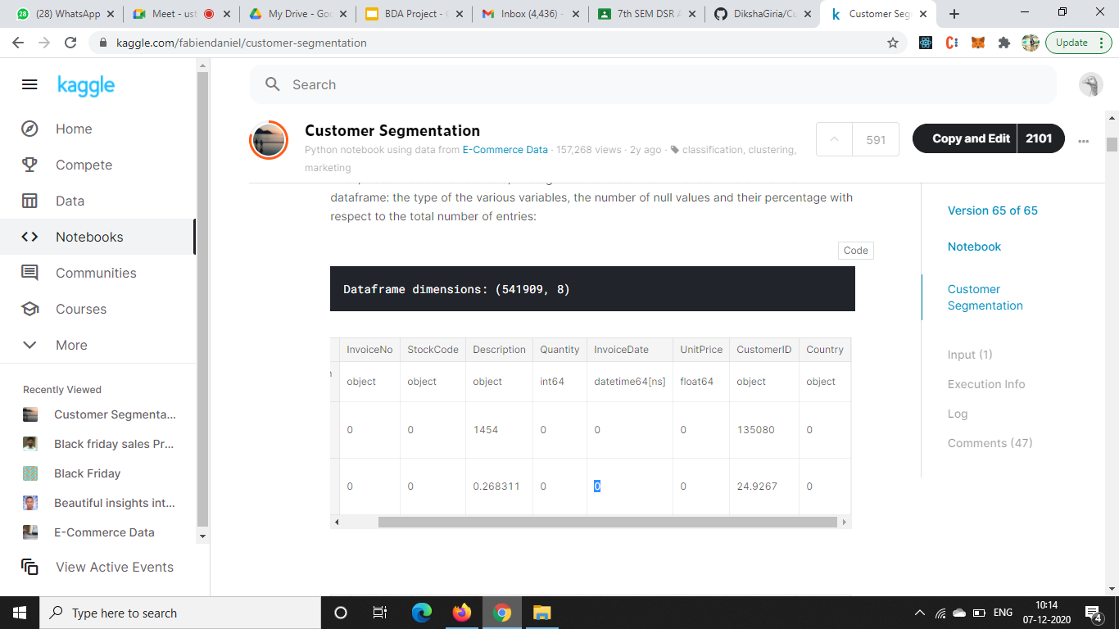
The Dataset

Slide 3
Aim of the Project
The paradigm shift in the E-commerce sector; data is no longer seen as the by-product of their business activities, but as their biggest asset providing:
Key insights to the needs of their customers
Predicting trends in customer’s behaviour
Democratizing of advertisement to suit consumers varied taste
providing a performance metric to assess the effectiveness in meeting customer’s needs

Slide 4
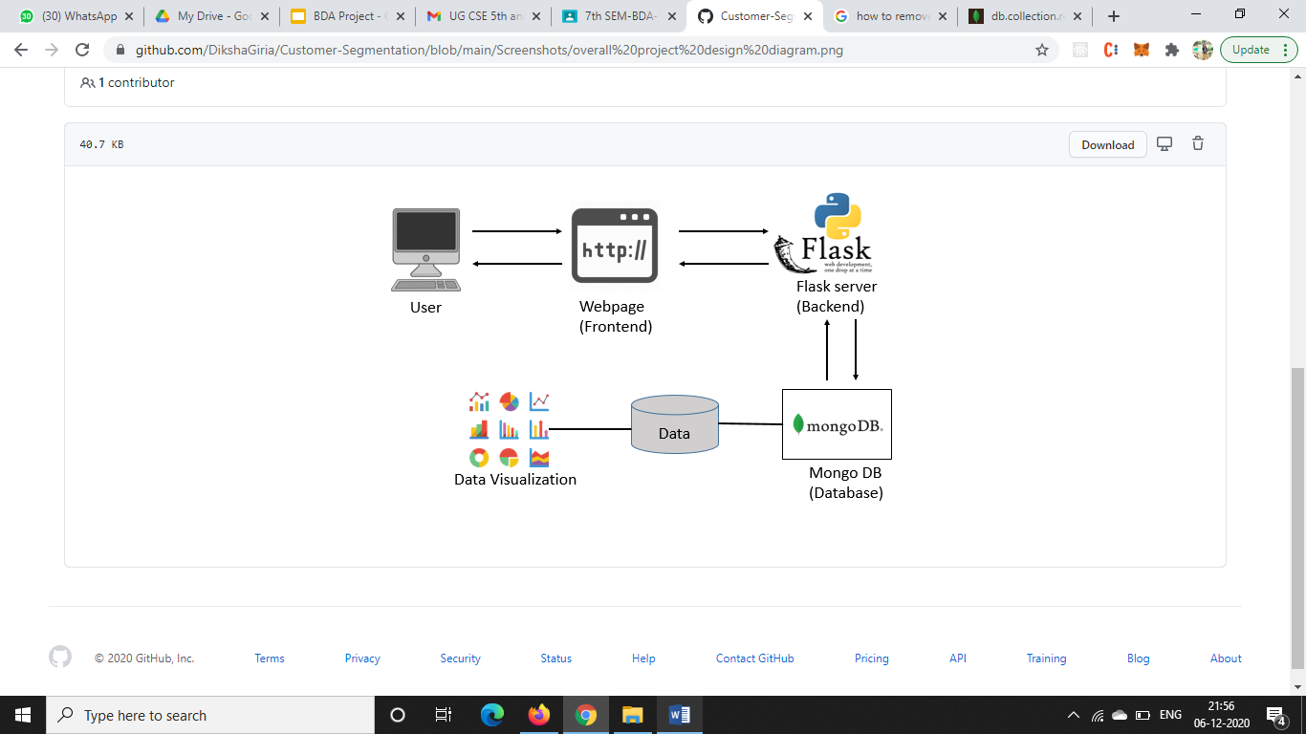
Project Design
User experience
Physical Computing
HTML, CSS,JS

Slide 5
List of Queries executed & their results

Slide 6
Graphs

Slide 7
Thank You

