Slide 1
Docker
Presented by: Vijay Pandey

Slide 2
Overview
Docker is an open platform for developing, shipping, and running applications. Docker enables you to separate your applications from your infrastructure so you can deliver software quickly. With Docker, you can manage your infrastructure in the same ways you manage your applications. By taking advantage of Docker’s methodologies for shipping, testing, and deploying code quickly, you can significantly reduce the delay between writing code and running it in production.
.NET Core can easily run in a Docker container. Containers provide a lightweight way to isolate your application from the rest of the host system, sharing just the kernel, and using resources given to your application.

Slide 3
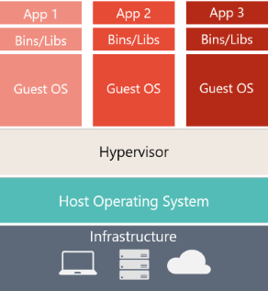
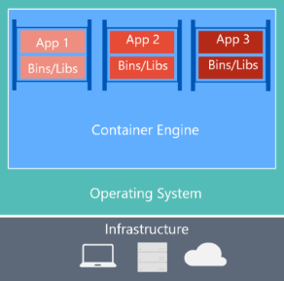
Comparing Docker containers with virtual machines

Slide 4
Some terminologies
Docker image: An image is an ordered collection of filesystem changes that form the basis of a container. The image doesn't have a state and is read-only. Much the time an image is based on another image, but with some customization. For example, when you create an new image for your application, you would base it on an existing image that already contains the .NET Core runtime. Because containers are created from images, images have a set of run parameters (such as a starting executable) that run when the container starts.

Slide 5
Some terminologies
Docker container: A container is a runnable instance of an image. As you build your image, you deploy your application and dependencies. Then, multiple containers can be instantiated, each isolated from one another. Each container instance has its own filesystem, memory, and network interface. Simply container is a instance of the image you created of your application.

Slide 6
Some terminologies
Docker registry: Container registries are a collection of image repositories. You can base your images on a registry image. You can create containers directly from an image in a registry. Simply container is a instance of the image you created of your application.

Slide 7
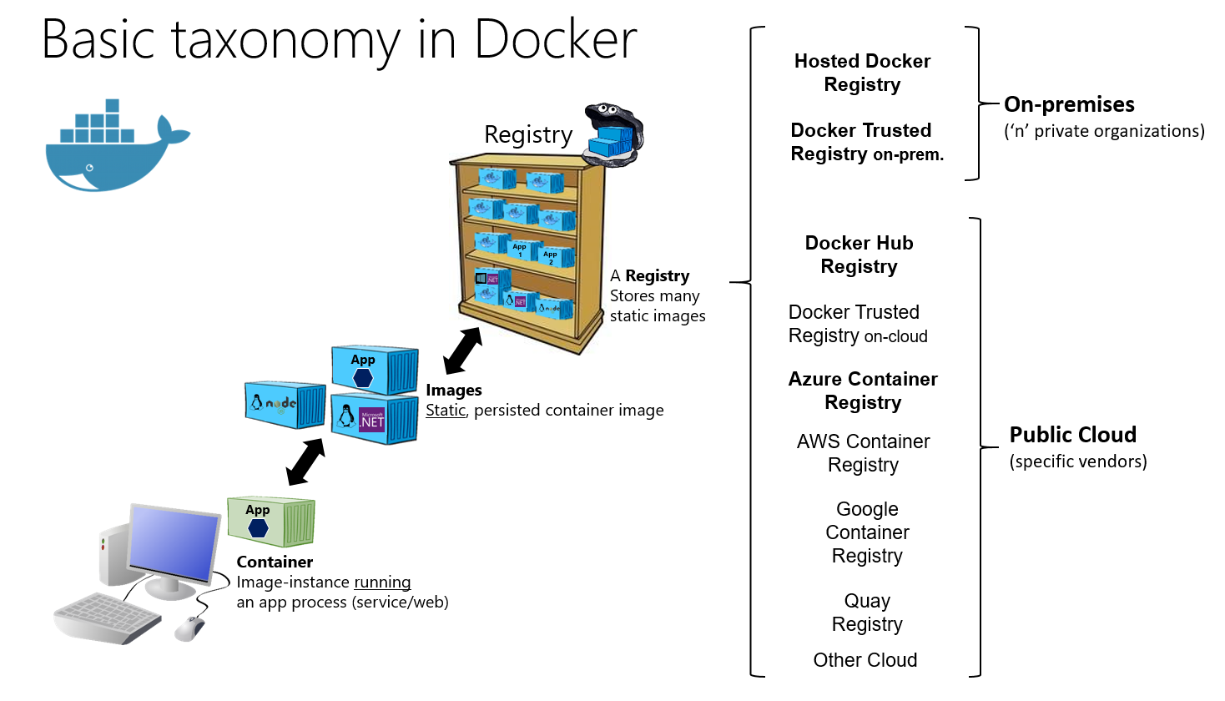

Slide 8
Some terminologies
Dockerfile: A text file that contains instructions for how to build a Docker image. It's like a batch script, the first line states the base image to begin with and then follow the instructions to install required programs, copy files and so on, until you get the working environment you need.

Slide 9
Commands:
docker run – Runs a command in a new container.
docker start – Starts one or more stopped containers
docker stop – Stops one or more running containers
docker restart – Restart one or more containers
docker build – Builds an image form a Docker file
docker pull – Pulls an image or a repository from a registry
docker push – Pushes an image or a repository to a registry

Slide 10
Commands:
docker ps – List all the running containers.
docker ps -a – List all containers.
docker image ls – List all images.
docker rm – Removes a container
docker rmi – Removes a image
docker logs – Fetch the logs of a container
docker exec – Runs a command in a run-time container

