Slide 1
ML-Driven Real-Time Emotion and Stress Level Monitoring
Paper ID: 1403
Track No. : 3
All authors Name and Affiliation
Bharti Parate, Diksha Mathankar
Richa Khandelwal, Prashant Dwivedy
{RCOEM, Nagpur}
Presented by
Bharti Parate

Slide 2





Abstract
KEY FEATURES
PROBLEM
SOLUTION
APPLICATION
Stress-related disorders require non-invasive, real time monitoring solutions
CNN-based emotion recognition using FER-2013 dataset, mapped to stress levels (low, high, moderate)
Real-time visual feedback (gauge interface). Non-invasive, sensor-free approach.
Mental health,
Workplace stress management,
Personal well-being.

Slide 3

Overview of the System Architecture
Data collection
Pre-processing and feature extraction.
Machine learning
models
Real-time monitoring and Feedback

Slide 4

Real-time Data collection
Input Source: Live video feed from a camera captures facial expressions in real time.
Face Detection: Haar Cascades or MTCNN are employed to detect and segment the face from the background. A bounding box isolates the facial region for further analysis.
Dataset for Training: The FER-2013 dataset (35,887 labelled facial images across seven emotions: anger, disgust, fear, happy, sad, surprise, neutral)

Slide 5
Data Preprocessing & Feature Extraction
Resizing and Grayscale Conversion: Detected face regions are sized 48 x 48 pixels and converted to grayscale to standardize input dimensions.
Data Augmentation: During training, techniques like rotation, horizontal flipping, and zooming are applied to enhance dataset diversity and reduce overfitting.
Edge Detection and Segmentation:
Canny Edge Detection: Highlights key facial features ( eyes, mouth, nose) by detecting intensity gradients.
Region of Interest (ROI) Segmentation: Focuses on critical micro-expressions and emotional cues.

Slide 6

Machine Learning Model
Convolution Neural Network (CNN) Architecture:
Convolution Layers
Extract spatial features (edges, textures) using 3x3 kernels.
Stabilizes training by standardizing layers outputs.
Reduces dimensionality while retaining dominant features.
Reduces computational cost while maintaining accuracy.
Replaces fully connected layers to minimize overfitting.
Outputs emotion probabilities across seven classes.
Batch Normalization
Max Pooling
Separable Convolution
Global Average Pooling
Softmax Activation

Slide 7
EMOTION TO STRESS MAPPING
Training Protocol:
Loss Function: Categorical cross-entropy
Optimizer: Adam with adaptive learning rates
Epochs: 25 epochs, achieving 73.21% training accuracy
Emotion
Stress Level
{ Happiness, Surprise }
{ Neutral }
{ Anger, Fear, Sadness, Disgust }
Low Level
Moderate Level
High Level

Slide 8

Real-time Monitoring & Feedback
Dynamic Interface:
Bounding box : Highlights the detected face in real-time video feed.
Emotion label: displays the predicted emotion with a confidence score.
Stress Gauge: A visual needle-based gauge updates dynamically to reflect stress levels (low, moderate, high)
This methodology combines robust CNN-based emotion recognition with non-invasive real-time feedback, providing an accessible solution for stress monitoring.

Slide 9

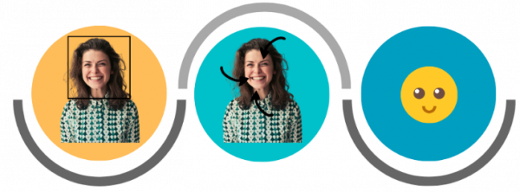
How Model work on the Data?
Face Detection
Facial Expression Detection
Classification to Emotion State “Happy”

Slide 10
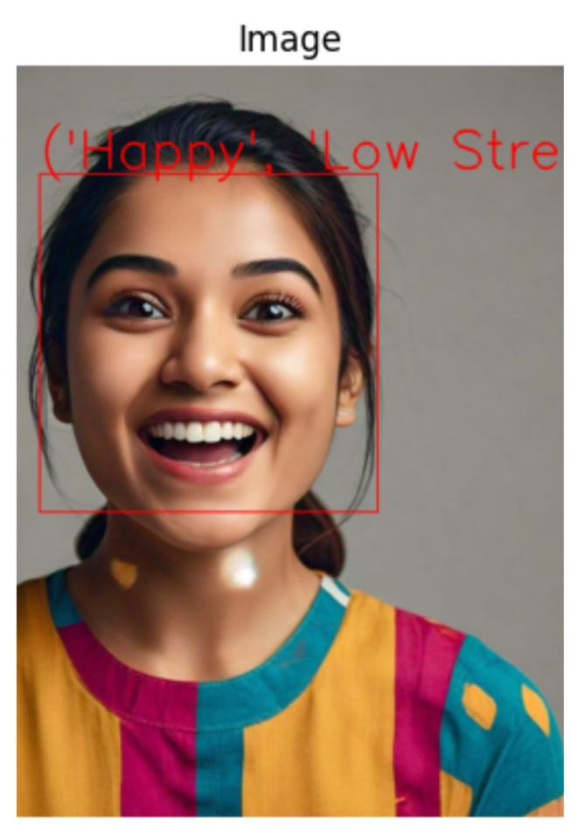
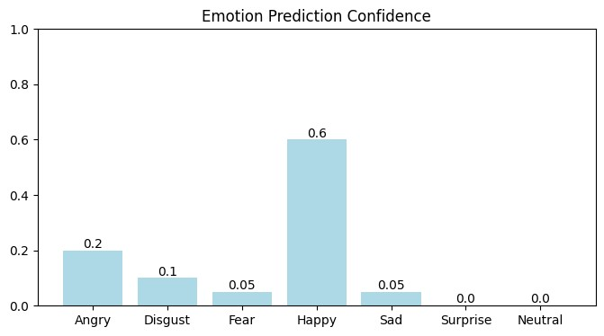
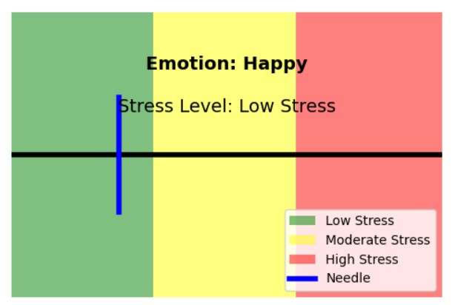
Test Result
Fig.4: Dynamic visual box with needle
Fig.2: Bar Graph for Visual Understanding
Fig.1: CNN Test Cases for Stress Detection

Slide 11
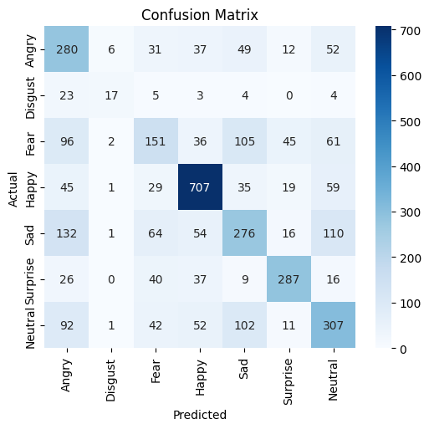
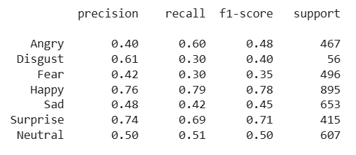
Performance Evaluation of Emotion
Confusion Matrix:
Shows how well the model predicts each emotion
2. Classification Metrics
Precision: How many predictions were correct
Recall: How many actual cases were identified
F1-Score: Balance between precision and recall
Support: Number of Samples per class

Slide 12
CONCLUSION
Non-invasive, real-time stress detection via facial expressions.
A system that eliminates the need for intrusive sensors.
Optimized CNN model with 73.21% accuracy.
A potential tool for improving workplace productivity, mental health and smart environments.

Slide 13


