Slide 1
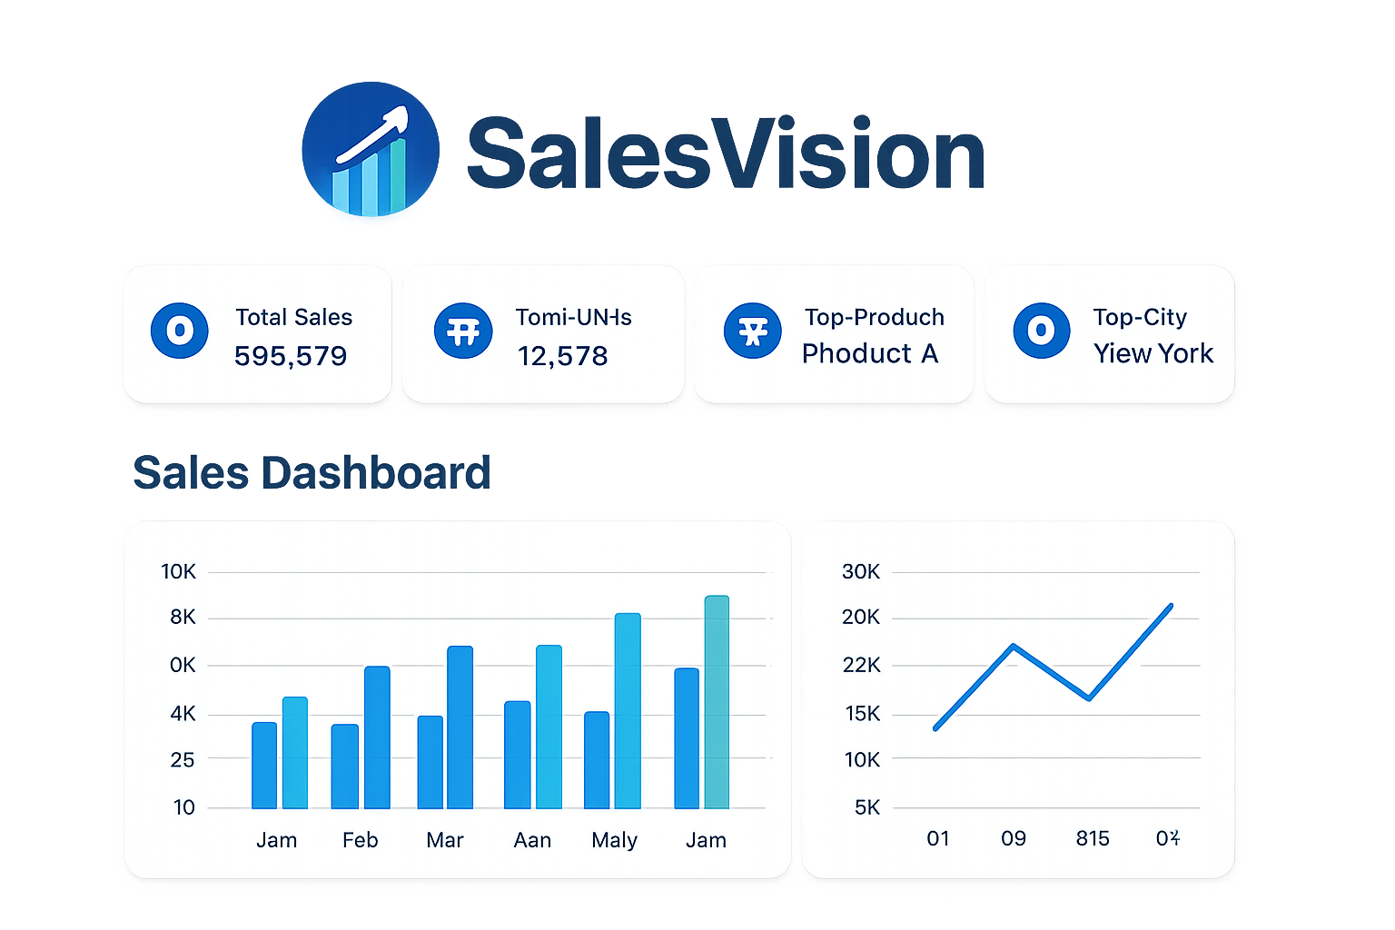
TRANSFORMING DATA INTO STRATEGIC DECISIONS
Presented by -: Diksha Paramane

Slide 2
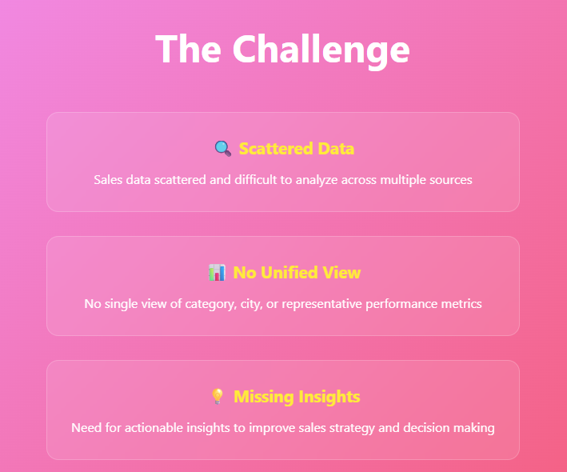
Problem Statement
- Sales data scattered and difficult to analyze
- No single view of category, city, or representative performance
- Need for actionable insights to improve sales strategy

Slide 3
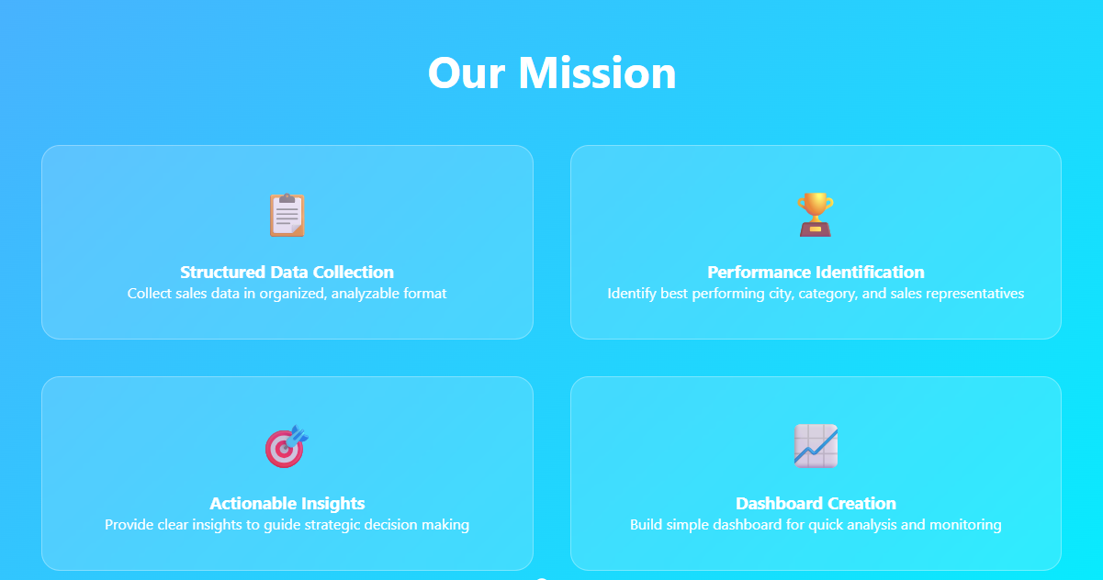
Data Objective
- Collect sales data in structured format
- Identify best performing city, category, and sales rep
- Provide clear insights to guide decision making
- Build simple dashboard for quick analysis

Slide 4
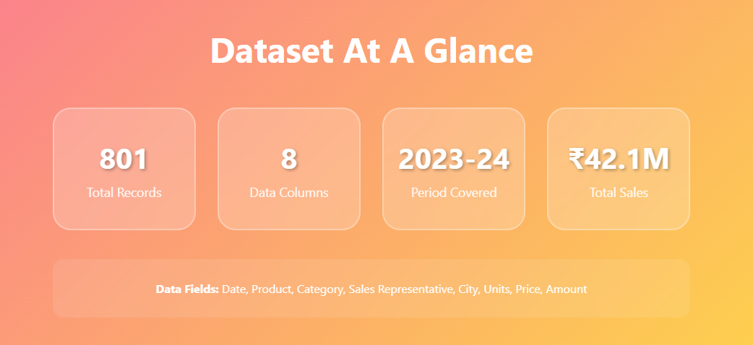
Overview of Dataset
- Total Records: 801
- Columns: 8 (Date, Product, Category, Sales Representative, City, No of Units, Price, Amount)
- Period covered: 2023 - 2024
- Total Sales Amount: 42,123,670

Slide 5
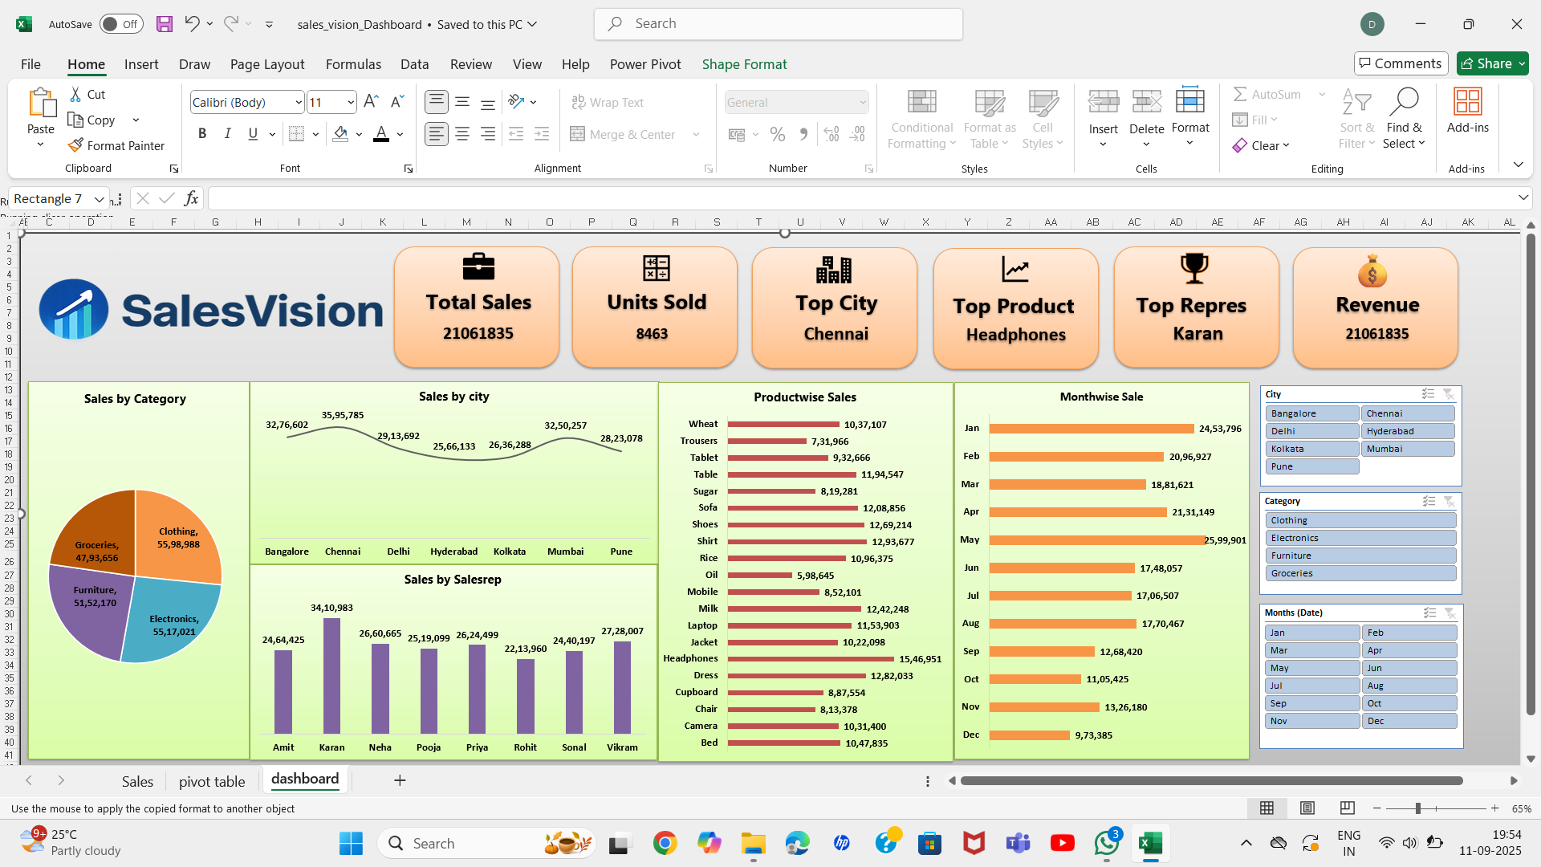
DASHBOARD

Slide 6
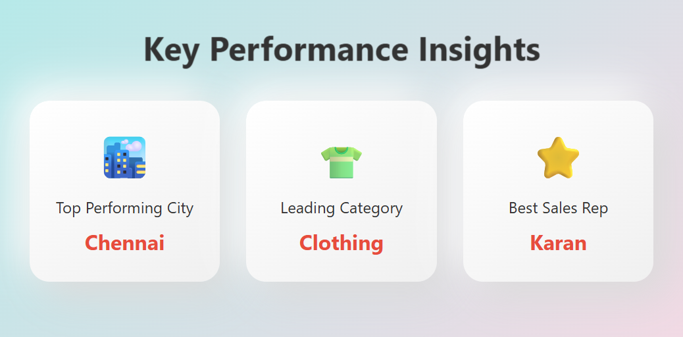
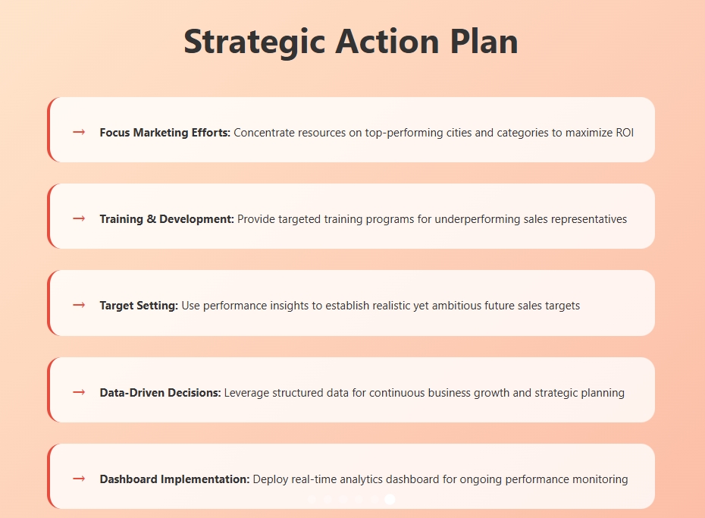
Insights and Actions
- Top City: Chennai
- Top Category: Clothing
- Best Sales Representative: Karan
- Focus marketing efforts on top cities and categories
- Provide training to underperforming representatives
- Use insights to set future sales targets

Slide 7
THANK YOU

