Slide 1
AI-Powered Resume Screening and Job Category Prediction System
Diksha Verma
Roll No.: 202401100800074
KIET Group of Institutions, Ghaziabad
B.Tech IT | 5th Semester

Slide 2
Introduction
• Automates resume screening using AI.
• Uses NLP and Machine Learning.
• Reduces manual HR effort.
• Predicts job category from resume text.

Slide 3
Problem Statement
• Manual screening is slow.
• Large number of resumes.
• Human errors.
• Need automated classification.

Slide 4
Objectives
• Build ML model.
• Create Flask API.
• Develop frontend.
• Integrate end-to-end system.

Slide 5
Technology Stack
• Python
• Scikit-learn
• Pandas
• Flask
• HTML/CSS/JavaScript
• VS Code

Slide 6
System Architecture
• User → Frontend → Flask API → TF-IDF → LinearSVC → Prediction

Slide 7
Dataset
• Source: Kaggle Resume Dataset
• 2484 resumes
• Columns: ID, Resume_str, Resume_html, Category

Slide 8
Machine Learning Model
• Text Cleaning
• TF-IDF Vectorization
• LinearSVC Classifier
• Model stored with Joblib

Slide 9
Working
• Paste Resume
• Click Predict
• API Receives Text
• Model Predicts Category
• Result Displayed

Slide 10
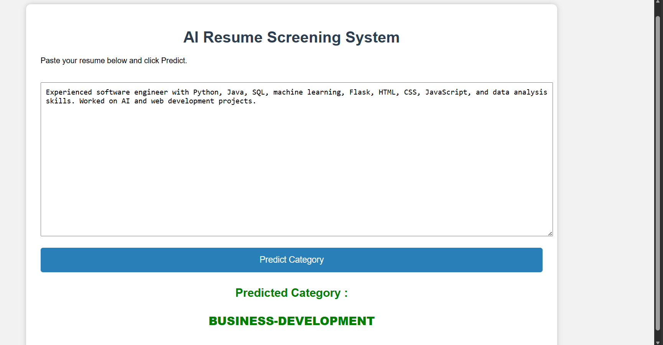
Results
• Application successfully predicts resume categories.

Slide 11
Future Scope
• PDF/DOCX upload
• Skill extraction
• Resume ranking
• Job recommendation
• Cloud deployment

Slide 12
Conclusion
• End-to-end AI application completed.
• Automates initial resume screening.
• Improves recruitment efficiency.

Slide 13
Thank You
Thank You

