Slide 1

Evaluation of e-learning websites using multi criteria decision making approaches
Name-Diksha Raturi
Under the guidance of:
Mr. Prakash Srivastava
University Roll No.-2019660
SEMESTER- 6
Section/Roll no-CST SPL/25

Slide 2
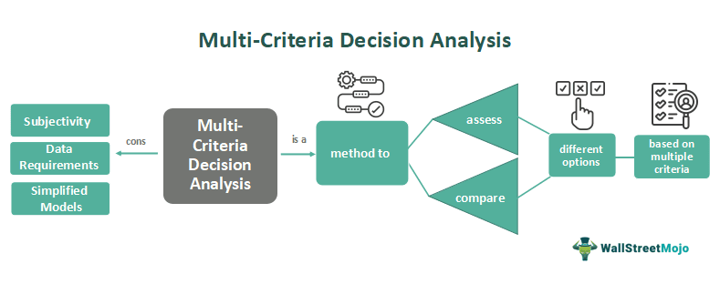
Introduction
In today's digital age, e-learning has become a crucial component of education and professional development. Each e-learning website offers unique features and content quality, making it essential to have a systematic method for evaluation and comparison.
Multi-Criteria Decision Making (MCDM) approaches provide a robust framework for evaluating complex decision-making scenarios involving multiple, often conflicting criteria. This project focuses on leveraging MCDM methods to assess and rank e-learning websites based on various critical criteria. The primary objective is to create a comprehensive and user-friendly tool that can aid users in making informed decisions about the best e-learning platforms.

Slide 3
Methodology
Criteria Identification
Cost: Affordability and value for money.
Content Quality: Accuracy, comprehensiveness, and relevance of the educational material.
User Interface and Experience: Ease of navigation, aesthetic design, and user engagement.
Technical Support and Reliability: Availability of technical assistance and website uptime.
Criteria Weighting
Each criterion's importance should be weighted to reflect its significance in the overall evaluation. Techniques such as the TOPSIS, WSM, WPM,Analytic Hierarchy Process (AHP) can be used to determine these weights:
Step 1: Pairwise Comparison
Step 2: Construct Pairwise Comparison Matrix
Step 3: Calculate Weighting

Slide 4
Data Collection
- Gather data from e-learning websites through surveys, expert judgments, and existing sources.
Application of MCDM Techniques
- Use TOPSIS method to evaluate and rank websites.
Analysis and Ranking
- Analyze results using MCDM techniques to rank e-learning websites. Compare rankings for consistency and reliability.

Slide 5
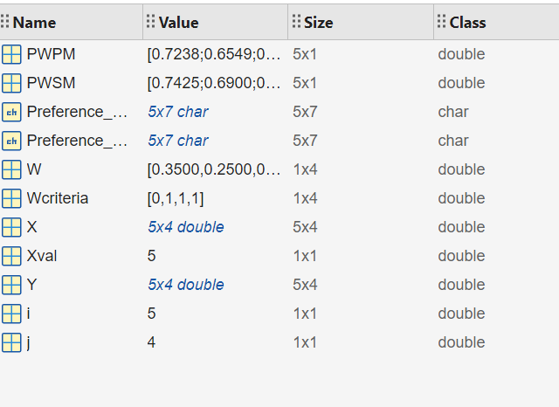
Result and Discussion
After executing the MATLAB code, the preference scores for each alternative are obtained as follows:
For wsm and wpm:

Slide 6
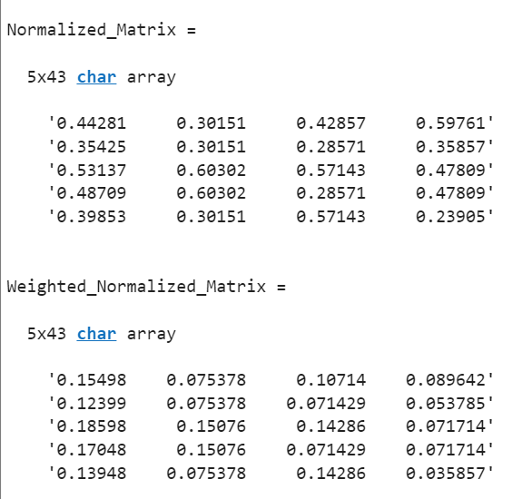
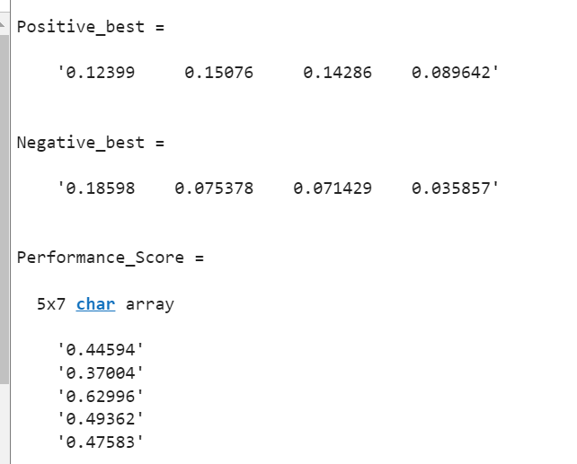
For topsis method:

Slide 7
Conclusion and Future work
Incorporate Additional Decision-Making Models:
Explore and compare other multi-criteria decision-making (MCDM) techniques such as Analytic Hierarchy Process (AHP), ELECTRE, PROMETHEE, and VIKOR. This would provide a comprehensive understanding of how different models perform on the same dataset.
Dynamic Weight Assignment:
Develop methods for dynamic weight assignment based on stakeholder preferences or real-time data. This could involve using techniques like fuzzy logic, machine learning, or optimization algorithms to determine the weights dynamically.
Sensitivity Analysis:
Conduct sensitivity analysis to understand the impact of changes in weights and criteria on the final ranking of alternatives. This will help in assessing the robustness of the decision-making model.
Incorporate Uncertainty and Fuzziness:
Extend the models to handle uncertainty and fuzziness in the decision-making process. Techniques such as fuzzy TOPSIS, interval TOPSIS, or stochastic methods can be applied to account for uncertainty in criteria weights and performance values.
Real-World Applications and Case Studies:
Apply the developed models to real-world case studies in various fields such as supply chain management, environmental management, healthcare, and engineering. Documenting these applications can demonstrate the practical utility of the models.

Slide 8
Software Implementation and User Interface Development:
Develop user-friendly software or a web-based application that implements these decision-making models. This would make the models more accessible to practitioners who may not have a background in MATLAB or programming.
Multi-Objective Optimization:
Extend the decision-making framework to incorporate multi-objective optimization techniques. This allows for the simultaneous optimization of multiple conflicting objectives.
Collaborative Decision-Making:
Explore collaborative decision-making frameworks where multiple decision-makers contribute to the criteria and weight assignment. This can involve techniques like group decision-making and consensus-building methods.
Visualization and Reporting:
Enhance the visualization of results and reporting capabilities. Develop advanced graphical representations and dashboards to better communicate the decision-making process and outcomes to stakeholders.

Slide 9
Thank you

