Slide 1
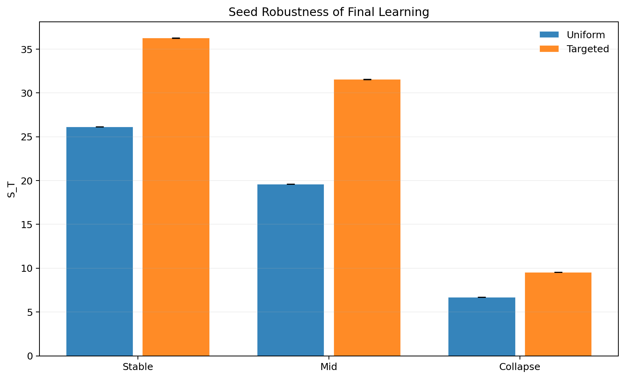
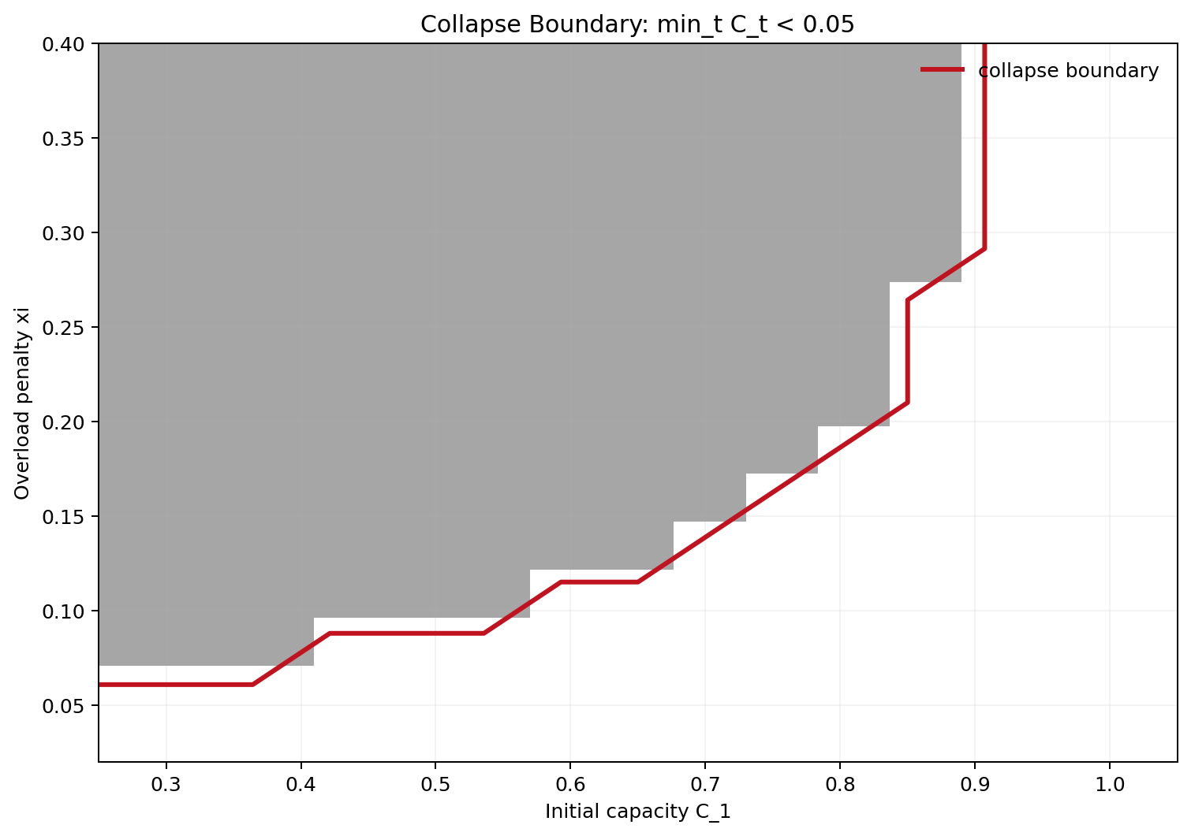
Selective Response for GenAI Under Forum Congestion
Game Theory 2026 mini project
Base paper + our extension
Dikshant Gupta (24108) | Paras Raina (24170)
8-minute plan: Dikshant slides 1-5, Paras slides 6-11
Selective response helps, but forum congestion changes the policy design problem.
Main message: traffic composition matters, not just answer volume.

Slide 2
Problem Setup
When should GenAI answer directly, and when should it defer users to a human forum?
Problem
Tension
System view
Answer too often: users stop creating human discussions that could become future training signal.
Defer too often: the forum gets overloaded, answers worsen, and experts burn out.
Good policy must trade off immediate service against long-run ecosystem health.
Users
->
GenAI
->
Forum
->
C_t
Overload damages future capacity
Core idea: the forum is not just a knowledge source. It is a limited shared resource.
Refs: Taitler et al. (2025); Hardin (1968); Ostrom (1990)
2

Slide 3
Why This Matters
The same routing problem appears in multiple real settings where human discussion creates reusable value.
Examples
Course forums
Developer support
Product communities
If GenAI answers every assignment question, fewer student-human explanations remain for later batches.
Redirected traffic can overload technical forums, making expert time the real bottleneck.
Automation can solve easy issues now while silently shrinking the future knowledge base.
Takeaway: abstention is not only an accuracy decision. It is a platform-design decision.
Refs: Horvitz (1999); Amershi et al. (2014); Bansal et al. (2021)
3

Slide 4
Literature Review
Our project lies where three literatures meet.
Related work
Selective response
Learning to defer
Congestion / commons
Chow (1970) El-Yaniv (2010) Geifman and El-Yaniv (2017)
Madras et al. (2018) Mozannar and Sontag (2020) Kleinberg et al. (2018)
Hardin (1968) Ostrom (1990) Kleinrock (1975) Vickrey (1969)
Question: when should the model abstain?
Question: when is human expertise more valuable than model output?
Question: what happens when shared systems are overloaded?
Gap: prior selective-response work does not model a congestible human forum with endogenous capacity.
Refs: Chow (1970); El-Yaniv (2010); Madras et al. (2018); Mozannar and Sontag (2020); Hardin (1968); Ostrom (1990)
4

Slide 5
Base Paper
This is prior work we build on, not our contribution.
Prior work
Base paper question
Base paper result
Limitation relevant to our project
Should GenAI selectively defer some users so human communities continue creating new knowledge?
Main idea: less answering can improve long-run learning.
Reason: deferred interactions generate future human signal.
Forum is treated as a source of knowledge, not as a congestible shared system.
No endogenous capacity decline or collapse mechanism.
No explicit separation between answer volume and traffic composition effects.
Always answer
vs
Selective response
Some deferral can beat always-answering in long-run learning.
Refs: Taitler et al. (2025)
5

Slide 6
Our Contribution
We turn the base paper into a congestion-aware ecosystem model.
Our work
Methodology
New checks we added
Deterministic simulator with horizon T = 40.
State tracks knowledge stock, forum capacity, choice share, and answered share.
Forum throughput falls under overload; capacity can decline over time.
Policies compared: uniform, targeted novelty, capacity-aware, novelty+capacity.
Matched answered-share control
rho = 0 ablation to switch off novelty
Collapse boundary in (C1, xi) space
30-seed robustness comparisons
Users
->
GenAI
->
Forum
->
C_t
Overload weakens future capacity
This is the part that is original to our team.
Refs: project simulator outputs in sim/results and sim/figs
6

Slide 7
Replication + Extension Result
First, we replicate the base intuition. Then we show what changes once congestion is modeled.
Replication
Replication statement
Numbers to say out loud
We recover the main base-paper intuition: selective response can improve long-run learning.
But once congestion is introduced, the correct question is not only how much to defer, but which traffic to defer.
Stable: S_T 26.15 -> 36.29
Mid: S_T 19.60 -> 31.56, overload 40 -> 25
Collapse: S_T 6.68 -> 9.54, but overload remains 40
This slide transitions from prior work to our work.
Learning gains across regimes
Refs: seed_robustness.csv
7

Slide 8
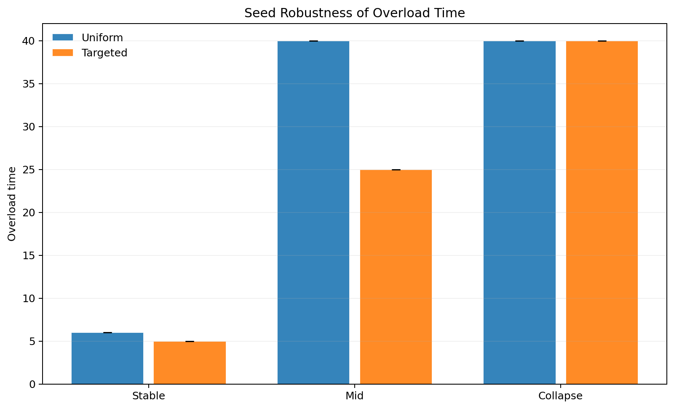
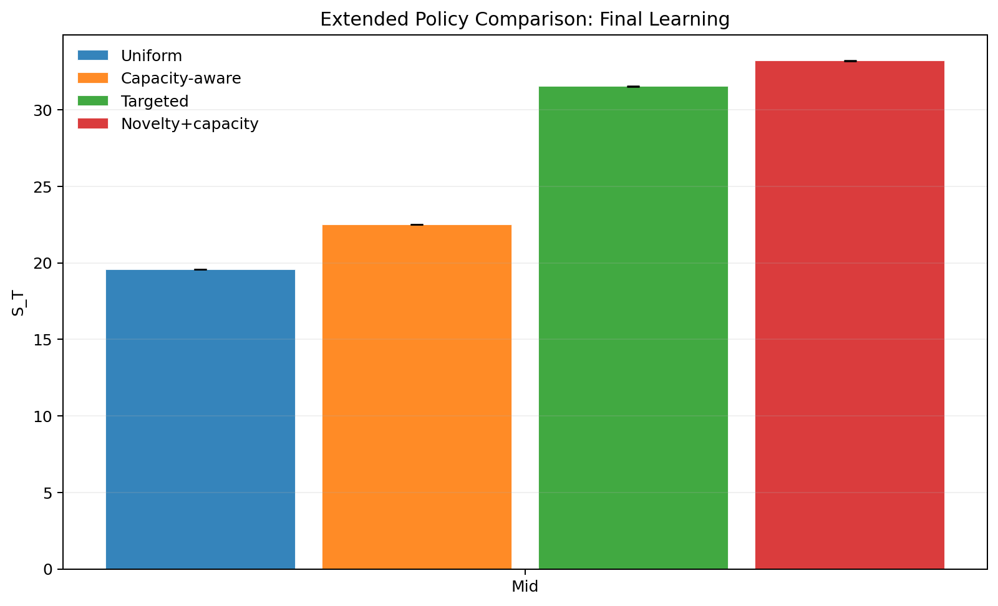
Main Results
Novelty-aware routing improves learning because it changes the composition of forum traffic.
Results
Interpretation
Uniform throttling controls only volume.
Targeted policy controls composition by sending higher-value traffic to the forum.
Benefit is strongest when the forum is still healthy enough to produce useful knowledge.
Overload-time comparison
Extended policy comparison
Refs: seed_robustness.csv; policy_compare_extended.csv
8

Slide 9
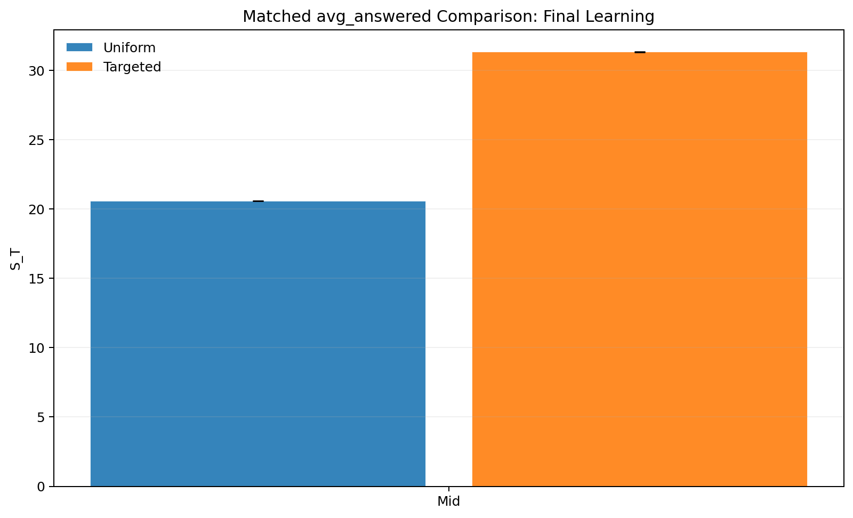
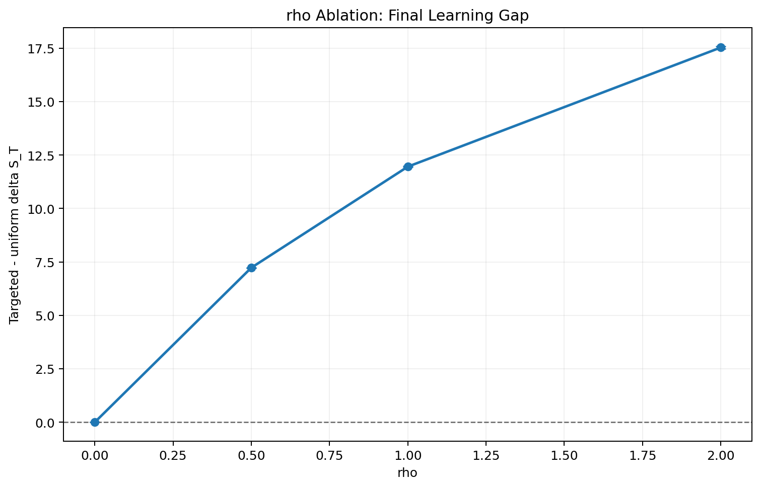
Mechanism Checks
We tested whether the gain is real or just a reporting artifact.
Validation
Why these checks matter
Matching raw answer rate is not enough once user choice shifts endogenously.
If novelty is the mechanism, the advantage should disappear when novelty has no value.
Matched answered-share control
rho ablation
Refs: matched_answered_compare.csv; rho_ablation.csv
9

Slide 10
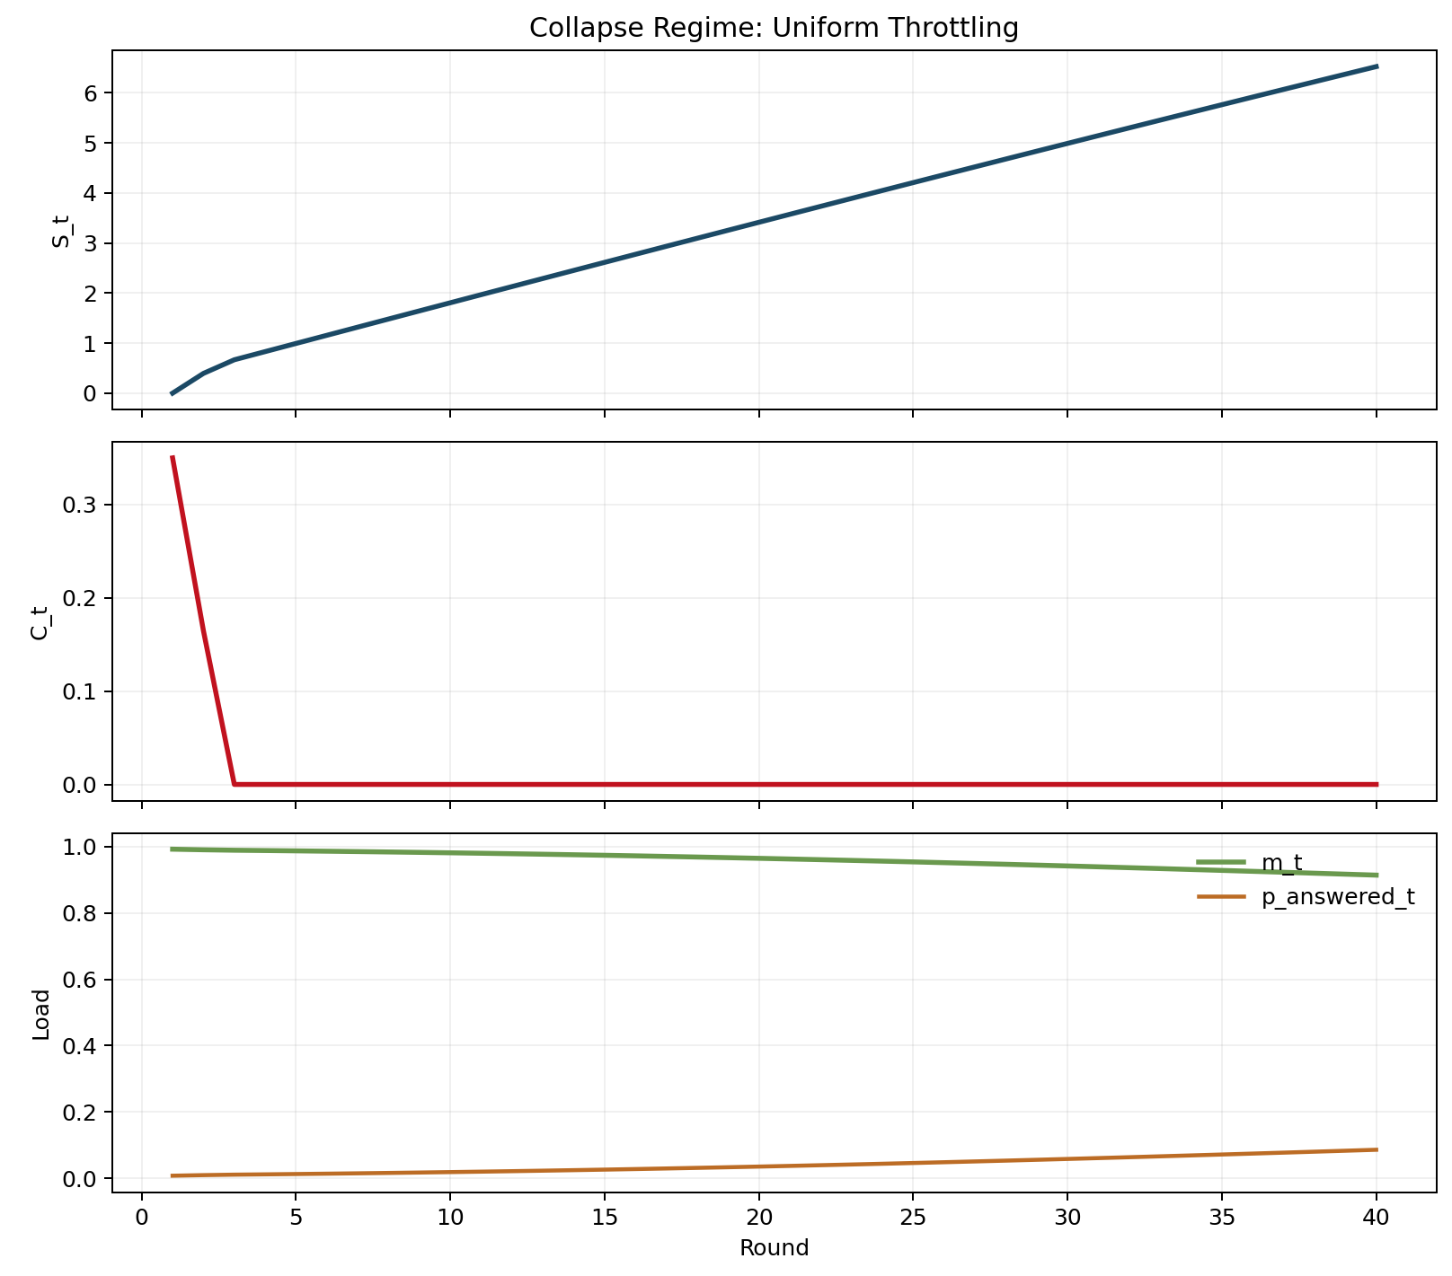
Tipping And Stronger Baselines
Congestion-aware design matters because forum collapse appears in a structured parameter region.
Phase view
Mid-regime ranking
Uniform: S_T = 19.60
Capacity-aware: S_T = 22.52
Targeted novelty: S_T = 31.56
Novelty+capacity: S_T = 33.23
Best mid-regime policy combines novelty and congestion response.
Explicit collapse boundary
Collapse time series
Refs: policy_compare_extended.csv; collapse_boundary_c1_xi.csv
10

Slide 11
Summary And Future Work
Final slide before closing: keep the distinction between prior work and our contribution explicit.
Wrap-up
Summary
Future work
References
Base paper gives the selective-response intuition.
Our work adds congestion, endogenous capacity, and mechanism tests.
Main lesson: the right traffic should reach the forum, not just less traffic.
Calibrate parameters from real forum data.
Learn routing policies instead of hand-designed rules.
Model multiple forums and heterogeneous experts.
Taitler et al. (2025) Chow (1970) El-Yaniv (2010) Madras et al. (2018) Mozannar and Sontag (2020) Hardin (1968) Ostrom (1990) Vickrey (1969)
Refs: full bibliography in refs.bib
11

Slide 12
Selective Response for GenAI Under Forum Congestion
Thank You
Questions?
Dikshant Gupta (24108) | Paras Raina (24170)
Novelty + capacity baseline is strongest in the mid regime.

