Slide 1
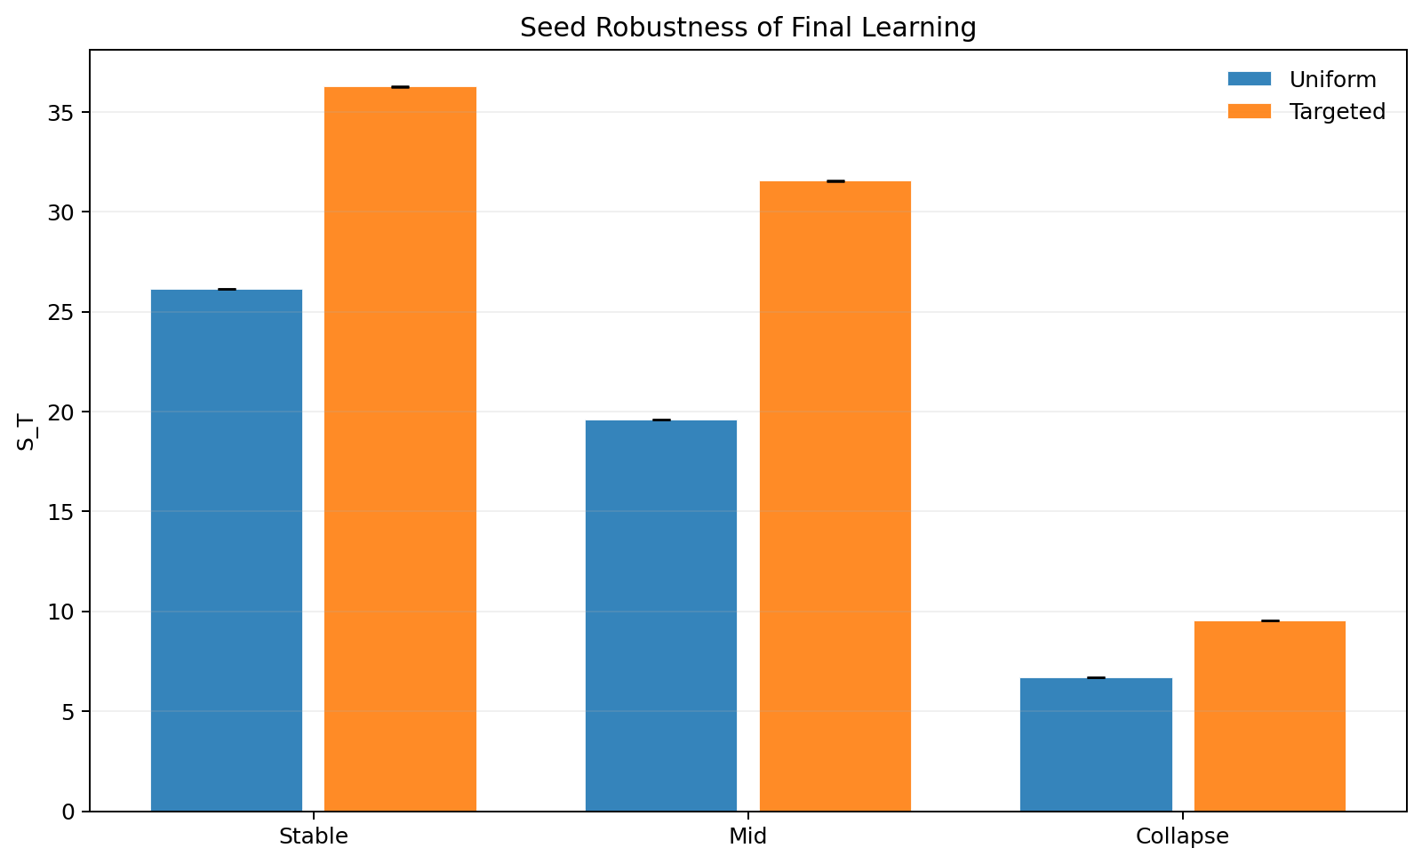
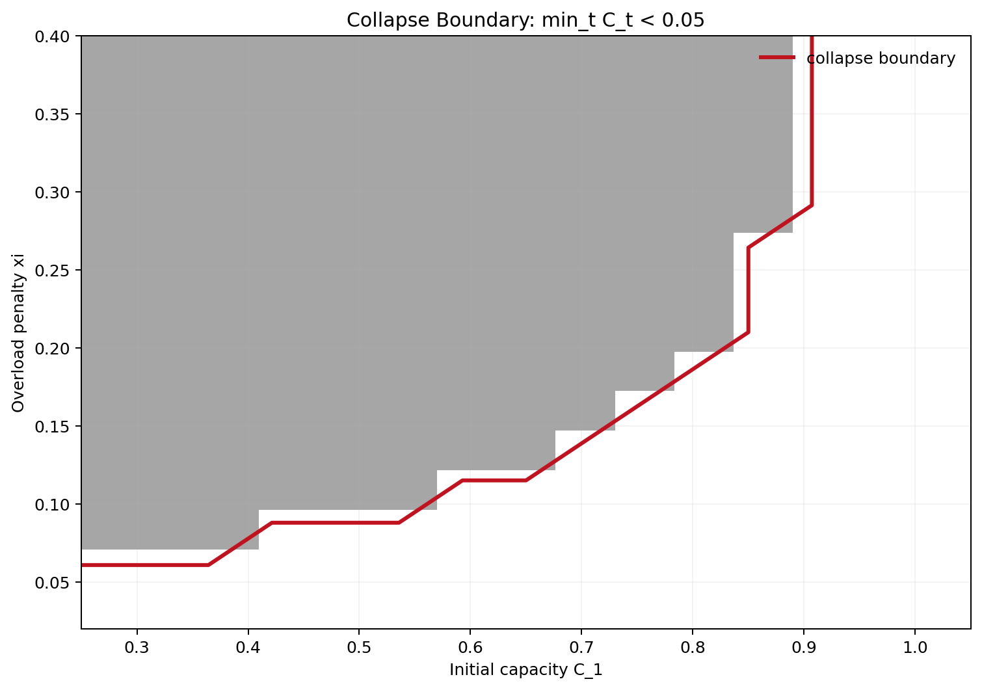
Selective Response for GenAI Under Forum Congestion
Game Theory 2026 mini project
Dikshant Gupta (24108) | Paras Raina (24170)
12 slides total: title + 10 content + thank you
Big picture: selective response can help learning, but forums can also collapse under load.

Slide 2
The Problem In One Intuition
GenAI and the human forum are connected. What helps now may hurt the system later.
Problem
Think of a classroom forum
If AI answers every doubt, fewer useful student discussions get created.
If AI sends everyone to the forum, the forum gets crowded and less useful.
So the policy question is: which queries should AI answer, and which should reach humans?
Users
->
GenAI
->
Forum
->
C_t
Forum capacity is the missing idea: if load exceeds capacity, future human help becomes weaker.
Refs: Taitler et al. (2025); Hardin (1968); Ostrom (1990)
2

Slide 3
Why Should We Care?
The same tradeoff appears whenever human discussion creates reusable knowledge.
Why care
Course forums
Developer forums
Product communities
Good student discussions help future batches. Too much AI can silently shrink that pool.
Redirected traffic can overload expert communities like Stack Overflow-style forums.
Automation can fix easy cases now while weakening the human knowledge pipeline later.
Professor-friendly intuition: AI policy is also ecosystem policy.
Refs: Horvitz (1999); Amershi et al. (2014); Bansal et al. (2021)
3

Slide 4
Literature Review
Three threads lead to our project.
Literature
Selective response
Learning to defer
Congestion / commons
Chow (1970) El-Yaniv (2010)
Madras et al. (2018) Mozannar and Sontag (2020)
Hardin (1968) Ostrom (1990) Kleinrock (1975)
When should the model abstain?
When should humans take over?
What happens when shared systems get overloaded?
Gap: prior selective-response work does not treat the human forum as a congestible resource.
Refs: Chow (1970); El-Yaniv (2010); Madras et al. (2018); Mozannar and Sontag (2020); Hardin (1968); Ostrom (1990)
4

Slide 5
Base Paper
Important: this idea is from the prior paper, not from us.
Prior work
What the base paper says
Intuition
Why that is incomplete for us
AI should not always answer.
Deferring some queries can improve long-run learning.
Reason: human discussions create future signal.
Forum is not modeled as capacity-limited.
No collapse dynamics under overload.
No clean test of whether gains come from composition or just volume.
Always answer
Selective response
Sometimes less answering is better in the long run.
Refs: Taitler et al. (2025)
5

Slide 6
Our Original Work
We extend the base idea with congestion, capacity, and stronger validation checks.
Our work
Method
What we additionally test
Deterministic simulator, horizon T = 40.
Tracks knowledge stock and forum capacity over time.
Forum throughput falls under overload.
Capacity can shrink if overload persists.
Matched answered-share control
rho = 0 ablation
Collapse boundary in (C1, xi) space
Extended baselines: capacity-aware and novelty+capacity
Users
->
GenAI
->
Forum
The human side is now a limited shared system.
Refs: project simulator outputs in sim/results and sim/figs
6

Slide 7
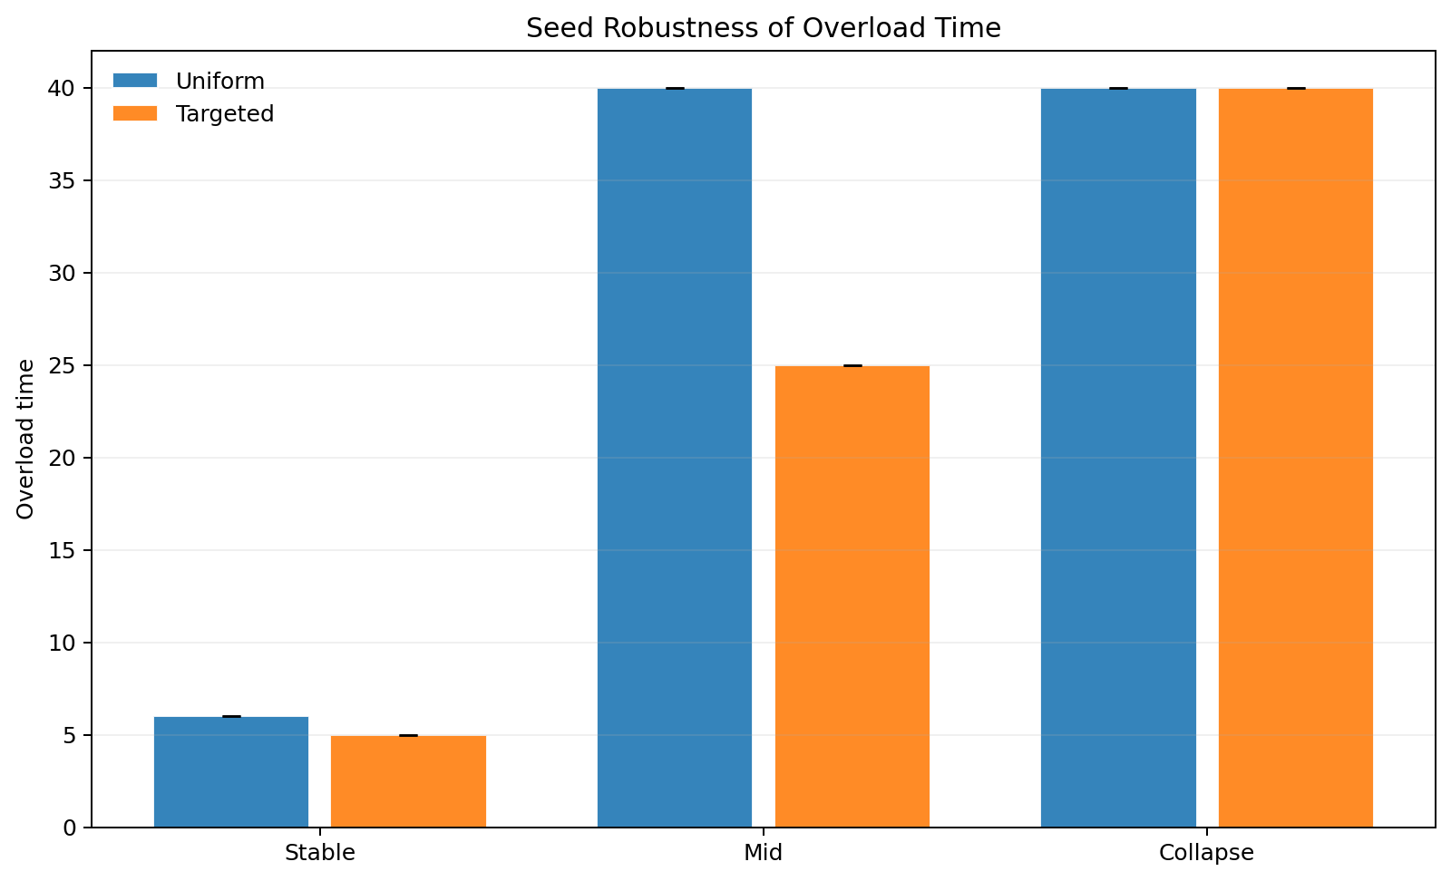
Main Result
Novelty-aware routing improves long-run learning across regimes.
Results
Say these numbers
Stable: 26.15 -> 36.29
Mid: 19.60 -> 31.56
Collapse: 6.68 -> 9.54
Mid overload also drops: 40 -> 25
Easy intuition: send better traffic to the forum.
Refs: seed_robustness.csv
7

Slide 8
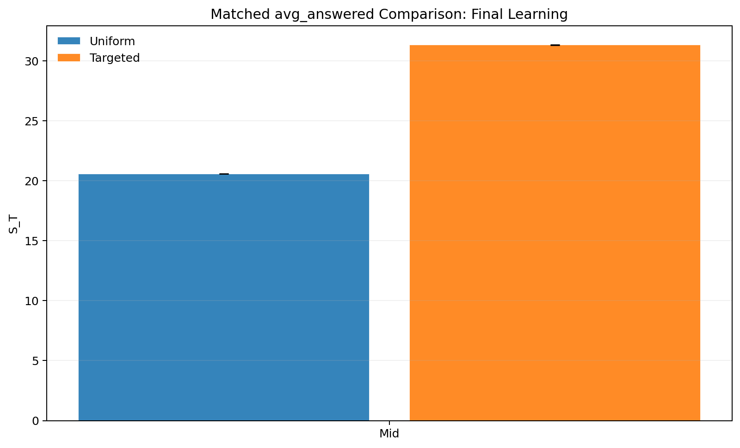
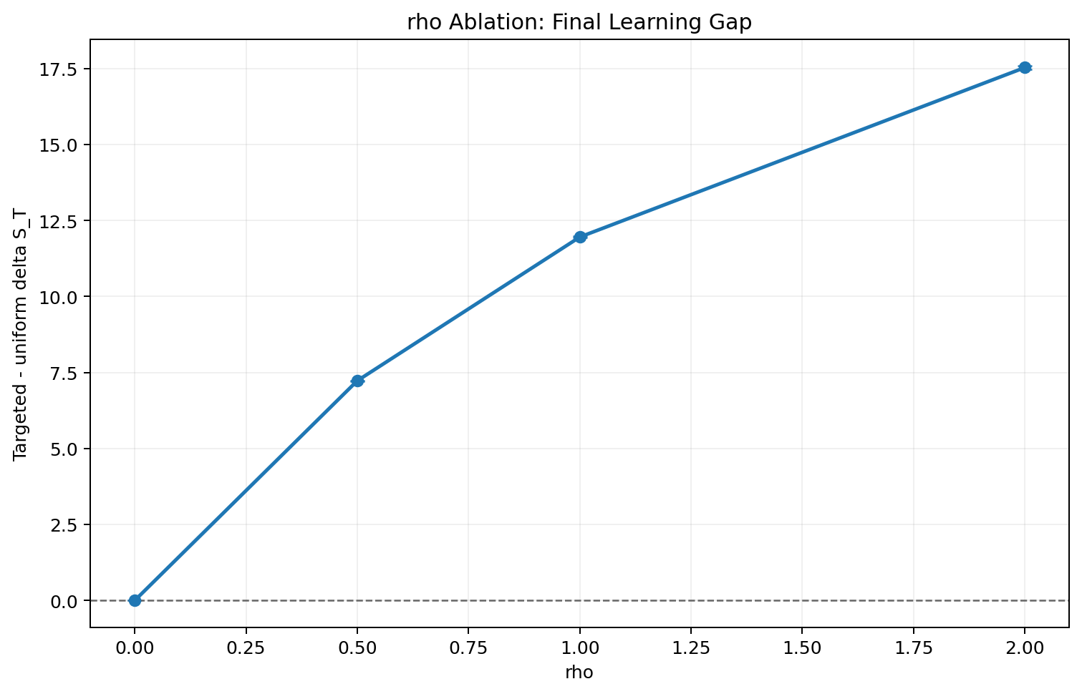
Why We Believe The Result
Two checks show the gain comes from composition, not just more answering.
Validation
Check 1
Check 2
Match the actual answered share.
Set novelty value to zero: rho = 0.
Even then, targeted still wins: 31.35 vs 20.58
The advantage disappears.
Refs: matched_answered_compare.csv; rho_ablation.csv
8

Slide 9
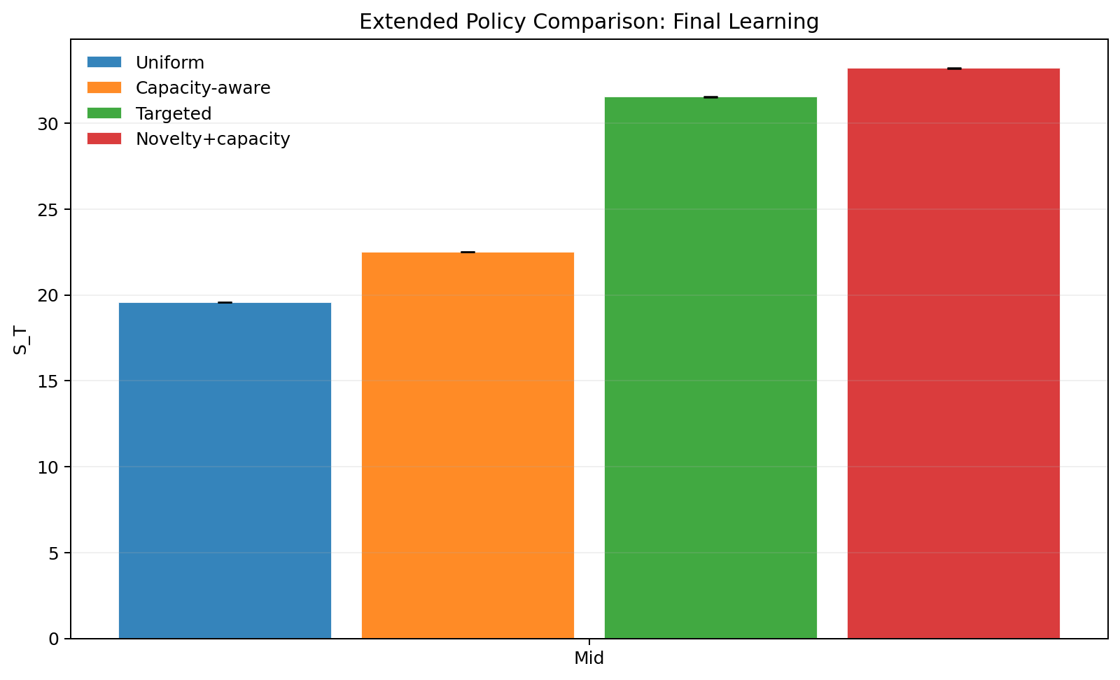
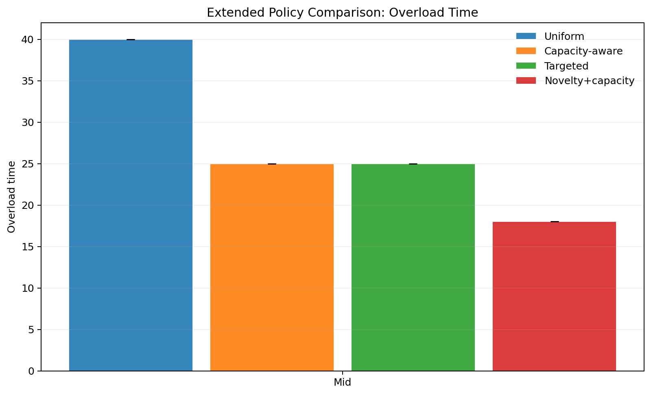
Stronger Baselines
Congestion feedback helps, but novelty+capacity is strongest in the mid regime.
Baselines
Ranking
Uniform: 19.60
Capacity-aware: 22.52
Targeted novelty: 31.56
Novelty + capacity: 33.23
Simple message: composition and congestion both matter.
Refs: policy_compare_extended.csv
9

Slide 10
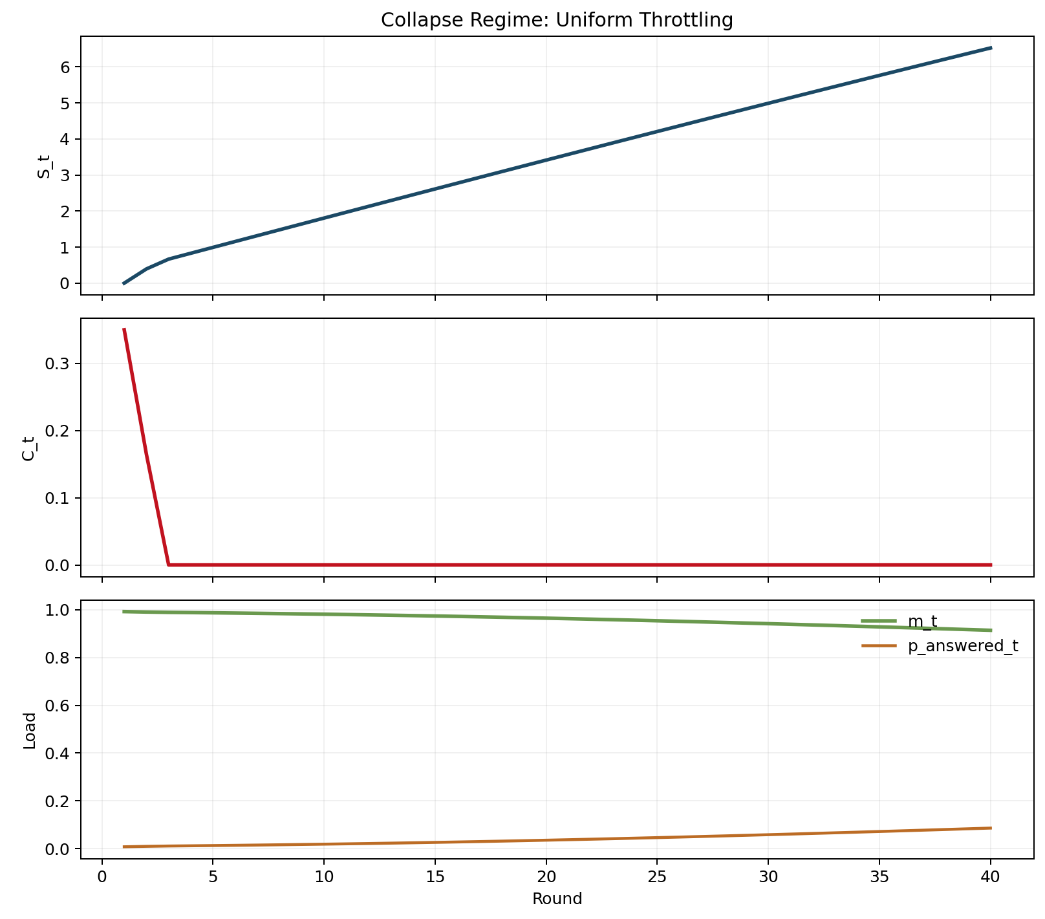
Tipping And Collapse
The forum does not fail smoothly. There is a collapse region.
Phase view
Intuition
If initial capacity is low, overload starts early.
If overload damage is strong, recovery becomes hard.
That creates a tipping boundary instead of a small gradual effect.
Refs: collapse_boundary_c1_xi.csv
10

Slide 11
Summary And Future Work
This is the slide to conclude the story clearly for class and professor.
Summary
Three lines to conclude
Future work
References
Base paper: selective response can help learning.
Our extension: forums are congestible, so capacity matters.
Main lesson: defer the right traffic, not just more traffic.
Use real forum data for calibration.
Learn policies instead of hand-designed rules.
Model multiple forums and heterogeneous experts.
Taitler et al. (2025) Chow (1970) El-Yaniv (2010) Madras et al. (2018) Mozannar and Sontag (2020) Hardin (1968) Ostrom (1990) Vickrey (1969)
Refs: full bibliography in refs.bib
11

Slide 12
Thank You
Questions?
Dikshant Gupta (24108)
Paras Raina (24170)
Strongest mid-regime rule: novelty + capacity.

