Slide 1
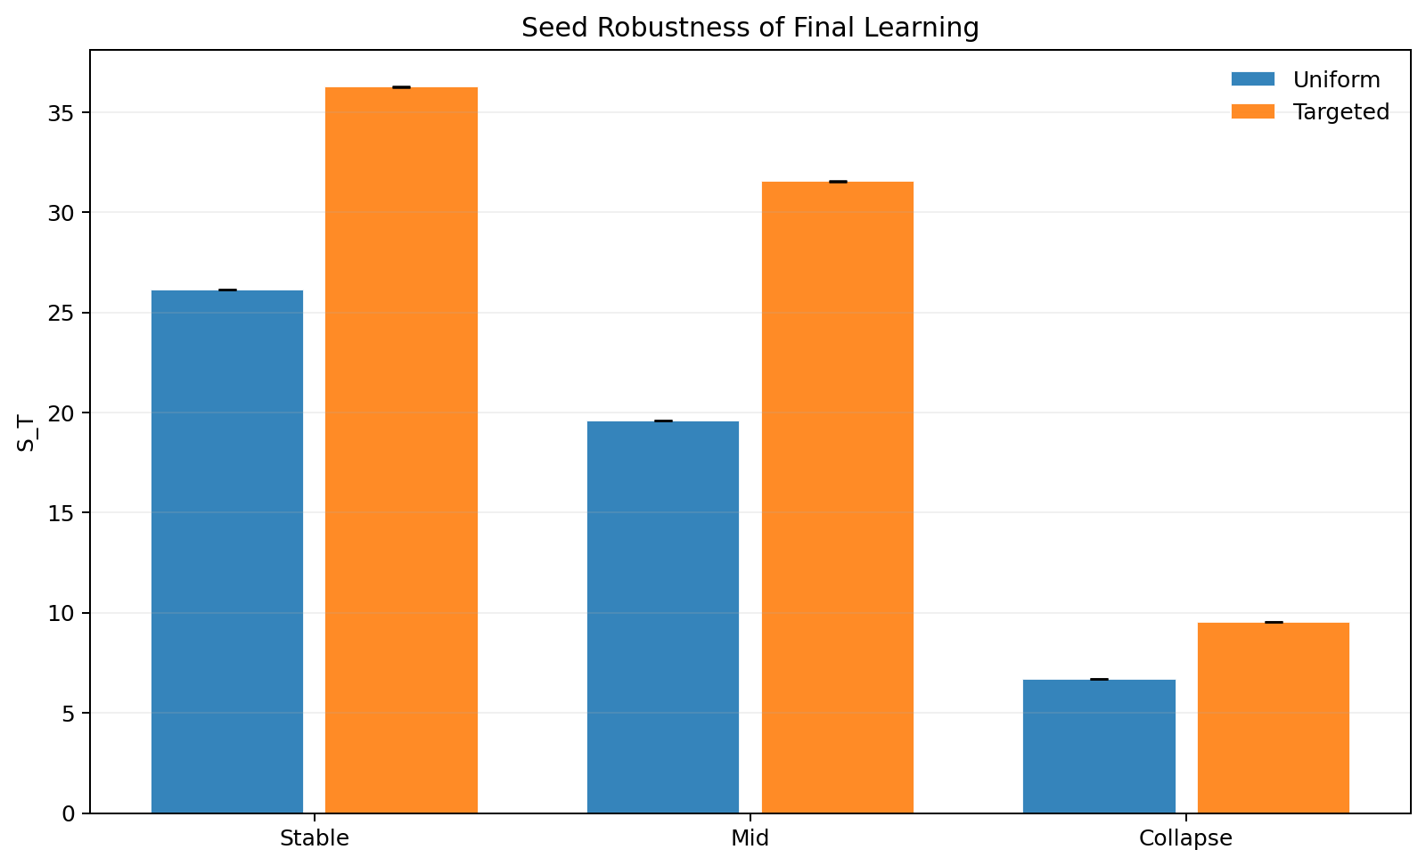
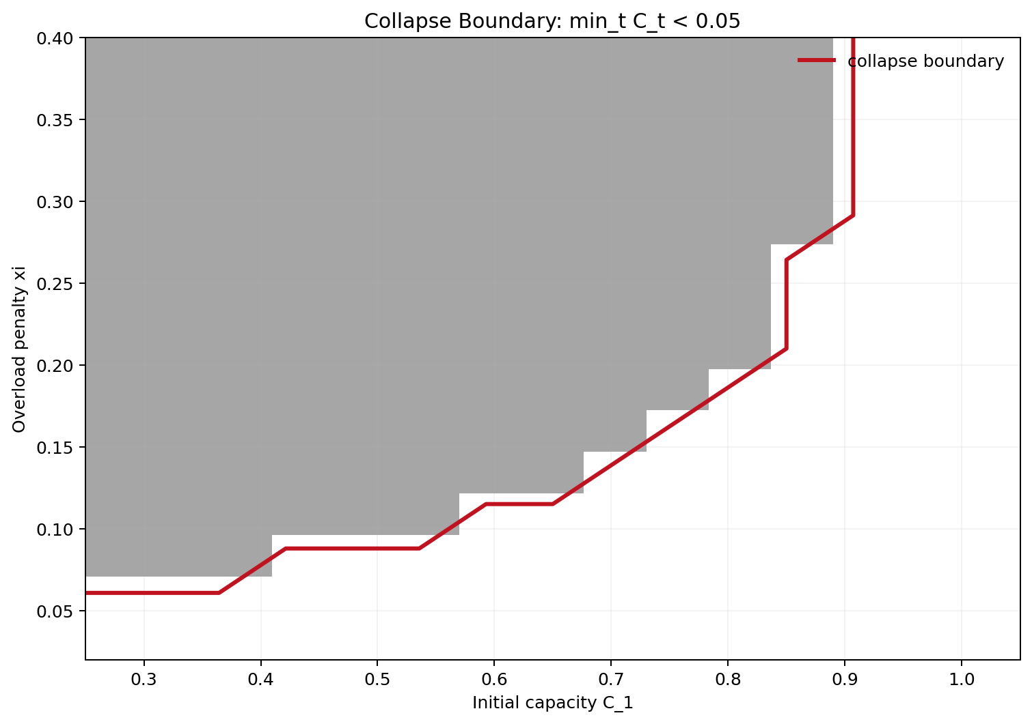
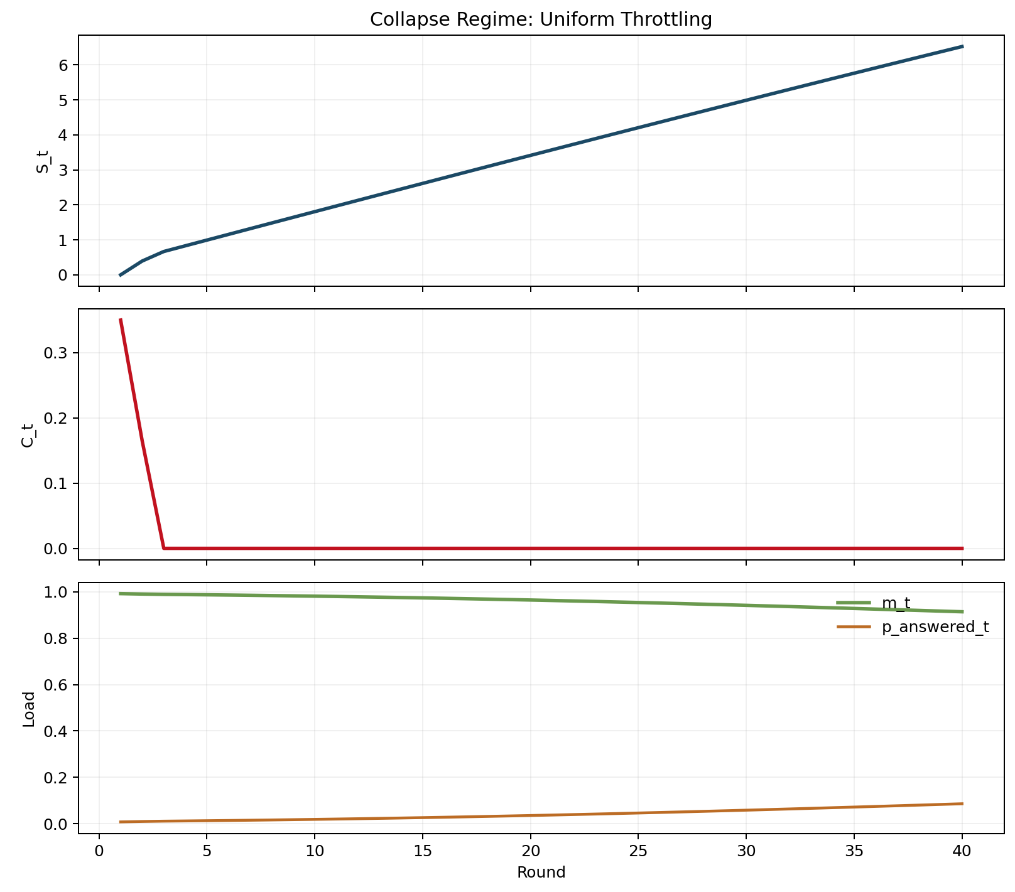
Selective Response for GenAI Under Forum Congestion
Game Theory 2026 mini project
Base paper: Taitler et al. (2025)
Our work: congestion + mechanism tests
Dikshant Gupta (24108) | Paras Raina (24170)
Speaker split: Dikshant slides 1-4, Paras slides 5-9
Talk in one line
Learning gains across regimes
Congestion creates a collapse boundary
Selective response can help long-run learning, but forums are not infinite-capacity resources.
We replicate the base paper's selective-response intuition and extend it with forum congestion and endogenous capacity.
Main finding: novelty-aware routing outperforms uniform throttling, and the gain survives stricter controls.
Collapse regime example
Refs: Taitler et al. (2025); Ostrom (1990); Vickrey (1969)
1

Slide 2
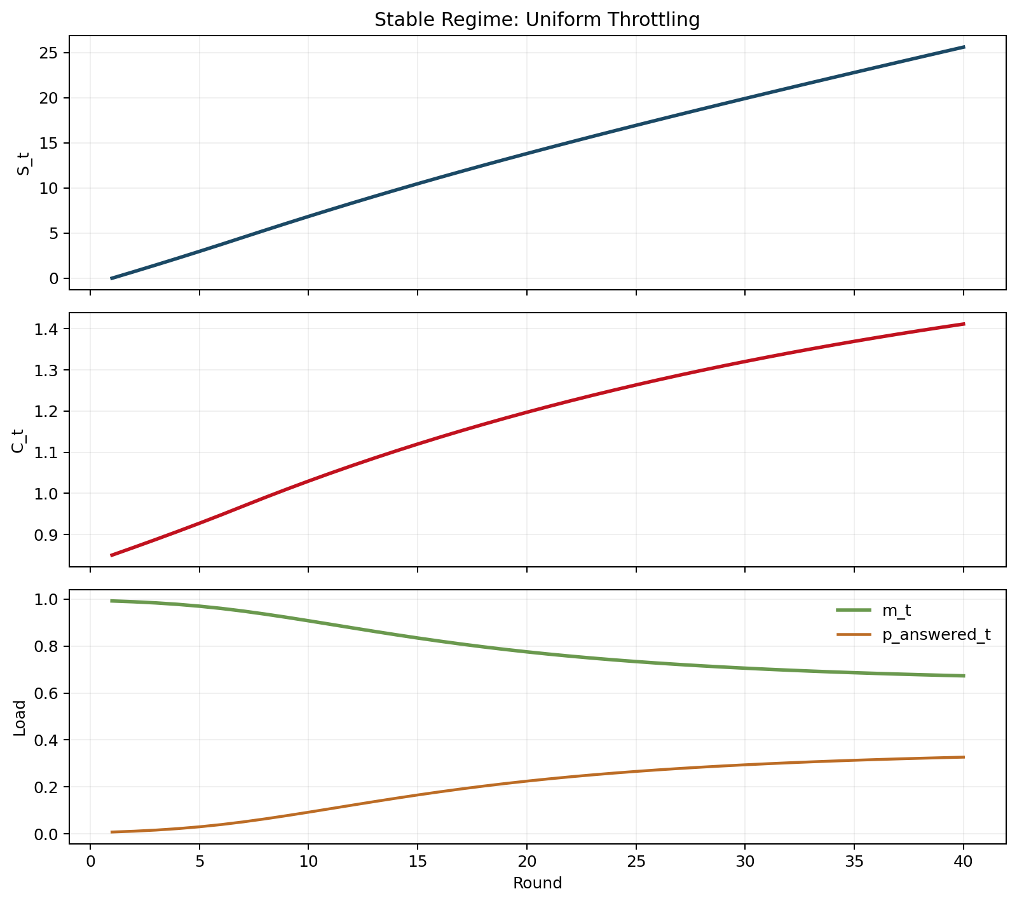
Problem And Why It Matters
Routing users between GenAI and human forums changes both current service and future knowledge creation.
Motivation
Core problem
Users
GenAI
Forum
C_t
If GenAI answers everything, fewer high-value forum discussions happen, so future training signal shrinks.
If GenAI defers too much, forum load rises, response quality drops, and expert capacity can collapse.
The planner must manage both traffic volume and traffic composition.
->
->
->
choice share
answered share
throughput + novelty
capacity
Overload damages future capacity
Load above capacity reduces useful throughput.
Repeated overload damages future capacity.
This creates tipping behavior instead of smooth decline.
Course forums
Hard questions create reusable explanations for later students.
Developer communities
Stack Overflow style forums can be swamped by redirected users.
Product support
Short-term automation can reduce the human knowledge pipeline.
Refs: Taitler et al. (2025); Hardin (1968); Ostrom (1990); Vickrey (1969)
2

Slide 3
Literature Review
The project combines selective response, human-AI delegation, and congestion economics.
Context
Selective response / reject option
Learning to defer / human-AI systems
Congestion / shared-resource view
Chow (1970), El-Yaniv (2010), Geifman and El-Yaniv (2017): when not to answer is part of the decision rule.
Madras et al. (2018), Mozannar and Sontag (2020), Kleinberg et al. (2018), Amershi et al. (2014): defer to humans when they add value.
Hardin (1968), Ostrom (1990), Kleinrock (1975), Vickrey (1969), Roughgarden and Tardos (2006): overloaded shared systems degrade.
Gap addressed here: prior selective-response work models knowledge creation, but not forum congestion and endogenous capacity loss.
Refs: Chow (1970); El-Yaniv (2010); Madras et al. (2018); Mozannar and Sontag (2020); Hardin (1968); Ostrom (1990); Kleinrock (1975)
3

Slide 4
Base Paper: Idea And Limits
Selective-response intuition comes from the prior paper; congestion modeling does not.
Replication / prior work
What the base paper studies
Base paper takeaway
Why that is not enough for our setting
Question: should GenAI answer every query, or selectively defer some users to human communities?
Key claim: answering less can improve long-run learning because deferred interactions create future human-generated knowledge.
Interpretation: abstention is not only about current accuracy; it also shapes the future data ecosystem.
Forum is treated as an implicit knowledge source, not a congestible shared resource.
No endogenous forum capacity or collapse dynamics.
No test of whether targeted gains survive when answered share is matched.
No mechanism ablation to verify that novelty is the real source of the gain.
Always answer
Less human discussion
^
Selective response
More future signal
Qualitative result: some deferral can beat always-answering in long-run learning.
Refs: Taitler et al. (2025); Chow (1970); El-Yaniv (2010)
4

Slide 5
Our Original Work: Methodology
We extend the base idea with congestion dynamics, new baselines, and mechanism-validation experiments.
Our extension
Extended simulator
Experiment design
40-round deterministic simulator 30 novelty seeds per comparison 3 regimes: stable, mid, collapse
Users
->
GenAI
->
Forum
C_t
->
choice share
answered share
throughput + novelty
capacity
Overload damages future capacity
New checks we added
Key policies compared
Matched answered-share control
rho=0 ablation to switch off novelty
Collapse boundary in (C1, xi) plane
Uniform throttling: fixed answer rate.
Targeted novelty policy: answer low-novelty items, defer high-novelty items.
Capacity-aware baseline: answer more when recent overload is high.
Novelty+capacity baseline: combine composition and congestion feedback.
Refs: Taitler et al. (2025); project simulator in sim/model.py, sim/policies.py, sim/run_experiments.py
5

Slide 6
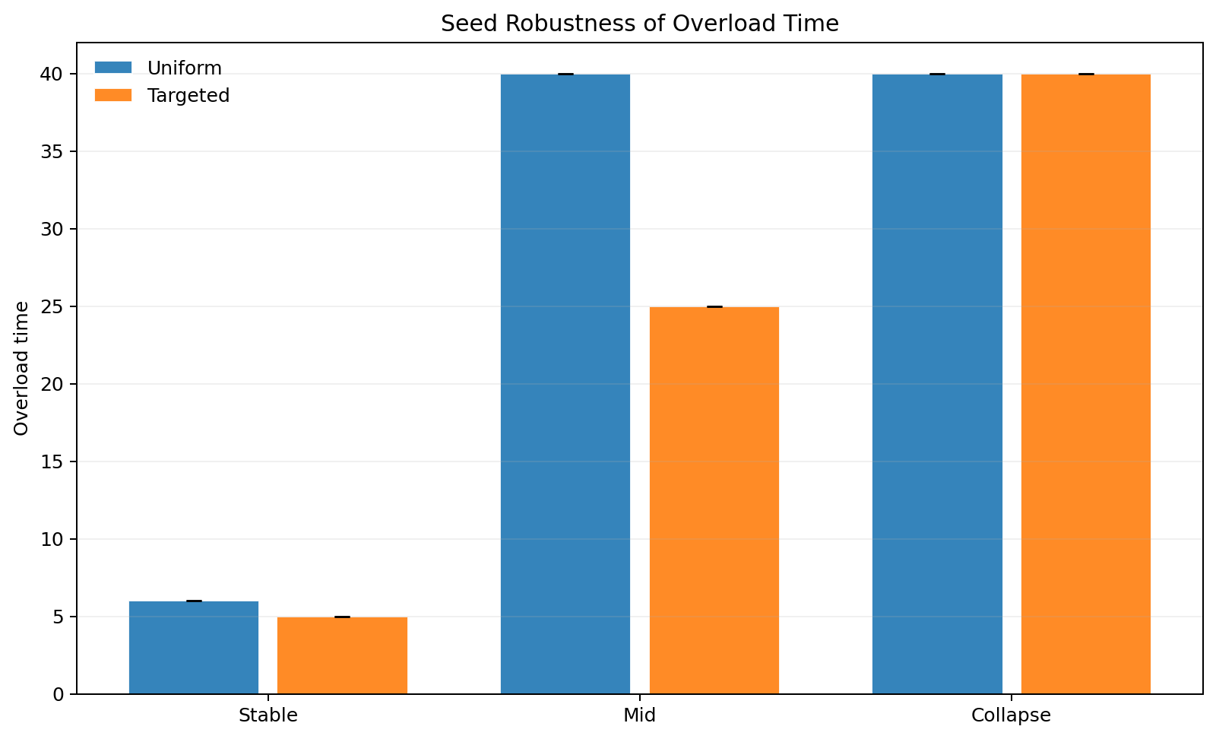
Main Results
Novelty-aware targeting beats uniform throttling across stable, mid, and collapse regimes.
Our result
Headline numbers
Stable regime: S_T rises from 26.15 to 36.29.
Mid regime: S_T rises from 19.60 to 31.56 and overload drops from 40 to 25 rounds.
Collapse regime: learning still improves from 6.68 to 9.54, but overload remains saturated.
Interpretation
Targeting helps most when the forum is still productive enough for traffic composition to matter.
Final learning across 30 seeds
Overload-time comparison
Refs: seed_robustness.csv; Taitler et al. (2025)
6

Slide 7
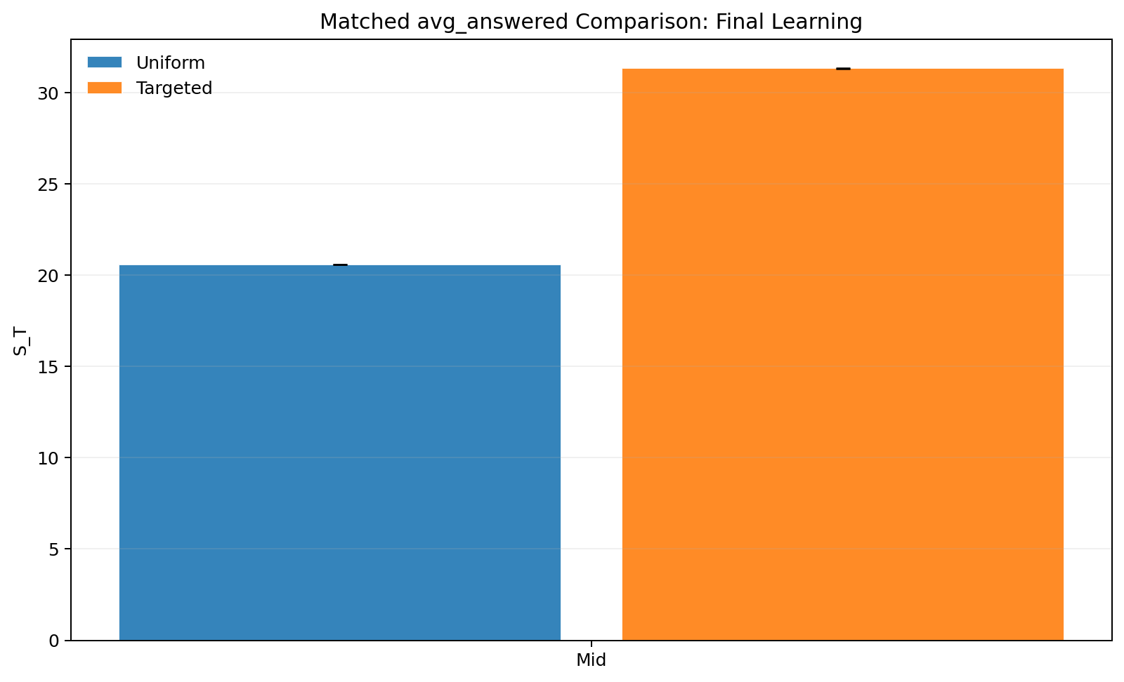
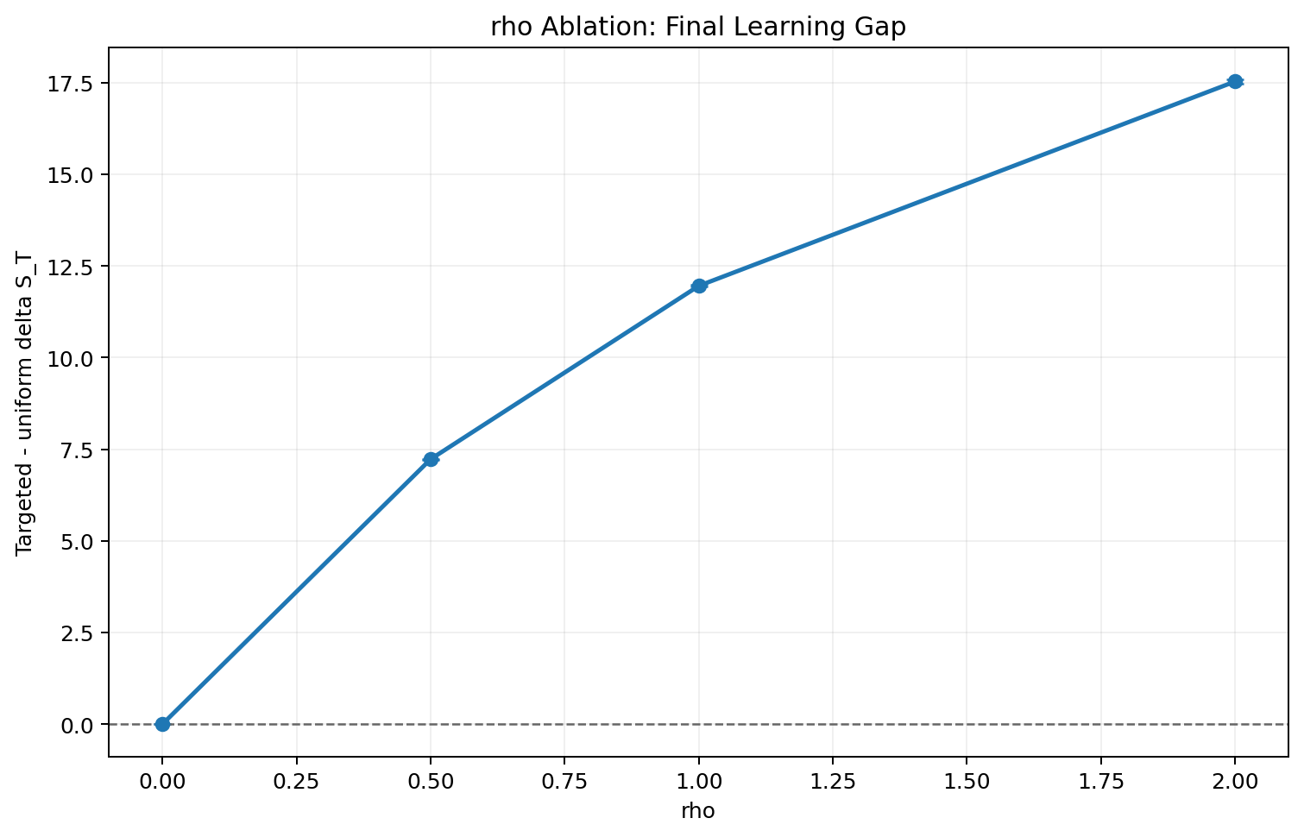
Mechanism Validation
We tested whether the targeted gain is real, not just an artifact of adoption or answer volume.
Our result
Two strongest checks
Matched answered share: both policies answer about 0.178 of users, but targeted still reaches S_T = 31.35 vs 20.58 for uniform.
rho ablation: when novelty has no effect (rho = 0), the targeted advantage becomes exactly zero.
Conclusion: the gain comes from sending better traffic to the forum, not just changing total answered volume.
Matched answered-share control
rho ablation
Refs: matched_answered_compare.csv; rho_ablation.csv
7

Slide 8
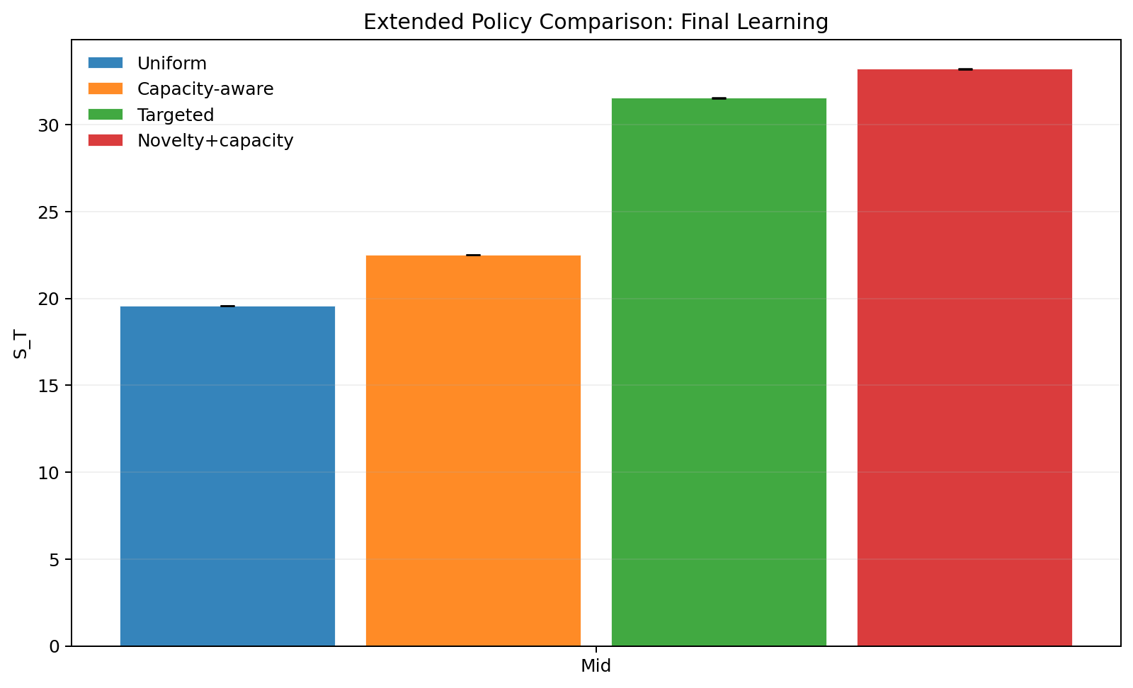
Stronger Baselines And Tipping
Congestion feedback helps, but novelty+capacity performs best in the mid regime.
Our result
Mid-regime policy ranking
Uniform: S_T = 19.60, overload = 40.
Capacity-aware: S_T = 22.52, overload = 25.
Targeted novelty: S_T = 31.56, overload = 25.
Novelty+capacity: S_T = 33.23, overload = 18.
Phase transition
First collapse points appear near C1 ~ 0.364 and xi ~ 0.074. Higher overload damage requires higher initial forum capacity.
Extended policy comparison
Explicit collapse boundary
Refs: policy_compare_extended.csv; collapse_boundary_c1_xi.csv
8

Slide 9
Summary And Future Work
References are listed on this slide; our contribution remains distinct from the base paper.
Close
Summary
Future work
References used in the talk
Base paper insight: answering less can improve long-run learning.
Our extension: forums are congestible, so routing must consider both quantity and quality of deferred traffic.
Main result: novelty-aware routing dominates uniform throttling and survives strict controls.
Best baseline in our mid regime combines novelty with congestion feedback.
Estimate parameters from real forum data instead of reduced-form calibration.
Replace hand-designed rules with learned routing policies.
Model heterogeneous experts, delayed retraining, and multiple forums.
Optimize jointly for learning, welfare, and revenue instead of one metric.
- Taitler et al. (2025) - Chow (1970) - El-Yaniv (2010) - Madras et al. (2018) - Mozannar and Sontag (2020) - Hardin (1968) - Ostrom (1990) - Vickrey (1969) - Kleinrock (1975)
Refs: full bibliography in refs.bib; slide cites shown inline throughout the deck
9
Practice target for 8 minutes: ~45-55 seconds per slide. Keep slide 4 explicitly labeled as prior work and slides 5-8 as our contribution.

