Slide 1
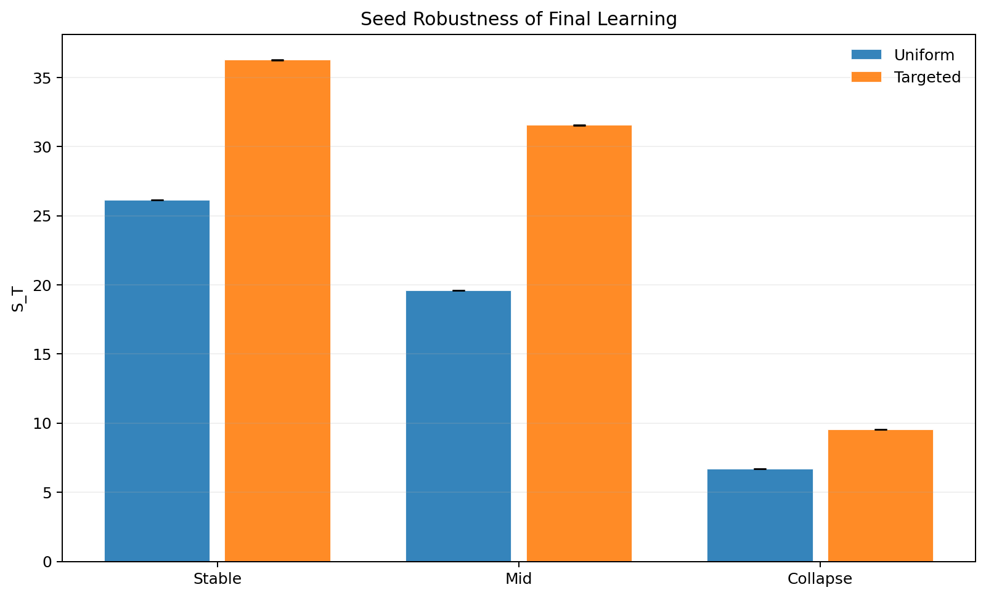
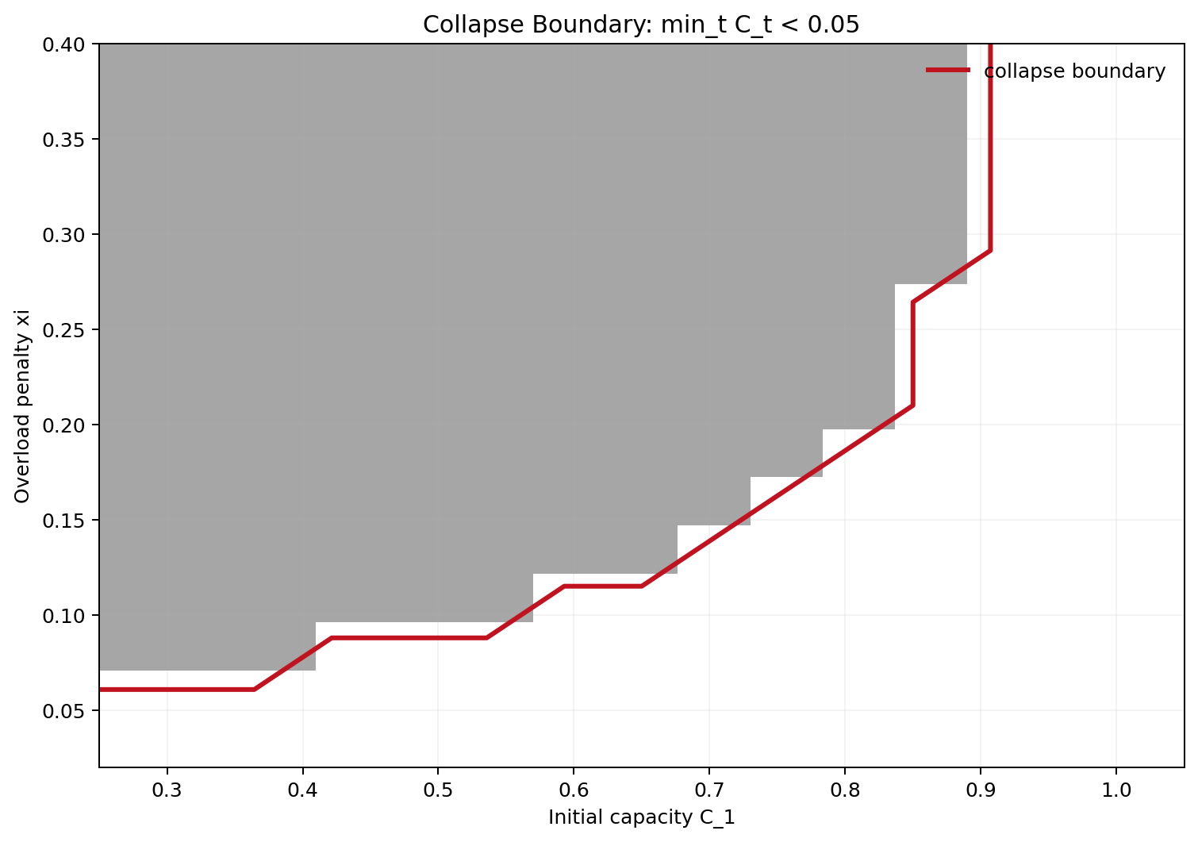
Selective Response for GenAI Under Forum Congestion
Game Theory 2026 mini project
Dikshant Gupta (24108) | Paras Raina (24170)
Professional deck: intuition + model + results + limitations
Question: should GenAI answer now, or preserve the forum that creates future knowledge?

Slide 2
Motivation
The key tradeoff is immediate convenience versus long-run knowledge creation.
Motivation
Intuition for class
If AI answers everything, users stop creating human discussions.
Those missing discussions reduce future signal that AI could have learned from.
But if AI defers too much, the human forum gets overloaded and less useful.
Users
->
GenAI
->
Forum
->
C_t
So selective response is not only a service decision. It is a system-design decision.
Refs: Taitler et al. (2025); Hardin (1968); Ostrom (1990)
2

Slide 3
Why This Problem Matters
The same mechanism appears in education, developer communities, and product support.
Examples
Course forums
Developer forums
Product communities
Too much AI can reduce the student explanations that help future batches.
Overloaded expert communities create slower and lower-quality answers.
Short-run automation may weaken the long-run human knowledge base.
Human discussion here is a productive resource.
Human discussion here is a productive resource.
Human discussion here is a productive resource.
Refs: Horvitz (1999); Amershi et al. (2014); Bansal et al. (2021)
3

Slide 4
Literature Review
Our project combines three strands of prior work.
Literature
Selective response
Learning to defer
Congestion / commons
Chow (1970) El-Yaniv (2010)
Madras et al. (2018) Mozannar and Sontag (2020)
Hardin (1968) Ostrom (1990) Kleinrock (1975)
When should the model abstain?
When should a human handle the task?
What happens when shared systems are overloaded?
Gap we address: prior selective-response work does not model a congestible human forum with endogenous capacity.
Refs: Chow (1970); El-Yaniv (2010); Madras et al. (2018); Mozannar and Sontag (2020); Hardin (1968); Ostrom (1990)
4

Slide 5
Base Paper And Its Limitation
This part is prior work; our project starts from its missing systems detail.
Prior work
Base paper message
Simple intuition
What the base paper leaves out
Selective response can improve long-run learning.
Reason: some unanswered queries create future human knowledge.
So always-answering is not automatically optimal.
The forum is not modeled as capacity-limited.
There is no overload damage or collapse dynamic.
It does not isolate volume effects from composition effects.
Always answer
Selective response
Less answering can sometimes create more future learning.
Refs: Taitler et al. (2025)
5

Slide 6
Our Model: Intuition And Mathematics
We keep the simulator reduced-form, but we make the mechanism explicit.
Model
Economic intuition
Core equations
Users choose between GenAI and the forum.
Forum output creates future knowledge stock S_t.
If load exceeds capacity C_t, useful throughput is discounted.
Repeated overload reduces future capacity.
m_t = 1 - p_t^answered
G_t = kappa * throughput_t * novelty_factor_t
S_{t+1} = S_t + G_t
C_{t+1} = max{0, (1-delta)C_t + eta R - xi max(m_t - C_t, 0)}
Professor-facing intuition: xi controls forum fragility, lambda controls how useful overloaded traffic remains, and rho controls how much novelty matters.
Refs: model summarized from paper/main.tex and simulator
6

Slide 7
Experiment Design
We test both the base intuition and our new congestion-aware mechanisms.
Design
Policies
Regimes
Metrics
Uniform throttling
Targeted novelty policy
Capacity-aware baseline
Novelty + capacity baseline
Stable: C1 = 0.85, xi = 0.04
Mid: C1 = 0.60, xi = 0.10
Collapse: C1 = 0.35, xi = 0.35
30 novelty seeds
Final learning S_T
Minimum capacity
Overload time
Average answered share
Welfare and revenue proxies
Refs: sim/results/summary.md; sim/results/extra/summary_extra.md
7

Slide 8
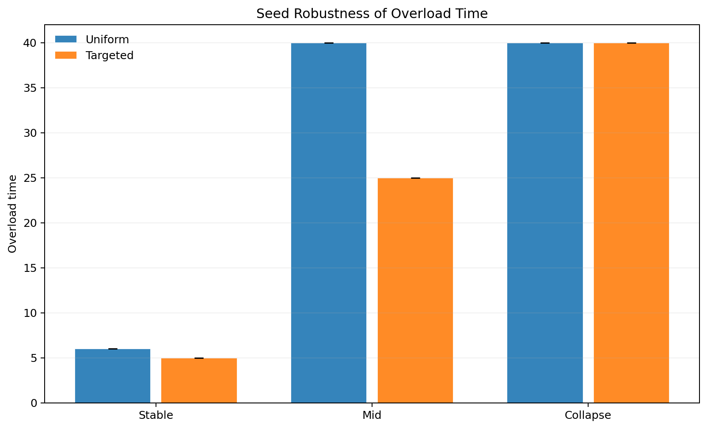
Main Results
Novelty-aware routing improves learning and often reduces overload.
Results
Headline numbers
Stable: 26.15 -> 36.29
Mid: 19.60 -> 31.56
Collapse: 6.68 -> 9.54
Mid overload: 40 -> 25
Interpretation: the forum receives more useful traffic.
Refs: seed_robustness.csv
8

Slide 9
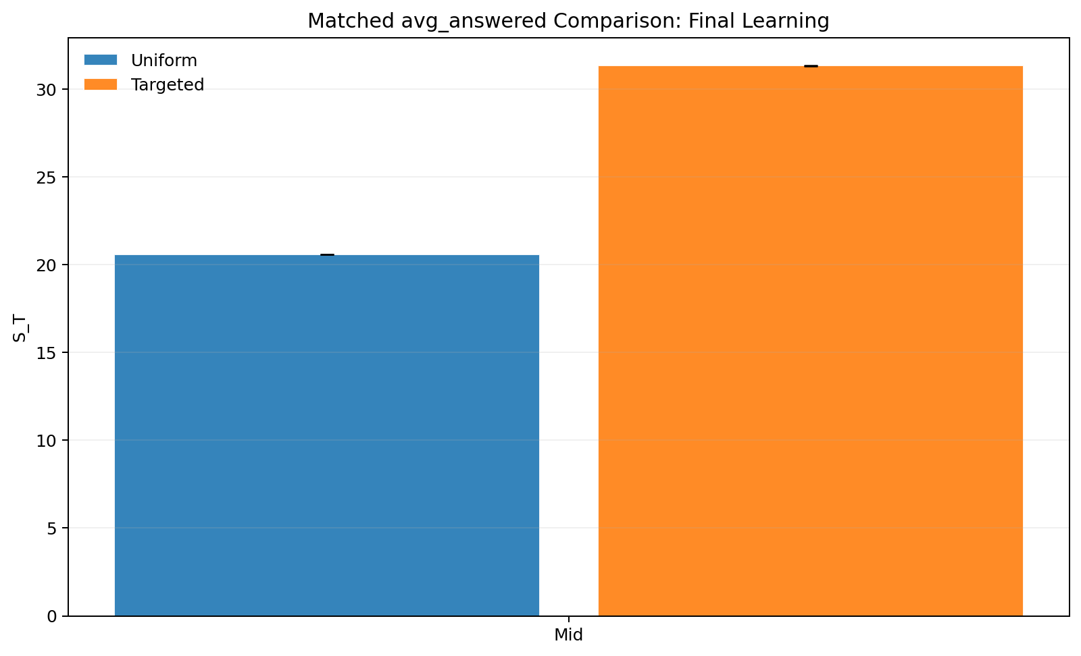
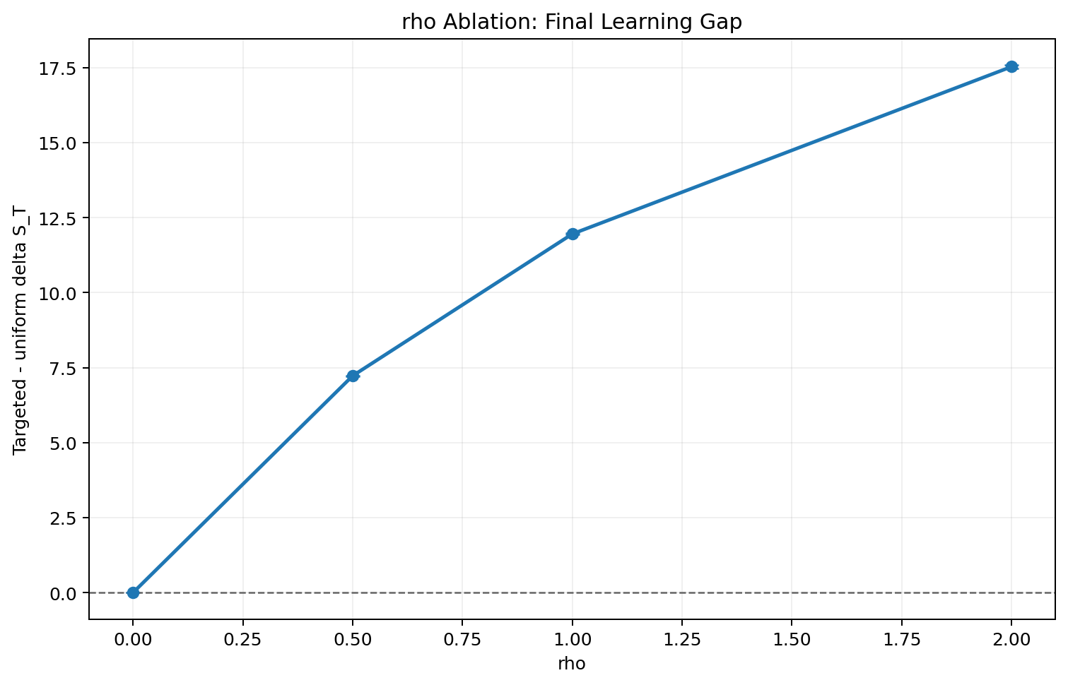
Mechanism Validation
We explicitly test whether the gain is composition-driven.
Validation
Two key checks
Matched answered-share control
rho = 0 ablation
If both pass, the novelty mechanism is credible
Refs: matched_answered_compare.csv; rho_ablation.csv
9

Slide 10
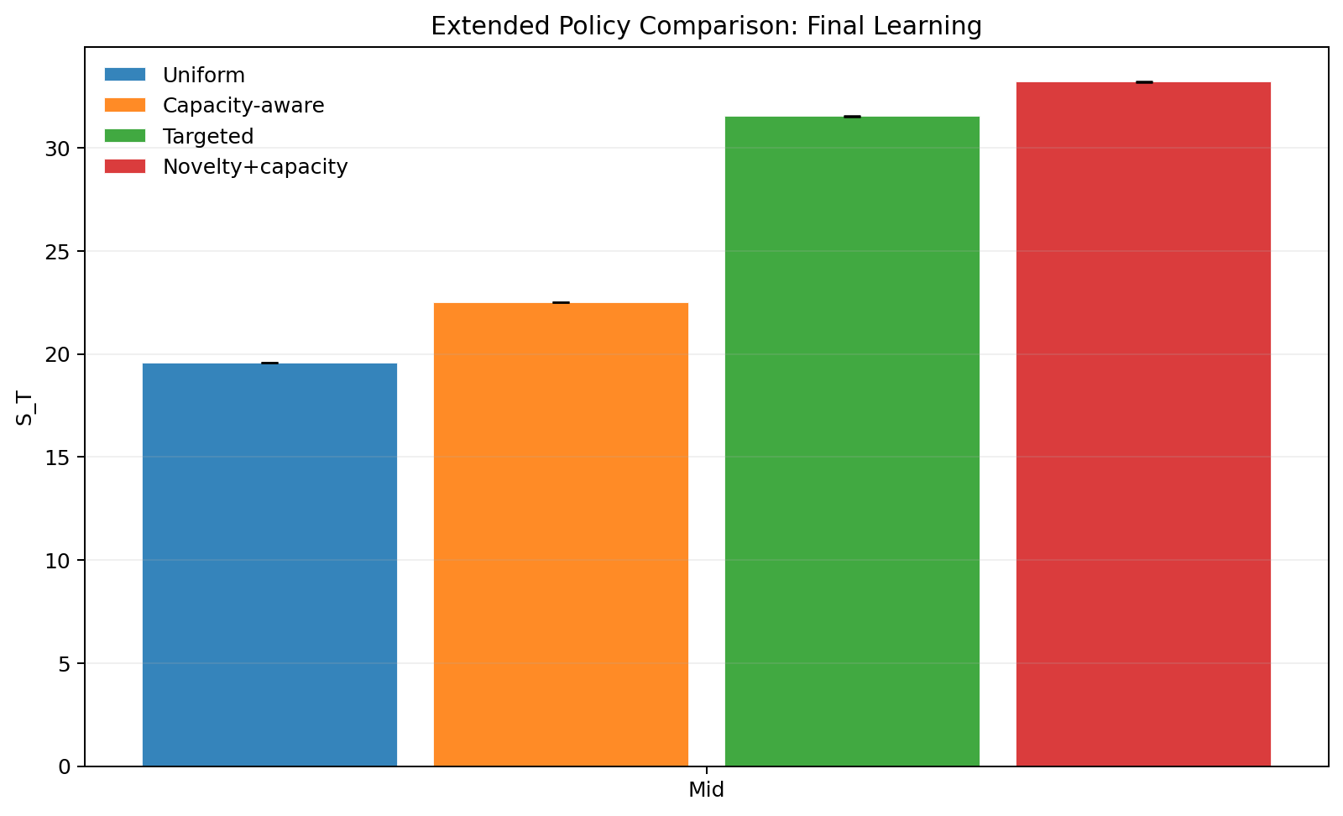
Tipping And Stronger Baselines
Congestion feedback helps, but novelty + capacity works best in the mid regime.
Phase view
Policy ranking
Uniform: 19.60
Capacity-aware: 22.52
Targeted novelty: 31.56
Novelty + capacity: 33.23
Refs: collapse_boundary_c1_xi.csv; policy_compare_extended.csv
10

Slide 11
Summary And Future Work
End by separating clearly what comes from the base paper and what comes from us.
Summary
Summary
Future work
References
Base paper: selective response can improve long-run learning.
Our contribution: forums are congestible and capacity-limited.
Main lesson: defer the right traffic, not just more traffic.
Use real forum data for calibration.
Learn routing policies.
Model multiple forums and heterogeneous experts.
Taitler et al. (2025) Chow (1970) El-Yaniv (2010) Madras et al. (2018) Mozannar and Sontag (2020) Hardin (1968) Ostrom (1990) Vickrey (1969)
Refs: full bibliography in refs.bib
11

Slide 12
Thank You
Questions?
Dikshant Gupta (24108)
Paras Raina (24170)
Final takeaway: novelty-aware routing is strongest when combined with congestion response.

