Slide 1


Selective Response for GenAI Under Forum Congestion
Base paper + our congestion-aware extension
Story: motivation -> literature -> base paper -> our model -> results -> validation
Dikshant Gupta (24108) | Paras Raina (24170)
Game Theory 2026
Notes:
Open with the question of when GenAI should answer versus defer.
State immediately that the base paper gives the selective-response intuition, while our work adds forum congestion and capacity.
Mention the talk structure in one sentence so the audience knows the flow.

Slide 2
The Problem In One Intuition
If AI helps too much, people stop creating the human knowledge that AI would have learned from later.
Problem
Classroom intuition
System view
If AI answers every forum question, fewer useful human discussions happen.
Those missing discussions reduce future training signal.
But sending everyone to the forum also creates congestion.
Users
->
GenAI
->
Forum
->
C_t
Missing idea in the base paper: the forum is a limited-capacity shared resource.
So the policy question is not only 'answer or not'. It is 'what kind of traffic should reach humans?'
Refs: Taitler et al. (2025); Hardin (1968); Ostrom (1990)
Game Theory 2026
2
Notes:
Explain the story as a feedback loop.
The left box gives the simplest intuition: AI can cannibalize the human forum that produces future knowledge.
The right diagram adds the missing systems idea: the forum has capacity, so too much deferral also creates a cost.

Slide 3
Why This Matters
The same selective-response problem appears in multiple real human-AI ecosystems.
Examples
Course forums
Developer forums
Product support
Student discussions can be reusable learning assets for future batches.
Expert communities can be overloaded if AI redirects too many queries.
Automation can solve today's issue while weakening tomorrow's human knowledge base.
In all three cases, human interaction is not just a backup. It is a productive input.
In all three cases, human interaction is not just a backup. It is a productive input.
In all three cases, human interaction is not just a backup. It is a productive input.
Refs: Horvitz (1999); Amershi et al. (2014); Bansal et al. (2021)
Game Theory 2026
3
Notes:
Give one crisp example from each box.
The point is not that these platforms are identical.
The point is that in each case, human interaction generates reusable value, so routing policy affects the ecosystem.

Slide 4
Literature Review
Our project sits where selective classification, learning to defer, and congestion economics meet.
Literature
Selective response
Learning to defer
Congestion / commons
Chow (1970) El-Yaniv (2010)
Madras et al. (2018) Mozannar and Sontag (2020)
Hardin (1968) Ostrom (1990) Kleinrock (1975)
When should the model abstain?
When should humans take over?
What happens when a shared system is overloaded?
Gap: prior selective-response work does not model the forum as a congestible, state-dependent resource.
Refs: Chow (1970); El-Yaniv (2010); Madras et al. (2018); Mozannar and Sontag (2020); Hardin (1968); Ostrom (1990)
Game Theory 2026
4
Notes:
This slide is the bridge to the professor-facing contribution statement.
Selective response says abstention matters.
Learning to defer says humans can be the right expert.
Congestion theory says shared systems degrade when overloaded.
Our paper combines those three ideas.

Slide 5
Base Paper: Idea, Result, Limitation
This slide is explicitly prior work and should be spoken as prior work.
Base paper
Base paper claim
Intuition
Limitation for our setting
Selective response can improve long-run learning.
Reason: unanswered queries can create future human-generated signal.
So always answering is not necessarily optimal.
The forum is not capacity-limited.
There is no overload damage or collapse.
Volume effects and composition effects are not separated.
Always answer
Selective response
Sometimes less answering creates more future learning.
Refs: Taitler et al. (2025)
Game Theory 2026
5
Notes:
State clearly that this is not our contribution.
We replicate the selective-response intuition, but the systems limitation becomes important once a real forum is involved.

Slide 6
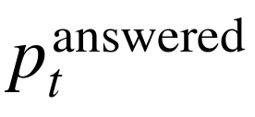
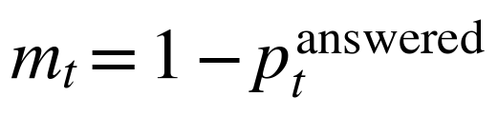


How The Equations Work
Read this slide left to right: each box corresponds to one term in the model.
Flowchart
Equation-aware flowchart
1. Routing
2. Forum load
3. Productive forum
4. Knowledge stock
5. Capacity update
Policy chooses answered vs deferred
->
Deferred users reach forum
->
Useful throughput and novelty matter
->
New knowledge is accumulated
->
Overload changes next period forum health
What AI answers
Load on forum
Knowledge gain
Future AI improves
Forum may weaken
This feedback loop is the main extension over the base paper.
If m_t > C_t
->
Next capacity falls
Refs: simulator structure from paper/main.tex and sim/model.py
Game Theory 2026
6
Notes:
Use this as the story slide for the whole model.
Read it left to right and point to one equation box at a time.
Routing determines answered share.
Answered share determines forum load.
Productive forum traffic generates knowledge gain.
Knowledge updates the stock.
If load exceeds capacity, the next-period forum becomes weaker.
End on the bottom overload loop because that is the core new idea.

Slide 7
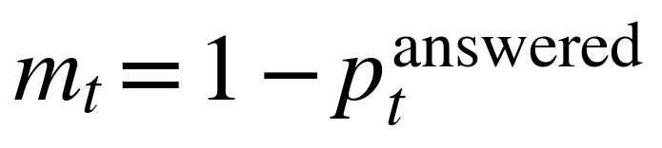
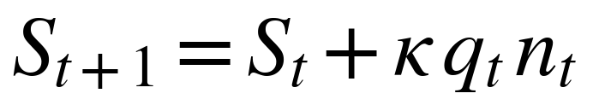
Core Equations And Notation
To satisfy the mathematical expectation, we make the mechanism explicit but keep the notation light.
Math
Model in 3 lines
How to read it
Line 1: how much traffic reaches the forum.
Line 2: forum traffic creates new knowledge.
Line 3: overload reduces future forum capacity.
Intuition: the forum helps learning today, but too much load can damage learning tomorrow.
Here, q_t = throughput and n_t = novelty factor; (x)^{+} means max(x,0).
Refs: model equations from paper/main.tex
Game Theory 2026
7
Notes:
Spend about 45-60 seconds here.
Say: the slide has only three lines.
First line tells us how much load reaches the forum.
Second line tells us how the forum turns traffic into new knowledge.
Third line tells us why congestion matters: overload reduces future capacity.
Mention that q_t is throughput and n_t is novelty factor only if asked.

Slide 8
Experiment Design
We test both replication and our new congestion-aware claims.
Design
Policies
Regimes
Metrics
Uniform throttling
Targeted novelty policy
Capacity-aware baseline
Novelty + capacity baseline
Stable: C1 = 0.85, xi = 0.04
Mid: C1 = 0.60, xi = 0.10
Collapse: C1 = 0.35, xi = 0.35
30 novelty seeds
Final learning S_T
Minimum capacity
Overload time
Average answered share
Welfare and revenue proxies
Refs: sim/results/summary.md; sim/results/extra/summary_extra.md
Game Theory 2026
8
Notes:
This slide tells the professor exactly what we compare and how.
Mention that the simulator is deterministic apart from novelty draws.
That is why seed variation here is meaningful but controlled.

Slide 9
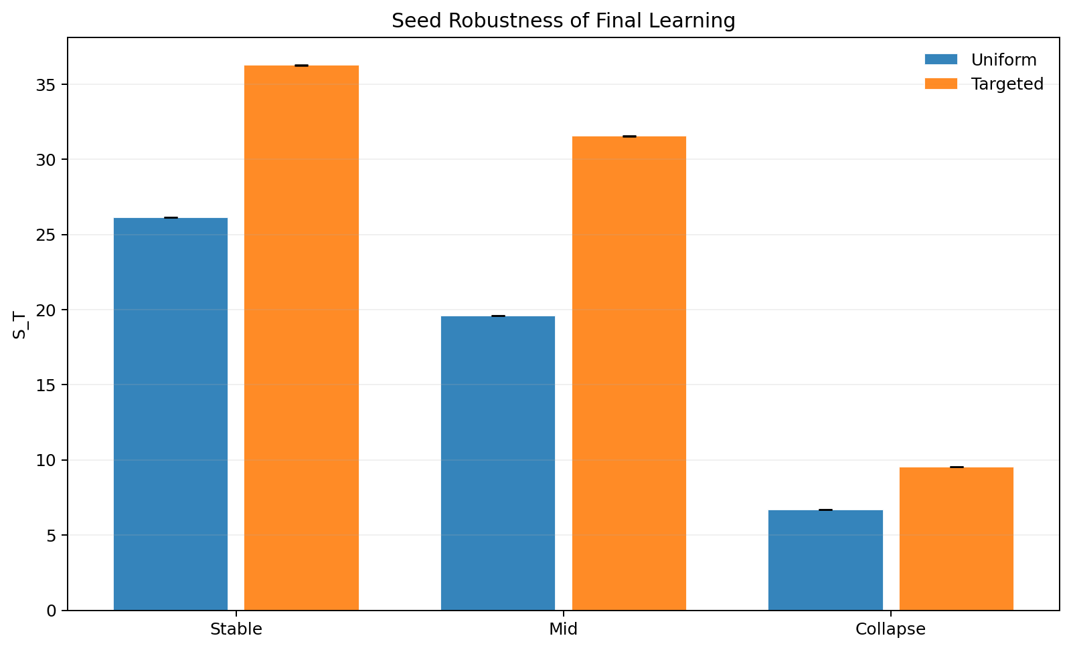
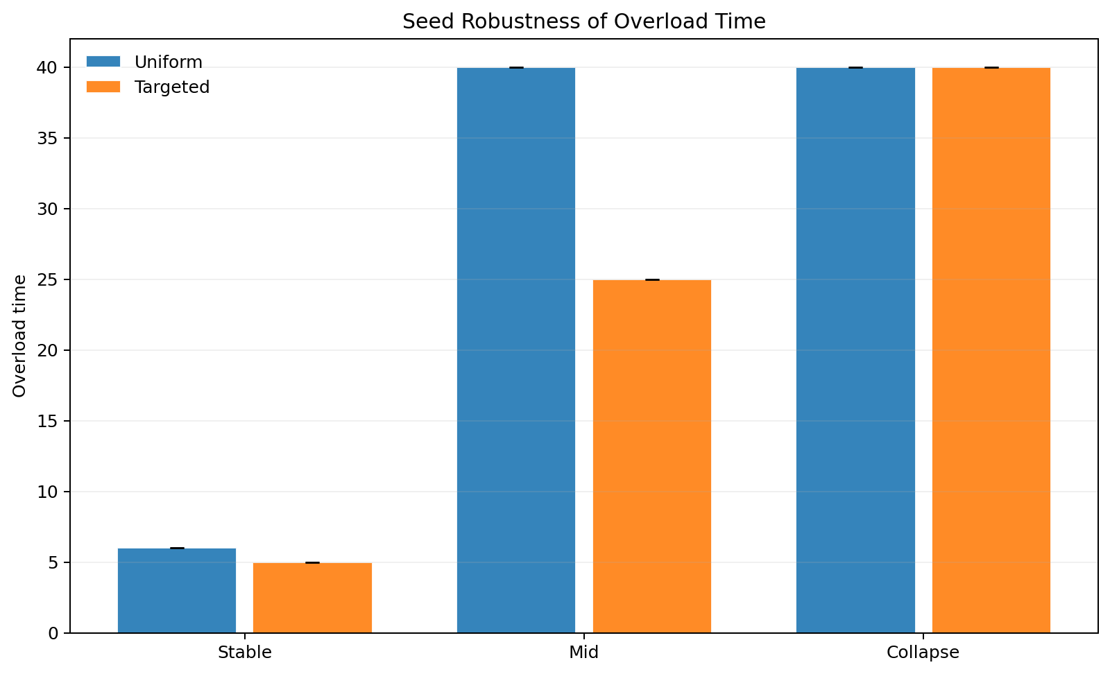
Main Results
Novelty-aware routing dominates uniform throttling across regimes.
Results
Results
Targeted novelty-aware deferral outperforms uniform throttling in all regimes.
The largest gain appears in the mid regime: 19.60 -> 31.56, with overload falling from 40 to 25.
Even in collapse, targeted routing still improves final learning: 6.68 -> 9.54.
Interpretation: the forum receives more useful traffic, not just more traffic.
Refs: seed_robustness.csv
Game Theory 2026
9
Notes:
Start with the middle regime because that is where the economics is clearest.
Then mention stable and collapse briefly.
The audience should leave this slide knowing that targeted novelty helps both learning and overload in the non-collapse region.

Slide 10
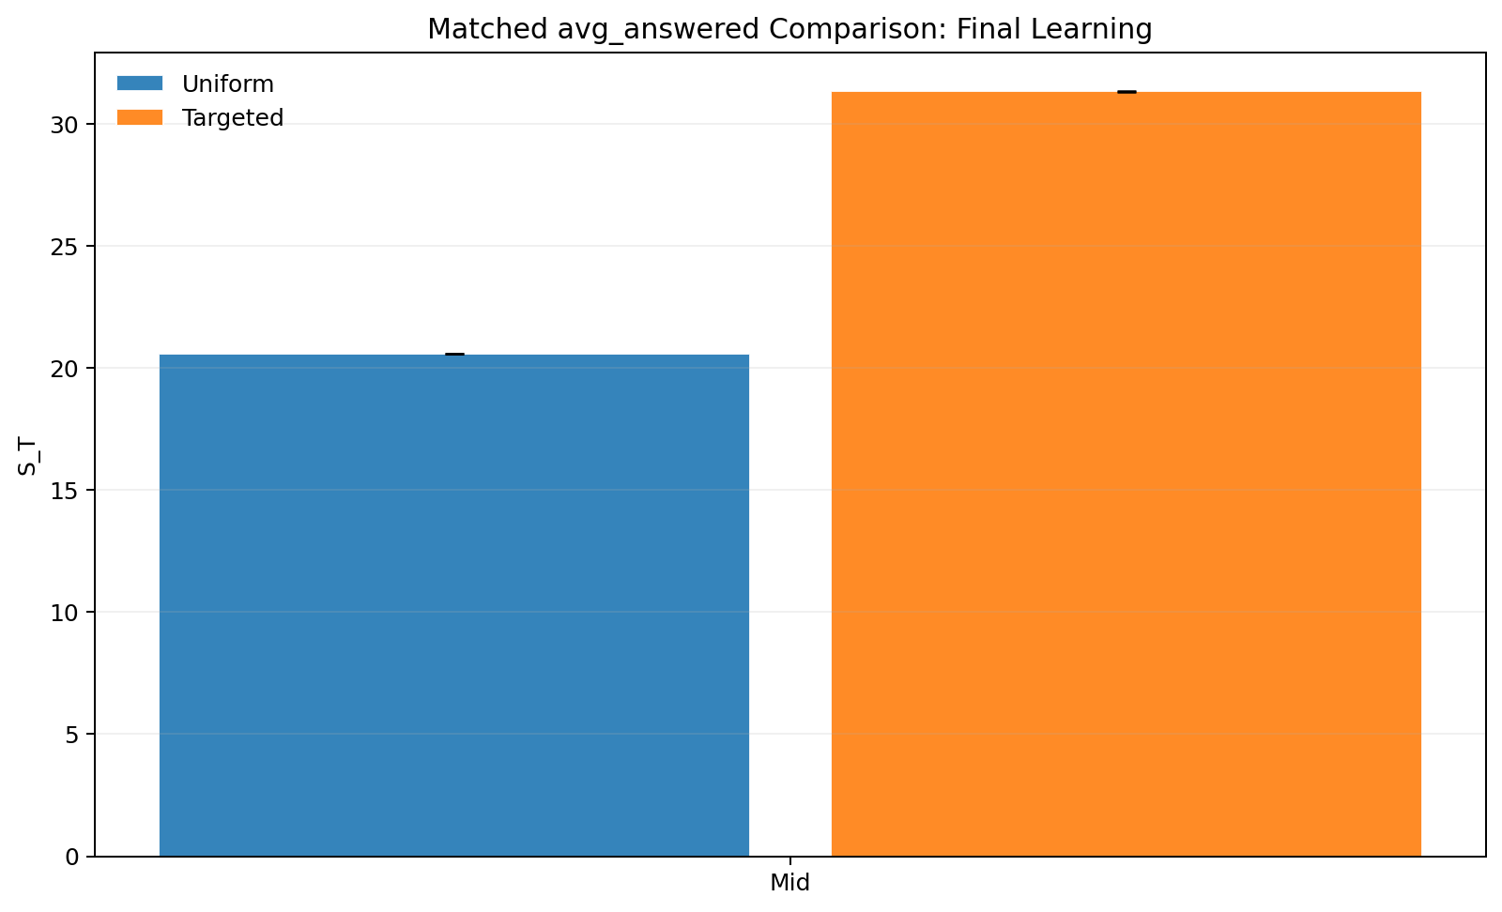
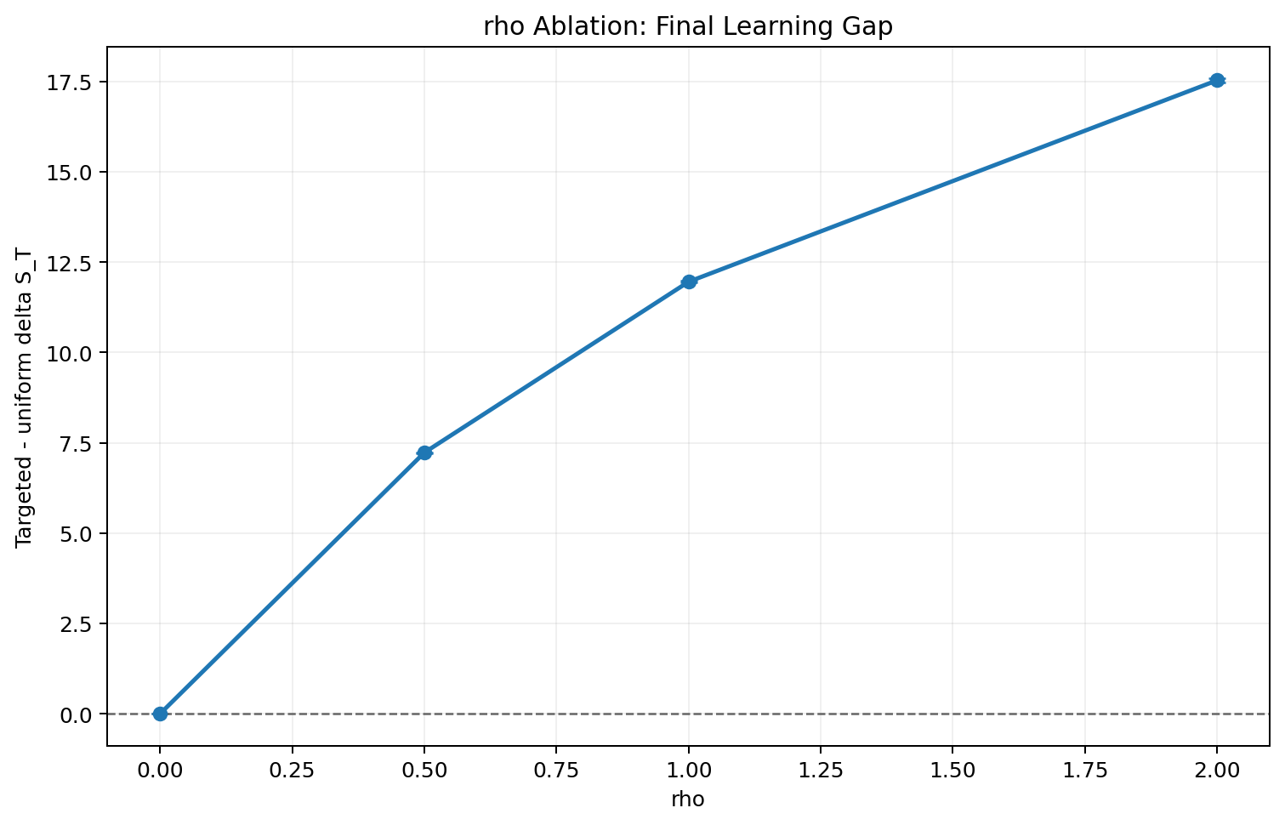
Mechanism Validation
We test whether the targeted gain is truly a composition effect.
Validation
Two strongest checks
Matched answered-share control
rho = 0 ablation
Together, they isolate the intended mechanism
Even at matched answered share, targeted reaches 31.35 vs 20.58.
When novelty has zero value, the targeted advantage disappears.
Refs: matched_answered_compare.csv; rho_ablation.csv
Game Theory 2026
10
Notes:
This is the professor's slide.
Check 1 says the result is not just because one policy answers more.
Check 2 says the result vanishes exactly when the novelty mechanism is switched off.
Together, these make the causal story much stronger.

Slide 11
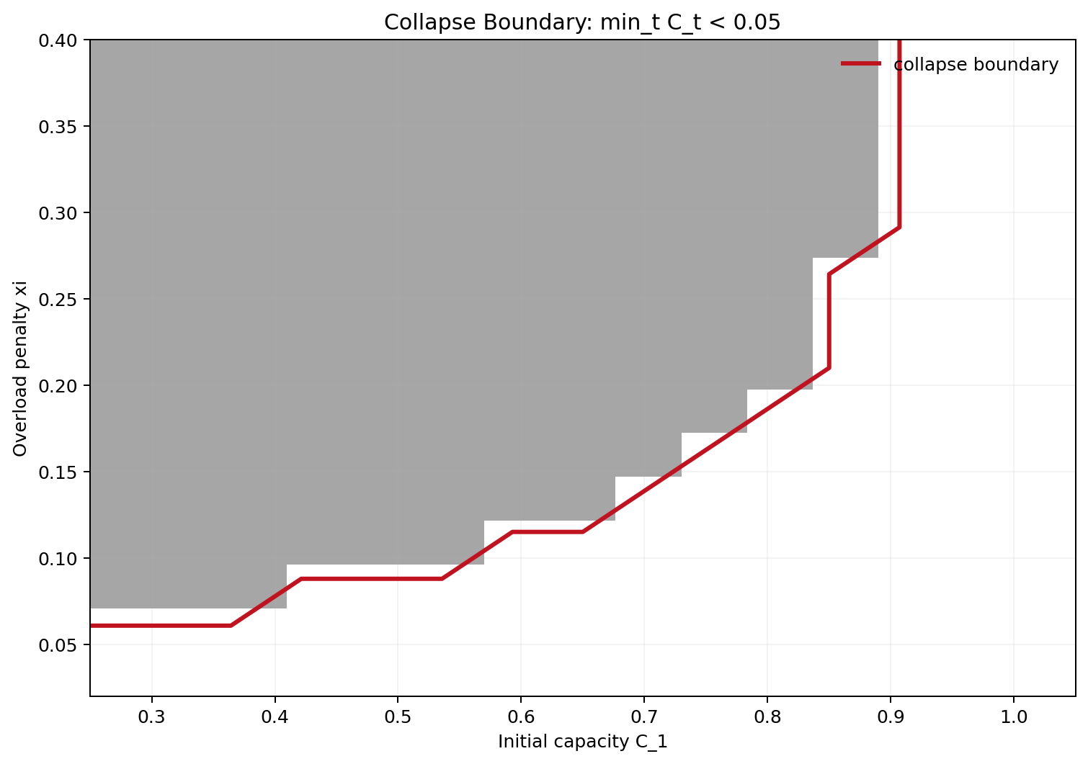
Tipping, Summary, Future Work
We end with the systems insight, the main lesson, and what remains open.
Summary
Tipping insight
Key takeaways
Future work
Low initial capacity and high overload damage create collapse.
Collapse is a region, not a random accident.
That is why forum health must be part of the policy objective.
Which queries are deferred matters as much as how many are deferred.
The rho = 0 ablation shows that the targeted advantage comes from novelty.
The model shows a clear collapse region in the parameter space.
Calibrate with real forum data.
Learn policies rather than hand-design them.
Model multiple forums and heterogeneous experts.
References: Taitler et al. (2025); Chow (1970); El-Yaniv (2010); Madras et al. (2018); Hardin (1968); Ostrom (1990).
Refs: collapse_boundary_c1_xi.csv; policy_compare_extended.csv
Game Theory 2026
11
Notes:
Use the left box to explain why tipping matters.
Then summarize in three lines.
Close with future work only briefly.
Keep the final sentence simple: in congested systems, composition matters as much as volume.

Slide 12
References
Key sources used in the presentation and project report.
References
Core paper
Congestion / systems
Taitler, S. et al. (2025). Selective Response Strategies for GenAI.
Hardin (1968) Ostrom (1990) Vickrey (1969) Kleinrock (1975)
Selective response / defer
Chow (1970) El-Yaniv (2010) Madras et al. (2018) Mozannar and Sontag (2020)
Project artifacts
paper/main.tex sim/results/extra/seed_robustness.csv sim/results/extra/matched_answered_compare.csv sim/results/extra/policy_compare_extended.csv
Refs: full bibliography in refs.bib
Game Theory 2026
12
Notes:
Use this slide only if asked for citations or if the professor wants a quick source summary.
Otherwise move through it quickly and then go to the thank-you slide.

Slide 13
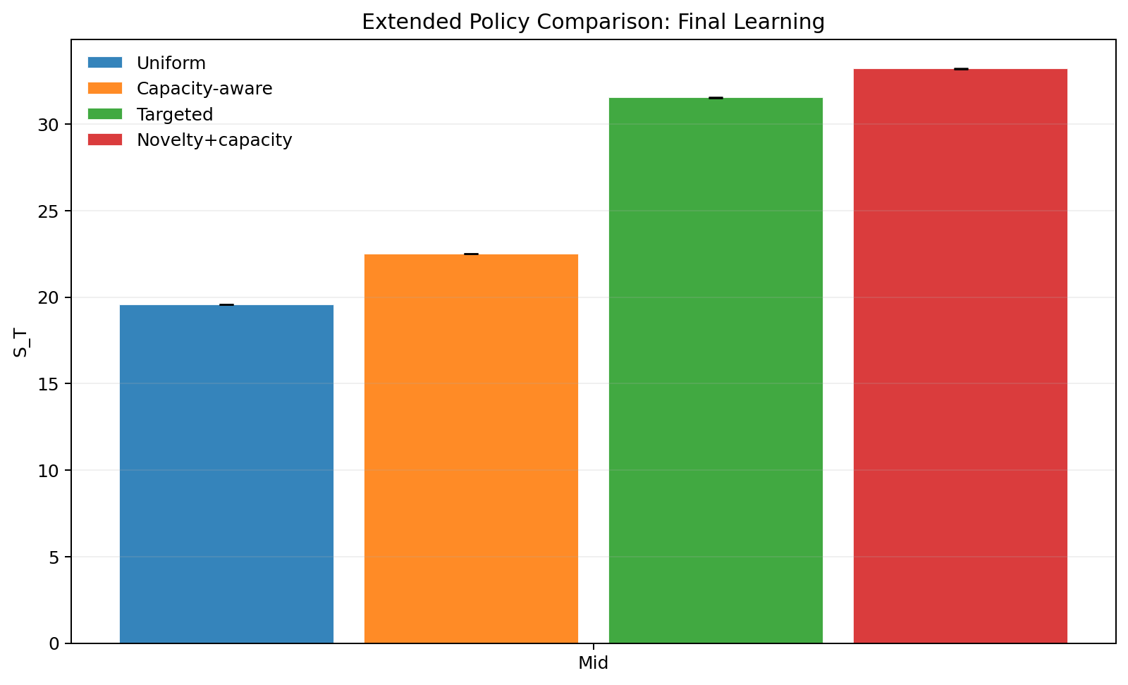
Thank You
Questions?
Dikshant Gupta (24108)
Paras Raina (24170)
Game Theory 2026
13
Notes:
Pause here for questions. If asked for the main contribution in one line: we extend selective response to a congested human-forum setting and show that traffic composition matters.

