Slide 1
Predicting Customer Bookings Using Machine Learning
Dikshant Badawadagi

Slide 2
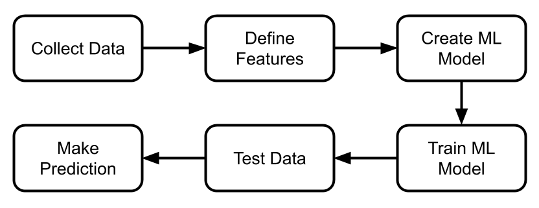
Introduction & Problem Statement
The challenge of predicting customer bookings for improved sales strategies
Importance of accurate forecasting for resource allocation and targeted marketing
Goal: Build a high-accuracy model that predicts bookings and identifies key factors

Slide 3
Dataset Overview
The Dataset includes columns like: ['num_passengers', 'sales_channel', 'trip_type', 'purchase_lead', 'length_of_stay', 'flight_hour', 'flight_day', 'route','booking_origin', 'wants_extra_baggage', 'wants_preferred_seat','wants_in_flight_meals', 'flight_duration', 'booking_complete']
Data was encoded in ISO-8859-1 format to ensure correct interpretation. Key Features:
purchase_lead: Time before booking flight_hour: Peak travel times
route and booking_origin: Key geographical indicators

Slide 4
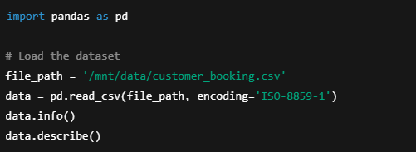

Slide 5
Data Cleaning & Pre-processing
Missing values filled using forward fill (.ffill()).
Categorical variables encoded using LabelEncoder.
Numerical features scaled using StandardScaler for consistency.

Slide 6
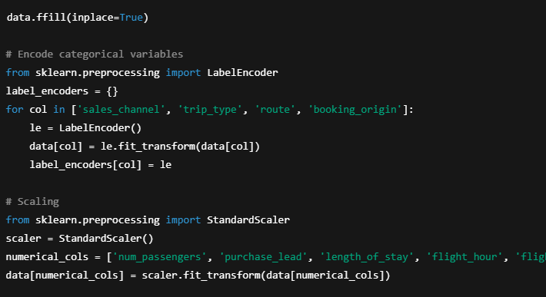

Slide 7
Exploratory Data Analysis
Peak Booking Trends: Bookings spike during specific flight hours. Influential Features: purchase_lead and route have strong correlations with bookings. Booking Behavior: Customers booking well in advance often opt for additional services.
Visual Element Suggestions:
Line Plot: Booking trends by flight_hour
Heatmap: Correlation matrix to highlight feature relationships

Slide 8
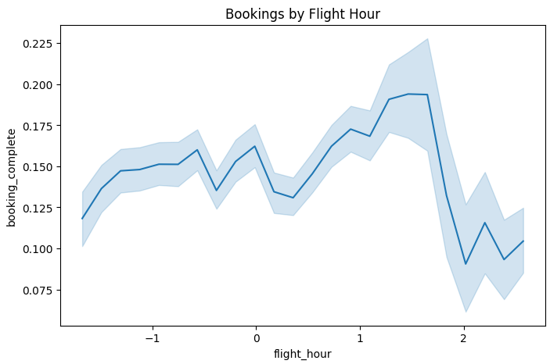

Slide 9
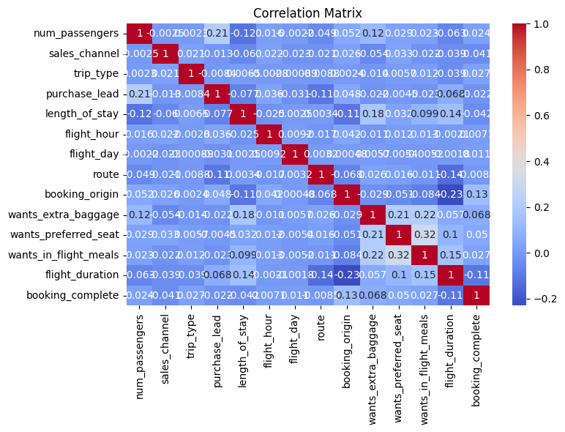

Slide 10
Model Selection & Training
Models tested:
RandomForestClassifier (Best Performance) XGBoost GradientBoostingClassifier
Key Techniques Applied:
Hyperparameter tuning via GridSearchCV Balanced data to improve model robustness
Result: The RandomForest model achieved the highest accuracy with optimized hyperparameters.

Slide 11
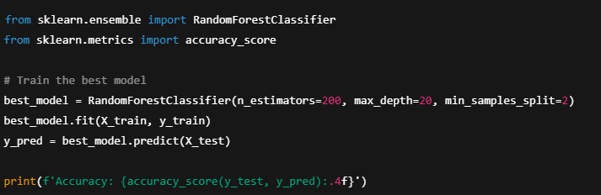

Slide 12
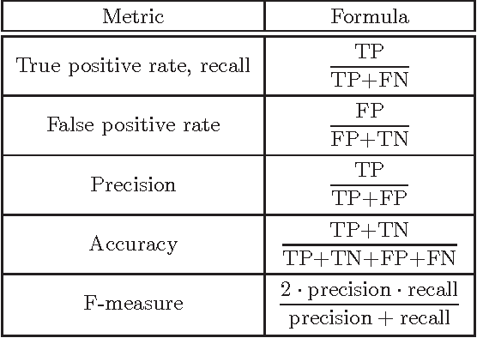
Evaluation Metrics

Slide 13
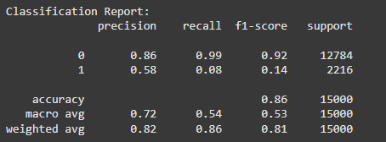

Slide 14
Key Insights
Top Features Influencing Bookings:
purchase_lead — Early bookers significantly increase booking probability. route — Specific routes exhibit notably higher booking success rates. Identified Peak Booking Hours:
Highlighted time frames where bookings surge, presenting a potential opportunity for targeted marketing campaigns. Actionable Insight:
Focus marketing efforts on customers booking flights with shorter purchase_lead windows to maximize conversion rates.

Slide 15
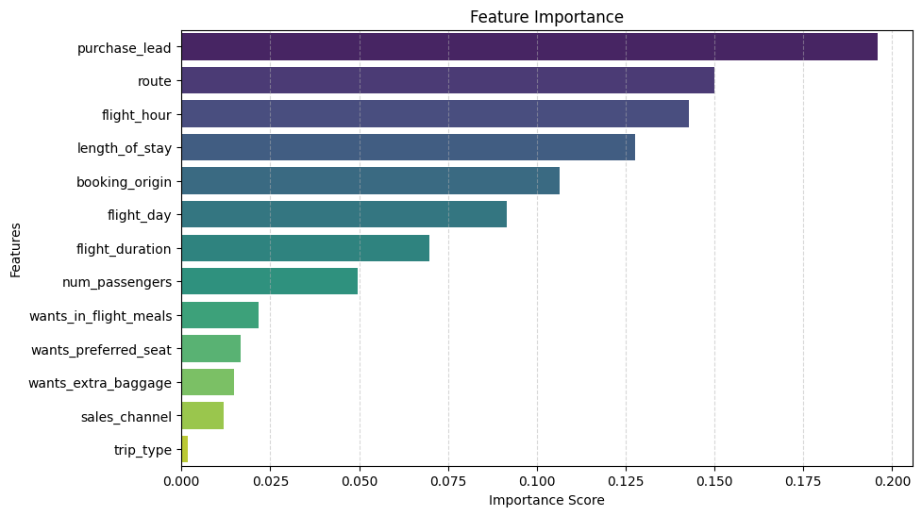
Feature Importance

Slide 16
Conclusion
Developed a robust ML model achieving ~86% accuracy.
Identified key trends in customer booking patterns.
Suggested strategies to improve targeted marketing and customer engagement.

