Slide 1

STOCK MARKET VOLATILITY & SECTOR ANALYSIS
A comparative study of volatility, momentum, and correlation across six market sectors,
grounded in modern portfolio theory and the empirical literature on financial returns
pandas • numpy • matplotlib • seaborn
No machine learning — fully manual indicator implementation
Notes:
Opening: this is a descriptive, theory-grounded statistical study -- not a predictive/trading model, and not ML. Lead with that if asked.

Slide 2

OBJECTIVE
Why compare volatility across sectors?
Different sectors react differently to macro events, interest rates, and commodity cycles.
Volatility is a core measure of investment risk -- comparing it across sectors reveals where risk concentrates.
Combining volatility with momentum (RSI) and correlation gives a fuller risk picture than any single metric alone.
18
6
2 yrs
Stocks
Sectors
Daily data
This is a descriptive statistical study, not a predictive or trading model.
Notes:
Descriptive, not predictive -- explains why no ML was needed or used. This framing also sets up the two theory slides that follow.

Slide 3

THEORETICAL FRAMEWORK
Why volatility is the right lens for risk
Modern Portfolio Theory (Markowitz, 1952) formalised investment risk as the variance -- equivalently, the standard deviation -- of an asset's returns. This study's volatility measure is a direct, textbook application of that definition.
Total risk decomposes into systematic risk (market-wide, cannot be diversified away) and idiosyncratic risk (sector- or firm-specific, can be diversified away). Comparing volatility across sectors is, in effect, comparing how much idiosyncratic risk each sector contributes.
The benefit of diversification depends on the correlation between assets, not on their individual volatility alone -- two volatile sectors that move independently can still reduce portfolio-level risk when held together. This motivates the correlation analysis later in this study.
Total Risk
= Systematic Risk (market-wide) + Idiosyncratic Risk (sector-specific)
Notes:
Markowitz's 1952 'Portfolio Selection' (Journal of Finance) is the foundational citation here -- it's the origin of using variance/std. dev. as the formal definition of risk, which is exactly what this study's volatility metric measures. If asked to justify using volatility as a risk proxy at all: this is literally the textbook definition, not an assumption unique to this study. The systematic/idiosyncratic split is the standard framing from CAPM-adjacent theory -- useful if asked how this connects to broader asset pricing theory.

Slide 4

THEORETICAL FRAMEWORK
Why standard distributional assumptions don't fully apply
Financial returns are well documented in the empirical finance literature to deviate from a normal distribution -- a set of recurring empirical regularities often referred to as the 'stylized facts' of asset returns.
Fat tails: extreme daily moves occur more often than a normal distribution would predict.
Volatility clustering: large price moves tend to be followed by more large moves (of either sign) -- volatility is not constant over time.
Evidence in this study
Why this matters methodologically
The return-distribution histogram (this study, sector comparison) shows visibly fatter tails than a normal curve would produce for every sector examined.
Because volatility clusters rather than staying constant, this study measures it with a rolling 21-day window -- not a single fixed number -- so the metric can move with the market instead of assuming stability it doesn't have.
Notes:
'Stylized facts' is an established term in empirical finance/econophysics (see e.g. Cont, 2001, on empirical properties of asset returns) -- fat tails and volatility clustering are among the most replicated findings in the literature, not something specific to this dataset. This slide is the direct theoretical justification for two design choices: (1) using a rolling window for volatility instead of one static figure, and (2) not being surprised or treating fat tails in the histogram as a data error -- it's expected.

Slide 5

DATA & METHODOLOGY
Universe, tools, and scope
Sector | Representative Stocks
IT | TCS, INFY, WIPRO
Banking | HDFCBANK, ICICIBANK, SBIN
Auto | TATAMOTORS, MARUTI, M&M
Pharma | SUNPHARMA, DRREDDY, CIPLA
FMCG | HINDUNILVR, ITC, NESTLEIND
Energy | RELIANCE, ONGC, NTPC
TOOLS USED
pandas -- data handling & manual indicator math
numpy -- log returns, annualisation
matplotlib -- price, trend, RSI charts
seaborn -- distribution & correlation charts
Date range: 2024-01-02 → 2026-01-01
9,414 total daily observations
No machine learning at any stage
Notes:
Data covers 2024-01-02 to 2026-01-01 (9414 rows). Pipeline is identical whether fed by live yfinance/Kite Connect data or the CSV sample used here.

Slide 6

METHODOLOGY
The seven-step pipeline
01
03
05
07
02
04
06
Load
Returns
Aggregate
Correlate
Read each stock's CSV into a DataFrame
Clean
Simple & log daily returns from Close
Indicators
Combine 18 stocks into sector-level views
Visualize
Seaborn: distribution & correlation
Sort, de-duplicate, forward-fill gaps
SMA, EMA, RSI, volatility -- manual
Matplotlib: price, trend, RSI bands
Notes:
Steps 1-2 are pandas hygiene. Step 3 is the foundation. Step 4 is the core technical content. Steps 5-7 move from single-stock to sector-level comparison.

Slide 7

CORE FORMULAS
Every indicator, implemented manually
SMA
Simple Moving Average
EMA
Exponential Moving Average
Plain average of the last N closes
EMA_t = P_t · α + EMA_{t-1} · (1-α), α = 2/(N+1)
RSI
Relative Strength Index (Wilder)
σ
Annualised Volatility
RSI = 100 − 100/(1+RS), RS = avg gain / avg loss
std(log returns, 21d) × √252
Theoretical origin: SMA/EMA rest on trend-following technical analysis · RSI was introduced by J. Welles Wilder (1978) · the √252 annualisation assumes i.i.d. daily returns, a random-walk simplification revisited in Limitations.
Notes:
Wilder introduced RSI in 'New Concepts in Technical Trading Systems' (1978), originally for commodity futures, since adopted broadly. The sqrt(252) annualisation assumes i.i.d. returns -- flagged explicitly here and revisited in the Limitations slide, since Slide 4 already showed that assumption is a simplification.

Slide 8
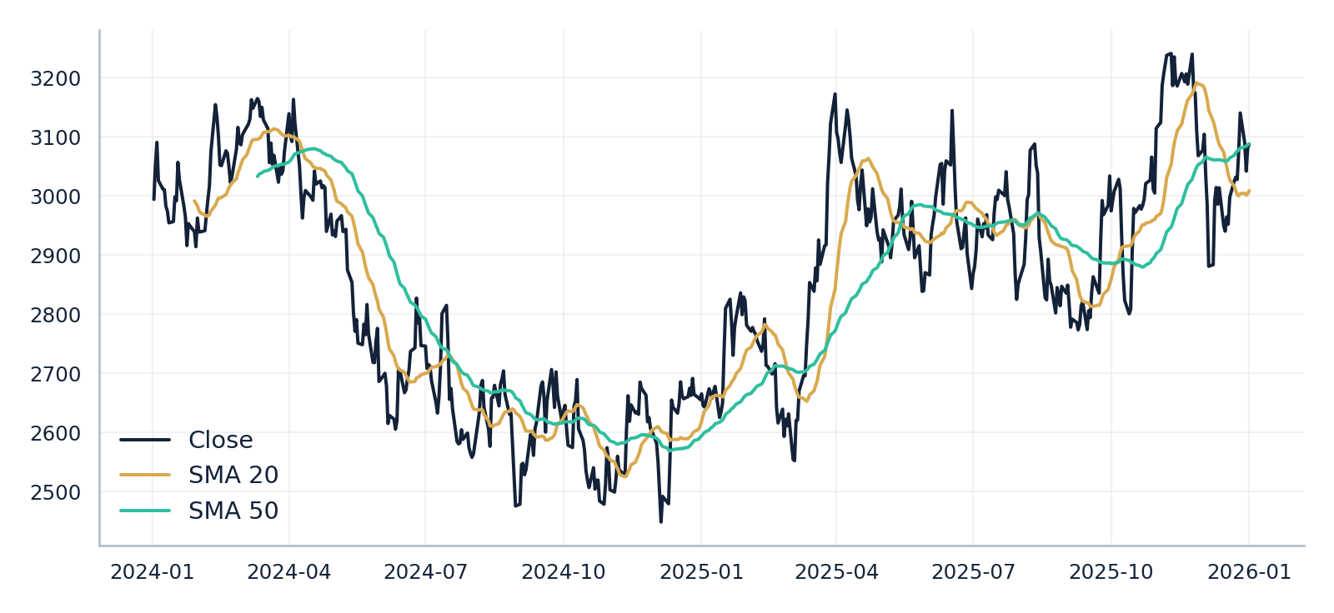
TREND ANALYSIS
Price with SMA-20 / SMA-50 -- TCS (IT sector)
Reading this chart
SMA-20 crossing above SMA-50 signals emerging upward momentum.
The gap between price and its moving average reflects short-term volatility.
Notes:
TCS as IT-sector representative. SMA crossovers are classic trend-following signals, theoretically grounded in the technical-analysis assumption that price momentum persists over short horizons.

Slide 9

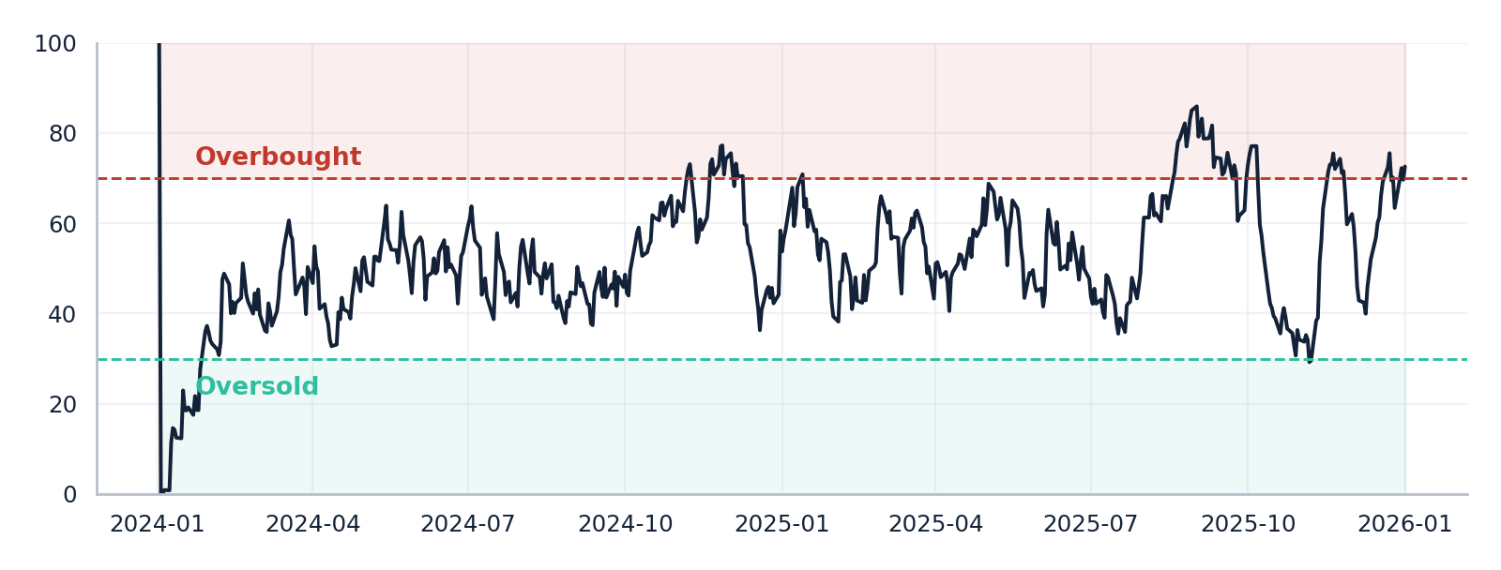
MOMENTUM ANALYSIS
RSI(14) -- HDFCBANK (Banking sector)
RSI above 70 signals overbought conditions; below 30 signals oversold. Banking shows more time in extreme RSI territory than defensive sectors, consistent with its higher volatility.
Notes:
Banking: 10.3% overbought, 3.5% oversold. RSI as a behavioural-finance-adjacent concept: it's a proxy for market overreaction (Wilder's original framing), not a mechanical prediction rule.

Slide 10

RISK COMPARISON
Mean annualised volatility by sector
Most volatile
Auto
Least volatile
FMCG
Notes:
Auto highest at 31.4%, FMCG lowest at 15.4%. Native editable chart -- numbers update if re-run on live data.

Slide 11

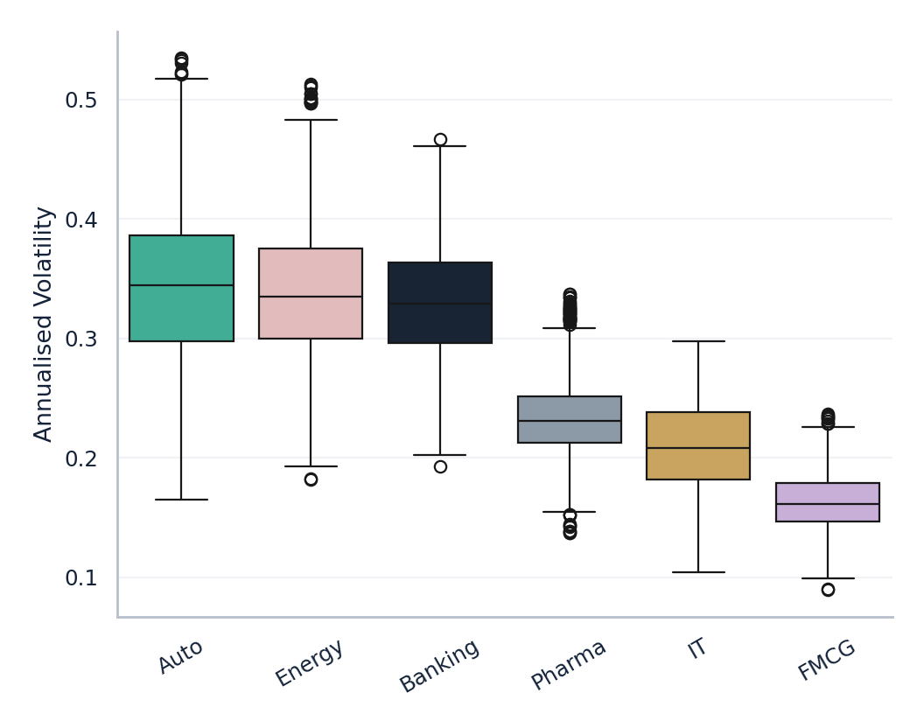
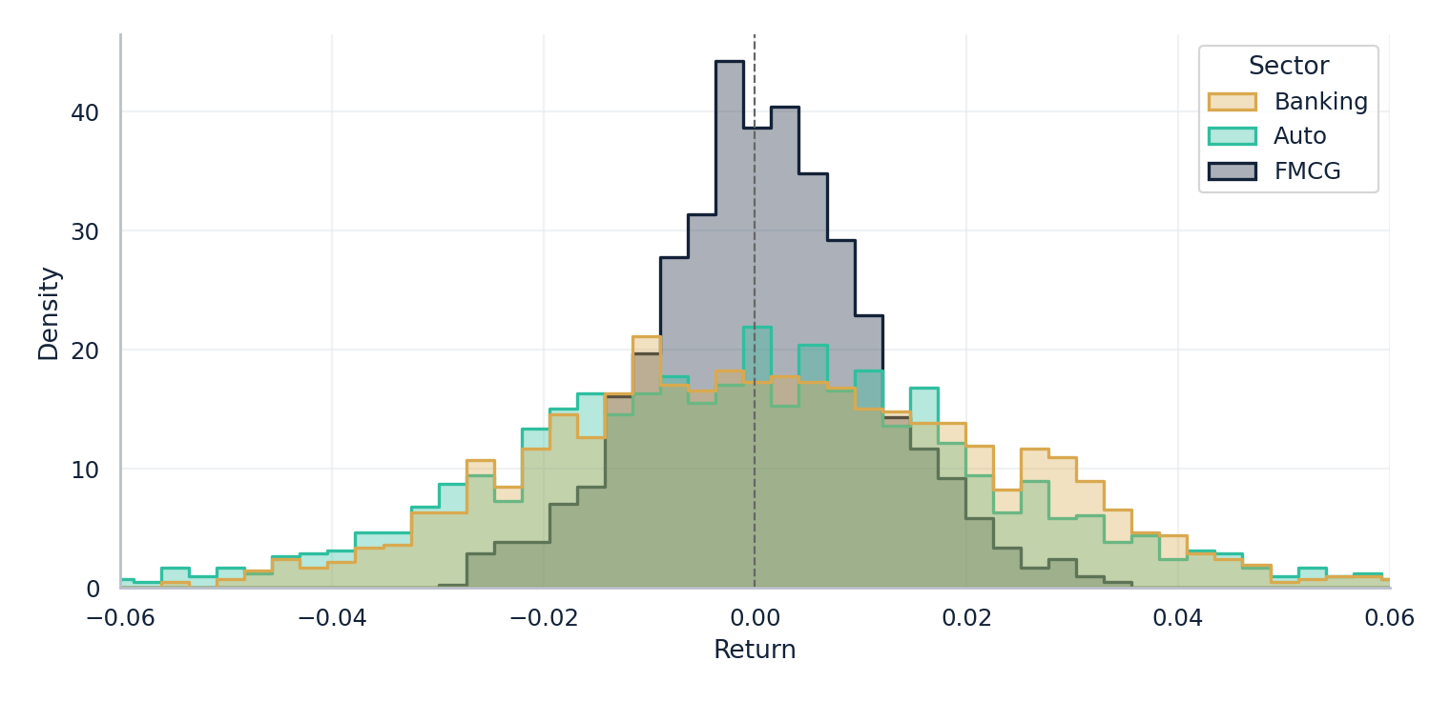
DISTRIBUTION SHAPE
Beyond the average: how returns are spread
Daily return distribution -- Auto, Banking, FMCG. Note the fat tails discussed in the theoretical framework (Slide 4).
Notes:
This is the direct empirical evidence for the stylized-facts theory slide -- fat tails visible in the histogram, wider boxes/more outliers in higher-volatility sectors on the boxplot.

Slide 12

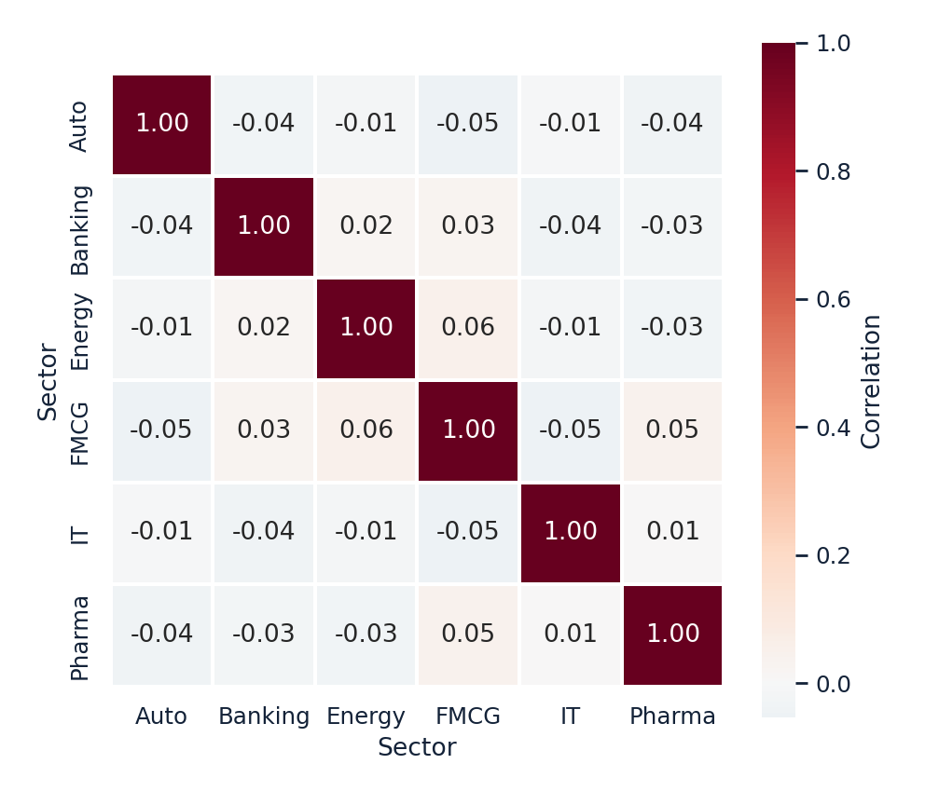
DIVERSIFICATION
Correlation of daily sector returns
What correlation tells us
Values near 0 mean two sectors move mostly independently of each other.
Values near 1 mean two sectors tend to rise and fall together.
Low correlation here directly supports the Markowitz diversification argument from Slide 3: combining low-correlation sectors reduces portfolio-level risk beyond what any single sector's volatility suggests.
Notes:
Computed via sector_returns.corr() (Pearson). Low cross-sector correlation here is the direct empirical link back to the portfolio theory slide -- diversification benefit is real in this sample, not just theoretical.

Slide 13

KEY FINDINGS
Summary statistics by sector
Sector | Ann. Return | Ann. Volatility | Return/Vol | % Overbought | % Oversold
Auto | -5.2% | 31.4% | -0.16 | 10.8% | 7.9%
Energy | 59.1% | 31.4% | 1.88 | 14.2% | 0.3%
Banking | 47.1% | 30.6% | 1.54 | 10.3% | 3.5%
Pharma | 8.8% | 21.7% | 0.41 | 12.0% | 7.1%
IT | 10.2% | 19.3% | 0.53 | 8.2% | 1.8%
FMCG | 21.7% | 15.4% | 1.41 | 8.3% | 5.9%
Auto and Banking carry the highest risk in this sample -- expected given macro/rate sensitivity.
FMCG is the most defensive sector -- lower swings, fewer extreme RSI days.
Energy shows the strongest return earned per unit of risk taken in this window.
Notes:
Ann. Return = mean(daily return) x 252; Ann. Volatility = std(daily return) x sqrt(252); Return/Vol is a simplified reward-to-risk ratio, not a formal Sharpe ratio (no risk-free rate) -- see Limitations.

Slide 14

ACADEMIC RIGOR
Limitations & scope
This is a descriptive statistical study; no hypothesis testing or significance testing (e.g. p-values) is performed on the differences observed between sectors.
Correlation reported is Pearson (linear) correlation -- nonlinear co-movement between sectors is not captured by this measure.
The Return/Volatility ratio omits a risk-free rate and is not a formal Sharpe ratio.
Annualisation via √252 assumes i.i.d. daily returns; Slide 4 already showed volatility clustering, so this is a simplifying assumption, not a claim that returns are truly independent day to day.
Findings reflect the specific sample window analysed and should not be extrapolated as permanent, time-invariant sector characteristics.
None of this invalidates the descriptive findings -- it defines the boundary of what this study claims, which is standard practice in empirical research.
Notes:
This slide is deliberately here -- naming limitations proactively is stronger than waiting for an examiner to raise them. If pressed on any one of these, the answer is 'yes, that's a known limitation, noted explicitly, and here's why it doesn't invalidate the descriptive findings': the sector rankings (most/least volatile) are robust even without formal significance testing, since the differences observed are large relative to typical sampling noise at this sample size.

Slide 15

THEORETICAL GROUNDING
Core references
Markowitz, H. (1952)
"Portfolio Selection," Journal of Finance.
Foundation for treating variance/std. dev. as the formal definition of investment risk.
Wilder, J. W. (1978)
New Concepts in Technical Trading Systems.
Original source of the Relative Strength Index (RSI), implemented manually in this study.
Stylized facts literature
e.g. Cont, R. (2001), empirical properties of asset returns.
Documents fat tails and volatility clustering in financial return series -- the basis for Slide 4.
Notes:
These three are the load-bearing theoretical references for this study -- Markowitz for the risk definition, Wilder for RSI's origin, and the stylized-facts literature for why rolling volatility (not a static number) and non-normal return distributions are treated as expected, not anomalous.

Slide 16

Conclusion & Future Work
Sector segmentation reveals meaningfully different risk profiles, consistent with the systematic/idiosyncratic risk decomposition from portfolio theory.
RSI and volatility together give a fuller picture than either alone.
Low cross-sector correlation empirically supports diversification as a genuine, not just theoretical, risk-reduction strategy in this sample.
FUTURE WORK
Extend to a full benchmark index (NIFTY 50)
Add drawdown / maximum-loss analysis
Formal significance testing across sector differences
Market-cap weighting instead of equal weighting
Live data via yfinance / Kite Connect
Thank you
Notes:
Close by reiterating scope: descriptive, theory-grounded, not predictive. If asked something outside scope, redirect to Future Work and explain why it's excluded (e.g. prediction would require ML, intentionally out of scope).

