Slide 1
Predictive Maintenance of Industrial Machinery
CAPSTONE PROJECT
Presented By:
Dikshant Singh Chib - Graphic Era Deemed to be university - B-tech (CSE)

Slide 2
OUTLINE
Problem Statement
Proposed System/Solution
System Development Approach
Algorithm & Deployment
Result
Conclusion
Future Scope
References

Slide 3
Problem Statement
Machinery is the foundation of production lines in many industries in the modern world. Significant operational disruptions, higher maintenance expenses, decreased productivity, and safety risks can result from unplanned equipment breakdowns.
Even with routine inspections, a lot of problems happen suddenly. Tool wear, inadequate heat dissipation, electrical or power problems, or other internal mechanical problems can all cause these failures. Industries are at risk of significant downtime and financial loss due to the incapacity to predict such breakdowns beforehand.
The goal of this study is to use both historical and real-time sensor data to anticipate the types of machinery failures. It seeks to create a system that uses machine learning to identify the possible failure type before it occurs, allowing for proactive and economical maintenance planning.

Slide 4
Proposed Solution
The proposed solution involves the design and implementation of a machine learning classification model that predicts various types of failures in industrial machinery utilizing sensor data.
Data Acquisition:
Sensor readings and machine failure reports are included in this Kaggle dataset.
A machine reading with characteristics like torque, rotational speed, tool wear, product kind, etc., is represented by each row.
Data Preprocessing:
Deal with outliers and missing values.
Use encoding to transform categorical variables (such as product type).
To improve model performance, normalize numerical features.
Model Development:
To anticipate failure types, train supervised classification algorithms like Random Forest, XGBoost, or Decision Tree.
Assess using F1-score, recall, accuracy, and precision.
Deployment:
IBM Watson Studio for model building and training
Dataset storage with IBM Cloud Object Storage
Utilizing IBM Watson Machine Learning, implement the model as an API.
Usage:
To determine whether a machine is likely to fail and what kind of failure it will encounter, send batch or real-time data to the deployed API.

Slide 5
System Approach
This project uses IBM Watson Studio to create a predictive maintenance solution for industrial machinery utilizing an organized, cloud-based methodology.
System Requirements:
IBM Cloud Lite account, IBM Watson Studio, IBM Cloud Object Storage, modern browser, stable internet.
Tools & Services Used:
IBM Cloud Object Storage – Data upload and storage
IBM Watson Studio (AutoAI) – Automated model generation
IBM Watson Machine Learning – Model deployment as REST API
Libraries & Algorithms (via AutoAI):
Internally makes use of preprocessing methods like encoding and scaling in addition to methods like Random Forest, Gradient Boosted Trees, and Logistic Regression.

Slide 6
Algorithm & Deployment
The Random Forest Classifier, chosen for its excellent accuracy, resilience, and capacity to manage multiclass classification issues, is used to construct the predictive maintenance model:
Algorithm Selection:
The most common class prediction is produced by Random Forest after it constructs an ensemble of decision trees. It was selected because
Excellent results on industrial datasets that are structured
Capacity to simulate non-linear connections
Resistance to noise and overfitting
Data Input:
Air Temperature
Process Temperature
Rotational Speed
Torque
Tool Wear
Product Type (L/M/H)
Training Process:
Data preprocessing, feature encoding, train-test split, model creation, and hyperparameter tweaking were all managed by IBM AutoAI. Models were assessed based on accuracy and F1-score.
Deployment:
IBM Watson Machine Learning was used to create the Random Forest model that performed the best. Using fresh input sensor data, a REST API was created for real-time failure prediction.

Slide 7
Result
The Random Forest Classifier in IBM Watson Studio's AutoAI environment was used to create the predictive maintenance model, which performed exceptionally well. Across all failure categories, the model's precision, recall, and F1-scores were all high. The model's ability to categorize failure categories like tool wear, heat loss, and power failure was validated by evaluation metrics and visualizations like the confusion matrix and feature importance plot. With IBM Watson Machine Learning, the finished model was effectively implemented as a REST API for real-time prediction.

Slide 8
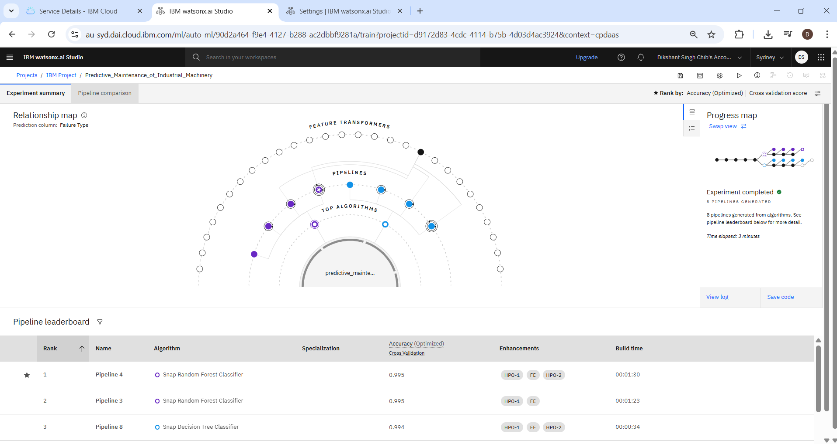
Result

Slide 9
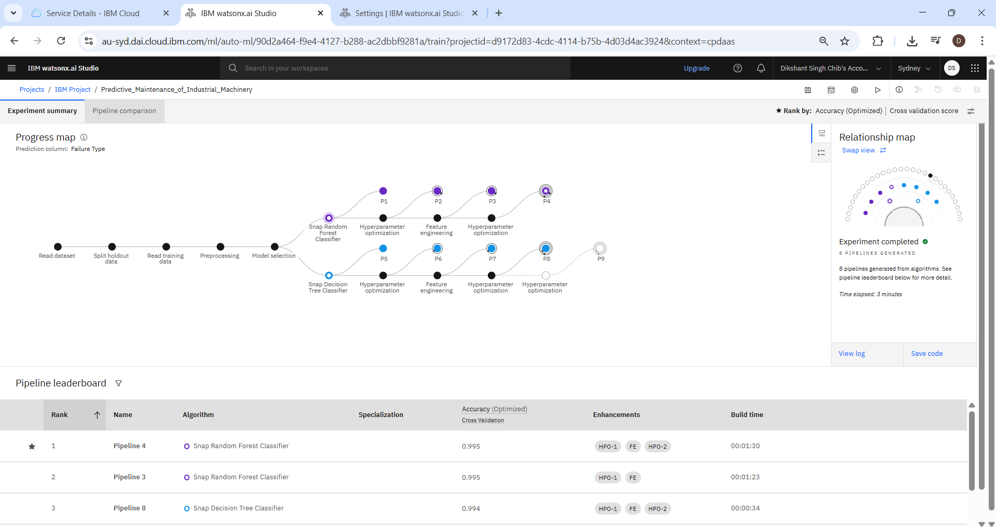
Result

Slide 10
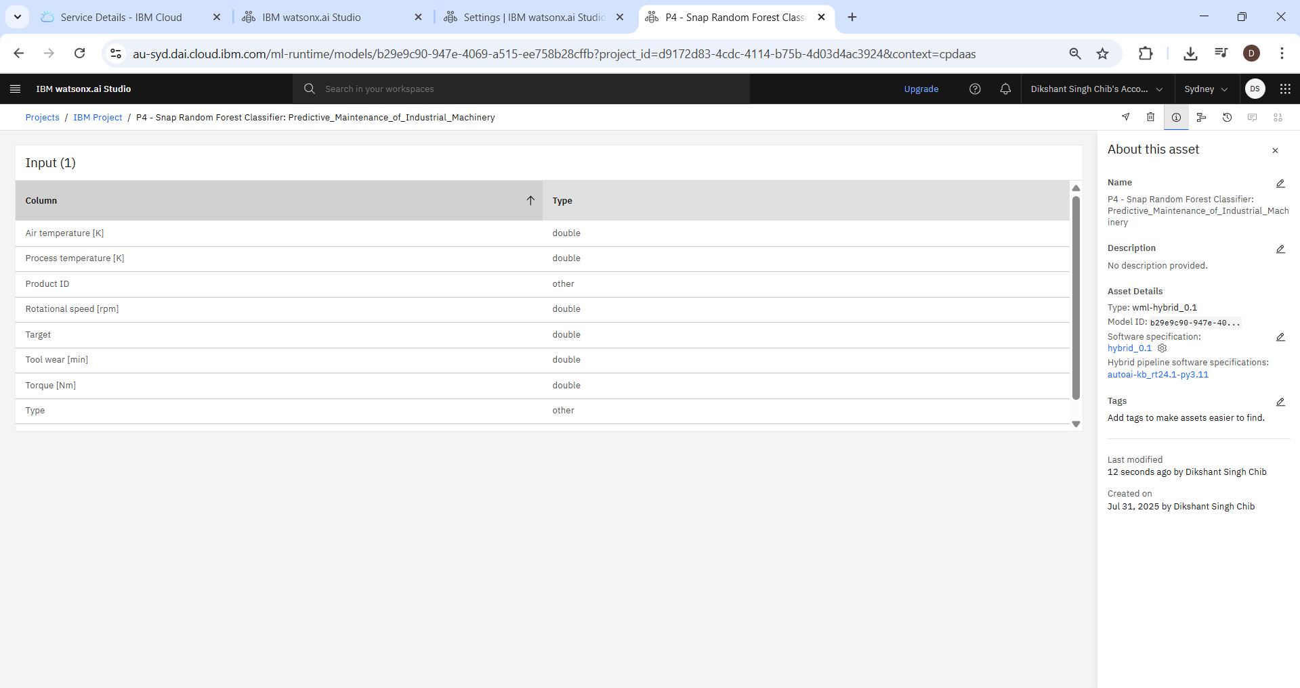
Result

Slide 11
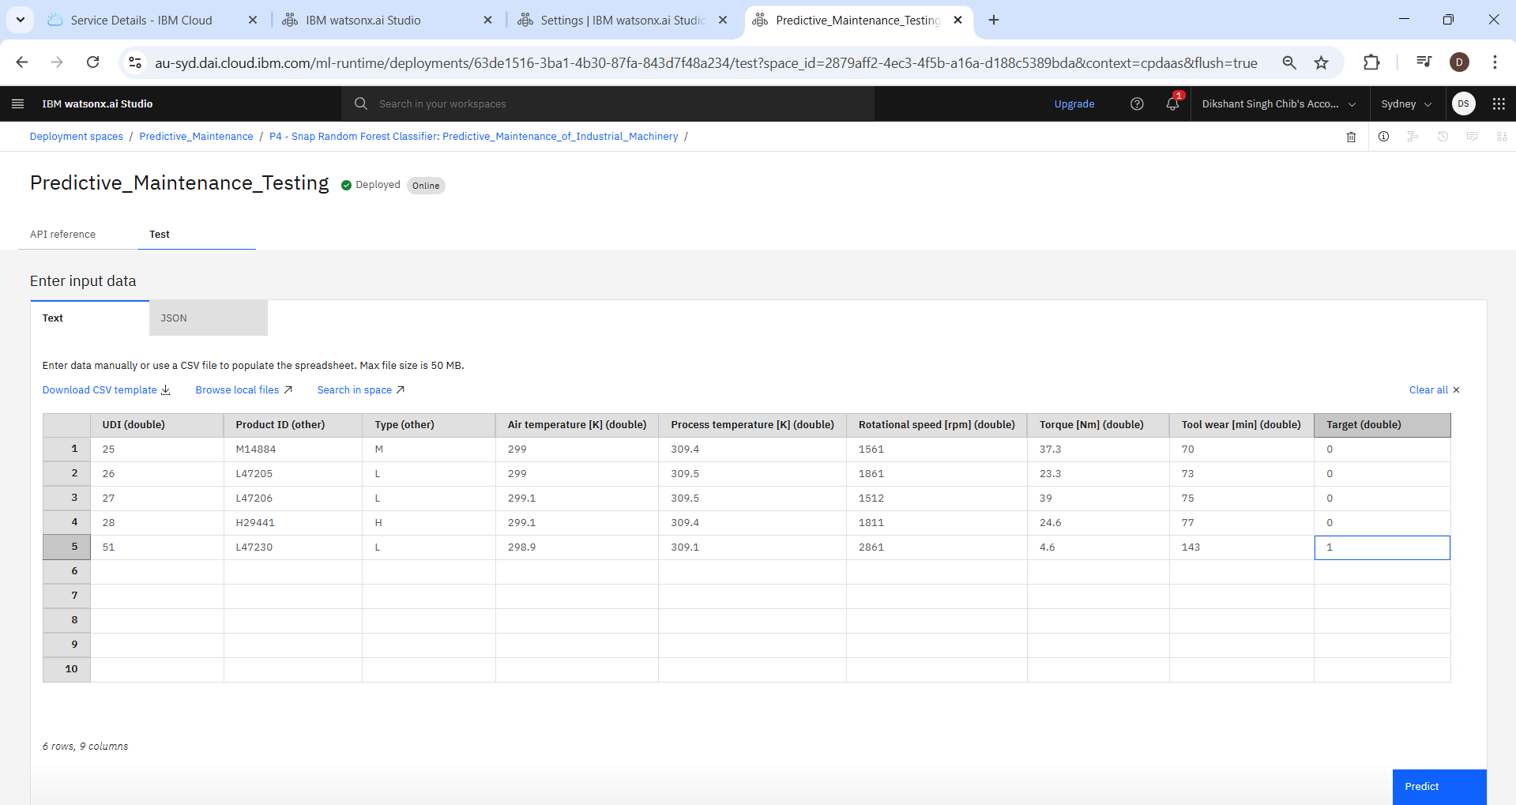
Result

Slide 12
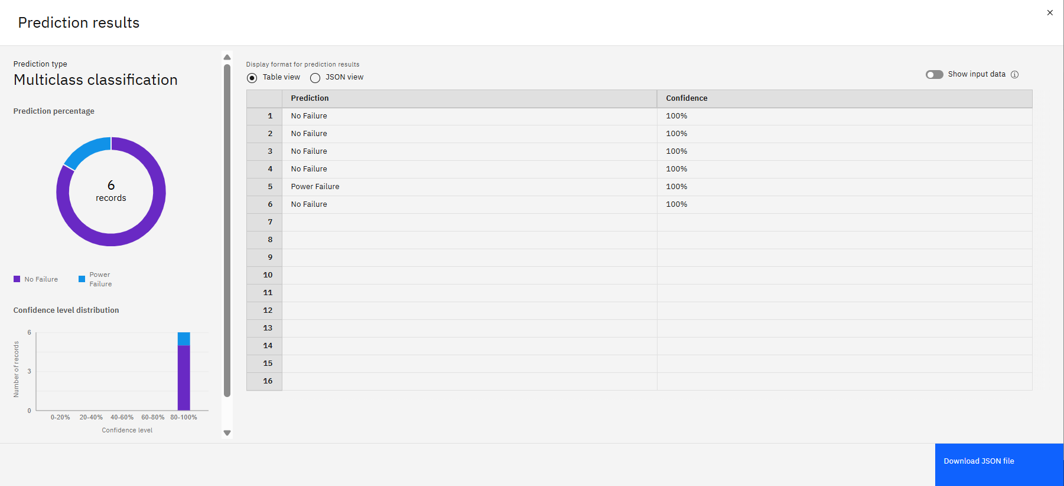
Result

Slide 13
Conclusion
The potential of machine learning in industrial maintenance planning is effectively illustrated by this study. Through the use of sophisticated classification techniques and previous sensor data, the model is able to anticipate various machine failure types with accuracy. From data ingestion to deployment, the entire development process was made simpler by the usage of IBM Cloud technologies. By taking preemptive steps, the solution helps companies minimize downtime, optimize maintenance schedules, and lower operating costs.

Slide 14
Future scope
There are numerous significant ways to grow the current system. Continuous monitoring and live failure prediction can be made possible by integration with real-time IoT sensor streams. Predictions and system health might be easily seen using a unique dashboard interface. Deploying the model at the edge, close to the machines, would also cut down on decision-making latency. For even more precise temporal failure prediction, future improvements might also incorporate time-series-based deep learning models, like LSTM.

Slide 15
References
Kaggle Dataset: Predictive Maintenance of Machines – https://www.kaggle.com/datasets/shivamb/machine-predictive-maintenance-classification
IBM Watson Studio and AutoAI Documentation – https://dataplatform.cloud.ibm.com/docs/content/wsj/getting-started/welcome-main.html?context=wx&audience=wdp
IBM Cloud Object Storage & Watson Machine Learning – IBM Cloud Services
Research Literature: IEEE papers on predictive maintenance using machine learning algorithms
Scikit-learn and ML algorithm references for theoretical understanding

Slide 16
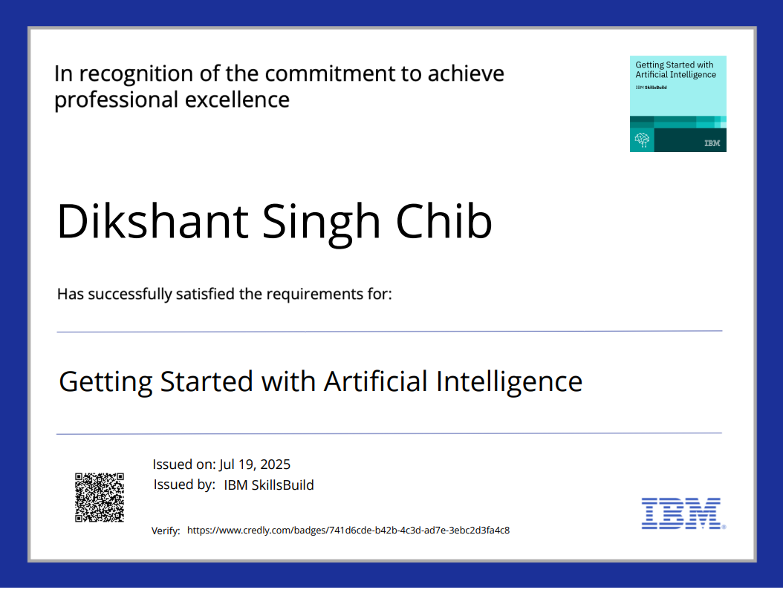
IBM Certifications

Slide 17
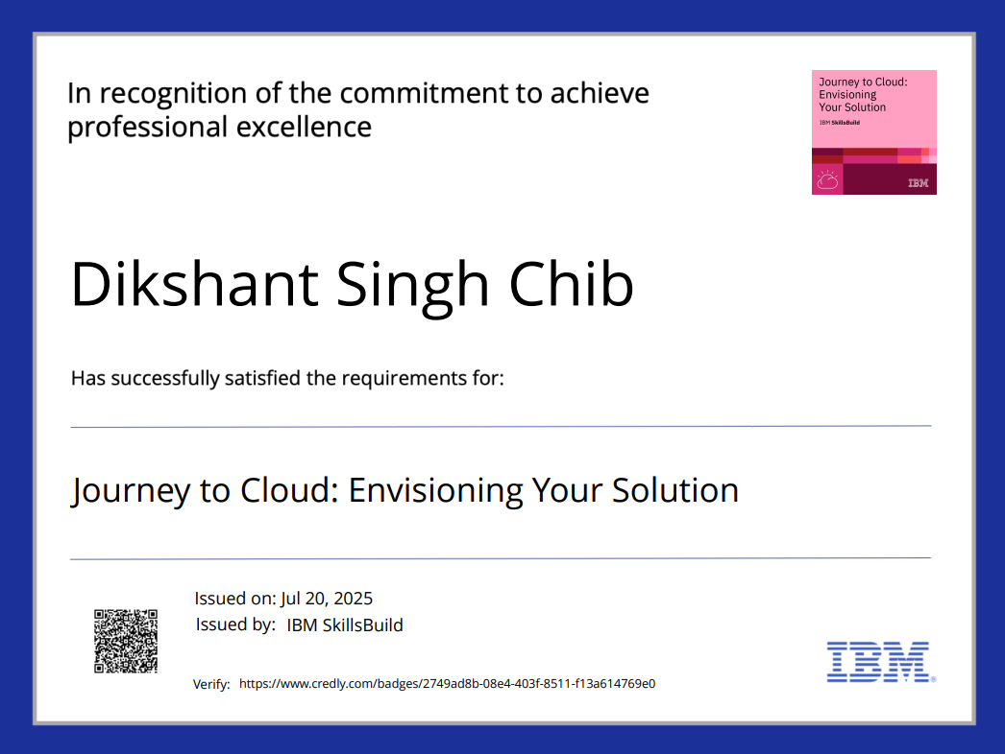
IBM Certifications

Slide 18
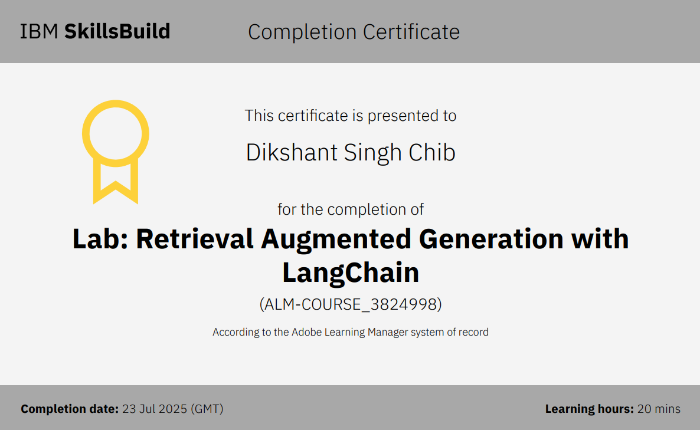
IBM Certifications

Slide 19
THANK YOU

