Slide 1


AI-BASED CREDIT SCORE IMPROVEMENT ADVISOR
Diversity & Inclusion Hackathon (2025)
Team 6:-
Diksha Verma
Mansi Negi
Nandini Maurya
Nuzha Razia

Slide 2
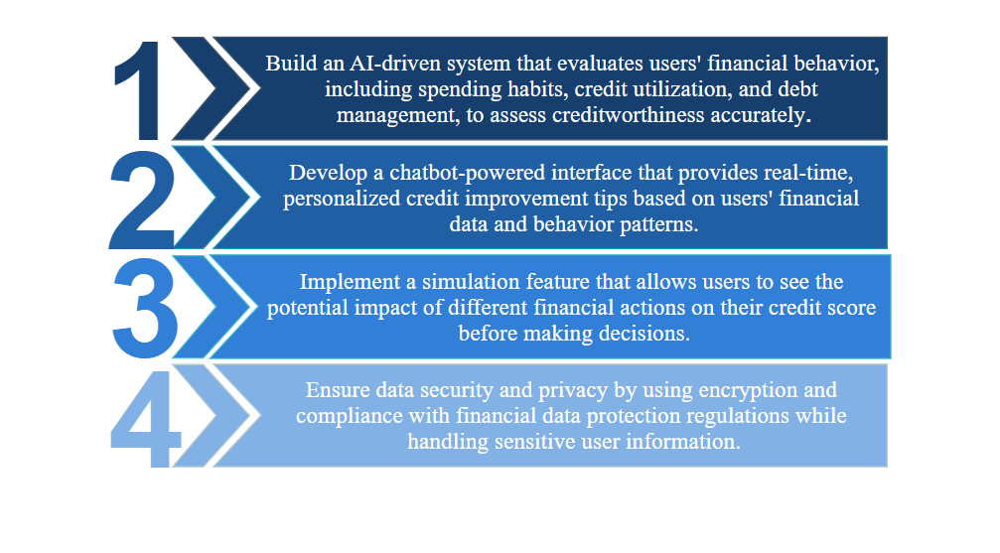
OBJECTIVES
BACK TO AGENDA PAGE

Slide 3



PROBLEM STATEMENT
Develop an AI-powered application that helps women improve their credit scores. The app
should analyze their financial behavior, provide personalized tips, and simulate the impact of
different actions on their credit score.
SOCIAL IMPACT

Slide 4
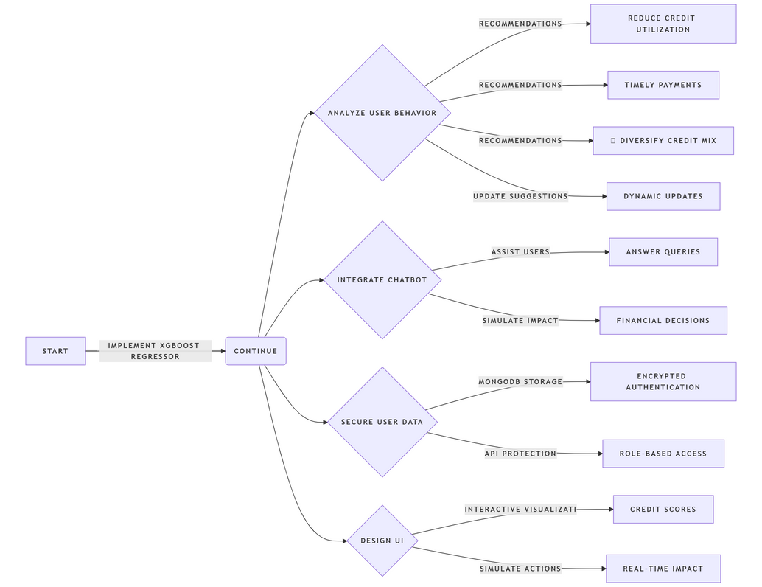
PROPOSED SOLUTION
Implement an XGBoost regressor model to predict credit scores based on key financial factors like debt-to-income ratio, credit utilization, and loan balances.Regular model updates using real financial data will enhance prediction accuracy.
Analyze user financial behavior and provide tailored recommendations, such as reducing credit utilization, making timely payments, and diversifying credit mix. The system should dynamically update suggestions based on new data.
Integrate a chatbot using Retrieval-Augmented Generation (RAG) and transformer models to assist users with credit-building strategies, answer financial queries, and simulate the impact of various financial decisions.
Use MongoDB for secure storage of user data with encrypted authentication for login and signup. Implement secure API endpoints and role-based access control to protect sensitive financial information.
Design an intuitive and interactive UI with clear visualizations of credit scores, financial insights, and future projections. Enable users to simulate different financial actions to see their impact on credit scores in real time.

Slide 5
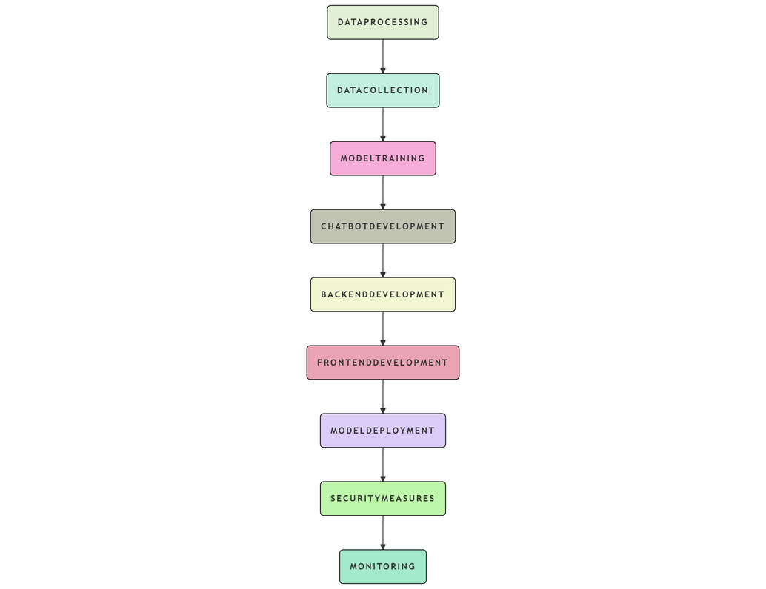
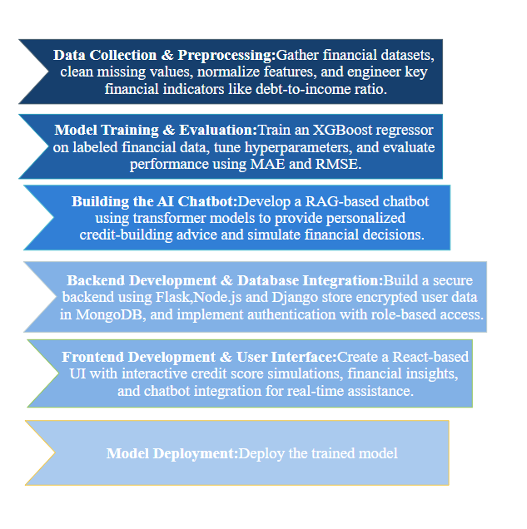
IMPLEMENTATION
We have developed two solutions to help women improve their credit scores. The first is a website featuring a credit score simulator that uses an XGBoost regressor to analyze financial behavior and predict credit scores. It provides interactive simulations, allowing users to see how different financial actions impact their credit standing while offering personalized recommendations for improvement.
The second solution is an AI-powered chatbot that leverages Retrieval-Augmented Generation (RAG) and transformer models to provide real-time financial guidance. It answers user queries, retrieves relevant insights, and offers personalized credit-building advice based on individual financial profiles, making financial literacy more accessible and engaging.
Both solutions work together to provide an intuitive and data-driven approach to credit management, offering users a seamless way to track, understand, and enhance their financial health.

Slide 6
TECHNOLOGY STACK
Hardware
High-performance CPU/GPU for AI/ML processing
Cloud servers (AWS, Azure, or Google Cloud)
Secure storage solutions for financial data
Reliable networking infrastructure for seamless connectivity
Software
Python-based libraries (NumPy, Pandas,Scikit-Learn) for data preprocessing and ML Model training
React.js for Front-End Development
Django and Express.js for Back-End Development
Mongo-DB for Data Storage
FAISS Vectorbase and Transformer library for Chatbot implementation.
Axios and mongoose for Integration
BACK TO AGENDA PAGE

Slide 7
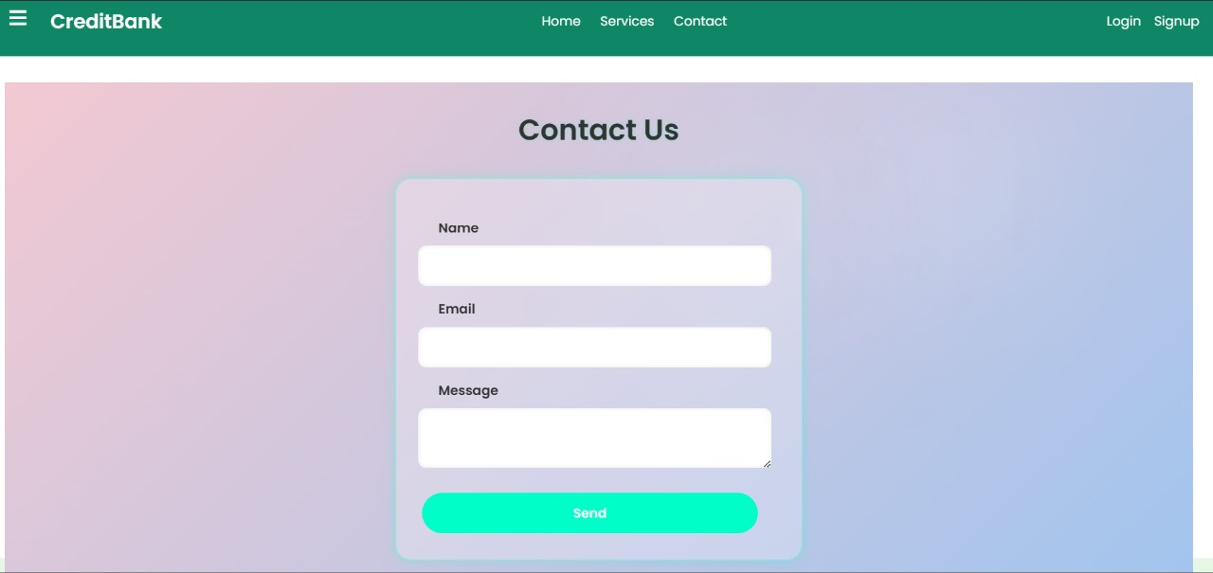
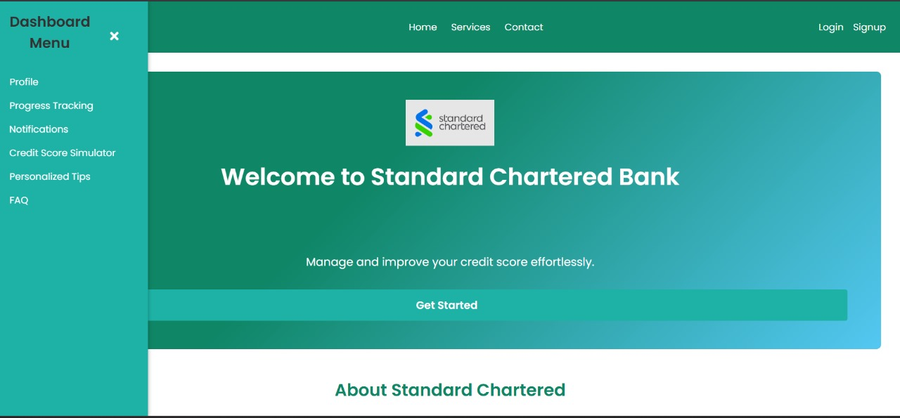
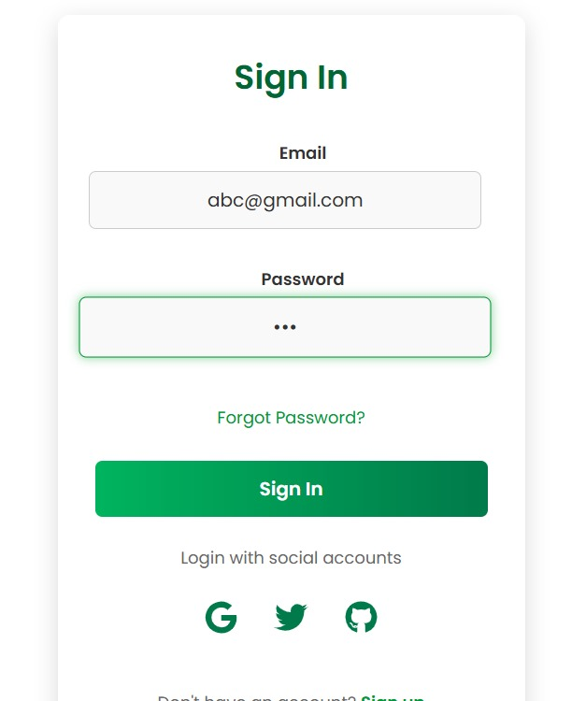
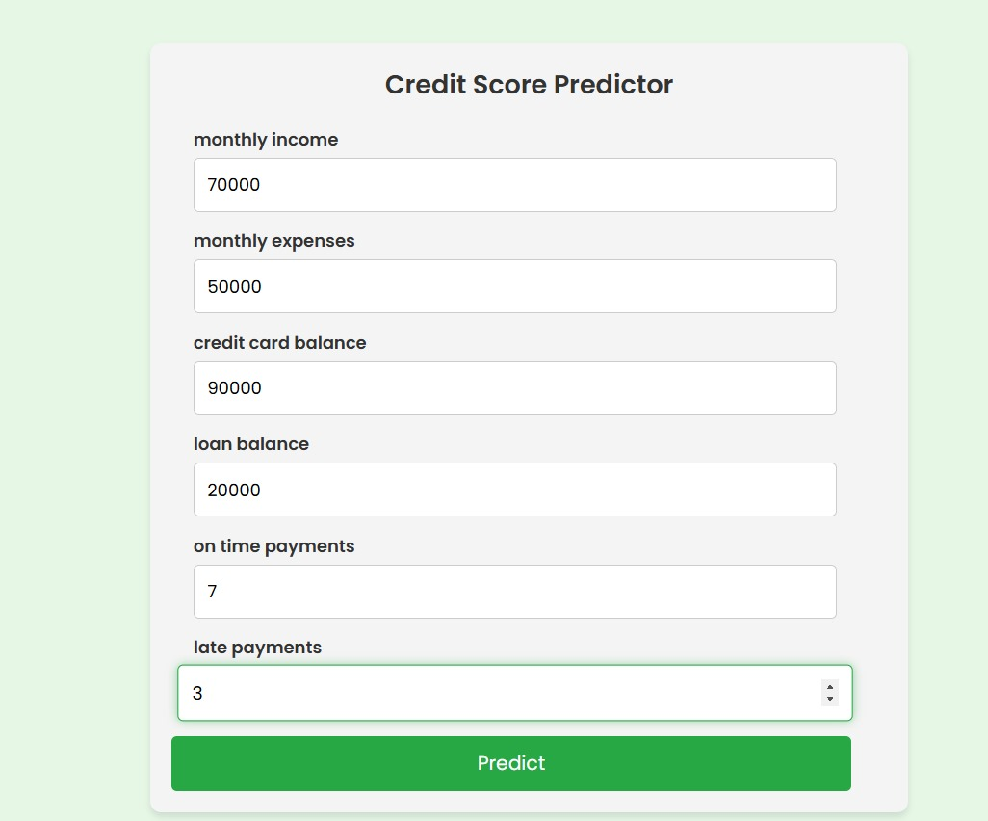
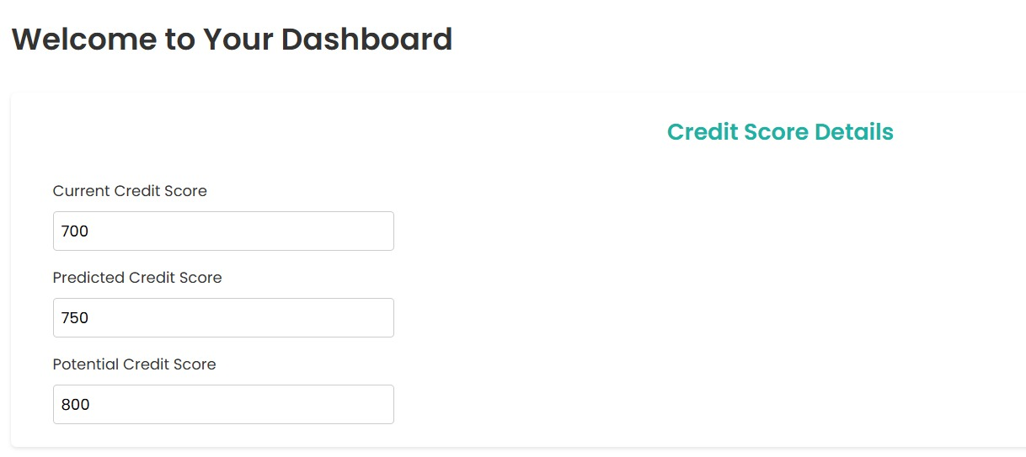
Generated Output
BACK TO AGENDA PAGE

Slide 8
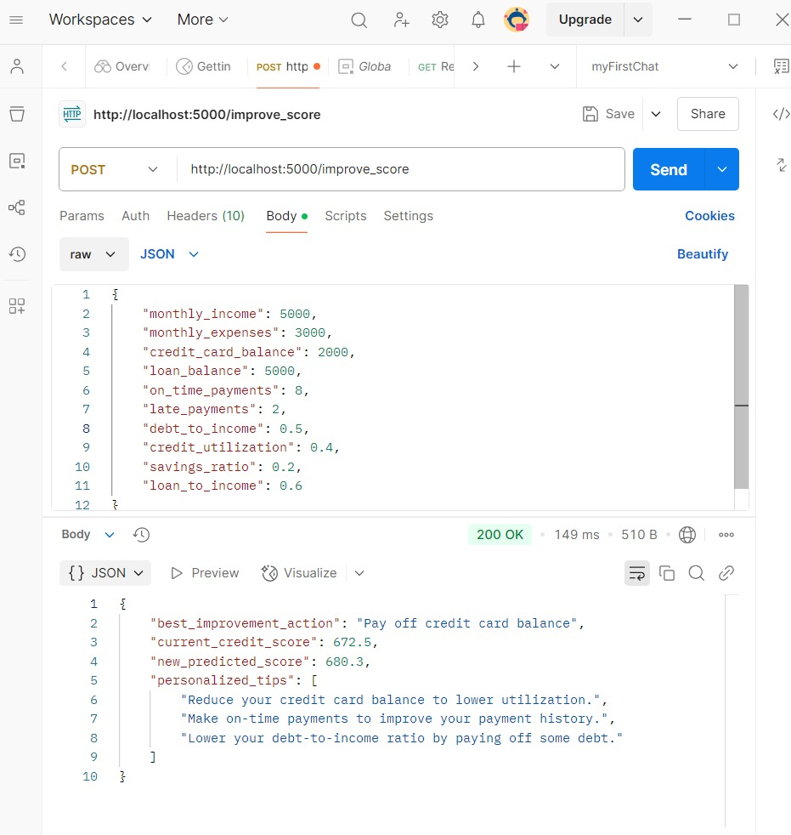
Generated Output
BACK TO AGENDA PAGE

Slide 9



CHALLENGES
CONCLUSION
This AI-powered application aims to empower women by providing personalized financial insights, helping them improve their credit scores with actionable advice. By leveraging AI and a chatbot interface, it ensures accessibility, security, and user-friendly engagement. Overcoming technical challenges will be key to delivering an effective and impactful solution.
BACK TO AGENDA PAGE

Slide 10
THANK YOU

