Slide 1

HIVE

Slide 2
Introduction
Hive is a tool which was developed to help people work with Big Data without actually needing to spend time learning MapReduce.
Hive is a “data warehouse software” that enables you to query and manipulate data using a SQL-like language known as HiveQL.
It was developed at Facebook so that people who had experience in SQL would be able to work on querying datasets without actually learning new paradigms like MapReduce or new programming languages.

Slide 3
Developers face problem in writing MapReduce logic
● How to port existing
○ relational databases
○ SQL infrastructure with Hadoop?
● End users are familiar with SQL queries than MapReduce
and Pig
● Hive’s SQL-like query language makes data churning easy

Slide 4
Key Features OF Hive
The main features of Hive are:
● An SQL-like interface to write queries on large datasets.
● Hive can be used to process all variants of data i.e. Structured, Semi-structured and Unstructured.
● A variety of built-in functions for working with dates, strings, etc.
● Easy ETL (extraction, transformation, and loading) of data.

Slide 5
HIVE architecture

Slide 6
Architecture of hive
User Interface - Hive is a data warehouse infrastructure software that can create interaction between user and HDFS. The user interfaces that Hive supports are Hive Web UI, Hive command line, and Hive HD Insight
Meta Store -Hive chooses respective database servers to store the schema or Metadata of tables, databases, columns in a table, their data types and HDFS mapping.
HiveQL Process Engine- HiveQL is similar to SQL for querying on schema info on the Megastore. It is one of the replacements of traditional approach for MapReduce program. Instead of writing MapReduce program in Java, we can write a query for MapReduce job and process it.

Slide 7
Architecture of hive
Execution Engine - The conjunction part of HiveQL process Engine and MapReduce is Hive Execution Engine. Execution engine processes the query and generates results as same as MapReduce results. It uses the flavour of MapReduce.
HDFS or HBASE - Hadoop distributed file system or HBASE are the data storage techniques to store data into the file system

Slide 9
Working of hive

Slide 10
Working
Execute Query- The Hive interface such as Command Line or Web UI sends query Driver to execute.
Get Plan- The driver takes the help of query complier that parses the query to check the syntax and query plan or the requirement of query.
Get Metadata- The compiler sends metadata request to Megastore
Send Metadata- Megastore sends metadata as a response to the compiler.

Slide 11
Send Plan- The compiler checks the requirement and resends the plan to the driver. Up to here, the parsing and compiling of a query is complete.
Execute Plan- the driver sends the execute plan to the execution engine.
Execute Job- Internally, the process of execution job is a MapReduce job. The execution engine sends the job to JobTracker, which is in Name node and it assigns this job to TaskTracker, which is in Data node. Here, the query executes MapReduce job.

Slide 12
Metadata Ops- Meanwhile in execution, the execution engine can execute metadata operations with Megastore.
Fetch Result- The execution engine receives the results from Data nodes.
Send Results- The execution engine sends those resultant values to the driver.
Send Results- The driver sends the results to Hive Interfaces.

Slide 13
Hive data types and data models
Hive stores and queries data using its data models. The purpose of using data models is to make querying convenient and fast.
There are four main components in Hive data models, which are similar to how an RDBMS stores data:
1. Databases
2. Tables
3. Partitions
4. Buckets

Slide 14
Tables in hive
Let’s start with tables. Hive has two types of tables:
● Managed (or internal) table
● External table
Note: 'Managed table' and the 'internal table' are synonymous terms.

Slide 15
You should use external tables when:
● You want to use the data outside of Hive as well. For example, when another existing program is running on the same cluster.
● You want the data to remain stored on the HDFS even after dropping tables because Hive does not delete the data stored outside (of the Hive database).
● You do not want Hive to control the storage of your data (location/directories of storage/etc.).

Slide 16
You use managed tables when:
● The data is temporary. So, when the Hive table is dropped, the data stored in the internal table is deleted along with the metadata
● You want Hive to manage the life cycle of the data completely, i.e. both store and process it

Slide 17
Hive data types
All the data types in hive are classified into four types
Column Types
Literals
Null Values
Complex Types

Slide 18
Integer Types - Integer type data can be specified using integral data types, INT. When the data range exceeds the range of INT, you need to use BIGINT and if the data range is smaller than the INT, you use SMALLINT. TINYINT is smaller than SMALLINT.
String Types - String type data types can be specified using single quotes (' ') or double quotes (" "). It contains two data types: VARCHAR and CHAR. Hive follows C-types escape characters.

Slide 19
Timestamp - It supports traditional UNIX timestamp with optional nanosecond precision. It supports java.sql.Timestamp format “YYYY-MM-DD HH:MM:SS.fffffffff” and format “yyyy-mmdd hh:mm:ss.ffffffffff”.
Dates - DATE values are described in year/month/day format in the form {{YYYY-MM-DD}}.
Decimals -The DECIMAL type in Hive is as same as Big Decimal format of Java. It is used for representing immutable arbitrary precision.
Union Types - Union is a collection of heterogeneous data types.You can create an instance using create union.

Slide 20
literals
Floating Point Types - Floating point types are nothing but numbers with decimal points. Generally, this type of data is composed of DOUBLE data type.
Decimal Type - Decimal type data is nothing but floating point value with higher range than DOUBLE data type. The range of decimal type is approximately -10-308 to 10308.

Slide 21
Complex types
Arrays - Arrays in Hive are used the same way they are used in Java.
Syntax: ARRAY<data_type>
Maps - Maps in Hive are similar to Java Maps.
Syntax: MAP<primitive_type, data_type>
Structs - Structs in Hive is similar to using complex data with comment.
Syntax: STRUCT<col_name : data_type [ COMMENT col_comment, … ]>

Slide 22
Hive Schemas
Hive is schema-on-read
Schema is only enforced when the data is read (at query time)
Allows greater flexibility: same data can be read using multiple schemas
Contrast with an RDBMS, which is schema-on-write
Schema is enforced when the data is loaded
Speeds up queries at the expense of load times

Slide 23
HIVE DDL
Create Database Statement
A database in Hive is a namespace or a collection of tables.
hive> CREATE SCHEMA userdb;
hive> SHOW DATABASES;
Drop database
hive> DROP DATABASE IF EXISTS userdb;

Slide 24
Creating Hive Tables
Create a table called T with two columns, the first being an integer and the other a string.
hive> CREATE TABLE T(a INT, b STRING);

Slide 25
Create Table Syntax
CREATE TABLE table_name
(col1 data_type,
col2 data_type,
col3 data_type,
col4 datatype )
ROW FORMAT DELIMITED
FIELDS TERMINATED BY ','
STORED AS format_type;

Slide 26
Simple Table
CREATE TABLE page_view
(viewTime INT,
userid BIGINT,
page_url STRING,
referrer_url STRING,
ip STRING COMMENT 'IP Address of the User' )
ROW FORMAT DELIMITED
FIELDS TERMINATED BY '\t'
STORED AS TEXTFILE;

Slide 27
More Complex Table
CREATE TABLE employees (
(name STRING,
salary FLOAT,
subordinates ARRAY<STRING>,
deductions MAP<STRING, FLOAT>,
address STRUCT<street:STRING,
city:STRING,
state:STRING,
zip:INT>)
ROW FORMAT DELIMITED
FIELDS TERMINATED BY '\t'
STORED AS TEXTFILE;

Slide 28
External Table
CREATE EXTERNAL TABLE page_view_stg
(viewTime INT,
userid BIGINT,
page_url STRING,
referrer_url STRING,
ip STRING COMMENT 'IP Address of the User') ROW FORMAT DELIMITED
FIELDS TERMINATED BY '\t'
STORED AS TEXTFILE
LOCATION '/user/staging/page_view';

Slide 29
Altering and Dropping Tables
hive> ALTER TABLE T RENAME TO K;
hive> ALTER TABLE K ADD COLUMNS (col INT);
hive> ALTER TABLE HIVE_TABLE ADD COLUMNS (col1 INT COMMENT 'a comment');

Slide 30
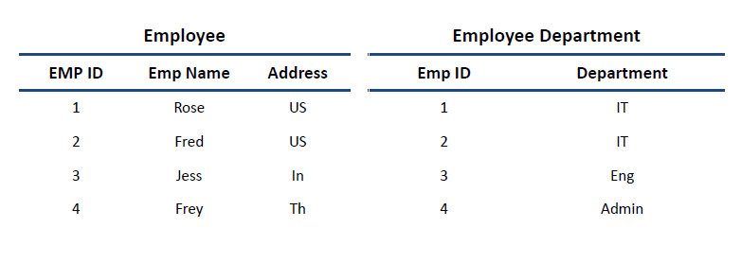
DML
To understand the Hive DML commands, let's see the employee and employee_department table first.

Slide 31
DML commands
LOAD DATA
hive> LOAD DATA LOCAL INPATH './usr/Desktop/kv1.txt' OVERWRITE INTO TABLE Employee;
SELECTS and FILTERS
hive> SELECT E.EMP_ID FROM Employee E WHERE E.Address='US';
GROUP BY
hive> SELECT E.EMP_ID FROM Employee E GROUP BY E.Addresss;

Slide 32
Sort by
Hive sort by and order by commands are used to fetch data in sorted order. The main differences between sort by and order by commands are given below.
hive> SELECT E.EMP_ID FROM Employee E SORT BY E.empid;
May use multiple reducers for final output.
Only guarantees ordering of rows within a reducer.
May give partially ordered result.

Slide 33
Order by
hive> SELECT E.EMP_ID FROM Employee E order BY E.empid;
Uses single reducer to guarantee total order in output.
LIMIT can be used to minimize sort time.

Slide 34
JOINS

Slide 35
INNER & LEFT OUTER
Inner joins
Select * from employee join employeedepartment ON (employee.empid=employeedepartment.empId)
Left outer joins
Select e.empId, empName, department from employee e Left outer join employeedepartment ed on(e.empId=ed.empId);

Slide 36
RIGHT OUTER & FULL OUTER JOIN
Right outer joins
Select e.empId, empName, department from employee e Right outer join employee department ed on(e.empId=ed.empId);
Full outer joins
Select e.empId, empName, department from employee e FULL outer join employee department ed on(e.empId=ed.emp);

Slide 37
More hive queries
AlexRon,123,Mathematics#Physics#Chemistry#MolecularBiology,semseterfee|18000.50#labfee|1000#examfee|2500,011#1023550456
Alexa,111,Mathematics#Physics#English#ComputerScience,semseterfee|17000.50#labfee|2000#examfee|3500,012#1045550451
Derek,143,Mathematics#Physics#Geography#MolecularBiology,semseterfee|20000.50#labfee|1500#examfee|2200,014#34523550456
Dona,115,Chemistry#Physics#English#ComputerScience,semseterfee|17400.40#labfee|1000#examfee|1500,011#10455545251
(let the name of the above data file is student.dat)

Slide 38
1. To create the table from the data use the below query
CREATE TABLE IF NOT EXISTS students (name STRING ,id INT ,subjects ARRAY < STRING >,feeDetails MAP < STRING , FLOAT >,phoneNumber STRUCT <areacode: INT , number : INT > )
ROW FORMAT DELIMITED
FIELDS TERMINATED BY ','
COLLECTION ITEMS TERMINATED BY '#'
MAP KEYS TERMINATED BY '|'
LINES TERMINATED BY '\n'
STORED AS TEXTFILE;

Slide 39
2. Load the data into the table (if stored on HDFS) , remember this will move the file to
load data inpath 'add path to your file here' overwrite into table students;
Note: If you are using the file located on your local directory you will need to use the below query.
load data local inpath 'add path to your file here' overwrite into table students;

Slide 40
3. To verify if the data has been loaded correctly use the below query
Select * FROM students;

Slide 41
EXPLODE FUNCTION
explode(ARRAY<T> a)
Explodes an array to multiple rows. Returns a row-set with a single column (col), one row for each element from the array.
explode(MAP<Tkey,Tvalue> m)
Explodes a map to multiple rows. Returns a row-set with a two columns (key,value) , one row for each key-value pair from the input map.
posexplode(ARRAY<T> a)
Explodes an array to multiple rows with additional positional column of int type (position of items in the original array, starting with 0). Returns a row-set with two columns (pos,val), one row for each element from the array.
inline(ARRAY<STRUCT<f1:T1,...,fn:Tn>> a)
Explodes an array of structs to multiple rows. Returns a row-set with N columns (N = number of top level elements in the struct), one row per struct from the array.

Slide 42
Using Advanced Functions
1. Explode()
Select explode(feedetails) FROM students;
Select explode(subjects) FROM students;
Select explode(feedetails) FROM students WHERE name = "Alexa" ;
2. Upper()
Select upper ( name ) from students;
3. Regex_Replace()
Select regexp_replace( concat ( upper ( name ), id ), ' ' , '' ) as username from students;

Slide 43
Nested query example
1. Query to determine the set of students having lab fees greater than 1000
Select name , feeDetails[ 'labfee' ] from students where feeDetails[ 'labfee' ] > 1000 ;
2. Assume that the labfees are getting hiked by 20% and you would like to see the projected values in case it is greater than 1500.
Select name , feeDetails[ 'labfee' ]* 1.2 as projected_fee from students where feeDetails[ 'labfee' ]* 1.2 > 1500 ;
FROM
( SELECT name , feeDetails[ 'labfee' ]* 1.2 as projected_fee from
students) newfee
SELECT newfee.name where newfee.projected_fee > 1500 ;

Slide 44
Partitioning and bucketing
Partitioning : Partitions are used to make queries faster by dividing the tables into smaller parts using partition key columns.
( For example, if in a table with details of employees in a company(name, salary, department, designation), you can create a partition for each department. Hive will store each partition separately and will scan only the partition that is needed, thereby making the query faster.)
2. Bucketing : Like partitioning, bucketing also divides the data into smaller and more manageable parts. The key difference between partitioning and bucketing is bucketing uses the hash of a column to create multiple 'buckets', whereas partitions are more straightforward - they are simply segmented directories according to the value of a column (year, month etc.).

Slide 45
Partitioning and clustering
For creating partitions, "PARTITIONED BY" clause is used. Similarly for creating buckets, "CLUSTERED BY“ clause is used.
Guidelines for when to use partitioning and bucketing:
● You typically perform partitioning on columns (or groups of columns) such that it produces a manageable number of partitions (directories), such as year, month, state, country etc.
● However, if you partition on say customer ID, the number of partitions will be enormous and may actually reduce performance; thus, you can choose to create buckets on customer ID
Partitioning is of two types :Static and Dynamic Partitioning

Slide 46
Static Partitioning example
1. To create table use the below query
CREATE TABLE IF NOT EXISTS customer_partitioned(customer_fname varchar ( 64),customer_lname varchar ( 64 ),customer_addr string ,city varchar ( 64 ))PARTITIONED BY (country VARCHAR ( 64 ),state VARCHAR ( 64 ))
ROW FORMAT DELIMITED
FIELDS TERMINATED BY ','
STORED AS TEXTFILE;

Slide 47
Static partiTIoning
2. To load data into the table use the below command
LOAD DATA LOCAL INPATH 'yourfilepath'
INTO TABLE customer_partitioned
PARTITION (country= 'usa' , state= 'az’ );

Slide 48
Dynamic partitioning example
1. To create table use the below query
CREATE TABLE customer(customer_fname VARCHAR(64),customer_lname
VARCHAR(64),customer_addr STRING,city VARCHAR(64),state
VARCHAR(64),country VARCHAR(64)) ROW FORMAT DELIMITED FIELDS
TERMINATED BY ‘,’ STORED AS TEXTFILE;

Slide 49
2. To load data into the table use the below command
LOAD DATA LOCAL INPATH 'yourdatapath' INTO TABLE customer ;
3. By default, dynamic partitioning is disabled in Hive to prevent accidental partition creation. To enable, we use:
set hive.exec.dynamic.partition = true ;
set hive.exec.dynamic.partition.mode=nonstrict;

Slide 50
4. Create a partitioned table using the below query
CREATE TABLE partitioned_customer(customer_fname
varchar ( 64 ),customer_lname varchar ( 64 ),customer_addr string ,city
varchar ( 64 ))PARTITIONED BY (country VARCHAR ( 64 ),state VARCHAR ( 64 ));

Slide 51
5. Load data into the partitioned table using the previously created normal table
Insert into table partitioned_customer partition (country,state) select customer_fname,customer_lname,customer_addr,city,country,state from
customer;
6. To show all the partitions
show partitions partitioned_customer;

Slide 52
7. Simple select query using partition
Select * from partitioned_customer where state= 'az' and country= 'usa' ;
8. If you want to drop any partitions, it can be done as:
ALTER Table partitioned_customer DROP IF EXISTS PARTITION (country= 'usa' ,
state= 'nw' ,);
9. If you need to change the file to be referred by a partition you can use the below query
ALTER TABLE customer_partitioned PARTITION (country= 'usa' ,state= 'az' ) SET
LOCATION 'newpath' ;

Slide 53
One more example of partitioning
Creation of table all states with 3 column names such as state, district, and enrollment
Loading data into table all states
Creation of partition table with state as partition key
In this step Setting partition mode as non-strict( This mode will activate dynamic partition mode)
Loading data into partition tablestate_part
Actual processing and formation of partition tables based on state as partition key
There is going to 38 partition outputs in HDFS storage with the file name as state name

Slide 54
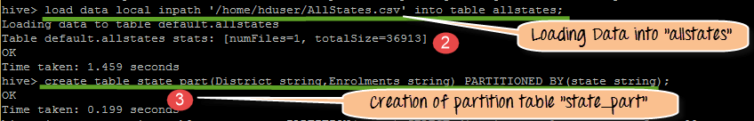

Slide 55
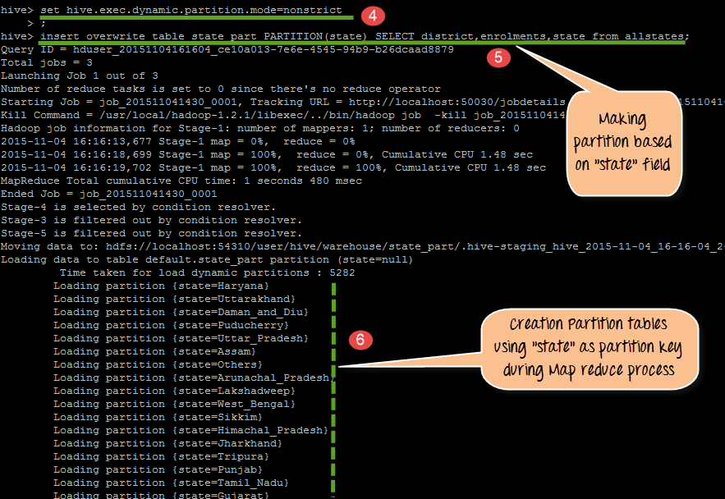

Slide 56
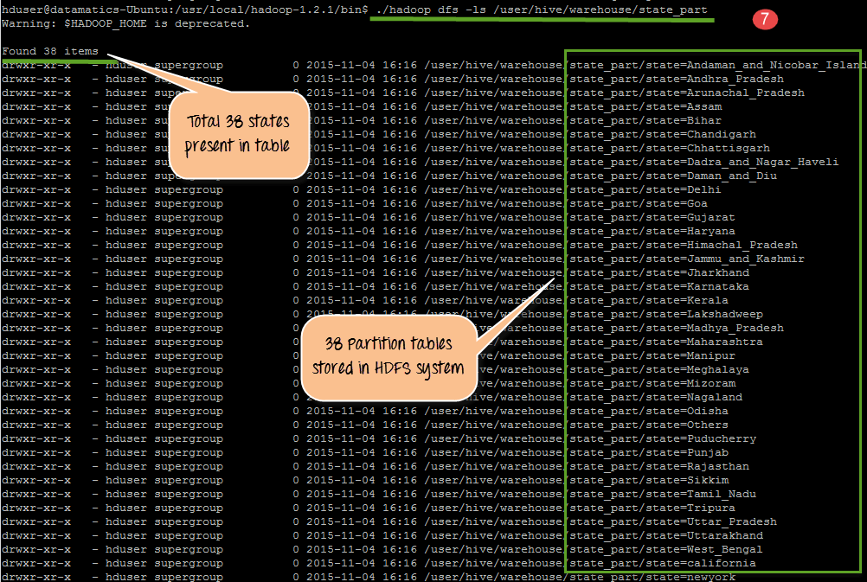

Slide 57
Bucketing
Buckets in hive is used in segregating of hive table-data into multiple files or directories. it is used for efficient querying.
The data i.e. present in that partitions can be divided further into Buckets
The division is performed based on Hash of particular columns that we selected in the table.
Buckets use some form of Hashing algorithm at back end to read each record and place it into buckets
In Hive, we have to enable buckets by using the set.hive.enforce.bucketing=true;

Slide 58
Bucketing example
1. To create a normal table use the below query
CREATE TABLE IF NOT EXISTS products_input(productid int ,transactiondate date ,amount int , store string ) ROW FORMAT DELIMITED FIELDS TERMINATED BY ',' STORED AS TEXTFILE;

Slide 59
2. To load data into the table use the below command
load data inpath 'yourdatapath' into table products_input;
3. To enable bucketing use:
set hive.exec.dynamic.partition.mode=nonstrict;
set hive.exec.dynamic.partition= true ;
set hive.enforce.bucketing= true ;

Slide 60
4. Create a bucketed table using the below query
CREATE TABLE IF NOT EXISTS products_bucket(productid
int ,amount int ) PARTITIONED BY ( store String ,transactiondate date ) CLUSTERED
BY (productid) into 4 buckets
ROW FORMAT DELIMITED
FIELDS TERMINATED BY ','
STORED AS TEXTFILE;

Slide 61
5. Load data into the bucketed table using the previously created normal table
insert into table products_bucket partition ( store ,transactiondate) select
productid,amount, store ,transactiondate from products_input;
6. Simple select query using buckets
select * from products_bucket where store = "walmart" and
transactiondate= "2018-01-01" and productid = 123 ;

Slide 62
7. Select query for comparison
select * from products_input where store = "walmart" and transactiondate= "2018-01-01" and productid = 123 ;

Slide 63
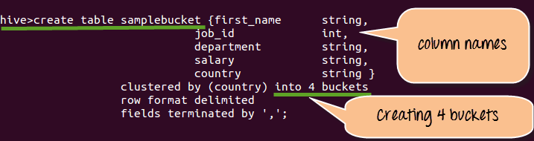
1. create samplebucket with column names as first_name, job_id, department, salary and country .

Slide 64
2. Loading Data into table sample bucket

Slide 65
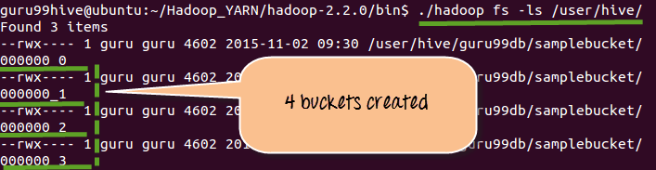
3. Displaying 4 buckets that created in Step 1

Slide 66
UDFs(User defined functions) in hive
User Defined Functions, also known as UDF, allow you to create custom functions to process records or groups of records.
To write a simple UDF:
Extend the org.apache.hadoop.hive.ql.exec.UDF class
Write an "evaluate" method that has a signature equivalent to the signature of your UDF in HiveQL.

Slide 67
Simple udf example
package udfs;
import org.apache.Hadoop.ql.exec.UDF;
class SimpleUDFExample extends UDF
{ public Text evaluate(Text input)
{ if (input==null) return null;
return new Text("Hello " + input.toString()); } }
hive> ADD JAR /root/hivedemo/hello.jar;
hive> CREATE TEMPORARY FUNCTION helloworld as ‘udfs.SimpleUDFExample’;
hive> select helloworld(name) from tablename limit 1000;

Slide 68
/** A simple UDF to convert Celcius to Fahrenheit */
package p;
import org.apache.Hadoop.ql.exec.UDF;
public class ConvertToCelcius extends UDF
{ public double evaluate(double value)
{ return (value - 32) / 1.8; } }
hive> add jar temperature.jar
hive> create temporary function fahrenheit_to_celcius using “p.hive.udf.ConvertToCelcius“; hive> SELECT fahrenheit_to_celcius(temp_fahrenheit) from temperature_data;

Slide 69
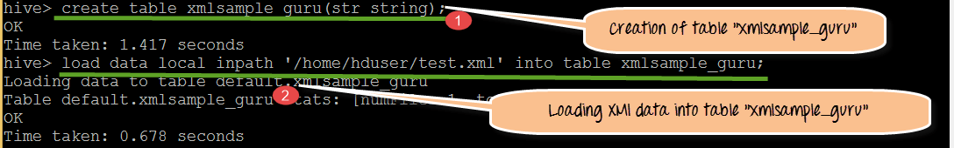
Working with Semi structured data using Hive (XML, JSON)
Step 1) Creation of Table "xmlsample_guru" with str column with string data type.

Slide 70
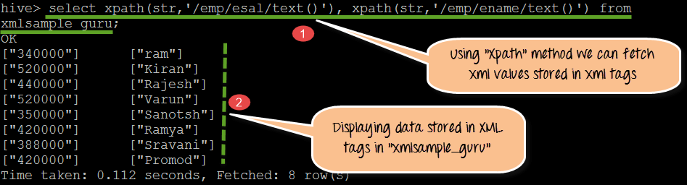
Step 2) Using XPath () method we will be able to fetch the data stored inside XML tags.

Slide 71
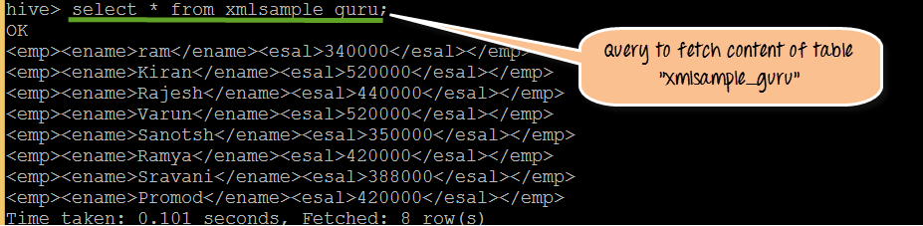
Step 3) In this step, we will fetch and display the Raw XML of table "xmlsample_guru."

Slide 72
Json format
Twitter and websites data is stored in JSON format.
Whenever we try to fetch data from online servers it will return JSON files.
Using Hive as data store we can able to load JSON data into Hive tables by creating schemas.

Slide 73
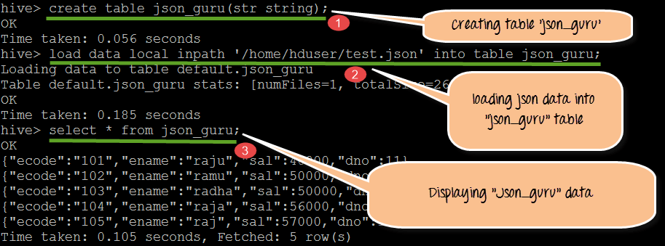
Step 1) In this step, we are going to create JSON table name "json_guru". Once created loading and displaying contents of the actual schema.

Slide 74
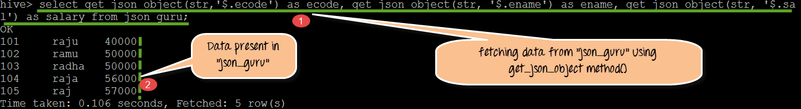
Step 2) Using get_json_object() Method we can able to fetch the Data values stored in JSON hierarchy

