Slide 1
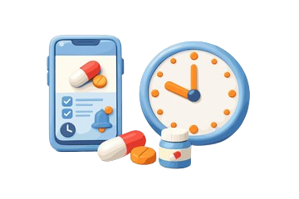
Care Buddy App
Submitted By: Pun Sharada (2577513) | Rana Yugal (2577502) | Pokhrel Sohan (2577512) | Giri Dikshit (2577501)
Submitted To: Prof. Ibrahim Musa | Dongshin University | Dept. of Software Convergence
Date: April , 2026

Slide 2
Agenda
01
Problem Statement
02
Introduction & Scope
Why this app is needed
What the app does
03
04
Functional Requirements
UI/UX Requirements
Core features
Design principles
05
06
Non-Functional Requirements
Data Model
Performance & privacy
Entities & attributes
07
08
User Workflow
Future Scope
Step-by-step scenario
Roadmap ahead
09
10
Requirement Traceability Matrix
Gantt Chart

Slide 3
Problem Statement
⚠️
📋
Missed Doses
No Centralized Tracking
Many patients forget to take medications on time, leading to treatment failure or health complications.
People managing multiple medications lack a single tool to organize schedules and types efficiently.
🔕
📊
No Smart Alerts
No Adherence History
Generic calendar/alarm apps don't understand medication schedules or recurring interval-based dosing.
There is no easy way to monitor past intake patterns or share records with healthcare providers.

Slide 4
Introduction & Scope
What is Care Buddy?
Scope
Care Buddy a Kotlin-based Android mobile application that helps users:
Platform:
Android (Kotlin)
✔ Manage medication schedules
Target Users:
Patients & caregivers
✔ Set smart reminders & alerts
Med Types:
Tablet, Capsule, Syrup, Drops, Spray, Gel
✔ Track intake adherence
Schedule:
Daily / Interval-based
✔ Review medication history
Notifications:
Push alerts with ±30s accuracy

Slide 5
Functional Requirements
💊 Medication Onboarding
📅 Scheduling & Frequency
• Enter Medication Name
• Select frequency (Daily / Every N Days)
• Select Type (Tablet/Capsule/Syrup/Drops/Spray/Gel)
• Set Duration via calendar (Start–End Date)
• Optional Dose Amount (e.g. '1', '5ml')
• Add multiple time slots per medication
🔔 Notification System
📊 Dashboard & Tracking
• Push notifications based on schedule
• Home screen: horizontal weekly calendar
• Summary before confirming (e.g. '14 alerts scheduled')
• 'Medication Break' state for empty days
• History tab for past adherence tracking

Slide 6
UI/UX Requirements
🧭
🎨
♿
Navigation
Visual Feedback
Accessibility
Bottom navigation bar with Home and History icons for quick access.
Active calendar dates highlighted (e.g. April 06 styled distinctly).
High-contrast buttons in dark purple with clear medication type icons.
📱
📋
💡
Responsive Layout
Confirmation Summary
Intuitive Onboarding
Optimized for various Android screen sizes and resolutions.
'All Done!' summary screen before finalizing each medication entry.
New user can add a medication in under 60 seconds.

Slide 7
Non-Functional Requirements
⚡
🔔
👤
🔒
< 2s
±30s
< 60s
GDPR/HIPAA
Performance
Reliability
Usability
Data Privacy
App loads daily schedule in under 2 seconds
Notifications trigger within 30 seconds of scheduled time
New user adds a medication in under 60 seconds
User data stored securely per health data regulations

Slide 8
Data Model (Conceptual)
🗂 User
🗂 Medication
UserID • Name • Settings
MedID • Name • Type (Enum) • Dosage • Frequency
🗂 Schedule
🗂 Log
ScheduleID • MedID • StartDate • EndDate • AlertTimes[ ]
LogID • MedID • TakenTime • Status (Taken/Missed)

Slide 9
User Workflow (Scenario)
1
2
3
Open App
Enter Details
Set Schedule
User taps 'Add Medication' on the Home screen
Input name (e.g. 'Fever'), select type (Tablet / Capsule / Syrup / Drops / Spray / Gel)
Choose frequency (e.g. 'Every 2 Days') and duration (Start – End date)
4
5
6
Set Time
Review & Confirm
Track Daily
Add specific time slot(s) for the dose (e.g. '10:10 PM')
System shows 'All Done!' summary with scheduled alerts; user confirms
Home screen shows weekly calendar; History tab logs all past intake

Slide 10
Future Scope
🤖
👨‍⚕️
📈
AI Drug Interaction
Doctor Integration
Analytics Dashboard
Warn users about potential interactions between multiple medications.
Allow physicians to remotely update prescriptions and track compliance.
Visual adherence reports and trends over weeks/months.
⌚
🌐
☁️
Wearable Sync
Multi-Language
Cloud Backup
Sync with smartwatches for haptic medication reminders.
Localization support for non-English speaking users globally.
Securely backup and sync medication data across devices.

Slide 11
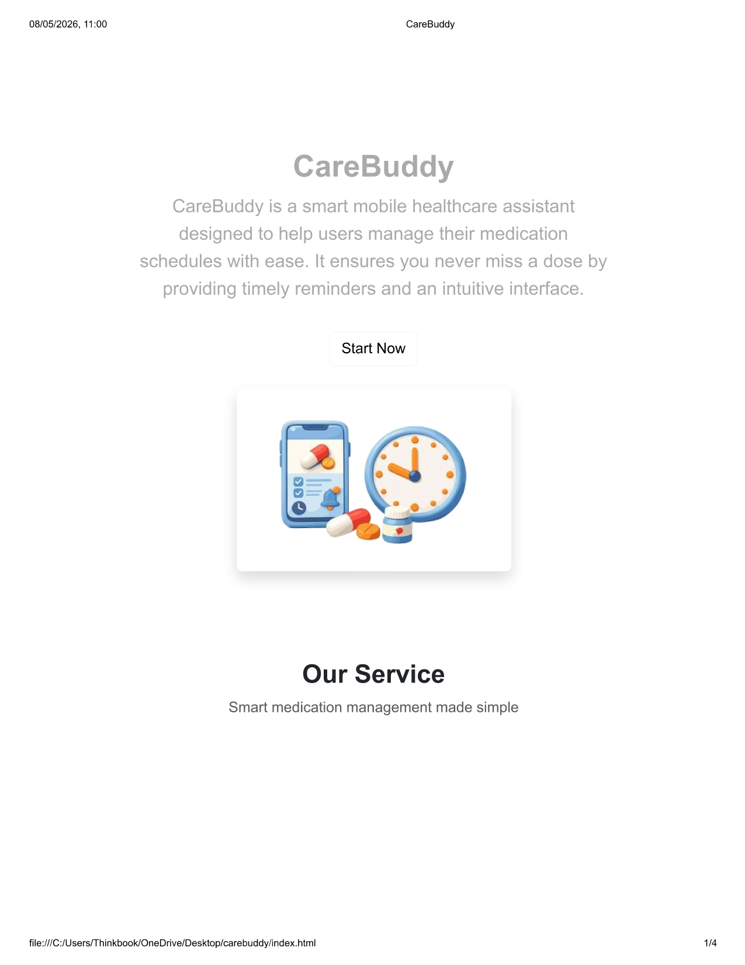
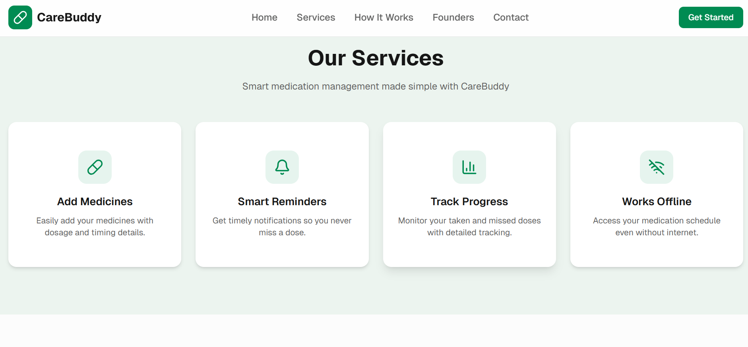
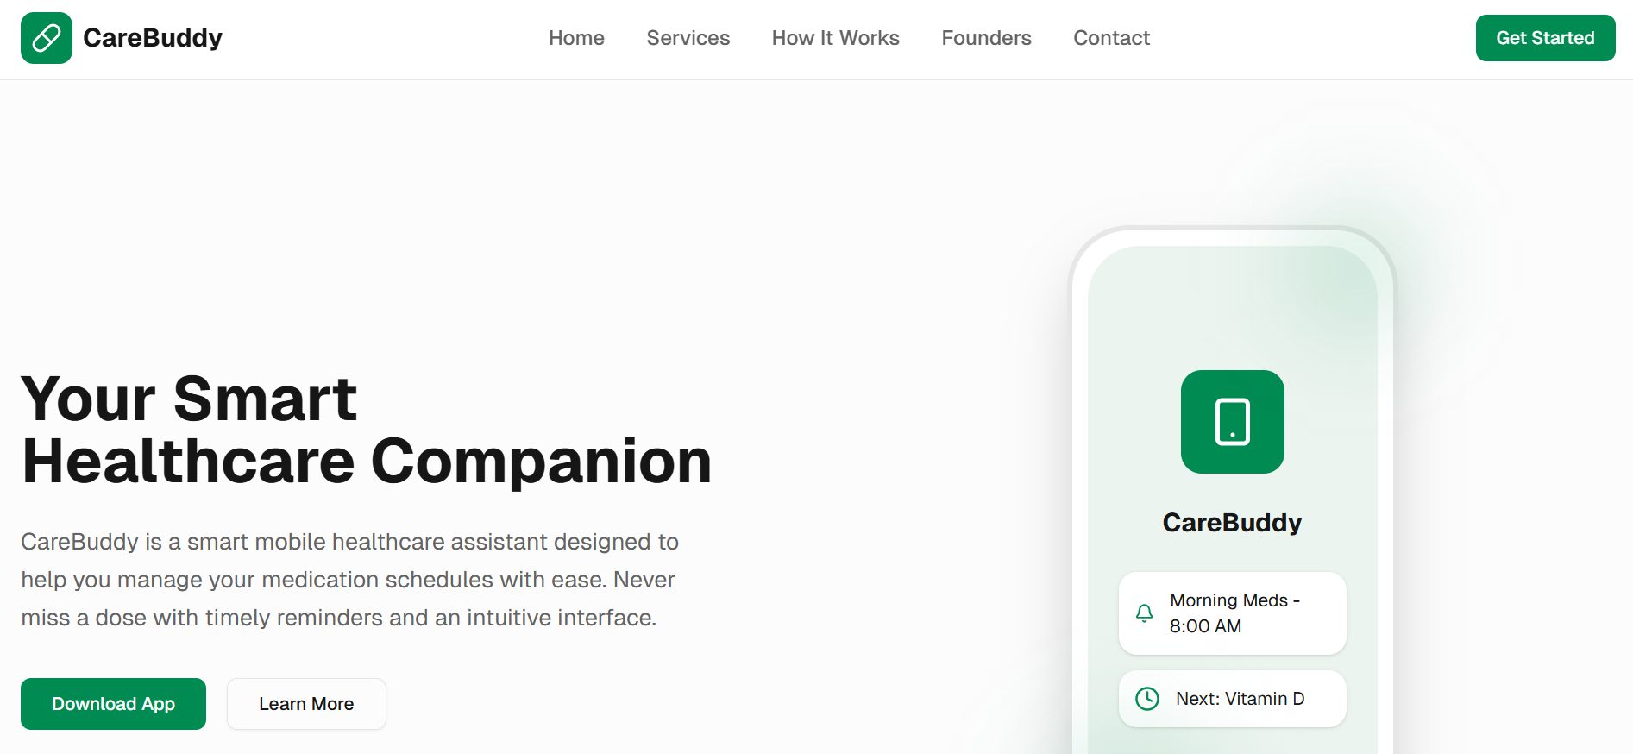
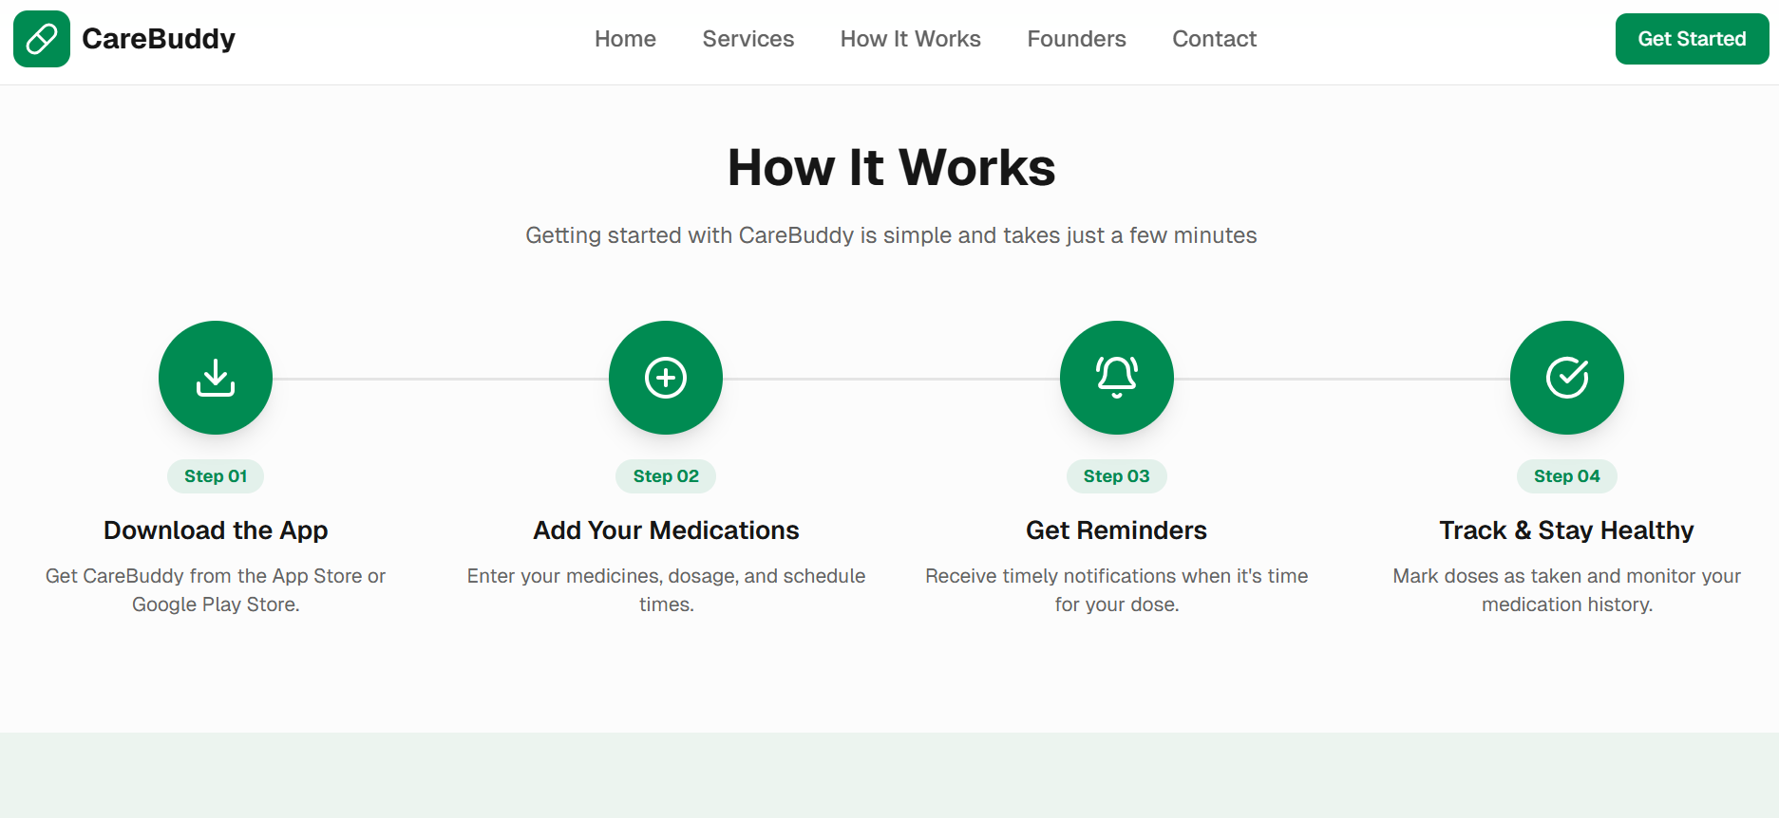
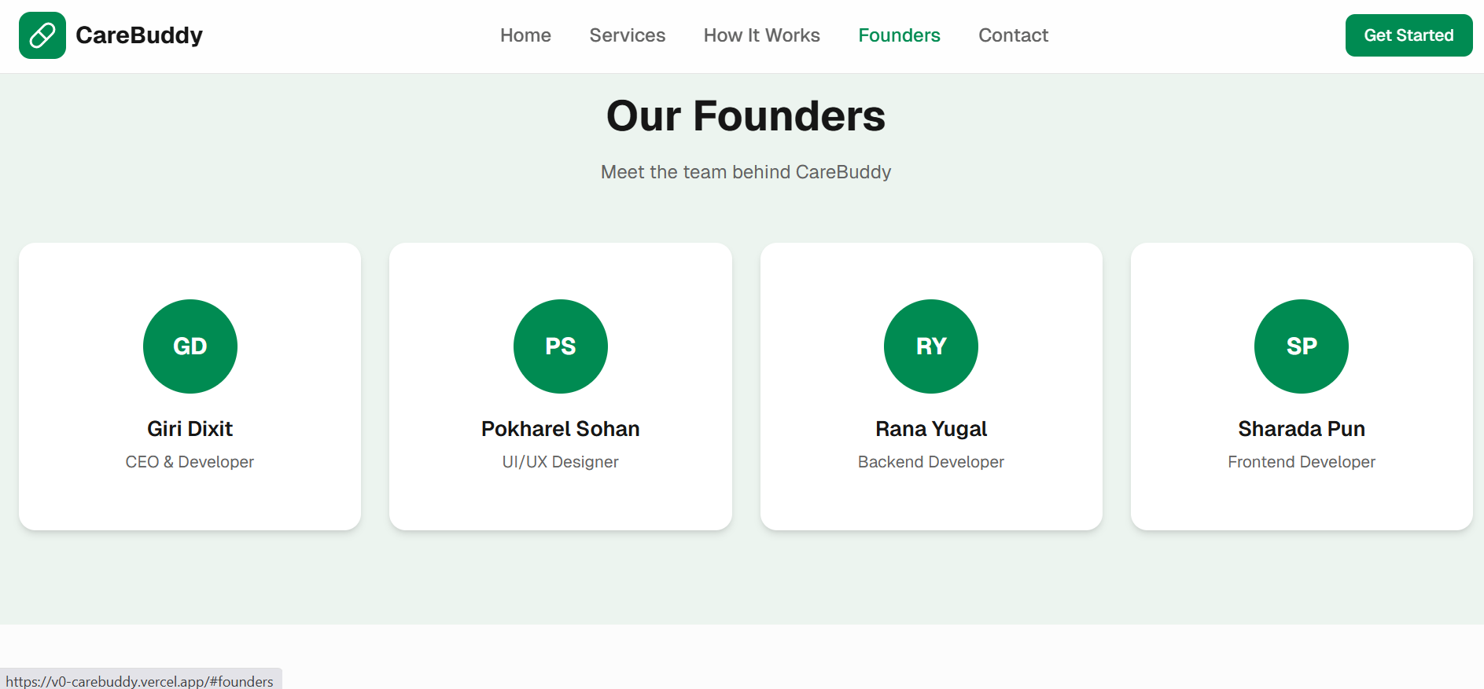
Landing Page

Slide 12
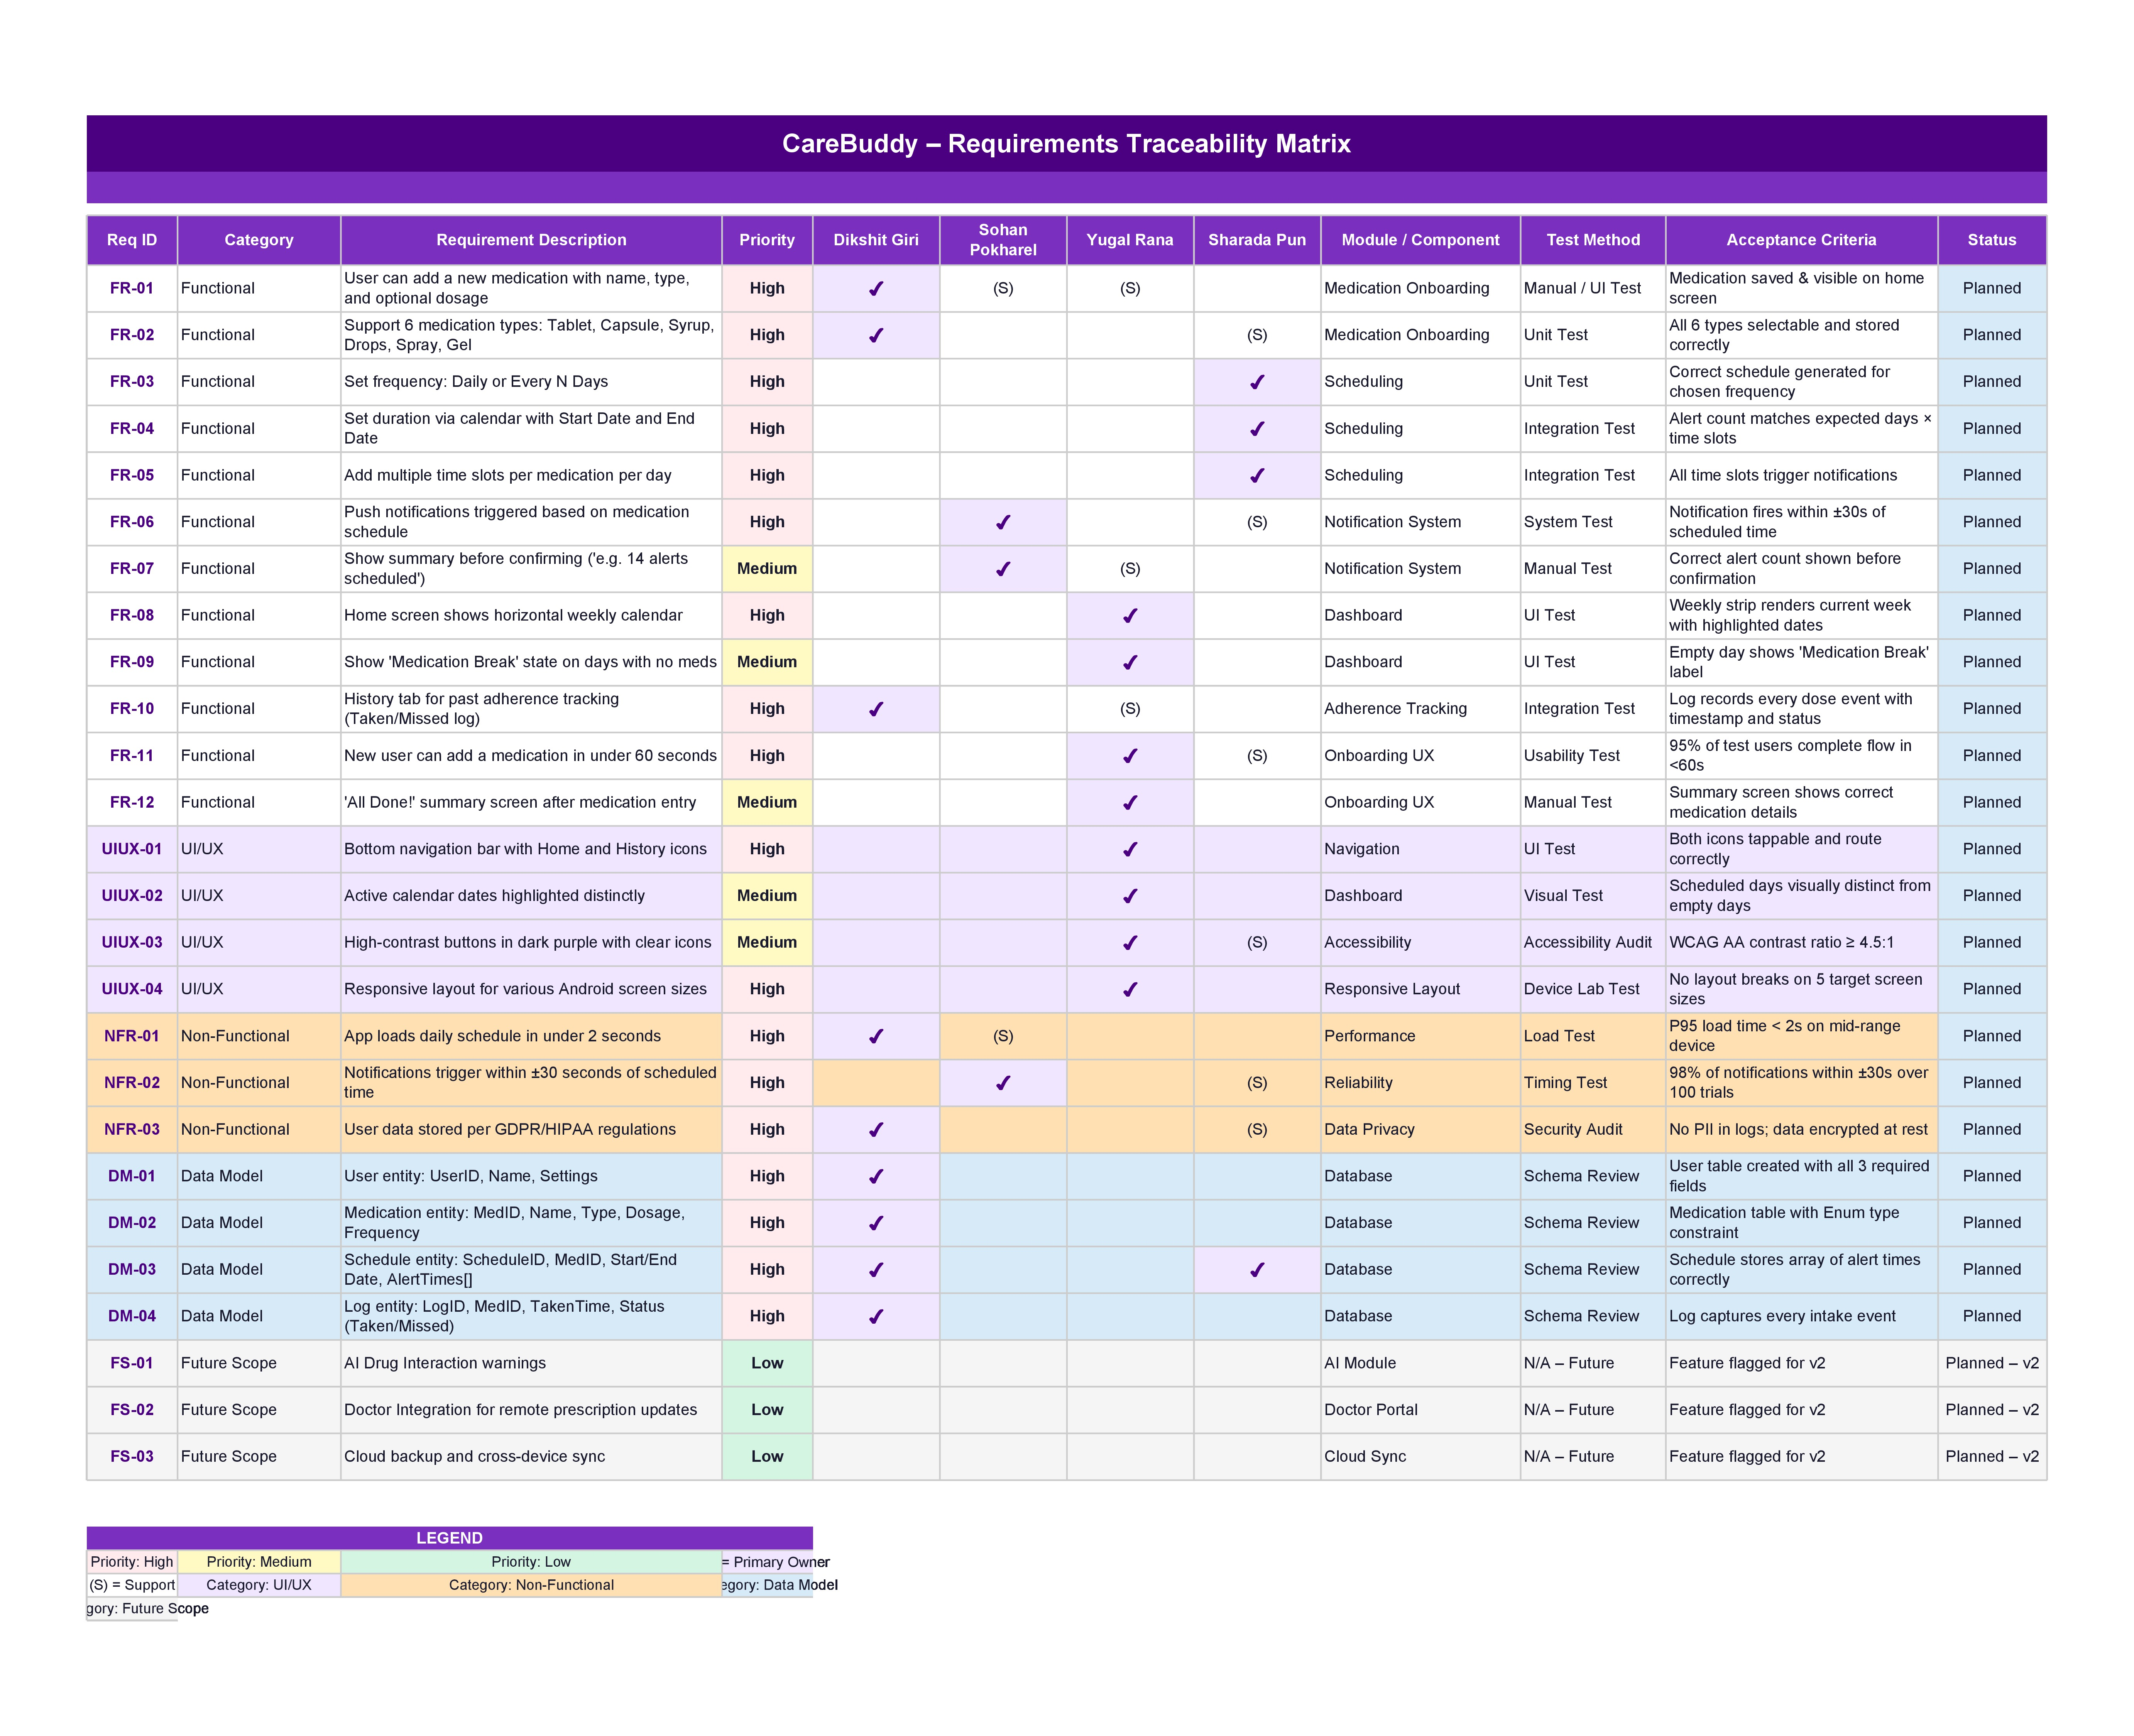
Requirement Traceability Matrix

Slide 13
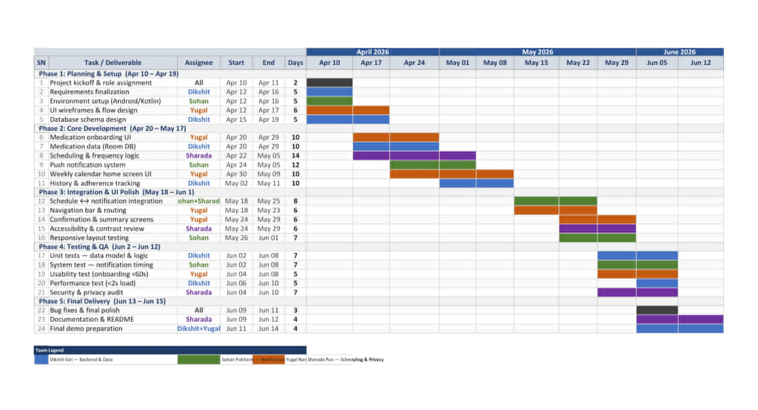
Gantt Chart

Slide 14
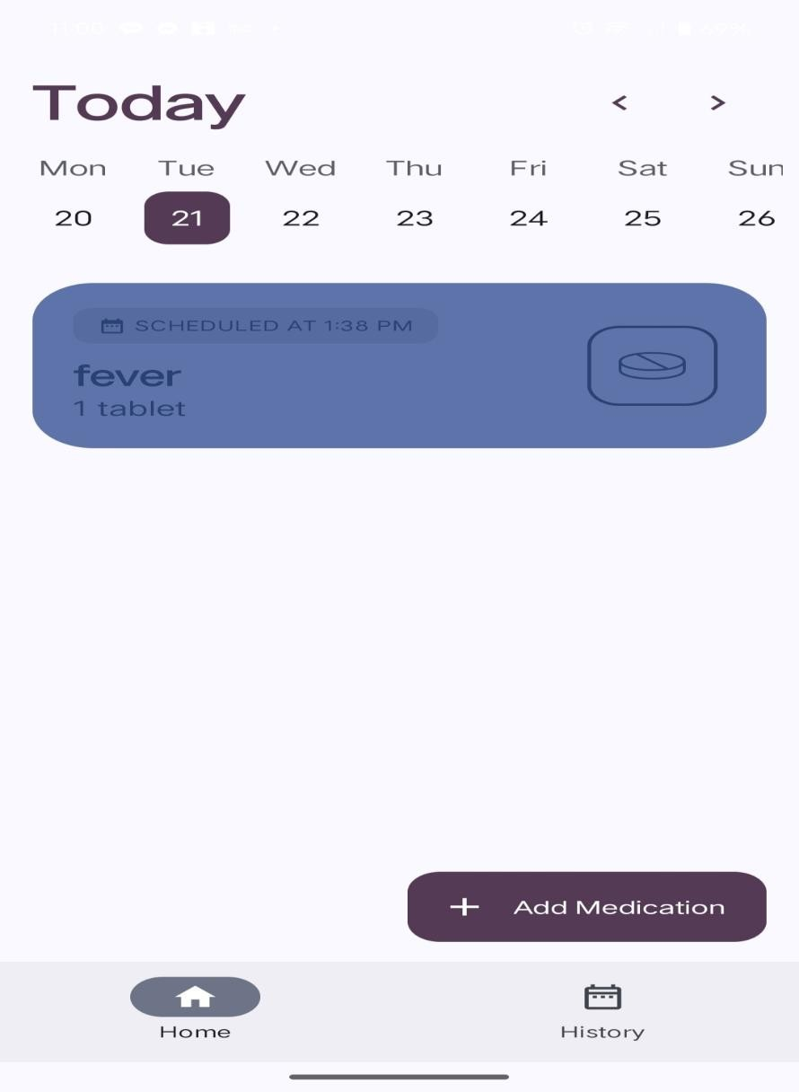
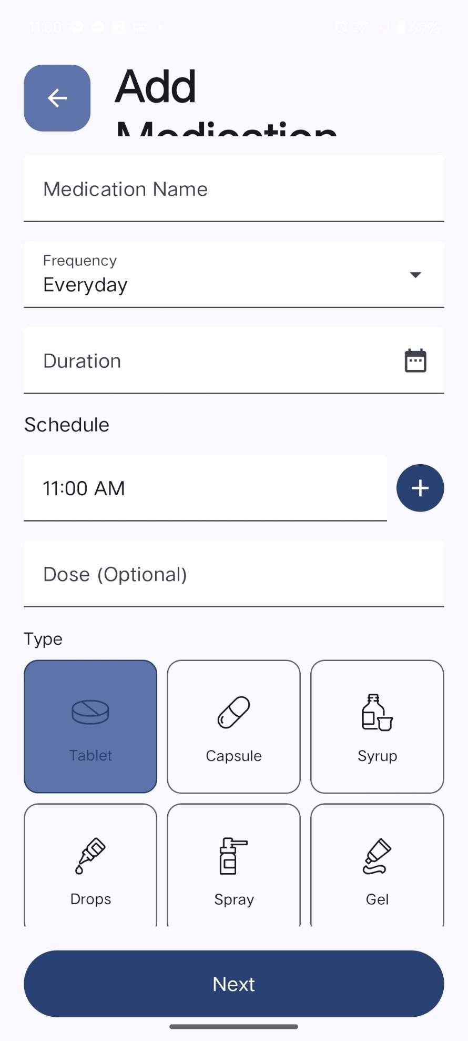
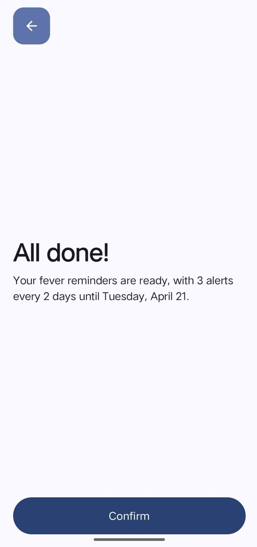
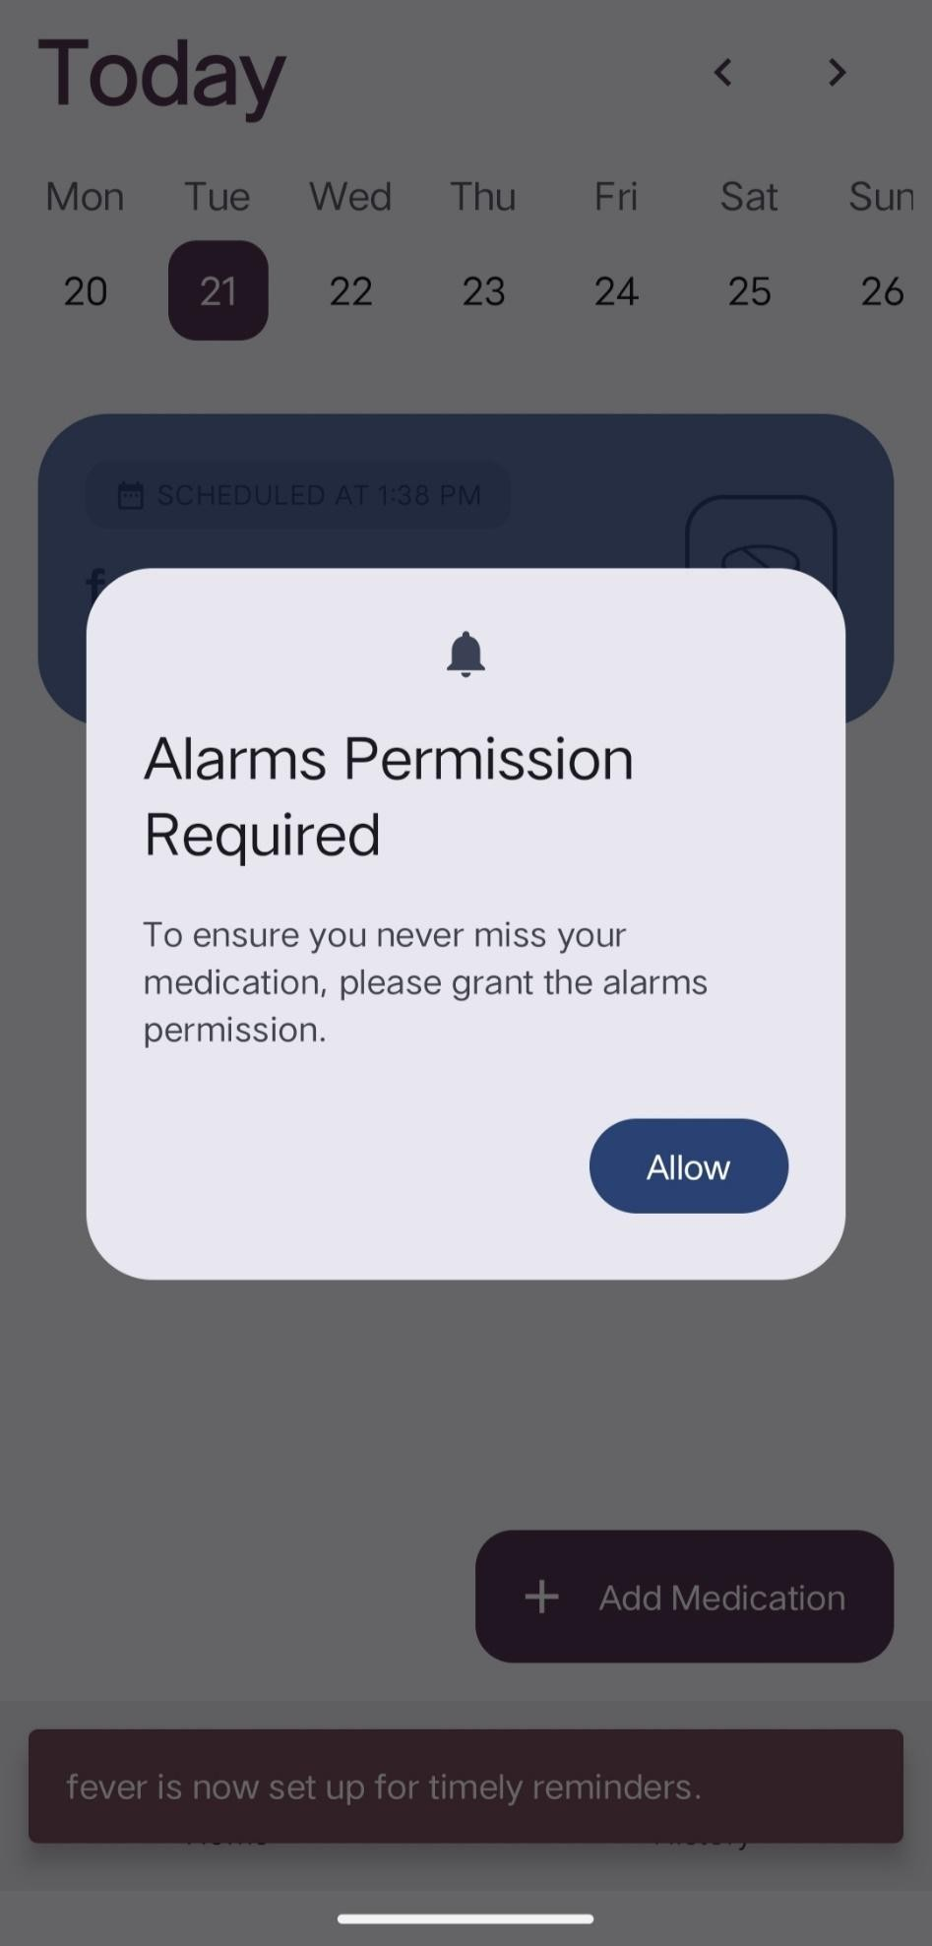
Final Result
Home Screen
Add Medication
Completion
Reminder

Slide 15
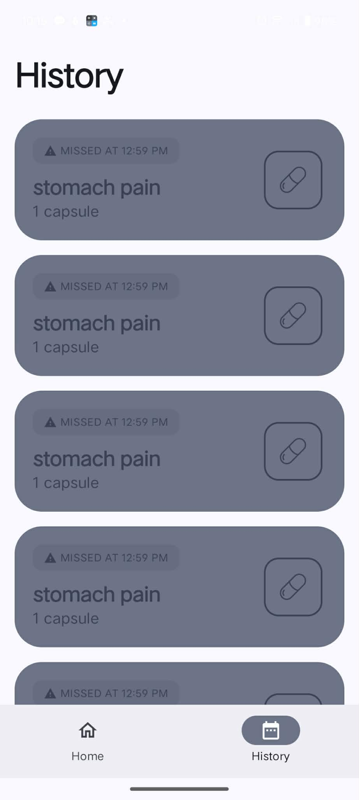
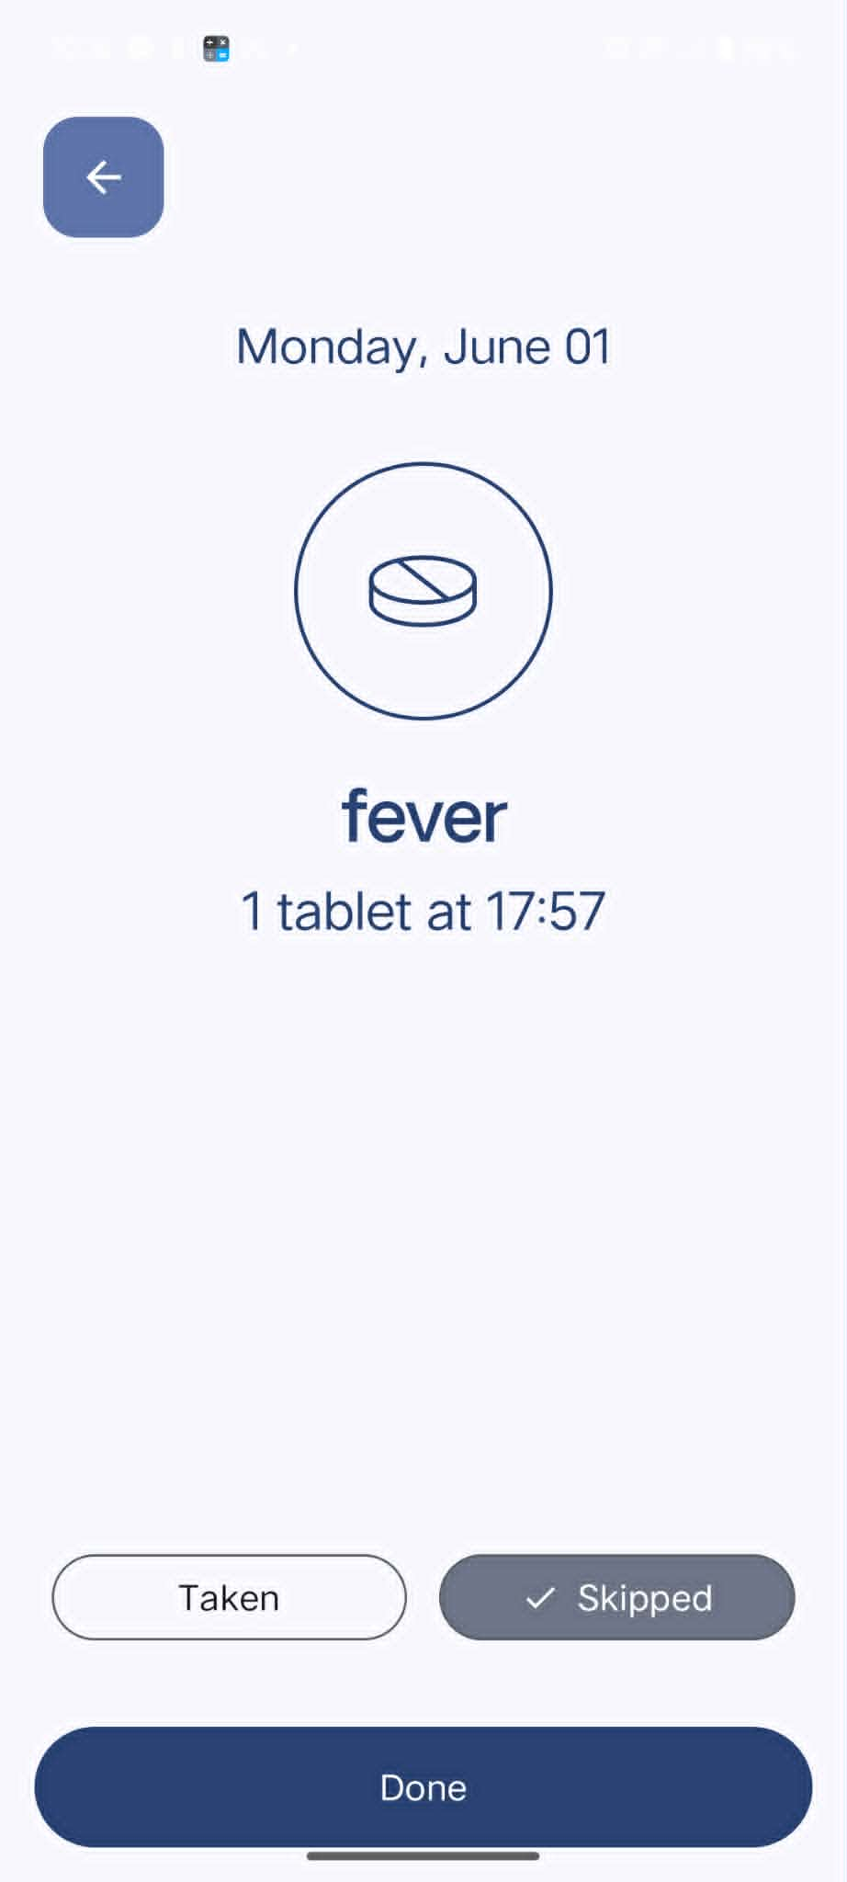
Final Result
History
Confirmation

Slide 16
Thank You!
Care Buddy App
Pun Sharada (2577513)
Rana Yugal (2577502)
Pokhrel Sohan (2577512)
Giri Dikshit (2577501)
Prof. Ibrahim Musa | Dongshin University | Dept. of Software Convergence

