Slide 1

What is Node js?

Slide 2
🧱 What is Node.js?
Node.js is a runtime environment that allows JavaScript to run outside the browser.
Built on Chrome’s V8 JavaScript Engine.
Used for server-side development, APIs, and real-time applications.

Slide 3
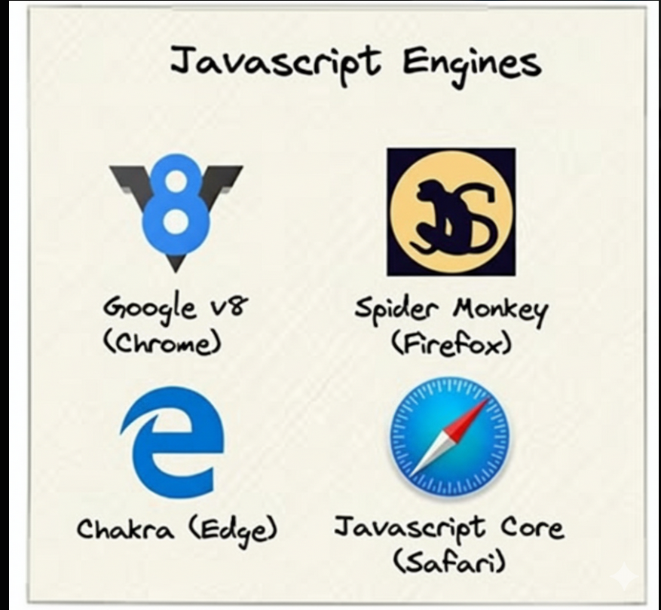

Slide 4
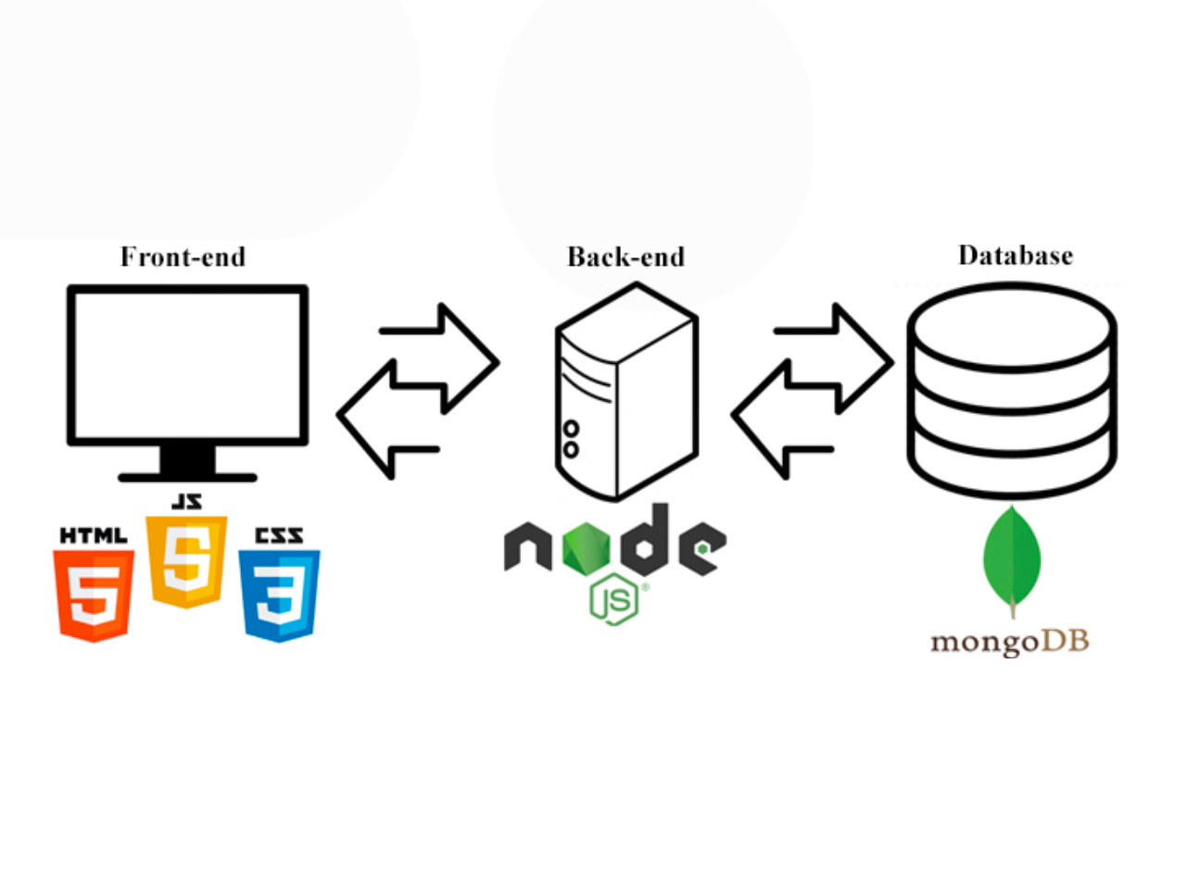

Slide 5
Why Node.js?
Node.js excels at handling many simultaneous connections with minimal overhead, making it perfect for:
Real-time applications (chats, gaming, collaboration tools)
APIs and microservices
Data streaming applications
Command-line tools
Server-side web applications
Its non-blocking, event-driven architecture makes it highly efficient for I/O-heavy workloads.

Slide 6

Asynchronous Programming
Node.js uses asynchronous (non-blocking) programming.
This means it can keep working while waiting for tasks like reading files or talking to a database.
With asynchronous code, Node.js can handle many things at once—making it fast and efficient.

Slide 7
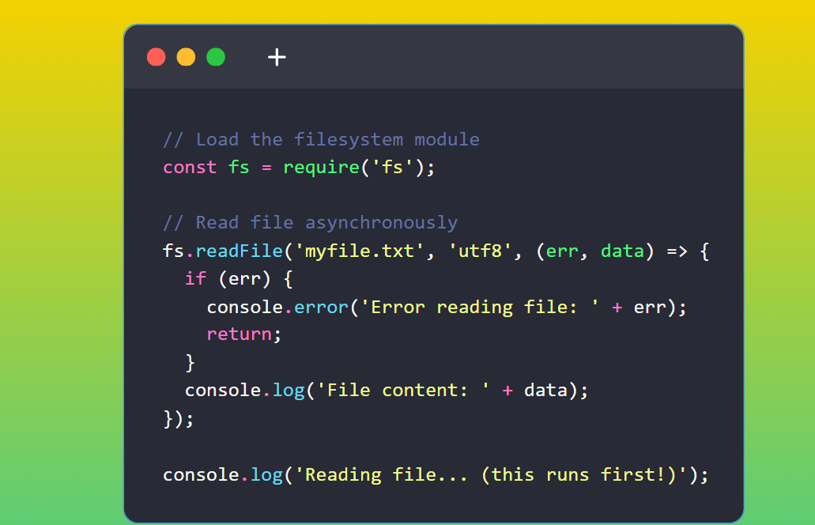
In this example:
We load the built-in fs module
We call readFile to read a file
Node.js continues to the next line while reading the file
When the file is read, our callback function runs
This non-blocking behavior lets Node.js handle many requests efficiently.

Slide 8
What Can Node.js Do?

Slide 9
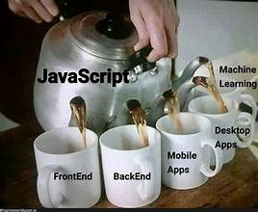
The large kettle represents JavaScript itself.

Slide 10
What Can Node.js Do?
Web Servers: Create fast, scalable network applications
File Operations: Read, write, and manage files on the server
Database Interaction: Work with databases like MongoDB, MySQL, and more
APIs: Build RESTful services and GraphQL APIs
Real-time: Handle WebSockets for live applications
CLI Tools: Create command-line applications

Slide 11
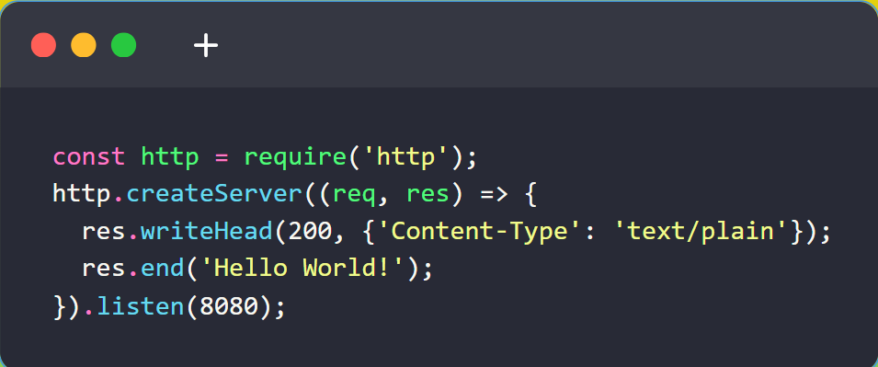
Example: Simple Web Server

Slide 12

Node.js Get Started

