Slide 1


| Tech Management, SRI-B
CLAWS
CLASH OF THE
College:M S Ramaiah Institute of Technology
Team Name:MindForge
Personalized AI-copilot for long-term project productivity
Dikshith S(1MS24IS406)
Harshitha M V(1MS24IS407)
Nuthana T M(1MS24IS410)
Suman J M(1MS23IS130)

Slide 2
Idea
Problem Statement
Theme: Productivity & GenAI Research
What Problem Are We Solving?
Project management tools are passive trackers, not intelligent execution partners.
Developers lose 40% of time to context switching across 10+ tools daily.
70% of work goes untracked due to manual logging fatigue.
Who Faces It?
Software dev teams
freelancers
startup founders
engineering managers
remote teams
Why It Matters?
$300B lost annually due to poor project management (PMI).
67% of projects fail due to lack of visibility.
No AI guidance means teams work on wrong priorities.

Slide 3
Idea
Current Solution & Gaps
Existing Tools & Their Gaps
Trello/Asana: Static task tracking, no AI, manual updates required
Jira: Complex, enterprise-heavy, no execution intelligence
GitHub Projects: No AI productivity reasoning or auto-tracking
Toggl/RescueTime: Track time but don’t understand what you’re building
Critical Gaps
No automatic activity detection
No AI delay prediction
No intelligent recovery plans
No real-time collaboration
No unified developer workspace
Opportunity
Build an AI-native execution OS that automatically tracks developer activity
uses AI to recommend tasks
detect delays
provide recovery plans

Slide 4
Idea
Your Solutions
What We Built: ProjectMind
An AI-powered developer productivity OS combining automatic activity tracking
AI planning
real-time collaboration
GitHub integration
multi-provider AI (Cloud + Local).
Core Idea
Traditional PM: You tell it what you did.
ProjectMind: It watches what you do, AI analyzes patterns, recommends next steps, predicts problems, and suggests recovery plans.
Key Features
AI Task Planning
VS Code Activity Tracking
AI Copilot Chat
Explainable AI
GitHub Integration
Real-Time Collaboration
Deep Focus Mode
AI Demo Generator
Predictive Analytics
Intelligent Task Workspace

Slide 5
Idea
Demo/Product Walkthrough
User Flow
1. Register/Login → 2. Create Project (AI generates tasks, estimates, dependencies) → 3. Invite team members → 4. View AI productivity dashboard
5. Intelligent Task Workspace (AI recommends VS Code, Postman, GitHub) → 6. VS Code extension auto-tracks edits & focus time → 7. GitHub commits auto-linked to tasks
8. AI Copilot: “What should I focus on?” → 9. AI detects stalled tasks & generates recovery plans → 10. Real-time team sync via Socket.IO
Key Demo Moments
AI Task Generation
Platform Auto-Launch
Automatic Tracking
Live AI Copilot
Delay Detection
Real-Time Team Updates

Slide 6
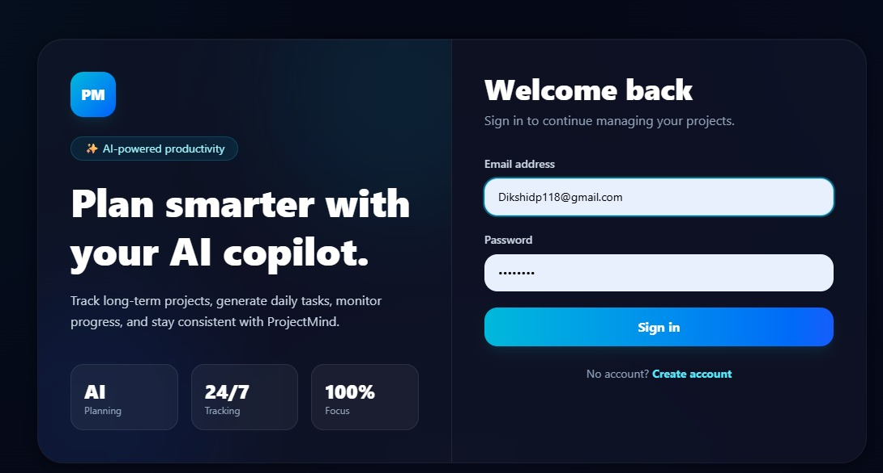
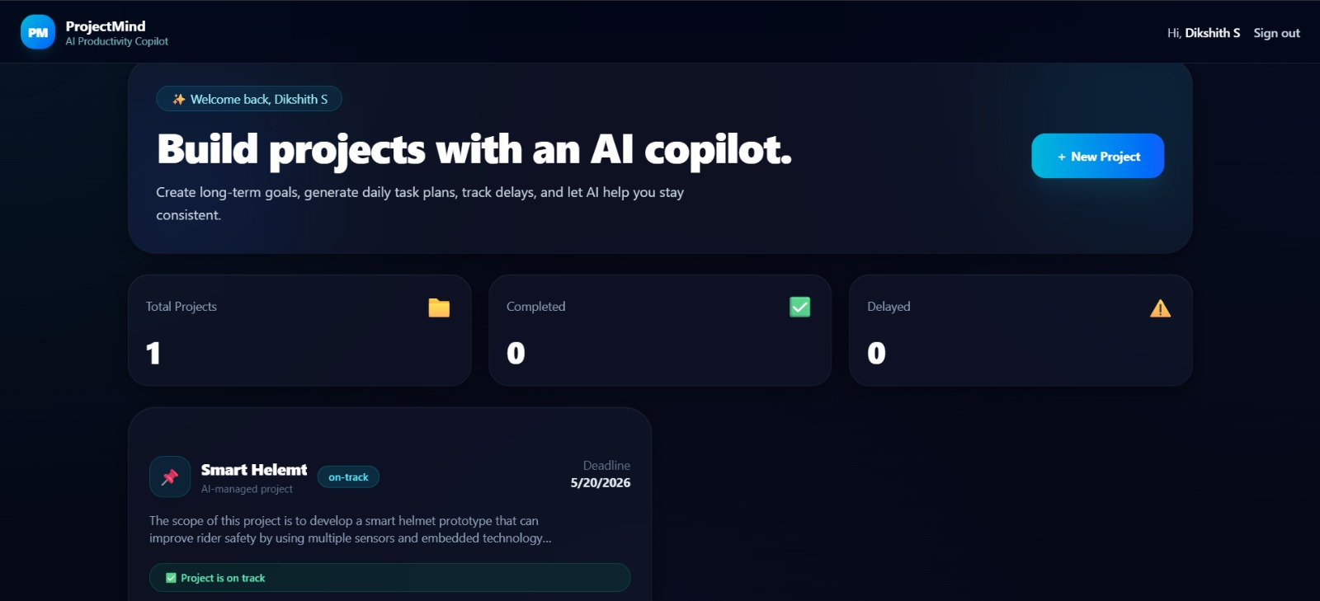
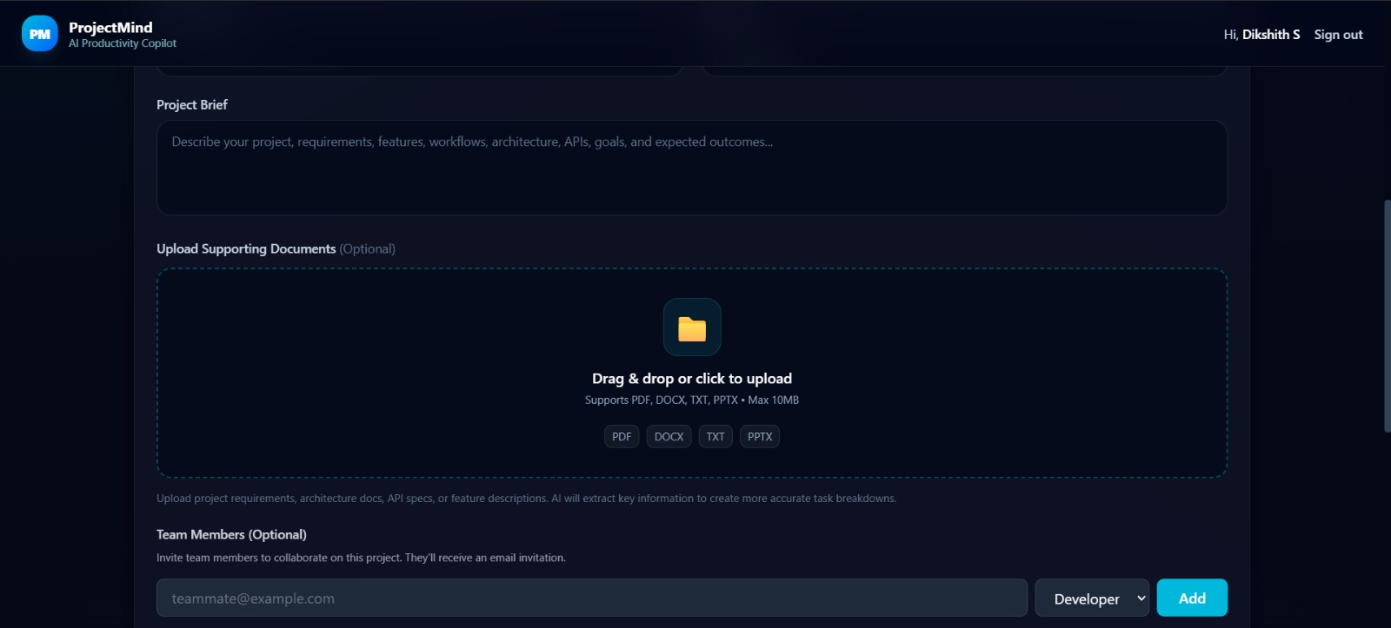
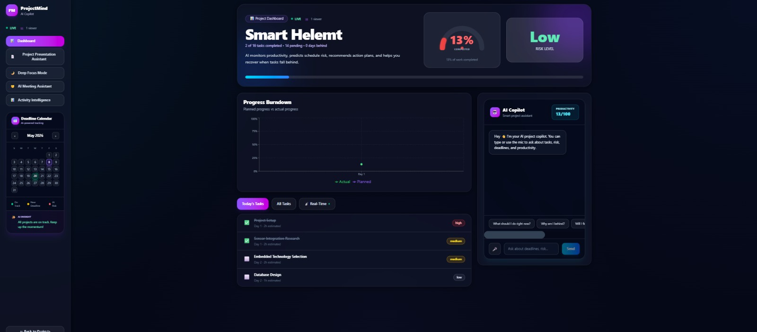

Slide 7
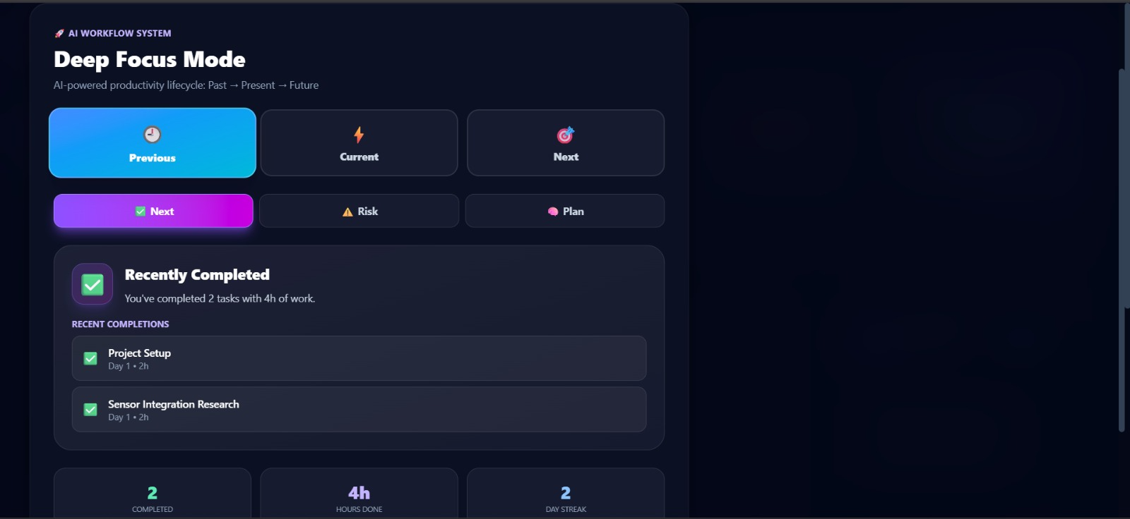
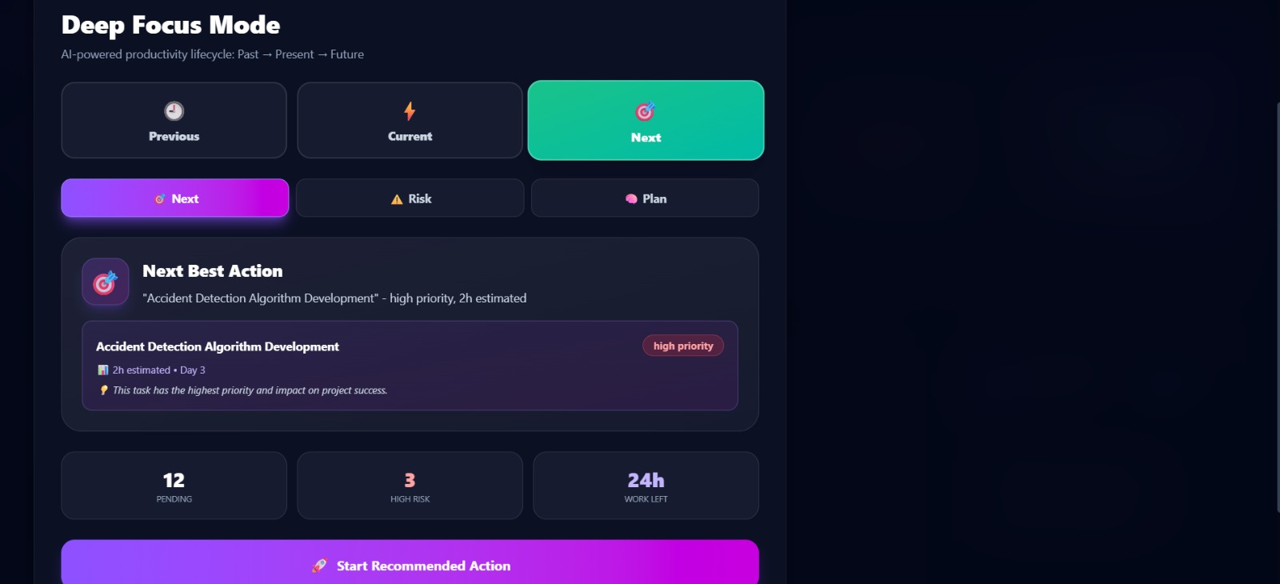
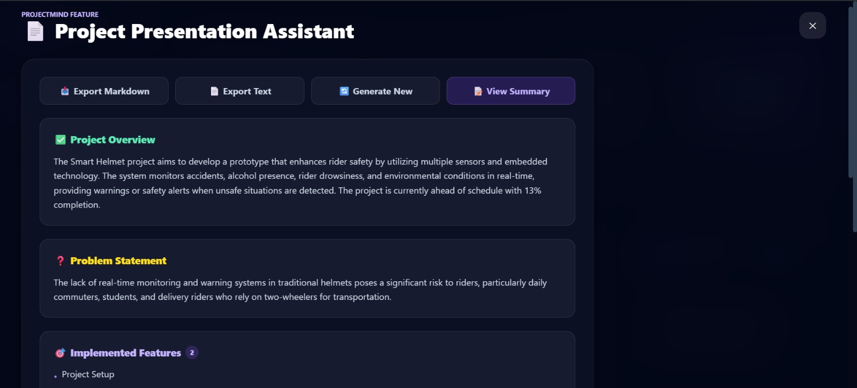
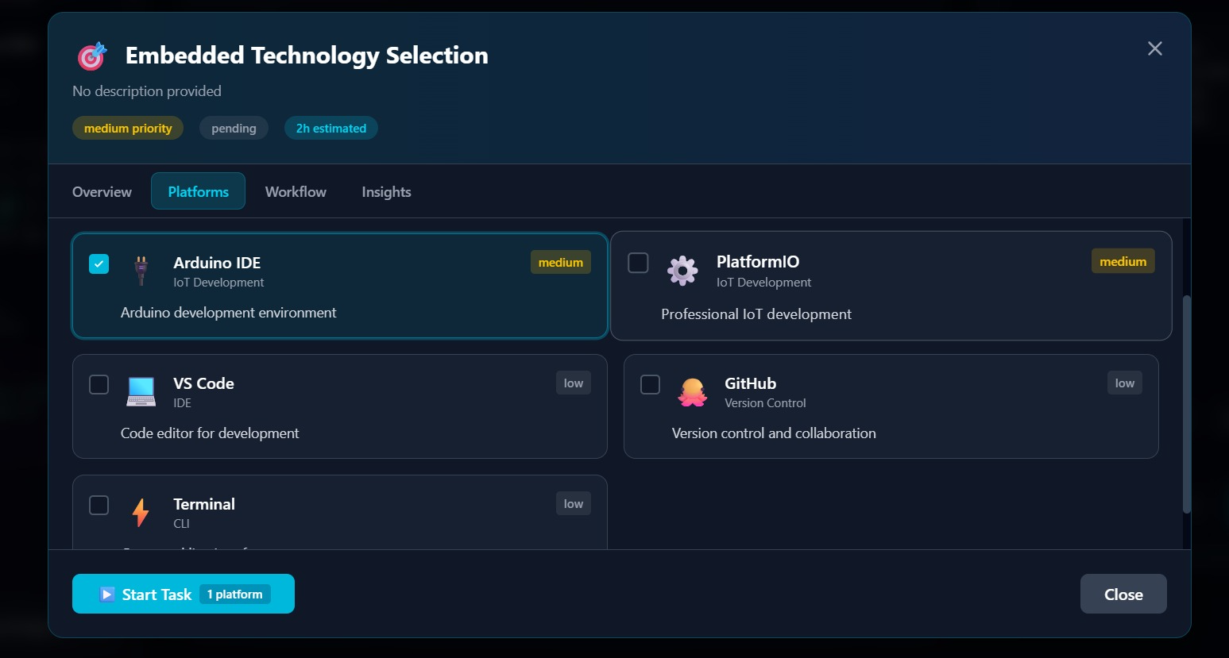

Slide 8
Idea
Tech & Architecture
Tech Stack
Frontend: React 18, Vite, Tailwind CSS, Recharts, Socket.IO Client, Zustand
Backend: Node.js + Express, MongoDB + Mongoose, Socket.IO, JWT Auth, Multer
Integrations: GitHub API, VS Code Extension API, GitHub OAuth
AI Layer
Model: Groq llama-3.3-70b-versatile (FREE, 14,400 req/day)
Fallback: Ollama (local AI)
Features: Task Planning, Copilot, Commit Analysis, Delay Detection, Recovery Plans
System Flow
VS Code Extension → Activity Logs → Backend API → MongoDB → Socket.IO broadcast → AI Analysis → Insights → Dashboard

Slide 9
Idea
Impact & Use cases
Real-World Scenarios
Startup MVP: 3-person team, tight deadline → ProjectMind auto-tracked work, AI recommended priorities → Shipped MVP 2 weeks early, 40% productivity increase
Remote Team: 10 devs across 5 time zones → Real-time activity feed & auto-tracking → 60% fewer status meetings, improved collaboration
Freelancer: Managing 5 client projects → Automatic time tracking + AI task recommendations → Saved 10 hours/week on admin work
Enterprise Team: 50+ devs, projects always delayed → AI delay detection & recovery plans → 35% reduction in project delays
Scale Potential
27M software developers worldwide
$6.68B PM software market growing at 10.67% CAGR
Freemium: Free → $10/user/month Pro → $25/user/month Enterprise

Slide 10
Idea
Differentiation
Why ProjectMind Stands Out
Automatic Activity Tracking: VS Code extension tracks work without manual logging (competitors require manual updates)
AI-Native Architecture: Built with AI at the core, not bolted on as an afterthought like Jira/Asana
Real-Time Collaboration: Socket.IO instant updates vs polling-based competitors GitHub commit auto-analysis and task correlation
2 Strong MOATs
MOAT 1: Automatic Activity Intelligence – VS Code + AI + GitHub integration creates complete developer picture. Network effects: more data = better AI. Technically complex to replicate.
MOAT 2: Multi-Provider AI with Fallback – Cloud (Groq) + Local (Ollama) architecture. 99.9% uptime. Privacy option for enterprises. Unique technical architecture no competitor has.

Slide 11
Idea
Demo Link
GitHub Repository
https://github.com/Dikshith118/projectmind.git
Demo Video
https://drive.google.com/drive/folders/1rBuxT9IImB2-se9nUwWRZBEdcPzfucTr?usp=sharing
Documents Submitted
https://drive.google.com/drive/folders/1Htehz235RAI-ZwC4iAQTQz3qvHiaeCTN?usp=sharing

Slide 12
Idea
Future Roadmap
Future Roadmap
Phase 1 (Q3 2026): Mobile app (React Native), Slack/Discord integration, advanced analytics dashboard
Phase 2 (Q4 2026): AI autonomous execution engine, AI sprint manager, voice AI assistant
Phase 3 (2027): GitHub PR intelligence, IDE-native AI execution, AI team orchestration, Enterprise SSO, custom AI model training
Production-Ready Highlights
Clean MVC architecture
JWT + bcrypt security
Comprehensive README & API docs
Multi-tenant scalable design
API-first approach
Built by developers, for developers

