Slide 1

Dixen
Event Management, Discovery & Ticketing System
Dikshya Singh Shah
Class: 1205hf26016per
TEC Ballerup
Supervisor: Flemming Sørensen
Date: 19-01-2026 – 18-02-2026

Slide 2

agenda
Introduction
Problem Formulation
Requirement Specification
Technology Choice
Project Plan
Conclusion
Logbook & lessons learned
Question and suggestion
Architecture & structure
LiveDemo

Slide 3

Who am i
Dikshya Singh Shah
Full-stack Developer | Student at TEC Ballerup
Mother of two
Contributed to full system architecture and development

Slide 4

Case /idea description
Dixen: All-in-one event management system
Target users: event attendees, Admin & organizers
Core features: secure registration, 2FA, event creation, social sharing

Slide 5

Problem Formulation
Key questions
Secure authentication without reducing usability?
Clear separation role?
Keep frontend and backend synchronize?
Improve engagement and communication?

Slide 6

Requirements specification
Secure registration and login with 2FA.
Event CRUD (proposal, approval, booking).
Social Share, search and filter event.

Slide 7
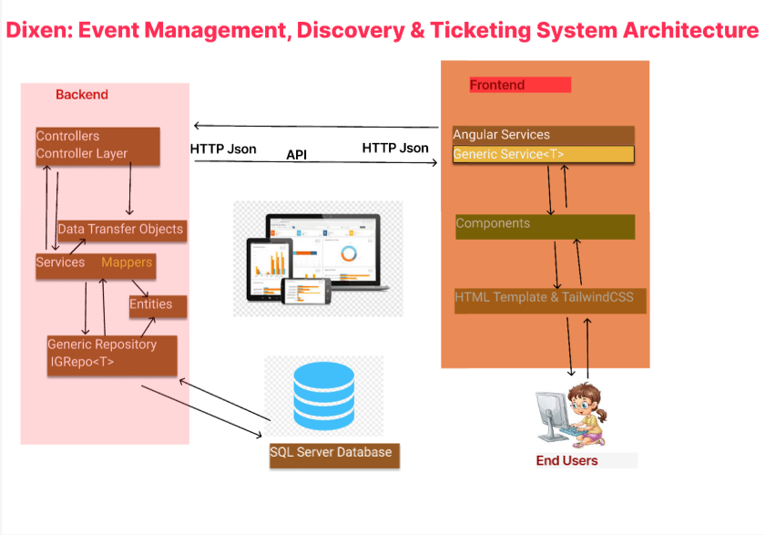
ARCHITECTURE AND STRUCTURE

Slide 8

LIVE DEMO

Slide 9

Technology Choice
Frontend: Angular 20 + Tailwind CSS 4.1
Backend: ASP.NET Core 8 + EF Core
Database: MS SQL Server
Security: JWT + ASP.NET identity (PBKDF2 hashing ),2FA
Testing: x-Unit, swagger and Dev tools

Slide 10
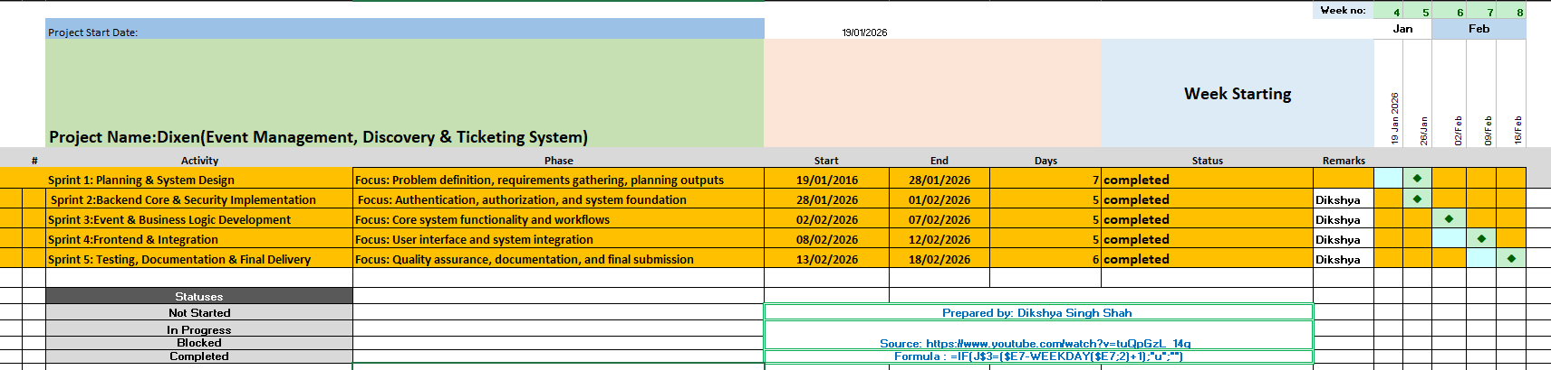
Project Plan

Slide 11

Reflection/ Learnings
Learned importance of clean architecture and modular design
Learned the importance of creating reusable components to save development time and reduce duplication
Gained knowledge of hard, soft, and cascade delete strategies
Gained understanding of OOP principles for better code structure and maintainability
Learned to identify and manage risks in software development
Practiced testing strategies with Moq and in-memory databases

Slide 12


Secure and scalable event system
Met all core goals
Ready for future enhancements: payments, analytics, calendar sync

Slide 13

Any question and feedback??

