Slide 1

Project Presentation on
Handwritten Nepali Digit
Feature Extraction
Image Processing & Pattern Recognition (IPPR)
Presented By
Submitted To
Dikshya Khanal
Mamata Tharu

Slide 2
Introduction / Background
Handwritten Nepali (Devanagari) digits are widely used in forms, exams and records.
Recognizing them automatically is hard due to varied handwriting styles and scan quality.
Feature extraction converts raw digit images into structured, measurable data.
These features form the foundation for training a digit recognition model.
1

Slide 3
Objectives
Build a pipeline to extract handwritten Nepali digits from scanned sheets.
Preprocess and normalize each digit into a clean, uniform image.
Extract meaningful handcrafted and gradient-based (HOG) features.
Produce ready-to-use feature datasets for future classifier training.
2

Slide 4
Project Pipeline Overview
1
2
3
4
5
6
Data
Collection
Digit
Extraction
Feature
Extraction
Dataset
Export
→
→
Labeling
→
Preprocessing
→
→
3

Slide 5
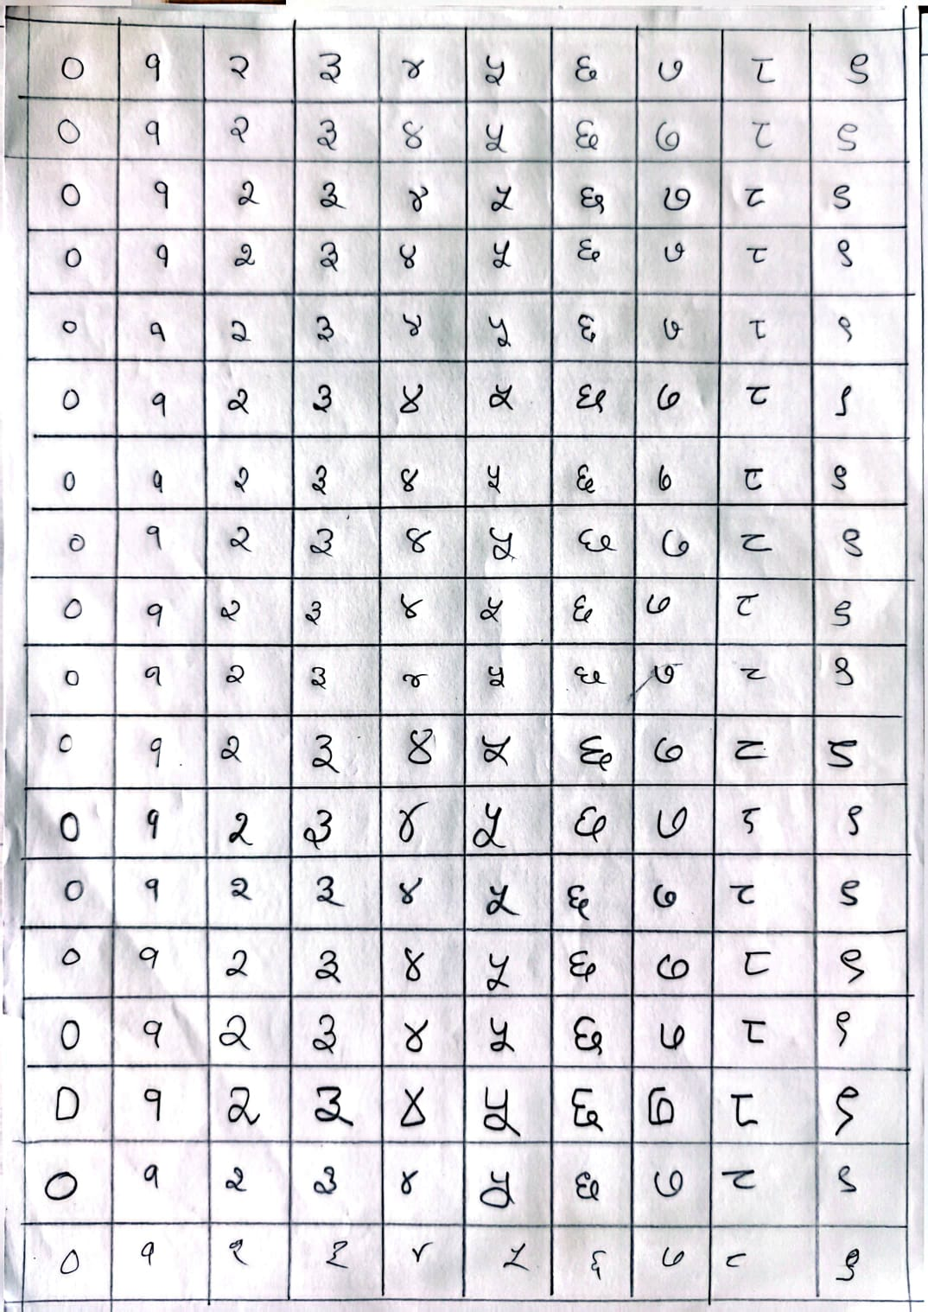
Step 1: Data Collection
Handwritten digits are written on fixed-grid sheets by different people.
Each sheet is scanned/photographed as a single image.
Digits follow a repeating 0–9 pattern across each row.
4

Slide 6


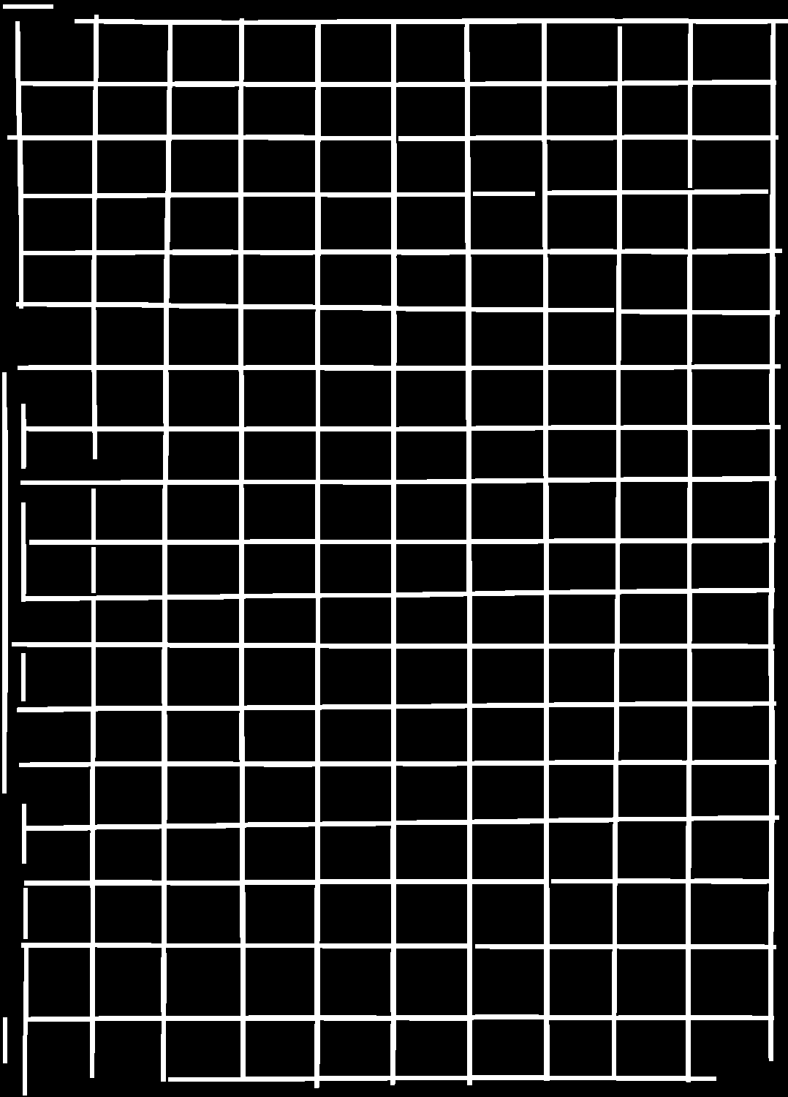
Step 2: Grid-Based Digit Extraction
The image is thresholded, then vertical and horizontal grid lines are detected.
Morphological filtering isolates clean straight lines from the digit strokes.
Line intersections mark cell boundaries, which are used to crop each digit.
Vertical lines
Horizontal lines
Combined grid used to
locate each digit cell
5

Slide 7
Step 3: Labeling Scheme
Digits repeat in a fixed order on each sheet: 0 to 9, so a cropped cell's position (mod 10) gives its label.
0
1
2
3
4
5
6
7
8
9
०
१
२
३
४
५
६
७
८
९
6

Slide 8
Dataset Overview
Sample raw extracted cells (digits 0–9 from one group):
540
54
54
total digit images
samples per digit
sample groups
7

Slide 9
Step 4: Image Preprocessing
Every cropped digit passes through six cleaning and normalization stages:
1
2
3
4
5
6
Grayscale
Gaussian
blur
Otsu
threshold
Remove grid
lines
Remove
noise
Crop & center
28×28
→
→
→
→
→
8

Slide 10
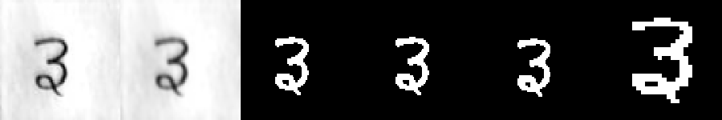
Preprocessing — Visual Result
Each stage applied to one sample digit:
Left to right: grayscale → blur → threshold → lines removed → noise removed → normalized.
9

Slide 11
Step 5: Feature Extraction — Overview
Each normalized digit is converted into a set of numeric features.
Two feature types are extracted: handcrafted shape features and HOG features.
Handcrafted features describe structure; HOG features describe stroke direction.
Both feature sets are combined into a single dataset for flexibility.
10

Slide 12
HOG Features — Concept
HOG (Histogram of Oriented Gradients) captures local edge direction and stroke shape.
Each 28×28 digit is resized to 32×32 before extraction.
Settings used: 9 orientation bins, 8×8 pixel cells, 2×2 cell blocks, L2-Hys normalization.
This produces a 324-dimensional feature vector per digit.
13

Slide 13

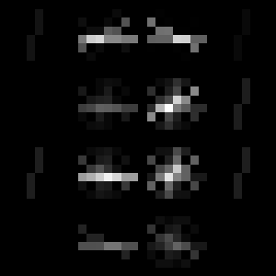
HOG Features — Visualization
Normalized digit → HOG gradient map
Input digit
Gradient orientation map
324 HOG features per digit
14

Slide 14
Final Feature Datasets
All extracted features are exported to CSV files:
Dataset
Contents
Shape
Basic Features
19 handcrafted shape/structure features
540 × 24
HOG Features
324-dim gradient-based features
540 × 329
Combined
Basic + HOG features together
540 × 348
Raw Pixels
Flattened 28×28 normalized pixels
540 × 789
15

Slide 15
Conclusion
A complete pipeline was built:
extraction → labeling → preprocessing → feature extraction.
540 handwritten Nepali digit samples were processed across 10 balanced classes.
Four ready-to-use feature datasets were generated for future model training.
16

Slide 16
Future Work
Train and compare classifiers such as KNN, SVM and CNN on the extracted features.
Expand the dataset with more writers and samples for better generalization.
Explore deep-learning-based end-to-end digit recognition.
17

Slide 17
Thank You !

