Slide 1
Freelancing Platform Database
Dikshya Tamling Limbu

Slide 2
Real world Domains
Connecting Remote talents with opportunities.
Are you an individual or business looking for specific talents and expertise?
Are you looking for a way to monetize your skills?
Inspired from: https://www.workforimpact.com/
Similar domains include Upwork, Fiverr, Toptal, Flexjobs and more.

Slide 3
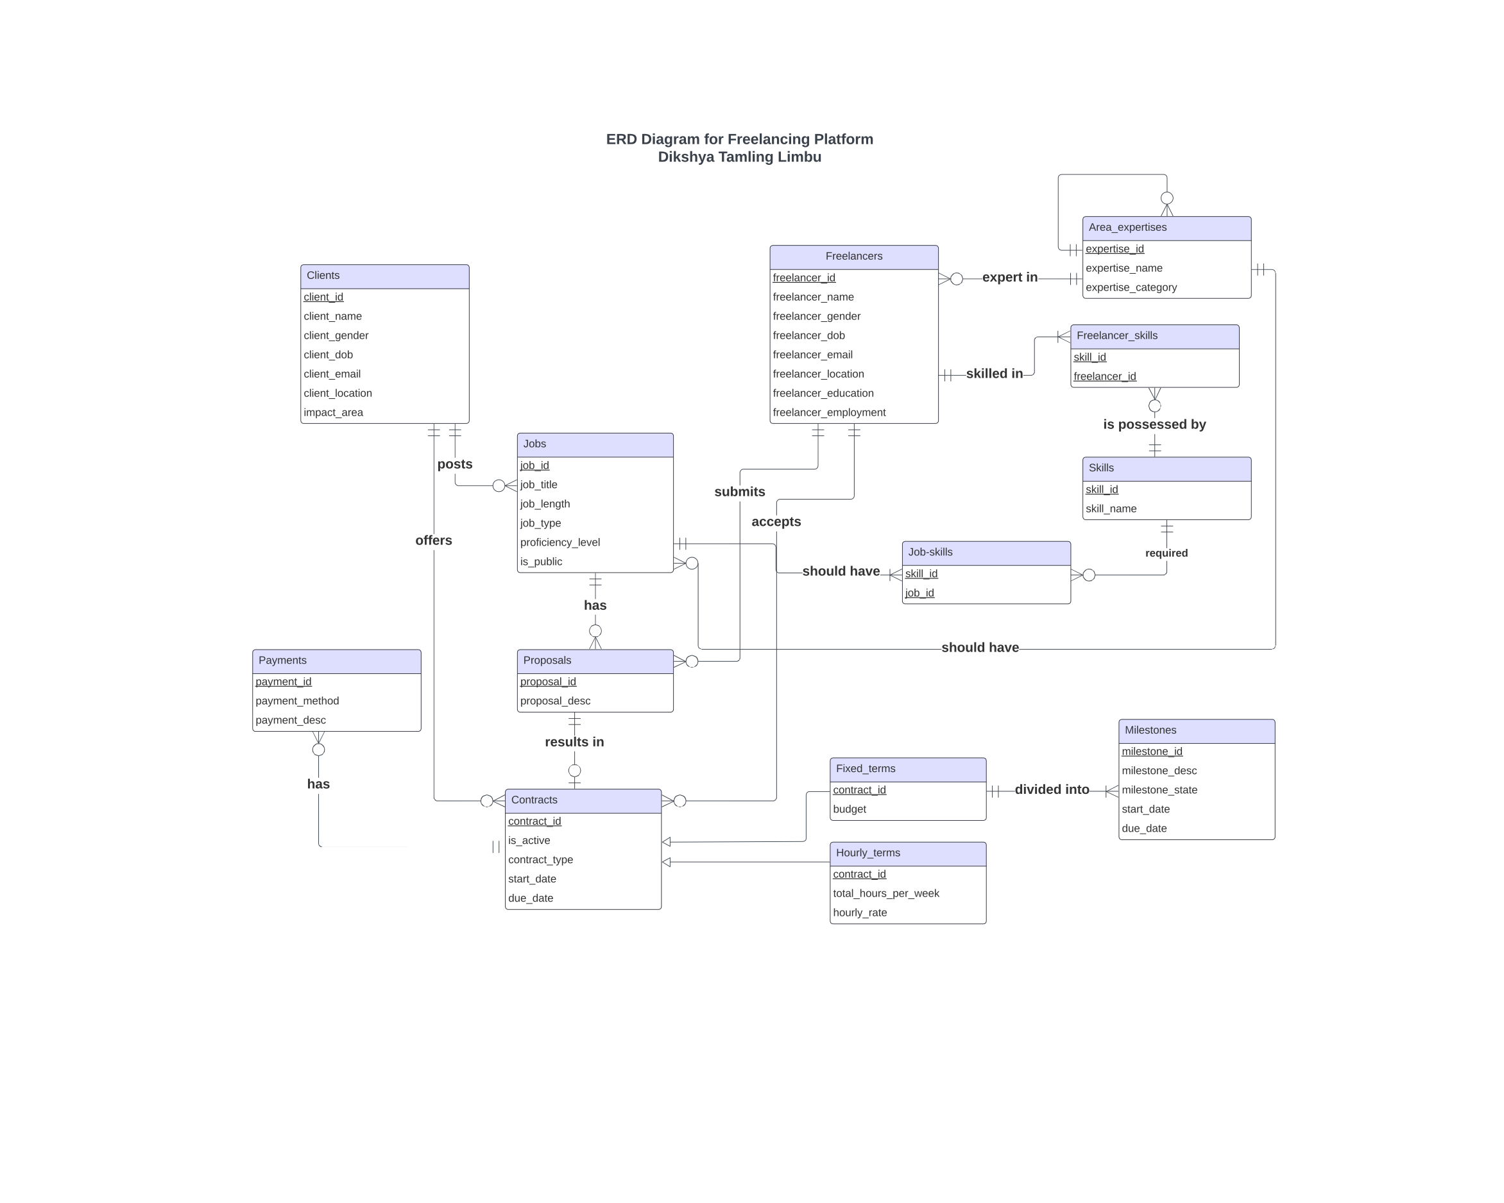

Slide 4
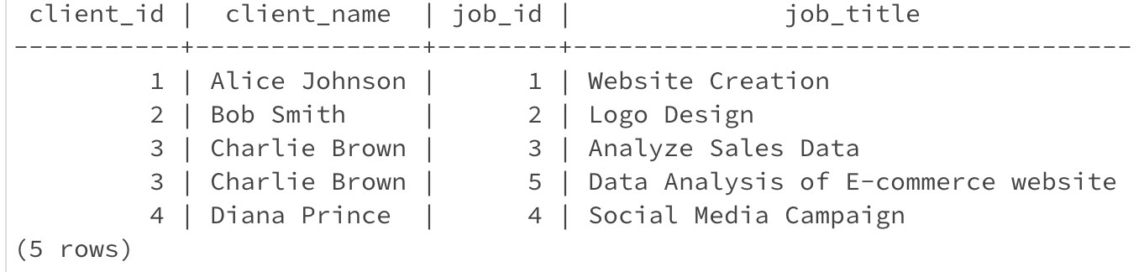
One to Many Relationship
Client and Jobs.
A client may post zero or many jobs.
SELECT c.client_id, c.client_name, j.job_id, j.job_title FROM Clients c JOIN Jobs j ON c.client_id = j.client_id ORDER BY c.client_id, j.job_id;

Slide 5
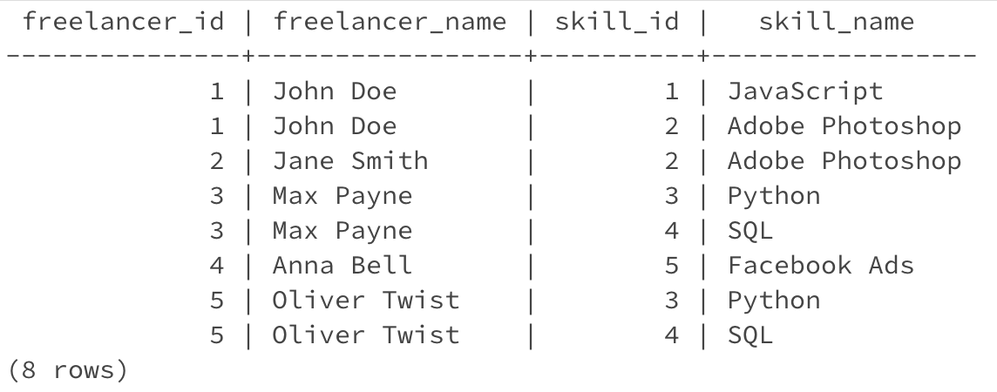
Many to Many Relationship
A freelancer may be skilled in 1 or many skills. A skill is possessed by 0 or more freelancers
SELECT f.freelancer_id, f.freelancer_name, s.skill_id, s.skill_name FROM Freelancers f JOIN Freelancer_Skills fs ON f.freelancer_id = fs.freelancer_id JOIN Skills s ON fs.skill_id = s.skill_id ORDER BY f.freelancer_id, s.skill_id;

Slide 6
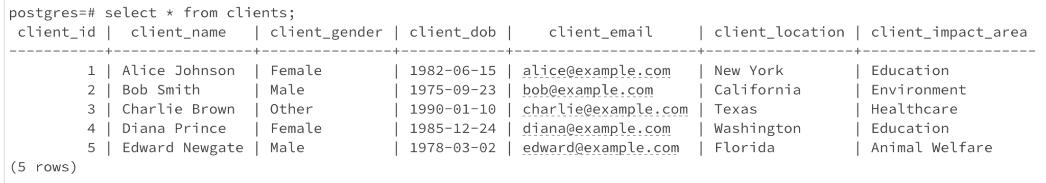
A simple query of a single table
SELECT * FROM Clients;
Retrieves a list of every single entry in the ‘Clients’ table.

Slide 7
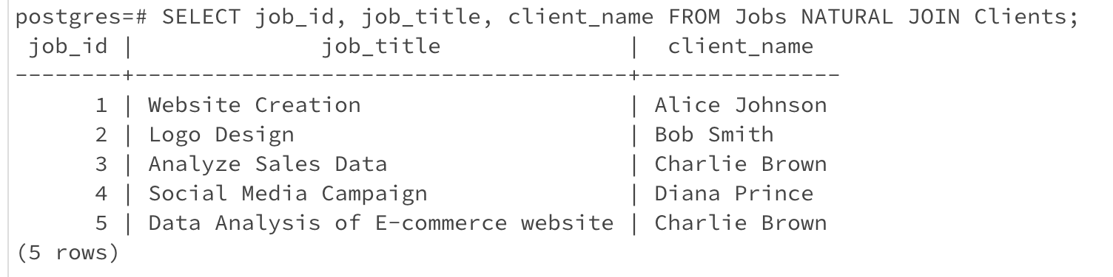
2. A query which uses Natural Join
SELECT job_id, job_title, client_name FROM Jobs NATURAL JOIN Clients;
A combined list of job details and the names of the clients who posted those jobs, showing which client is associated with each job.

Slide 8
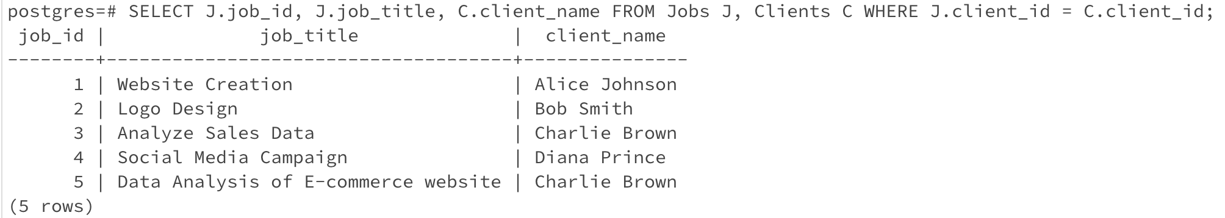
3. A Cross Product equivalent to Natural Join Query above
SELECT J.job_id, J.job_title, C.client_name FROM Jobs J, Clients C WHERE J.client_id = C.client_id;
Links Jobs and Clients based on shared identifier client_id.

Slide 9
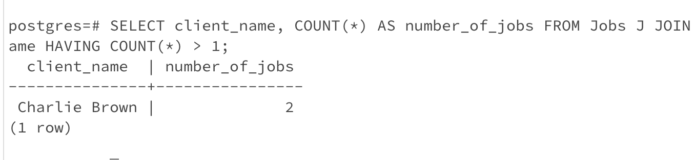
4. A Query involving ‘Group By’ and ‘Having’ clauses
SELECT client_name, COUNT(*) AS number_of_jobs FROM Jobs J JOIN Clients C ON J.client_id = C.client_id GROUP BY client_name HAVING COUNT(*) > 1;
Finds clients who have posted more than one job and shows each client's name along with the total number of jobs they've posted.

Slide 10
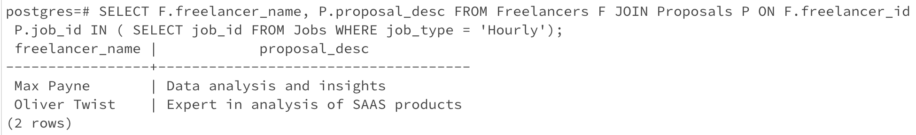
5. A query which uses a subquery
SELECT F.freelancer_name, P.proposal_desc FROM Freelancers F JOIN Proposals P ON F.freelancer_id = P.freelancer_id WHERE P.job_id IN ( SELECT job_id FROM Jobs WHERE job_type = 'Hourly');
Lists the names of freelancers along with their proposal descriptions for jobs that are classified as 'Hourly’.

Slide 11
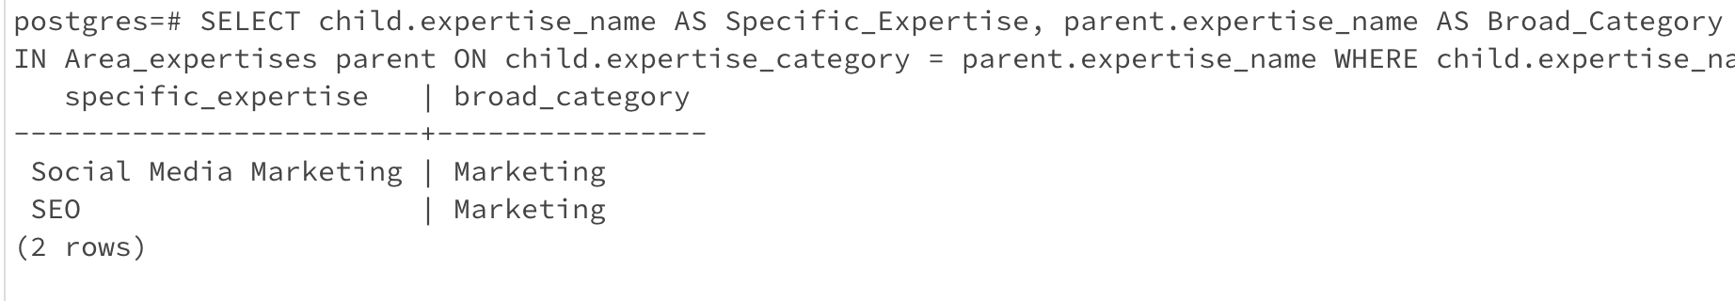
5. A Self Join query
SELECT child.expertise_name AS Specific_Expertise, parent.expertise_name AS Broad_Category FROM Area_expertises child JOIN Area_expertises parent ON child.expertise_category = parent.expertise_name WHERE child.expertise_name <> parent.expertise_name;
Lists specific areas of expertise along with their broader categories where both are distinct from each other.

Slide 12
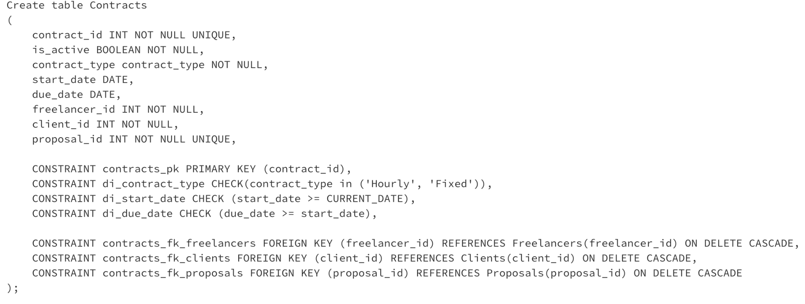
CHECK Statements used
Used to assert domain integrity.
ensure the data values entered into a database adhere to defined domain constraints and are within acceptable, predefined ranges.

Slide 13
Action Statement: On Delete Restrict
Prevent deletion of record from parent table if matching entries in child table.
1 Freelancer is an expert in 1 Area of Expertise (One to One).
CONSTRAINT freelancers_fk_area_expertises FOREIGN KEY (expertise_id) REFERENCES Area_expertises(expertise_id)ON DELETE RESTRICT
DELETE FROM area_expertises where expertise_id = 1;

Slide 14
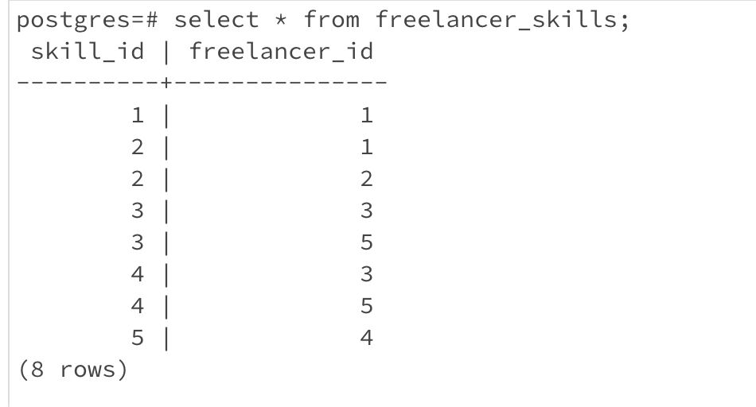
Action Statement: On Delete Cascade
Deleting a record in parent table automatically deletes all related records in child table.
Freelancers Skills Many to Many Relationships
CONSTRAINT freelancer_skills_fk_skills FOREIGN KEY (skill_id) REFERENCES Skills(skill_id) ON DELETE CASCADE

Slide 15
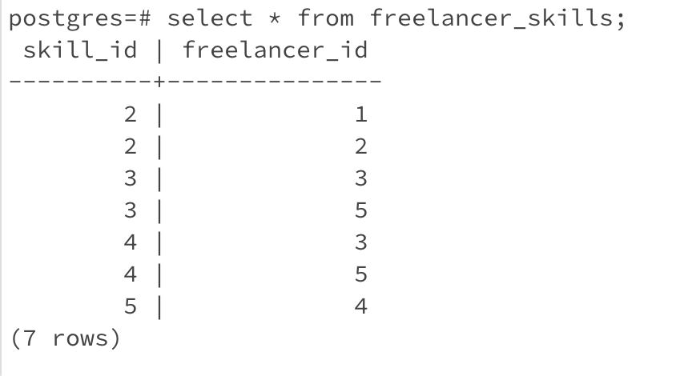
DELETE FROM skills where skill_id = 1;

Slide 16
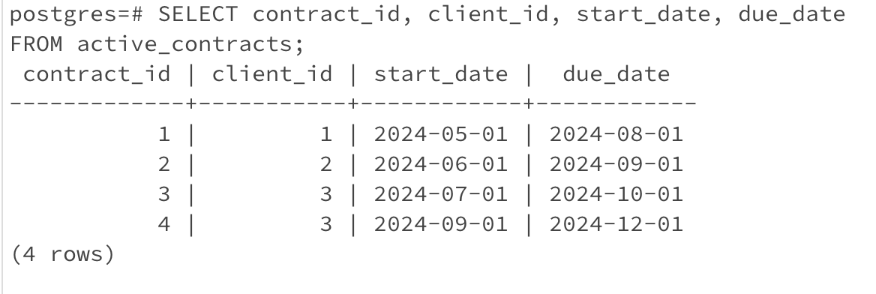
SQL View
A view of all active contracts in the platform as view Active_contracts.
SELECT contract_id, client_id, start_date, due_date FROM active_contracts;

Slide 17
That’s it!
Thank you

