Slide 1
Prototype version 1: with QR code popup

Slide 2
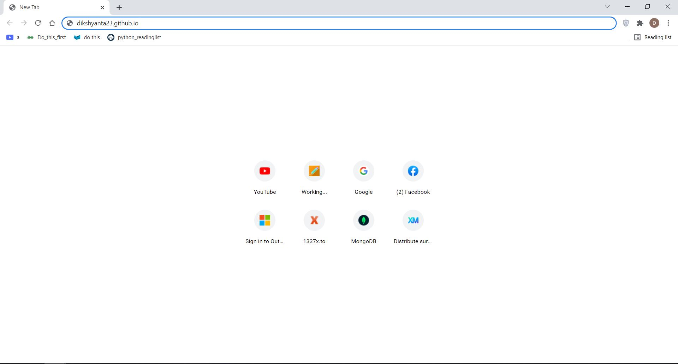
On a device connected to the internet, enter the link https://dikshyanta23.github.io on any browser of your choice.

Slide 3
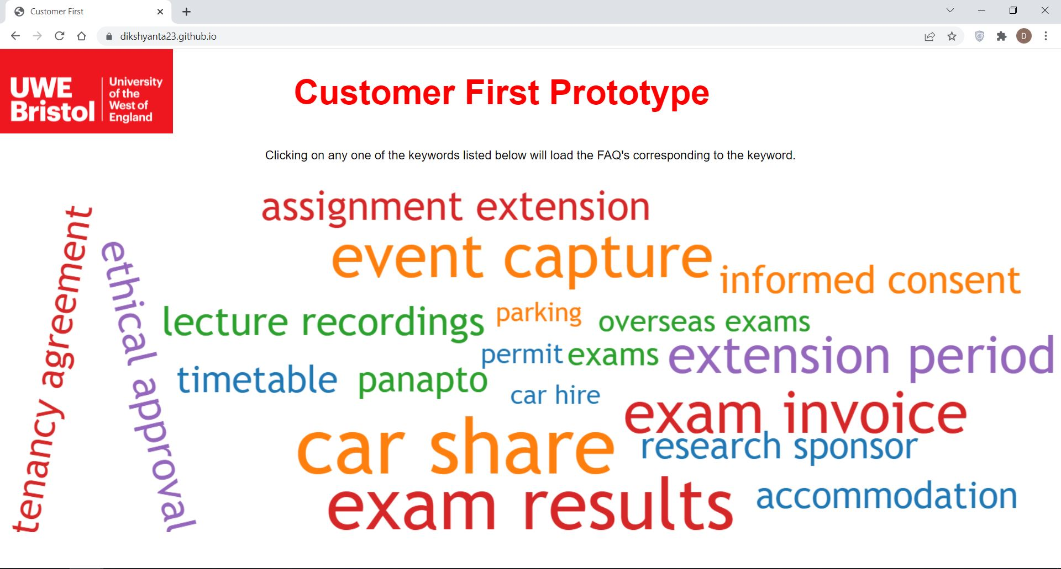
A page like this will load. From here, click on a keyword of your choice. For this example, assignment extension is clicked.

Slide 4
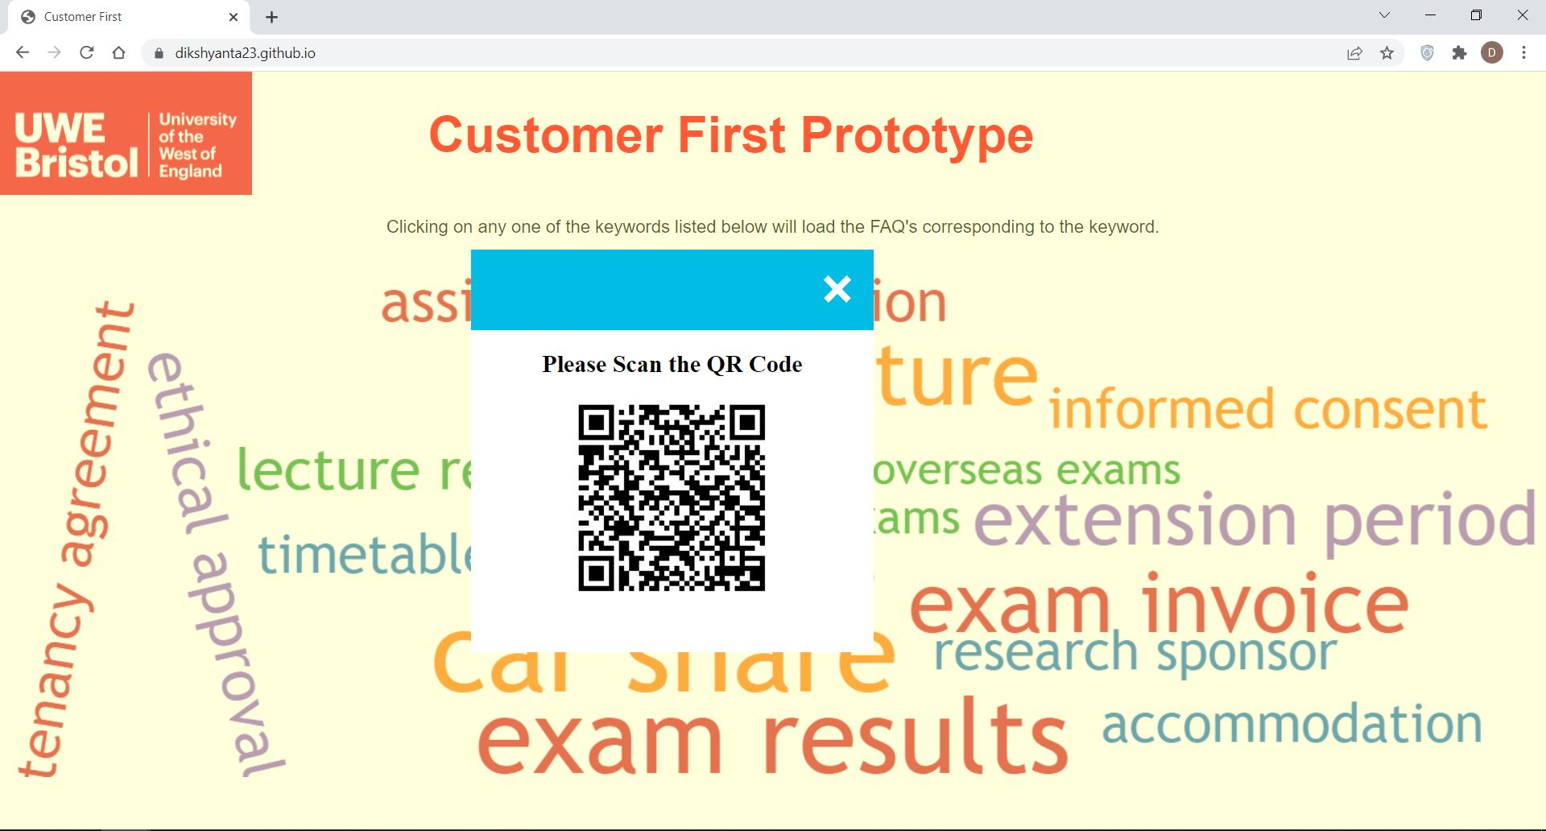
A box with a QR code pops up. Scan the QR code using your mobile phone’s camera.

Slide 5
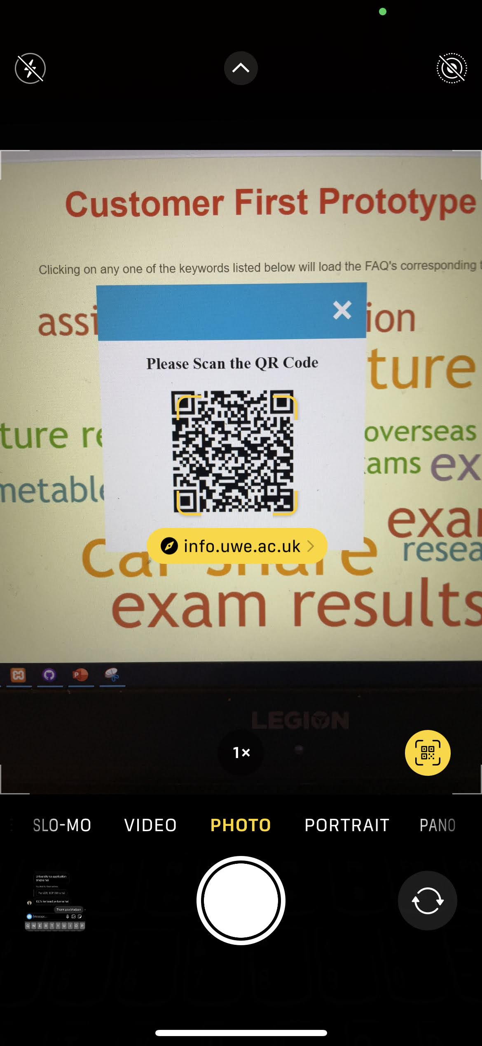
This step is done in an iOS device. Android devices may have a different layout. However, on either devices, the QR code will provide a pointer and the user should select that pointer. In this case, the pointer is the yellow popup on the screen

Slide 6
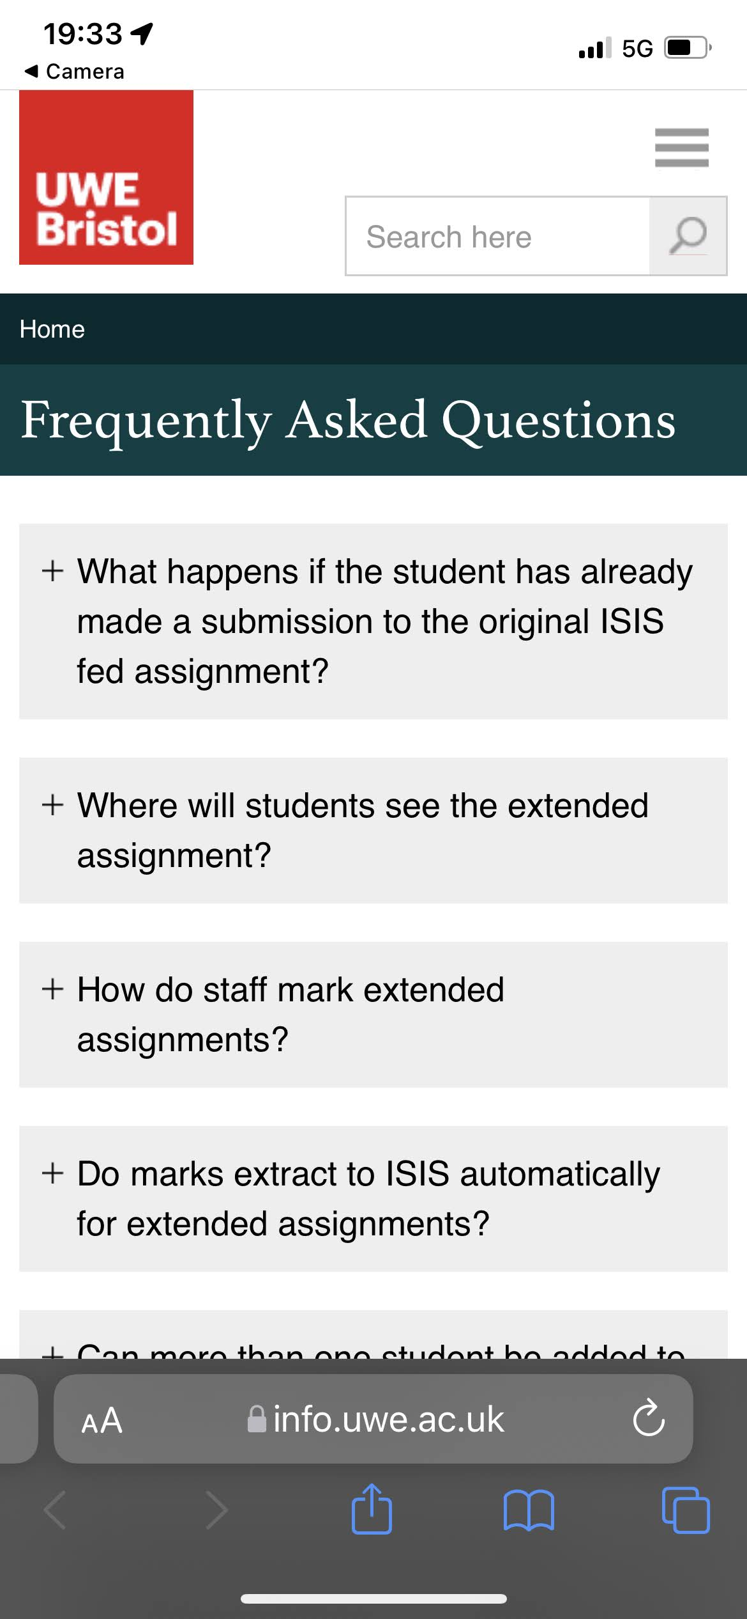
The pointer should lead the user to a FAQ page in the university website with FAQs corresponding to the selected keyword

Slide 7
Version 2: without QR code popup

Slide 8
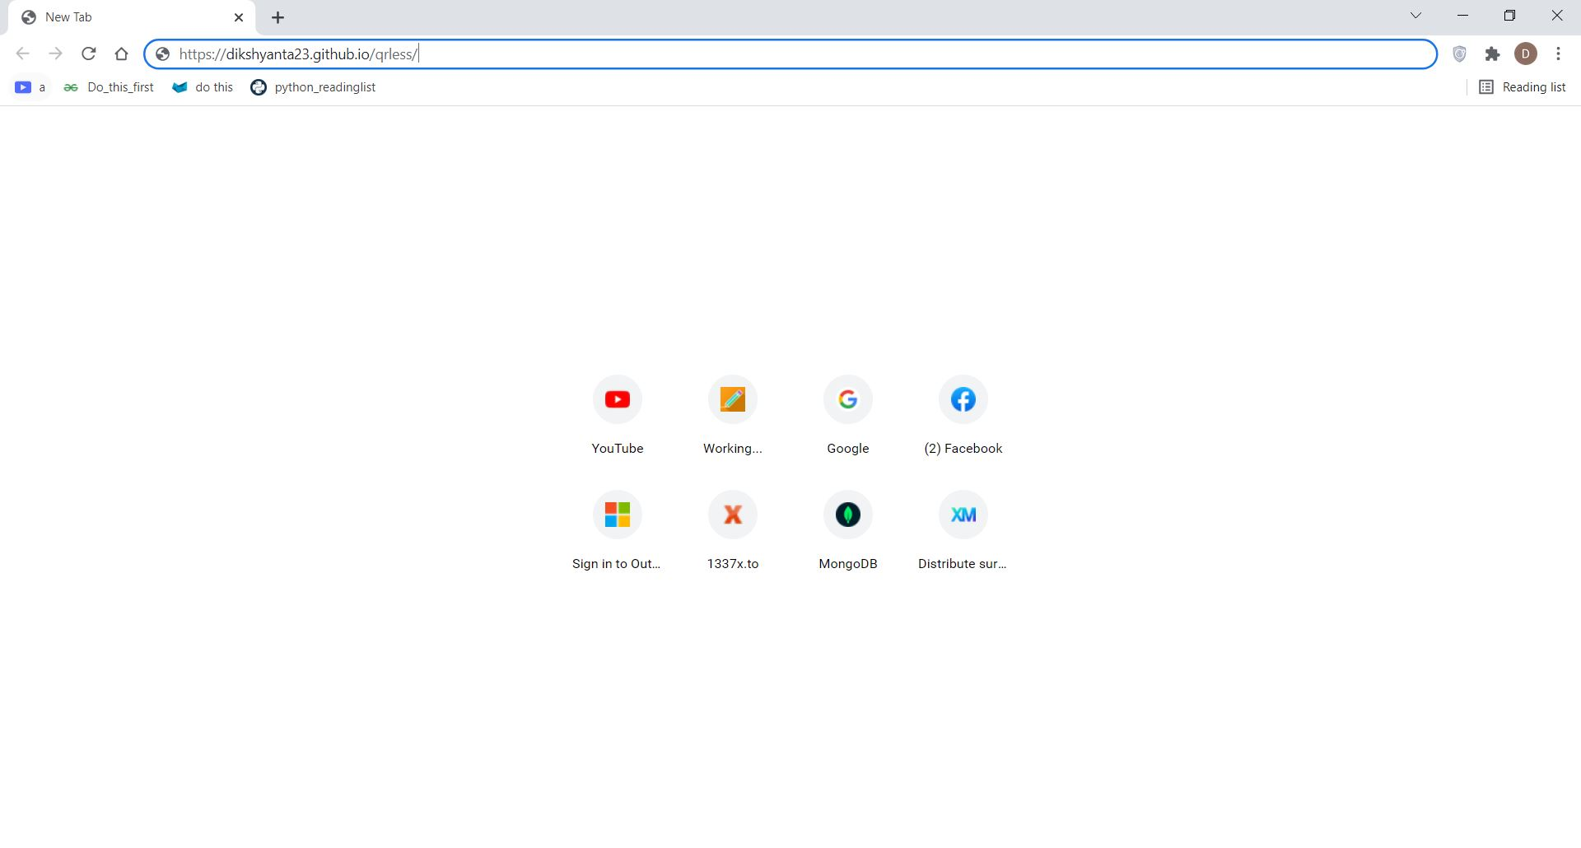
On a device connected to the internet, enter https://dikshyanta23.github.io/qrless on any browser of your choice

Slide 9
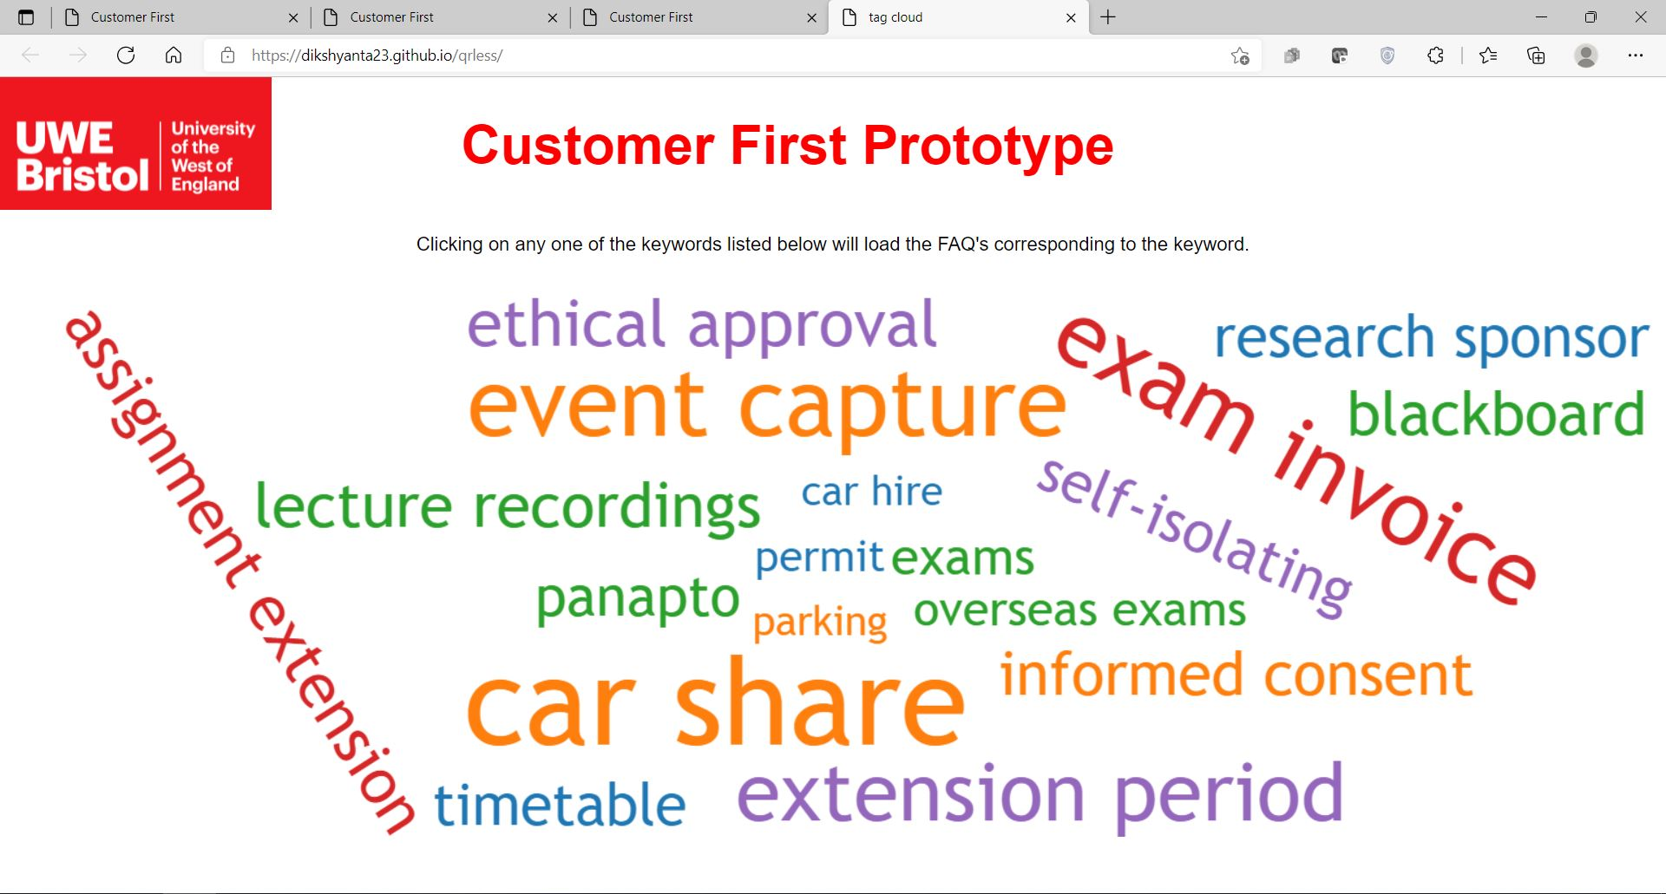
A page like this will load. From here, click on a keyword of your choice. For this example, assignment extension is clicked.

Slide 10
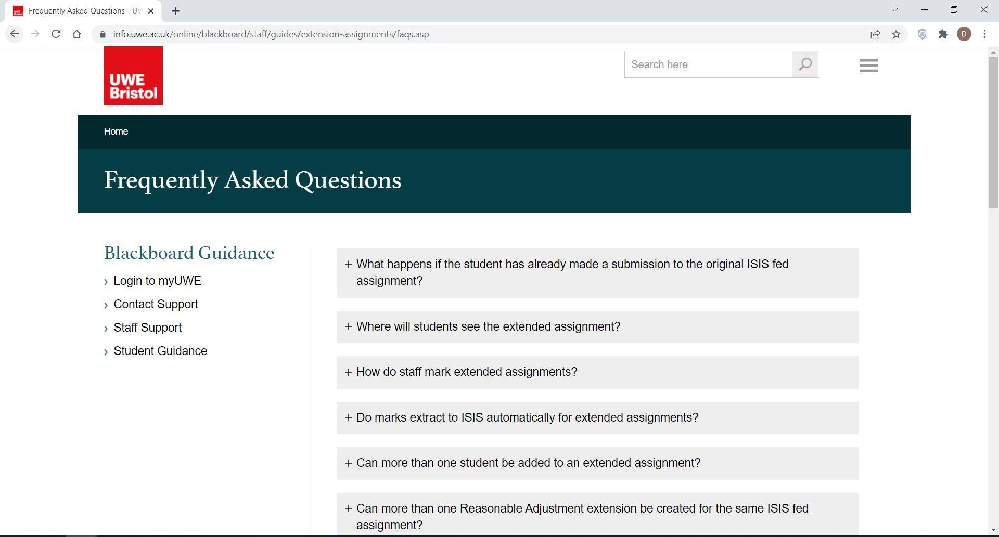
Upon clicking the keyword, a page containing FAQs corresponding to the keyword is displayed on the browser.

