Slide 1
A COMMUNITY TALK
The Attention Economy
The science of screen time — and how to take it back.
Presented by [Your Name]
Founder, Drift · [Library Name] · [Date]

Slide 2
THE HABIT WE BARELY NOTICE
When did you last
check your phone?
The average person now checks 205 times a day — about once every five waking minutes. Ask people to guess their own number, and most say ten.

Slide 3
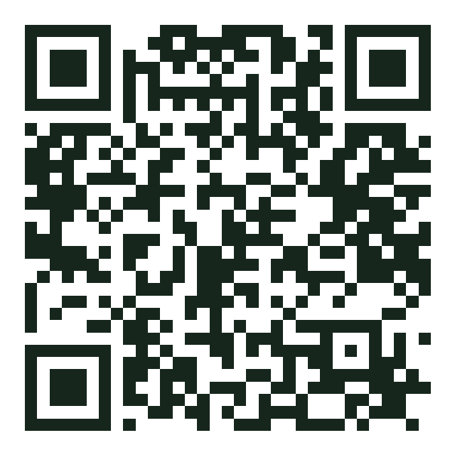
THE SCALE OF IT
This is the average — not the extreme
4h 39m
205×
2,617
Average time an adult spends on their phone every day (2024)
Times a day we check it — about once every 5 waking minutes
Separate taps, swipes and clicks on it every single day
That's more than 70 full days a year — over two months of your waking life, every single year, spent looking at a screen.
YOUR TURN
Scan to see your own number
A 20-second calculator: how many years of your life your phone adds up to.
Drift · The Science of Screen Time
3

Slide 4
PART 1
Why it's so hard
to put down
Four forces engineered into the apps in your pocket — none of them about your character.

Slide 5
THE MYTH
It is not a willpower problem
We treat phone habits like a moral failing — just put it down, show some discipline.
THE ASYMMETRY
You
But you are not facing a neutral tool. You're facing thousands of the world's best designers, data scientists and behavioral psychologists — whose full-time job is to keep your attention.
A few minutes of willpower, at the end of a tired day.
vs.
A billion-dollar industry
Optimizing every pixel, 24/7, with your data as feedback.
Drift · The Science of Screen Time
5

Slide 6
FORCE 1 · THE REWARD LOOP
A slot machine in your pocket
Variable-ratio reinforcement. B.F. Skinner found that rewards delivered on an unpredictable schedule are the most compulsive of all — more than a predictable reward every time.
1
Pull to refresh
the lever
2
Unpredictable payoff
Pull to refresh. Maybe something great, maybe nothing. That 'maybe' is the exact mechanism slot machines use — now on the screen you check 205 times a day.
the jackpot
3
Do it again
the compulsion
Drift · The Science of Screen Time
6

Slide 7
FORCE 2 · BRAIN CHEMISTRY
Dopamine isn't the pleasure chemical
The myth
What the research shows
“Dopamine = pleasure.
Likes make us feel good.”
Dopamine drives wanting — not liking.
Berridge & Robinson's work separates seeking from enjoying. Apps flood the ‘seeking’ system — so you keep chasing a hit you never quite land. That's the itch you can't scratch.
If it were really pleasure, we'd feel satisfied and stop. We don't.
Drift · The Science of Screen Time
7

Slide 8
FORCE 3 · NO BRAKES
Designed to have no natural stopping point
1
Infinite scroll
The old way had
stopping cues
The page never ends. Older designs had page 2, page 3 — a natural 'shall I go on?' moment. That pause was deliberately removed.
2
Autoplay
An empty plate. The end of a chapter. The last page of the newspaper. A signal that said: you're done.
The next video starts before you decide to watch it. The default is 'keep going,' and defaults win.
3
Streaks & badges
The feed removed all of them.
Manufactured obligations that punish you for stopping — quit and you 'lose' something.
Drift · The Science of Screen Time
8

Slide 9
FORCE 4 · THE HIDDEN TAX
Every glance costs more than the glance
Attention residue. Every time you switch — even a five-second glance at a notification — part of your mind stays stuck on the last thing. Sophie Leroy named this in 2009: your full attention doesn't arrive with you.
5 sec
The glance you notice
So a five-second check doesn't cost five seconds. UC Irvine's Gloria Mark clocked the average return to full focus at 23 minutes. Her latest work: our attention on any one screen now lasts about 47 seconds.
23 min
To refocus fully after a single interruption
Drift · The Science of Screen Time
9

Slide 10
THE BODY KEEPS THE SCORE
It follows you into the night
Blue light delays sleep
The bedtime doomscroll
Displacement
In a Harvard study (PNAS, 2015), reading on a screen before bed cut melatonin by 50%+ and pushed the body clock back ~1.5 hours — with groggier mornings after.
The variable-reward loop is most powerful when you're tired and your guard is down — exactly when you meant to sleep.
Every hour on the phone is an hour not spent sleeping, moving, or with people. Often it's the sleep and the face-to-face time that lose.
Drift · The Science of Screen Time
10

Slide 11
THE GENERATION THAT GREW UP ON IT
The timing is hard to ignore
Teen mental health held broadly steady through the 2000s — then turned sharply downward around 2012–2013, just as smartphones and social media became near-universal. The rise in anxiety, depression and self-harm was steepest among teen girls.
~2012
When the curves for teen depression and self-harm began to climb
Psychologist Jonathan Haidt (The Anxious Generation, 2024) calls it a 'great rewiring of childhood.' The science is still correlational and debated — but few dispute the pattern.
~20 hrs
A week the average teen girl now spends on social media
Drift · The Science of Screen Time
11

Slide 12
PART 2
The reframe
that changes everything
Stop fighting yourself. Start changing the design around you.

Slide 13
The problem was never your willpower.
The problem is the
design.
What follows from that
→
→
→
Willpower doesn't scale
Design does scale
This is good news
You can't out-discipline a system optimizing against you 24/7. It works for a day and fails on the tired ones.
Change your environment once and it keeps working while you sleep — no daily heroics required.
It means the fix isn't 'become a better person.' It's 'set things up smarter.' That's learnable.
Drift · The Science of Screen Time
13

Slide 14
PART 3
What actually
works
Five design principles you can use tonight — no app required.

Slide 15
THE TOOLKIT
Five principles that beat willpower
1
Add friction
4
Replace, don't just remove
Make the pull-to-open cost a few seconds more.
Give the freed-up time somewhere to go.
2
Design your environment
5
Make it accountable
Change defaults so the easy path is the good one.
Borrow social pressure — do it with others.
3
Use a commitment device
None of these require more discipline.
They require better setup — done once.
Lock in your future self while you're clear-headed.
Drift · The Science of Screen Time
15

Slide 16
PRINCIPLE 1
Add friction to the bad, remove it from the good
Small speed bumps beat big intentions. A 15-second delay is often enough to break the automatic reach.
Grayscale mode
Delete, don't just close
Log out every time
Draining the color makes the feed far less magnetic — the dopamine cues dim.
Kill the app from your phone; use it in the browser. The extra step is the point.
Re-typing the password is a 15-second pause that lets the urge pass.
Hide the triggers
Kill the badges
Charge it in another room
Off the home screen, into a folder on page 3. Out of sight, out of thumb.
Turn off red notification dots — they manufacture urgency that isn't real.
Friction for the worst offender: the bedtime and first-thing-morning scroll.
Drift · The Science of Screen Time
16

Slide 17
PRINCIPLE 2
Design defaults, because defaults win
You will not make a fresh, wise decision 205 times a day. So don't rely on deciding — set the default once, and let it carry you.
✓
Phone-free zones
✓
Analog alarm clock
The dinner table. The bedroom. The first 30 minutes awake. Make the rule about the place, not the moment.
Breaks the single most damaging loop: phone is the last thing at night, first in the morning.
✓
A basket by the door
✓
Scheduled downtime
A home for the phone when you walk in, so it isn't fused to your hand all evening.
Use the phone's own tools to auto-lock distracting apps at set hours — a default you don't renegotiate.
Drift · The Science of Screen Time
17

Slide 18
PRINCIPLE 3
Commitment devices: bind your future self
A commitment device is a choice you make now, while you're clear-headed, that limits what tired-you can do later. Odysseus tying himself to the mast so he couldn't chase the sirens — same idea, modern problem.
App limits with teeth
Stakes & promises
Earn-it systems
Set a hard cap you can't casually override in the moment of weakness.
Tell someone your goal, or put money on it. Now quitting has a cost.
Make screen time contingent on something first — a walk, a task, real life.
Drift · The Science of Screen Time
18

Slide 19
PRINCIPLE 4
Replace the habit — don't just delete it
A phone habit fills a real need — boredom, stress, connection, a moment's rest. Remove it without a replacement and the vacuum pulls you right back.
Bored in a queue → A book or podcast queued and ready
Winding down at night → A bath, a stretch, a few pages of fiction
Craving connection → A text to a real friend, or a call
Need a mental break → A walk outside — even five minutes resets more than a scroll
Drift · The Science of Screen Time
19

Slide 20
PRINCIPLE 5
Do it with other people
Willpower is a solo sport and it loses. Accountability borrows other people's — and turns a private struggle into a shared one.
✓
Phone stacks
✓
Family charging station
At dinner, everyone's phone goes in a pile. First to reach for it does the dishes.
One spot where everyone's phone sleeps at night. The rule applies to parents too.
✓
A screen-time buddy
✓
Tell people your why
Share weekly numbers with a friend. Being seen changes behavior more than any app setting.
Saying the goal out loud to others makes backing out cost something social.
Drift · The Science of Screen Time
20

Slide 21
SO FAR
What we've covered
The science
✓
Add friction Slow the bad, speed the good.
It's not willpower. Reward loops, dopamine-seeking, no stopping cues and attention residue are engineered in.
✓
Design defaults Decide once; let it carry you.
The reframe
✓
Commit ahead Bind your future self.
Stop fighting yourself. Change the design around you — that's what scales.
✓
Replace & share Fill the gap; do it with others.

Slide 22
PART 4
One tool that does
this for you
Full disclosure: this is the part I built. Everything before it stands on its own.

Slide 23
WHY I BUILT DRIFT
I couldn't out-willpower my own phone either.
I tried every tip on the last few slides. They worked — until a tired evening, when I'd just turn the limit off. So I built the commitment device I wished existed: one that makes the good thing the price of the screen time. Not more discipline — better design, running for me.

Slide 24
HOW DRIFT WORKS
Earn your screen time
1
2
3
Choose what to block
→
Do something real first
→
Unlock earned time
Pick the apps that eat your day. Drift puts a Screen Time shield in front of them.
Complete a task, a walk, a goal — the things you actually want to spend time on.
Real effort converts into minutes. The shield lifts for exactly what you've earned — then it's back.
The flip: screens stop being the default you fall into, and become the reward you unlock — after real life gets its turn first.
Drift · The Science of Screen Time
24

Slide 25
WHY IT WORKS
Drift is tonight's science, automated
✓
Adds friction
✓
Earn-it, built in
The shield is a real speed bump in front of the apps you chose — not a reminder you can wave away.
Screen time becomes contingent on real effort — Principle 3, running automatically.
✓
It's a commitment device
✓
Replaces, doesn't just block
You set the rules clear-headed; tired-you can't casually override them at 11pm.
The 'task first' step points you at the better thing, so blocking doesn't leave a vacuum.
You don't have to remember to do all five by hand. That's the only thing the app really sells: it makes the good design the default, so you don't have to.
Drift · The Science of Screen Time
25

Slide 26
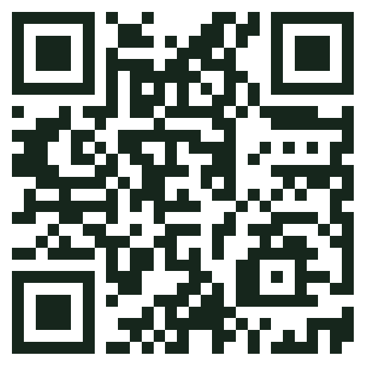
TRY IT TONIGHT
Start with one small thing
1
Pick one tip
Grayscale, or charge your phone outside the bedroom.
2
Try Drift free
Set up your first shield and earn time in two minutes.
3
Keep the calculator
Revisit your number anytime, and pass it to a friend.
Code: LIBRARY

Slide 27
OVER TO YOU
Questions?
If one idea tonight earns back even an hour of your week, that's a win.

Slide 28
SOURCES & FURTHER READING
Go deeper
eMarketer / Data.ai (2024)
Berridge & Robinson (2016)
US adults average ~4h 39m of daily phone use.
Dopamine as ‘wanting,’ not ‘liking.’
Reviews.org (2024)
Leroy (2009) · Mark, UC Irvine
Americans check their phones 205× a day, up from 144.
Attention residue; 23-min refocus; 47-sec spans.
dscout (2016)
Chang et al., PNAS (2015)
2,617 daily touches; 5,427 for heavy users.
Evening screen light suppresses melatonin, delays sleep.
Skinner · Harris / CHT
Haidt (2024)
Variable-ratio rewards & persuasive design.
The Anxious Generation — youth & screens (debated).
Read further
Stolen Focus (Hari) · Indistractable (Eyal) · Atomic Habits (Clear) · Digital Minimalism (Newport).
Thank you. — [Your Name], Drift · [email / getdriftapp.org]
Drift · The Science of Screen Time
28

