Slide 1

Homology Fed neural networks
Dilan Karaguler, CMSE802

Slide 2
Outline
Motivation
Math Background
Homology
Graphs
Dataset QM9
Results
Future Works

Slide 3
Motivation
How can topological features (like homology, persistent or Mayer homology) be used to enhance data analysis of graph/network dataset?

Slide 4
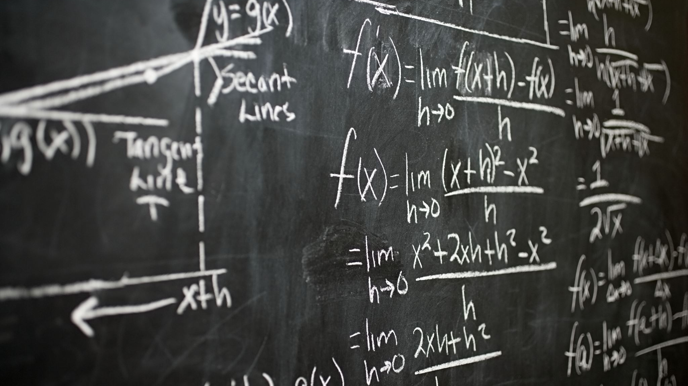
Math Background

Slide 5
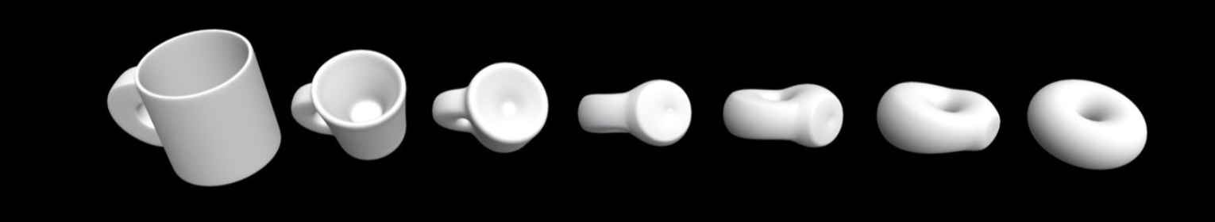
Homology
Homology is a topological invariant that helps understand the shape and structure of a space by analyzing its "holes" in different dimensions
Homology Groups: The homology groups capture the number of independent "holes" in a space at different dimensions:
H_0: Captures connected components of a space (0-dimensional holes).
H_1​: Captures loops or cycles (1-dimensional holes).
H_2​: Captures voids or cavities (2-dimensional holes), and so on.
Betti Numbers: The dimension of the homology groups

Slide 6
Graph Theory
Basic Terminology:
Vertex (Node): A point representing an object in the graph.
Edge: A connection between two vertices.
Directed vs. Undirected Graphs: In directed graphs (digraphs), edges have a direction (from one vertex to another). In undirected graphs, the edges do not have direction.

Slide 7
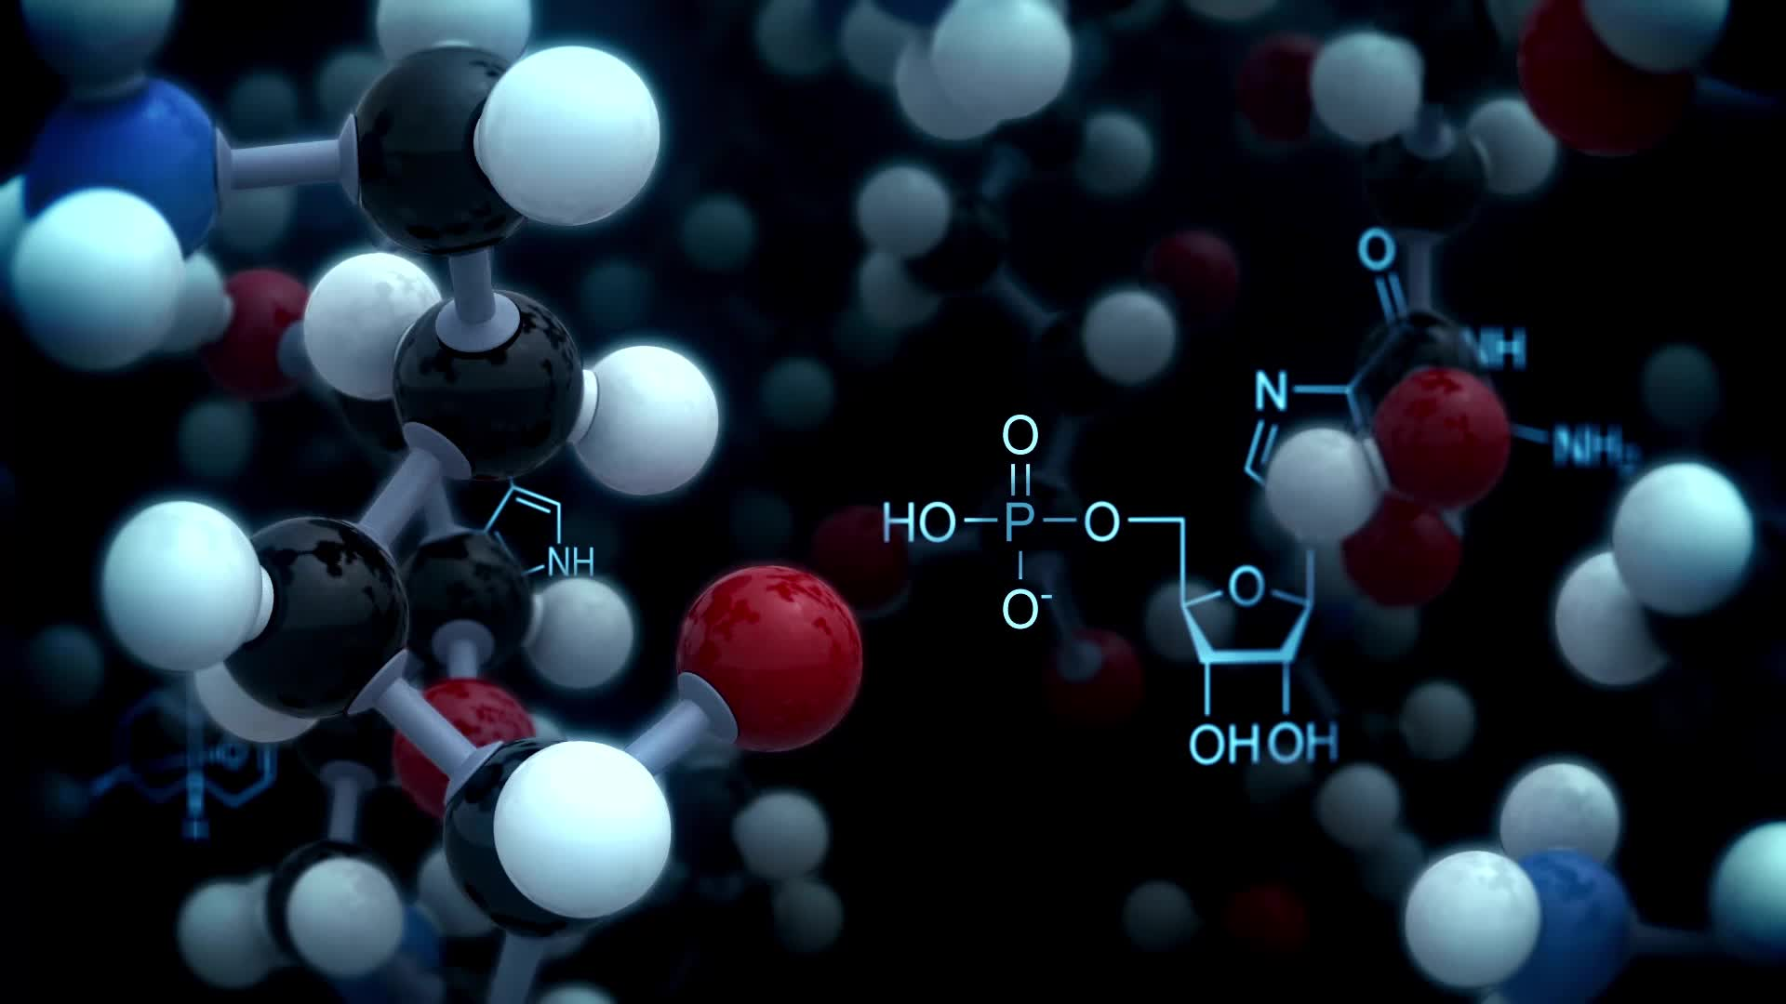
Dataset QM9
The QM9 dataset consists of quantum mechanical properties for 134,000 small organic molecules (up to 9 atoms) consisting of hydrogen, carbon, nitrogen, and oxygen. It is commonly used in computational chemistry and molecular machine learning.
Location of atoms in each molecule is provided.

Slide 8
Why QM9?
Multi-task Learning: Predict multiple properties from the same dataset.
Graph-based: Perfect for graph structured dataset, leveraging molecular structures.
Benchmark: A widely used dataset for molecular machine learning research.

Slide 9
Preprocess of QM9 dataset
Location information and atom types
Convert to Path Complexes
Compute the boundaries
Compute Betti Numbers

Slide 10
Structure of Neural Network
Input Layer: Betti numbers (list of length 6 for each molecule)
Hidden Layer 1: A layer with 64 units and ReLU activation to learn complex patterns from the input.
Hidden Layer 2: A second layer with 128 units and ReLU activation, allowing the model to capture deeper relationships.
Hidden Layer 3: A third layer with 64 units and ReLU activation, refining the learned features.
Output Layer: The final layer has 17 units with a linear activation, predicting 17 continuous properties for each molecule.

Slide 11
Model Compilation
Optimizer: The model is optimized using Adam, which adjusts the learning rate during training for better performance.
Loss Function: Mean Squared Error (MSE) is used to minimize the error between predicted and true values.
Metrics: The Mean Absolute Error (MAE) is tracked to evaluate prediction accuracy.

Slide 12
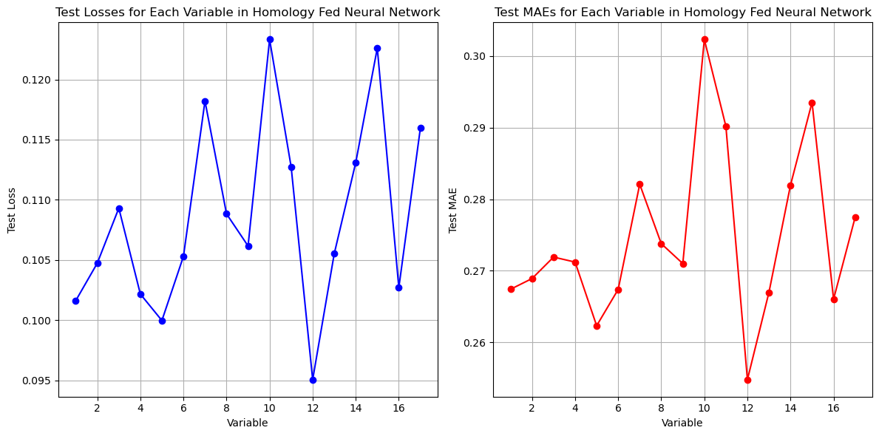
Results
Dipole Moment
Isotropic Polarizability
Highest Occupied Molecular Orbital Energy (HOMO)
Lowest Unoccupied Molecular Orbital Energy (LUMO)
Gap Between HOMO and LUMO
Electronic Spatial Extent
Zero Point Vibrational Energy
Internal Energy at 0K
Internal Energy at 298.15K
Enthalpy at 298.15K
Free Energy at 298.15K
Heat Capacity at 298.15K
Atomization Energy at 0K
Atomization Energy at 298.15K
Atomization Enthalpy at 298.15K
Atomization Free Energy at 298.15K
Rotational Constant
Rotational Constant (2nd value)
Rotational Constant (3rd value)

