Slide 1
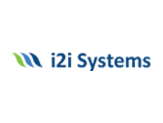

AGILE
DİLAN KAVAK
03/08/2021

Slide 2
CONTENTS
WHAT IS AGILE?
AGILE REPORT
RAPİD SOFTWARE DEVELOPMENT
PLAN-BASED DEVELOPMENT OR AGILE DEVELOPMENT
AGILE METHODS
WATERFALL OR AGILE
AGILE MANİFESTO
AGILE VALUES
AGILE DEVELOPMENT TECHNIQUES
AGILE PROJECT MANAGEMENT
SCRUM
THE SCRUM SPRİNT CYCLE
AGİLE ADVANTAGES/DİSADVANTAGES

Slide 3
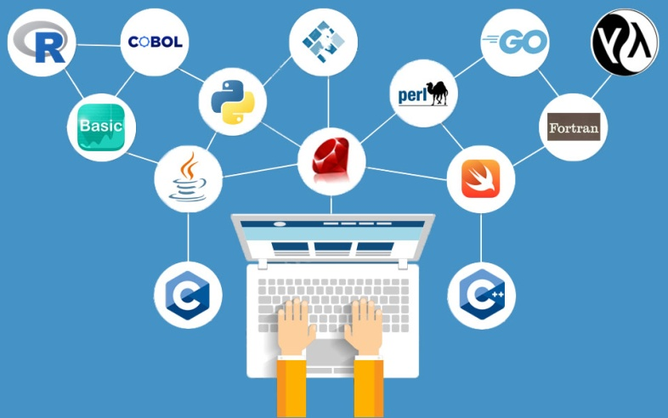
WHAT IS AGILE?
Agile is an organization's ability to adapt to new conditions and change direction to create new business opportunities.

Slide 4
WHY AGILE?
The most important concepts defining today's world stand out as the extraordinary speed of change, complexity and uncertainty about the future.
For this reason, the main factors that determine the success of organizations are;
It can be summarized as adapting to constant change, dealing with complexity with simple solutions, and trying to minimize uncertainty with learning to be obtained with an experimental approach.

Slide 5
AGILE REPORT
The 14th edition of the "State of Agile Report", the world's longest-running agility report, was published in May 2020.
According to the survey, which has been answered by more than 40 thousand professionals from all over the world, the most important gains created by agility in organizations are listed as follows.

Slide 6

AGILE REPORT RESULTS
Changing - Ability to Manage 70%
Project Visibility - 65%
Business - IT Compatibility - 65%
Delivery Speed / Time to Market - 60%
Team Morale - 59%
Increased Tool Productivity - 58%
Reducing Project Risk - 51%
Project Predictability - 50%

Slide 7
RAPID SOFTWARE DEVELOPMENT
Rapid development and delivery is now often the most important requirement for software systems.
Plan-driven development methods is essential for some types of system but does not meet these business needs.
Agile development methods emerged in the late 1990s whose aim was to radically reduce the delivery time for working software systems.

Slide 8
PLAN-DRIVEN DEVELOPMENT
A plan-driven approach to software engineering is based around separate development stages with the outputs to be produced at each of these stages planned in advance.
Not necessarily waterfall model – plan-driven, incremental development is possible
Iteration occurs within activities.

Slide 9
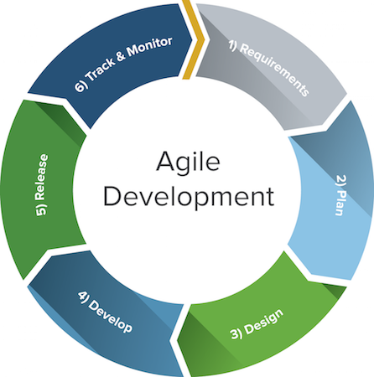
AGILE DEVELOPMENT
Specification, design, implementation and testing are interleaved and the outputs from the development process are decided through a process of negotiation during the software development process.

Slide 10
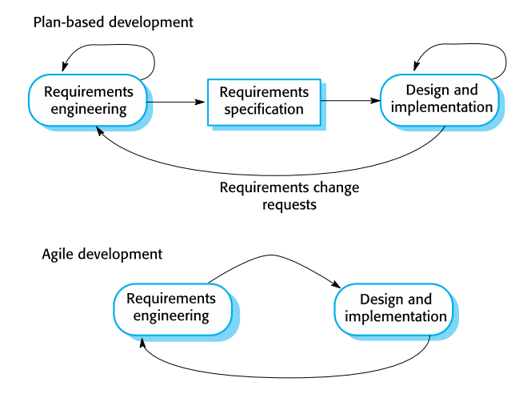
PLAN-BASED DEVELOPMENT OR AGILE DEVELOPMENT

Slide 11
AGILE METHODS
Dissatisfaction with the overheads involved in software design methods of the 1980s and 1990s led to the creation of agile methods. These methods:
Focus on the code rather than the design
Are based on an iterative approach to software development
Are intended to deliver working software quickly and evolve this quickly to meet changing requirements.
The aim of agile methods is to reduce overheads in the software process (e.g. by limiting documentation) and to be able to respond quickly to changing requirements without excessive rework.

Slide 12
WHAT AGILE MANİFESTO?
The Agile Manifesto and the Twelve Principles of Agile Software after industry failure emerged in the 1990s.
During this period, there was a significant delay between the business requirements, applications and features requested by customers and the delivery of technologies that meet customer demands, resulting in the cancellation of many projects.
During this delay, business requirements and customers' demands changed, and the final product could not meet current needs.
A group of 17 people came to a consensus at the end of their meeting and wrote the Agile Manifesto and the 12 Principles of Agile Software.

Slide 13


WATERFALL OR AGILE
In this period, the software development models of the day pioneered by the Waterfall model; it was insufficient to meet the demand for speed and could not take advantage of the rapid change of software.

Slide 14
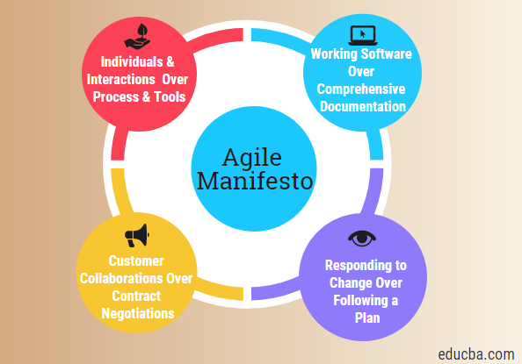
AGILE MANİFESTO
That is, while there is value in the items on the right, we value the items on the left more.

Slide 15
AGILE VALUES
Individuals and interactions over processes and tools
This value of Agile Manifesto emphasizes giving more importance to communication with customers.
There are many things customers may want to ask and it is the responsibility of team members to ensure that all questions and suggestions from customers are dealt with promptly.

Slide 16
AGILE VALUES
Working software over comprehensive documentation
In the past, more focus was placed on accurately documenting each phase of the project than on the project itself.
In fact, it has often been seen that proper documentation is done at the expense of the final product.
Agile values indicate that the first and foremost task of the project team is to complete the final deliverables set by the customers.

Slide 17

Is it the product that meets the user's wishes?
This question is very important

Slide 18

AGILE VALUES
Customer collaboration over contract negotiation
Agile principles require customers to be involved in every phase of the project.
The waterfall approach or traditional methodologies allow clients to negotiate only before and after the project.
This was a waste of both time and resources. If customers can keep the development process in the loop, team members can ensure that the final product meets all of the customer's requirements.

Slide 19
AGILE VALUES
Responding to change over following a plan
Contrary to management methodologies in the past, agile values are opposed to detailed plans created before starting the project and sticking to the plan no matter what.
Conditions may change and sometimes customers may request new features for the final product that can change the scope of the project.
In such cases, project teams and managers must adapt to rapidly changing new conditions in order to deliver a high quality product and achieve 100% customer satisfaction.

Slide 20
AGILE DEVELOPMENT TECHNIQUES
Extreme programming
User stories for requirements
Refactoring
Test-first development
Customer involvement
Test automation
Pair programming

Slide 21
AGILE PROJECT MANAGEMENT
The principal responsibility of software project managers is to manage the project so that the software is delivered on time and within the planned budget for the project.
The standard approach to project management is plan-driven. Managers draw up a plan for the project showing what should be delivered, when it should be delivered and who will work on the development of the project deliverables.
Agile project management requires a different approach, which is adapted to incremental development and the practices used in agile methods.

Slide 22
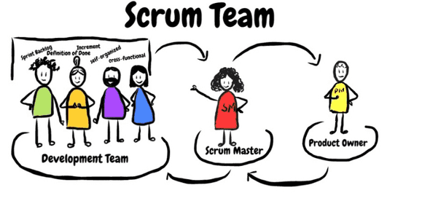
SCRUM
Scrum is an agile method that focuses on managing iterative development rather than specific agile practices.
There are three phases in Scrum.
The initial phase is an outline planning phase where you establish the general objectives for the project and design the software architecture.
This is followed by a series of sprint cycles, where each cycle develops an increment of the system.
The project closure phase wraps up the project, completes required documentation such as system help frames and user manuals and assesses the lessons learned from the project.

Slide 23
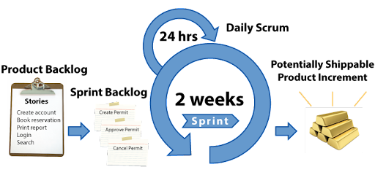
The Scrum sprint cycle
Sprints are fixed length, normally 2–4 weeks.
The starting point for planning is the product backlog, which is the list of work to be done on the project.
The selection phase involves all of the project team who work with the customer to select the features and functionality from the product backlog to be developed during the sprint.

Slide 24
The Scrum sprint cycle
Once these are agreed, the team organize themselves to develop the software.
During this stage the team is isolated from the customer and the organization, with all communications channelled through the so-called ‘Scrum master’.
The role of the Scrum master is to protect the development team from external distractions.
At the end of the sprint, the work done is reviewed and presented to stakeholders. The next sprint cycle then begins.

Slide 25
AGILE ADVANTAGES
Short planned cycles give your organization flexibility for changing requirements and sudden changes.
Your customers actively provide feedback to create the product and solve problems easily.It ensures faster resolution of problems thanks to the communication established by giving priority to team participation.
Any problem that arises as the project progresses rapidly is used as a stepping stone for a better solution in the next cycle.

Slide 26
AGİLE DISADVANTAGES
Costs are unpredictable as product requirements are constantly changing.
Constant feedback from customers may disappoint you, or some customers just may not have the time or interest.
When customers want to give feedback, new requests that come to mind reveal additional stages. This can prolong project costs and duration.
It will be difficult to implement in large Corporate structures where communication with the customer is difficult.

Slide 27
source
Ian Sommerville-Software Engineering
https://www.acmagile.com/agile-nedir/
https://guide.quickscrum.com/agile-transformation/
https://agilemanifesto.org/
https://www.pem360.com/blog/Agile/Agile-Yontemlerin-Avantajlari-ve-Dezavantajlari/183

Slide 28
THANK YOU FOR LISTENING TO ME ☺

