Slide 1


K.RAMAKRISHNAN COLLEGE OF ENGINEERING
(AUTONOMOUS), TRICHY
COLLEGE HOSTEL BOOKING SYSTEM
PRESENTED BY SUPERVISOR
DILANI R Mr.V.KUMARARAJA, M.E., (PhD),
8115U23EC023 AP/CSE
6/12/2024

Slide 2
PRESENTATION OVERVIEW
Project Introduction
Objective
Problem Statement
Java Concept
Modules Used
Architecture of the proposed system
Merits and Demerits
Program Execution and Output

Slide 3
PROJECT INTRODUCTION
The College Hostel Booking System is a software solution designed to streamline and automate the process of booking rooms in a college hostel
Traditionally, managing hostel bookings involves manual record-keeping, in-person requests, and limited room availability updates, which can be inefficient and prone to errors
This system aims to simplify and centralize the booking process, making it accessible for students and administrators alike

Slide 4
OBJECTIVE
To streamline and automate the hostel room allocation process for efficiency and accuracy
To eliminate human errors in room booking and record-keeping through a robust system
To provide a simple and user-friendly interface for students to register, log in, and book rooms easily
To offer flexible room options based on availability and special requirements

Slide 5
PROBLEM STATEMENT
Developing a Java application that allows students to view available rooms in real-time. Implementing a booking management module that updates room availability upon confirmation of a booking and prioritizes requests based on criteria such as application date or special requirements. Ensuring that room assignments are updated in real-time to prevent overbooking

Slide 6
JAVA CONCEPT
Object-Oriented Programming (OOP)
Class and Object : The program uses the CollegeHostelBookingSystem class to define the blueprint of the application
Encapsulation is achieved by grouping related data (fields) and methods within the class
AWT (Abstract Window Toolkit)
Used for building the GUI components such as Frame, Panel, TextField, Choice, Button, and Label
Components like Dialog are used for message display
Event Handling
ActionListener: Handles button clicks (registerButton, loginButton, etc.)
ComponentAdapter: Dynamically updates the room dropdown when the Room Allocation Page is displayed

Slide 7
JAVA CONCEPT
CardLayout
Used for switching between different views or "pages" of the application, such as the Registration, Login, and Admin pages.
Dynamic Data Structures
ArrayList: Stores the list of available rooms (specialRooms, generalRooms) and booking details (bookings). These lists are dynamically updated in real time

Slide 8
MODULES USED
Student Registration Module
Allows students to register by providing details like name, roll number, username, and password
Includes a checkbox for special requirements (e.g., "Special Child")
Validates inputs and stores user data temporarily
Student Login Module
Authenticates students using their username and password
Redirects to the room allocation page upon successful login
Ensures secure access to the booking system

Slide 9
MODULES USED
Room Management Module
Handles room allocation based on availability and user type (special/general)
Updates room availability dynamically in real time
Offers AC or Non-AC room preferences
Administrator Module
Enables the admin to view and manage bookings
Displays real-time booking details, including names, dates, and times
Updates and monitors room availability effectively

Slide 10
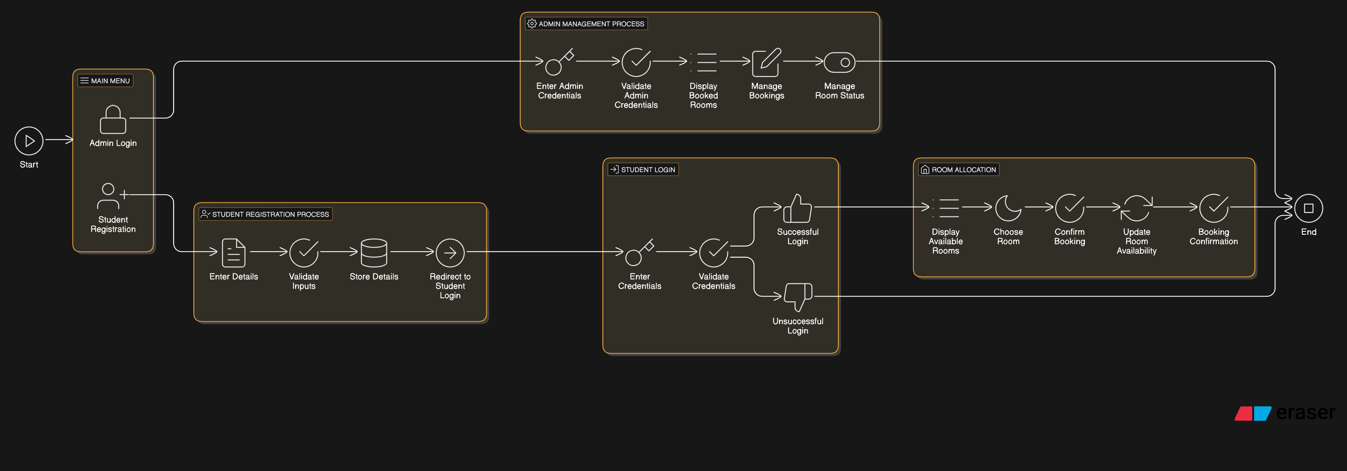
ARCHITECTURE OF PROPOSED SYSTEM

Slide 11
MERITS AND DEMERITS
MERITS
The system offers a simple and intuitive interface for both students and administrators, ensuring ease of navigation and usability
The dynamic room availability feature prevents overbooking by automatically updating room statuses based on bookings
DEMERITS
The system’s reliance on in-memory storage limits its ability to handle a large number of users, requiring a more robust database solution for scalability
The absence of advanced security measures like encrypted password storage makes the system vulnerable to potential security risks

Slide 12
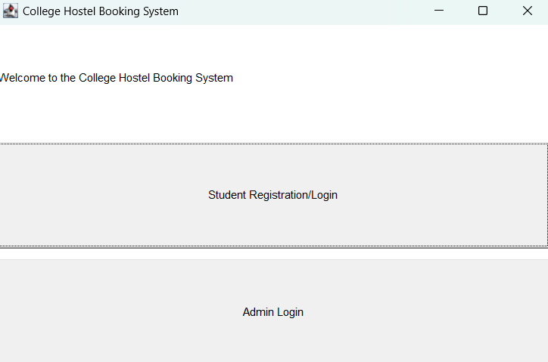
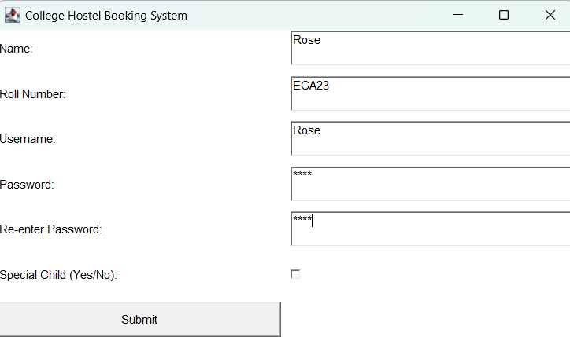
PROGRAM EXECUTION AND OUTPUT

Slide 13
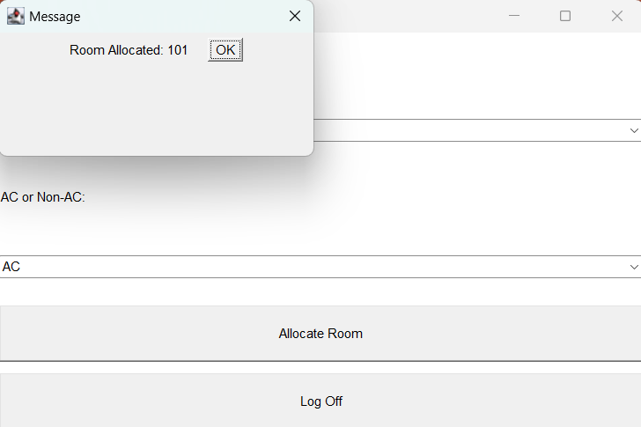
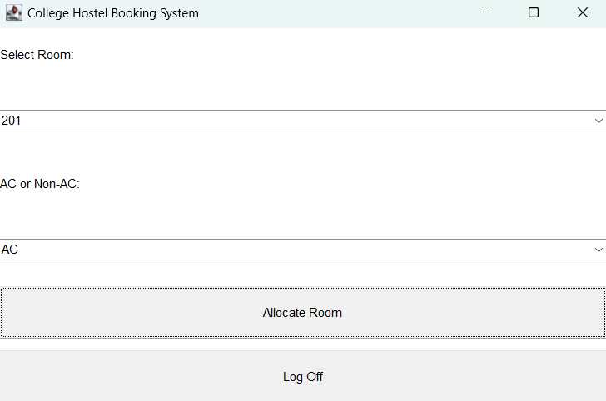
PROGRAM EXECUTION AND OUTPUT

Slide 14
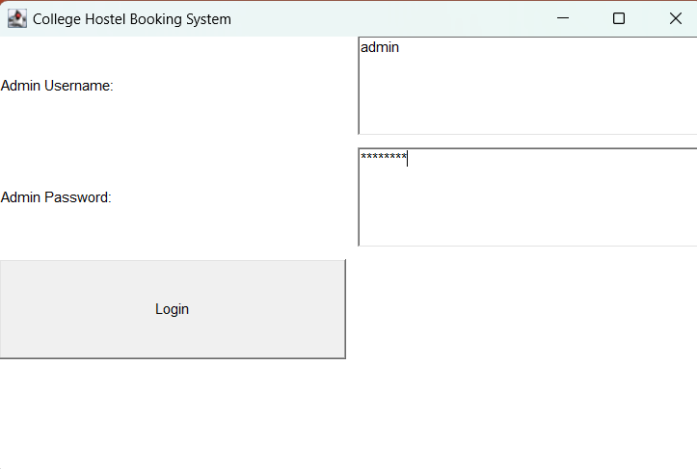
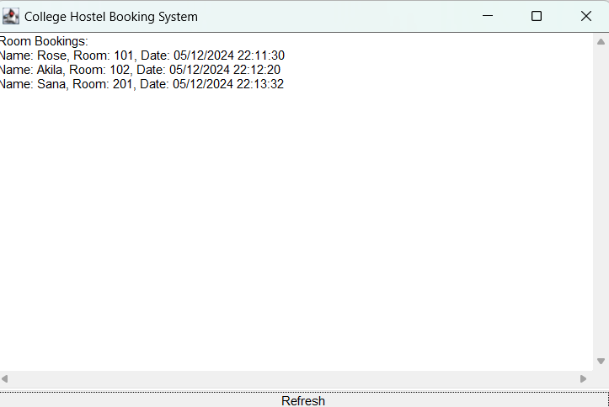
PROGRAM EXECUTION AND OUTPUT

Slide 15


