Slide 1
Online Cosmetics Ordering System
IT PROJECT MANAGEMENT | PROJECT REPORT
DRM
Website project for the online cosmetics shop Zetmart_uz
Team DRM
Usenadinova Dilaram · Baxtiyorova Ruxshona · Ergasheva Madinabonu
Notes:
Welcome. Introduce Team DRM and the project: a website for the online cosmetics shop Zetmart_uz, built with AI tools, Google Sites and Google Sheets. This report covers six deliverables: project plan, contract, use case model, business process model, work breakdown structure and Gantt chart.

Slide 2



Project Plan: Problem and Objectives
Key questions
CORE PROBLEM
1
Which product categories do customers browse and request the most?
Zetmart_uz lacks a single professional online presence. Product information is scattered, and customer inquiries and orders are handled manually, which is slow and leads to missed or inaccurate requests.
2
What information must a product page show so customers feel confident asking to order?
3
How can the manager update prices, stock and products without coding?
4
How can inquiries be recorded automatically and without errors?
Expected deliverables
Website
Google Sheets data
Documentation
Mobile-friendly Zetmart_uz site built with AI on Google Sites
Structured Products, Categories and Inquiries sheets
Contract, Use Case, BPM, WBS, Gantt and GitHub user guide
Notes:
Explain the business problem first: no single online presence, scattered product data, manual order handling. Then walk through the four questions that guide the design, and end with the three outputs the customer will receive.

Slide 3




Project Plan: Data and Approach
Dataset: Product Catalog & Customer Inquiry Records, a Google Sheets workbook provided by Zetmart_uz
Google Sites
GitHub
Google Sheets
AI tools
Site builder
Version history
Data source
Content and design
Data preparation (no code)
1
Ingestion
2
Cleaning
3
Feature engineering
Import the customer's product list and prices
Create sheets: Products, Categories, Inquiries
Fill missing descriptions, brands and photo links
Standardize names, categories and prices
Remove duplicates and test entries
Add helper columns:
in_stock_flag, discounted_price,
order_total, inquiry_status
Notes:
The whole stack is no-code: Google Sites for the website, GitHub for version history, Google Sheets as the database, AI tools for content and design. Data preparation has three steps: ingest, clean, and add helper columns with spreadsheet formulas.

Slide 4



Contract: Project Specifications
Scope
Customer requirements
Deliverables
Google Sites website built with AI
Google Sheets as the data source
Categorized catalog, search and browsing
Inquiry form recorded in Sheets
Responsive design, contact and delivery pages
Attractive site that reflects the brand
Manager updates the catalog via Sheets, no code
Automatic logging of inquiries and orders
Mobile-friendly experience
Clear contact and delivery information
Zetmart_uz website
Google Sheets workbook
Contract, Use Case, BPM, WBS and Gantt chart
GitHub repository with a user guide for the manager
Oct – Dec 2026
$0
Not included
Project timeline
Academic, non-commercial budget
Online payments, custom back-end, mobile apps
Notes:
The contract fixes what we will and will not build. Stress the boundary: functions not listed, such as online payment processing, a custom back-end or mobile apps, are outside the current scope. Timeline is October to December 2026 with no monetary budget.

Slide 5



Contract: Team Roles and Agreement Guidelines
Usenadinova Dilaram
Baxtiyorova Ruxshona
Ergasheva Madinabonu
UD
BR
EM
Team Leader & Project Manager
Information Analyst & Web Content Designer
AI Strategist & Data (Google Sheets) Specialist
Customer
Development team
Changes and approval
Explain business needs
Provide products, prices, photos and logo
Give timely feedback on milestones
Analyze requirements
Build the site and Sheets structure
Communicate regularly
Deliver results and documentation
Major scope changes are agreed by both sides first
Both parties cooperate in good faith
Signed by customer and Team Leader
Notes:
Introduce each team member and role. Then the agreement guidelines: what the customer must provide, what the team commits to, and how scope changes and approval work.

Slide 6
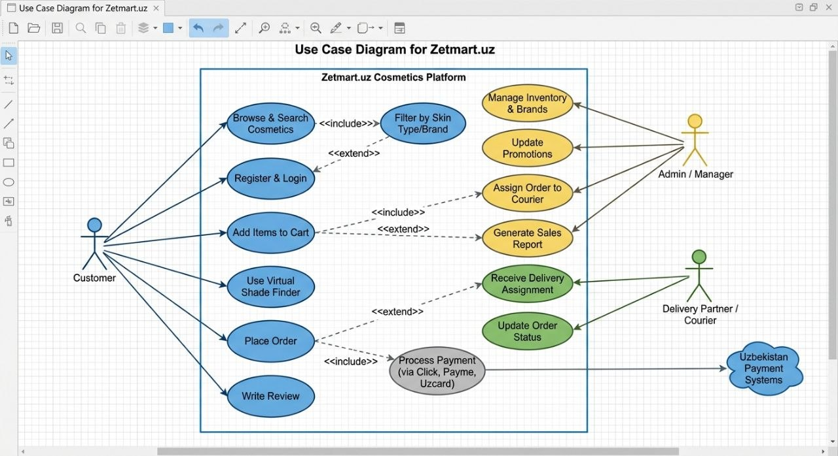
Use Case Modeling
14
use cases, 3 actors and 1 external system
Customer: browse, order, review
Admin / Manager: inventory, promotions, reports
Courier: delivery and status updates
Payment systems: Click, Payme, Uzcard
Include links: Browse & Search → Filter by Skin Type/Brand, and Place Order → Process Payment.
Notes:
Walk through the three actors. The customer drives the main flow: search, shade finder, cart, order, payment, review. The manager maintains inventory, promotions and sales reports and assigns orders to couriers. The courier receives assignments and updates status. Payment goes through local Uzbek systems.

Slide 7
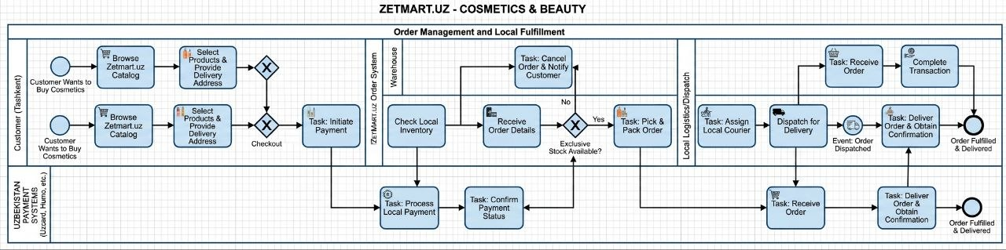


Business Process Model (BPMN)
Customer
Order system
Logistics and payments
Browses the catalog, selects products, enters a delivery address and initiates payment.
Checks local inventory and confirms stock, then picks and packs, or cancels and notifies the customer.
Local payment via Uzcard or Humo; a courier is assigned, dispatches and obtains delivery confirmation.
Notes:
Follow one order from left to right. The customer starts the process, the order system checks stock and either cancels or packs the order, payment is confirmed through local payment systems, and logistics deliver and confirm. The process ends when the order is fulfilled and delivered.

Slide 8
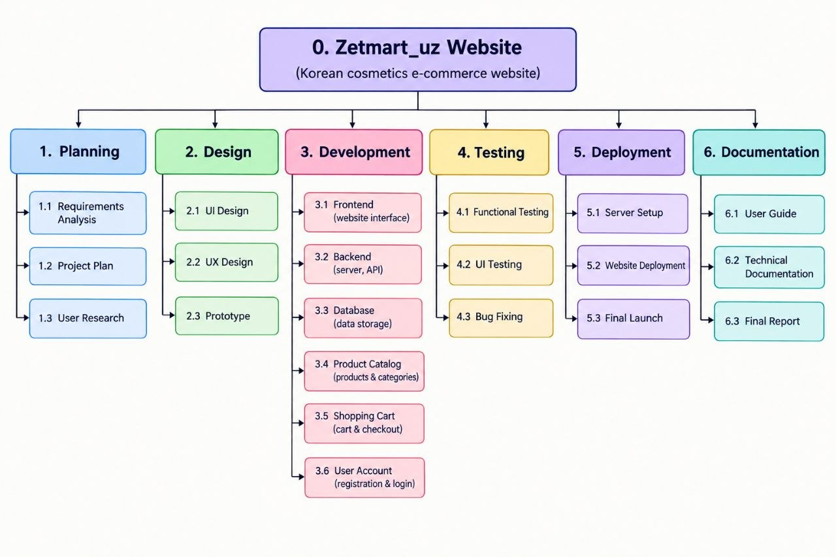
Work Breakdown Structure (WBS)
6
phases
21
work packages
1 Planning
3
2 Design
3
3 Development
6
4 Testing
3
5 Deployment
3
6 Documentation
3
Development is the largest phase: frontend, backend, database, catalog, cart and user accounts.
Notes:
The WBS breaks the project into six phases and 21 work packages. Development is the biggest, with six packages. Each work package is later scheduled in the Gantt chart, and the numbering matches between the two.

Slide 9
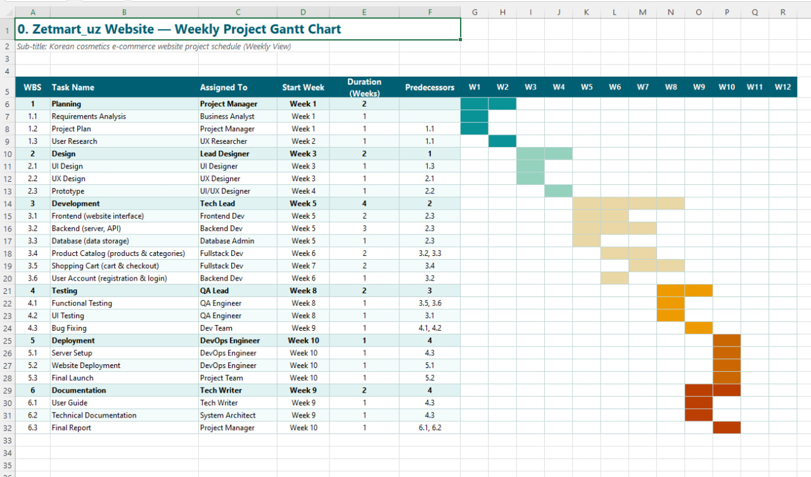
Gantt Chart: 10-Week Schedule
10
weeks from kickoff to launch
Planning: weeks 1–2
Design: weeks 3–4
Development: weeks 5–8
Testing: weeks 8–9
Documentation: weeks 9–10, alongside testing
Deployment and final launch: week 10
Tasks follow the WBS numbering, with predecessors shown for each work package.
Notes:
The schedule fits inside the October to December window. Work flows planning, design, development, testing, deployment. Documentation overlaps testing and deployment. Predecessors in the chart show which tasks block others.

Slide 10

Summary and Next Steps
Delivered
Next steps
Project Plan
1
Build the site on Google Sites with AI
Contract
Set up the Google Sheets workbook
2
Use Case Model
3
Test with the shop manager and fix issues
Business Process Model
4
Launch and hand over the user guide by week 10
Work Breakdown Structure
Gantt Chart
Thank you. Questions?
Notes:
Recap the six deliverables, then the next steps: build, set up data, test, launch. Invite questions.

