Slide 1
Seizure Prediction
Preprocessing • Regularization • Class Imbalance
A Comparative Study Across Three EEG Feature Representations
Dilawaiz khadija
Department of Computer Science
Semester Major Assignment

Slide 2
The Problem
Why pipeline choices matter more than model choice in seizure prediction
50M
people affected
by epilepsy worldwide
Four key questions we answer
Does preprocessing order affect results?
Which regularization generalizes best?
Does Elastic Net beat L1 and L2?
How does imbalance handling interact with regularization?
~20%
of EEG samples are
seizure (heavy imbalance)
178
raw features per
1-second EEG segment

Slide 3
Three Datasets, One Source
UCI Epileptic Seizure Recognition → 3 feature representations
TIME-SERIES
HAND-CRAFTED
SPECTRAL
D1 — Raw EEG
D2 — Statistical
D3 — Frequency
178
14
18
features
features
features
Raw time-domain samples
High-dim, noisy, redundant
Mean, std, skew, kurtosis,
RMS, MAV, zero-crossings...
Band powers (δ,θ,α,β,γ),
entropy, centroid, edge freq
4,000 stratified samples • 20% positive class • 4:1 imbalance ratio

Slide 4
Two Preprocessing Pipelines
We compare orderings to test the central hypothesis: order matters
Pipeline A
Pipeline B
1
StandardScaler
1
Feature Extraction
zero-mean, unit-variance
done at dataset level
2
Denoise
2
MinMaxScaler
clip outliers ±4σ
scale to [0,1]
3
SelectKBest
3
PCA
ANOVA F-score, top 50%
retain 95% variance
Hypothesis: A preserves interpretability; B compresses redundancy

Slide 5
Baseline Logistic Regression
Spectral features (D3) carry the most discriminative information
D3 wins
F1 = 0.997
spectral features are compact + discriminative
D1 lags
F1 = 0.83
high-dim raw EEG hits curse of dimensionality
Pipelines close
<1 F1 pt
small difference between A and B at baseline

Slide 6
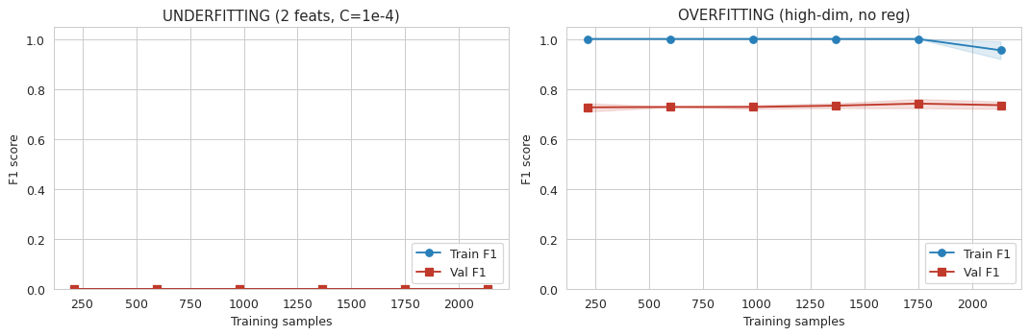
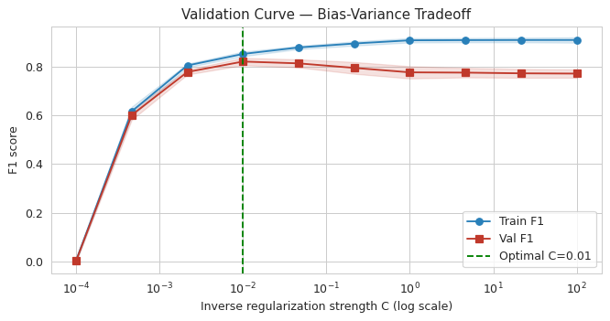
Overfitting & Underfitting
Two extreme regimes on D1 — visualized with learning curves
UNDERFIT
2 features + C = 10⁻⁴
Both curves stay low →
model too constrained
OVERFIT
178 + poly features, no reg
Train F1 = 0.96 / Val F1 = 0.74
→ 22-point gap = memorizing
Sweet spot
Validation F1 peaks around C ≈ 0.01.
Stronger reg → under-fit.
Weaker reg → no extra gain.

Slide 7
Regularization: L1 vs L2 vs Elastic Net
Sparsity tells the real story — performance differences are small

Slide 8
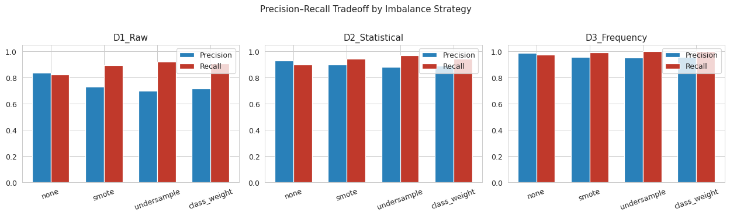
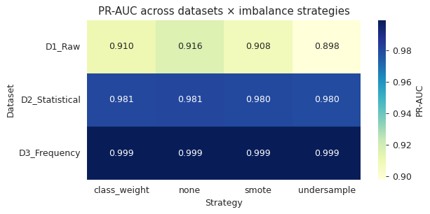
Class Imbalance: The Precision–Recall Trade
SMOTE / undersampling / class-weighting all raise recall at a precision cost
Key takeaways
D1 recall: 0.83 → 0.92 with undersampling, but precision drops 0.83 → 0.70
On D3, undersampling reaches 100% recall with almost no precision loss
Class-weighting matches SMOTE in F1 but costs nothing extra
PR-AUC barely moves: it summarizes the curve, not the operating point

Slide 9
Comparative Analysis — Four Answers
Q1
Does preprocessing order affect results?
Q2
Which regularization generalizes best?
Yes — but small effect
L1 wins narrowly
F1 differs by ≤0.5 pts between A and B. Direction flips with feature type.
Mean F1 = 0.911 (L1) vs 0.909 (L2 & EN). L1 also most stable across folds.
Q3
Does Elastic Net consistently beat L1/L2?
Q4
How does imbalance interact with reg?
No — EN won 1/6 head-to-heads
Small but coherent shift
On D1 the pure-sparse L1 wins; on D2/D3 all three converge.
Resampling costs F1 across all regs; class-weighting + L1 is best clinically.

Slide 10
Practical Recommendation
For a seizure-prediction logistic regression baseline
1
2
3
4
StandardScaler
SelectKBest
L1 Logistic
class_weight
zero-mean, unit-variance
ANOVA F-score
C tuned via validation
= 'balanced'
Report PR-AUC alongside F1 — it captures the imbalanced precision–recall surface
Future work: extend to multi-channel CHB-MIT, compare to gradient-boosted trees and lightweight CNNs

Slide 11
Thank you
Questions & Discussion
Code on GitHub • Notebook on Colab • Report on Overleaf

