Slide 1
Vector Space model
Dilawer Khan Cs_06
Bilal Hassan Cs_37

Slide 2
What is VSM?
Model for representing text documents
Model for searching query-based results
Documents and queries are represented as vectors.

Slide 3
Applications
information retrieval.
Plagiarism detection
Topic based search
Expert/Advisor Search

Slide 4
How it Works?
Strings
"Shipment of gold damaged in a fire“
"Delivery of silver arrived in a silver truck“
"Shipment of gold arrived in a truck”
Similarity of a string with other strings
“gold silver truck“

Slide 5
Example
D1: "Shipment of gold damaged in a fire“
D2: "Delivery of silver arrived in a silver truck"
D3: "Shipment of gold arrived in a truck”
query : "gold silver truck“

Slide 6
Terms
Term Frequency (tf) No of times a term occurred in a document
Document Frequency (df) No of documents in which a term occurred.
IDF = log(D/di ) Inverse Document Frequency

Slide 7
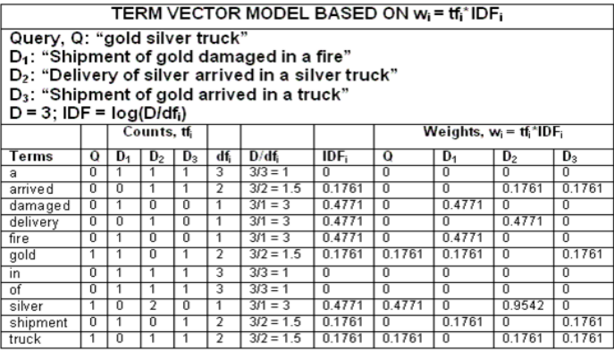
Calculation

Slide 8
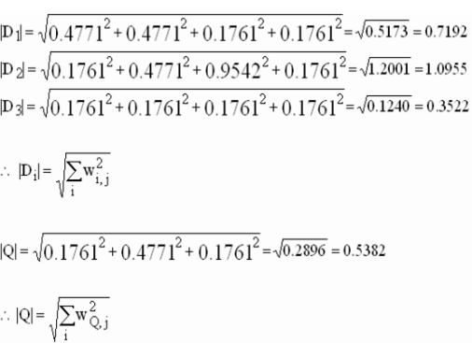

Slide 9
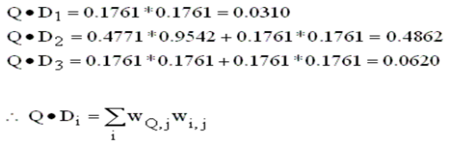

Slide 10
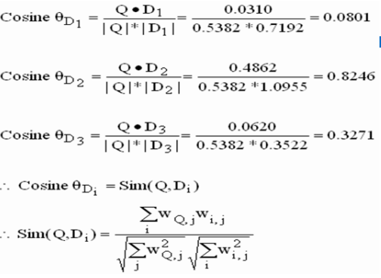

Slide 11
Ranking
Rank 1: Doc 2 = 0.8246
Rank 2: Doc 3 = 0.3271
Rank 3: Doc 1 = 0.0801

Slide 12
Algorithm Design
Read Document Files
Preprocess Documents
Create Vocabulary
Calculate Term Frequencies
Calculate Document Frequencies (DF)
Calculate Inverse Document Frequencies (IDF)
Process user_query
Calculate TF-IDF Weights
Calculate Cosine Similarity
Rank Documents
Display Results

Slide 13
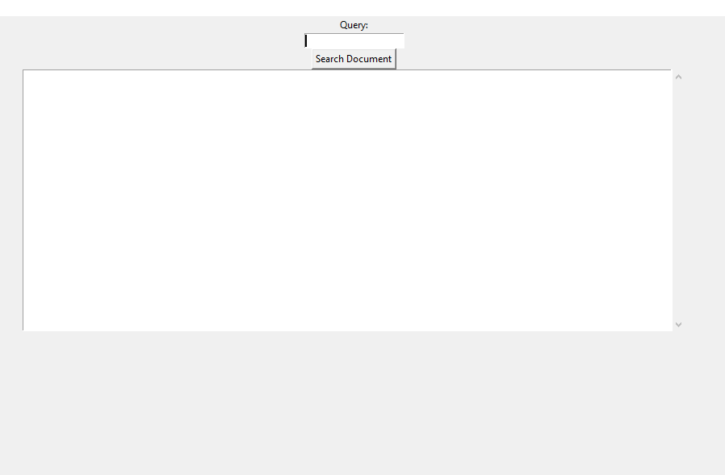
Output

Slide 14
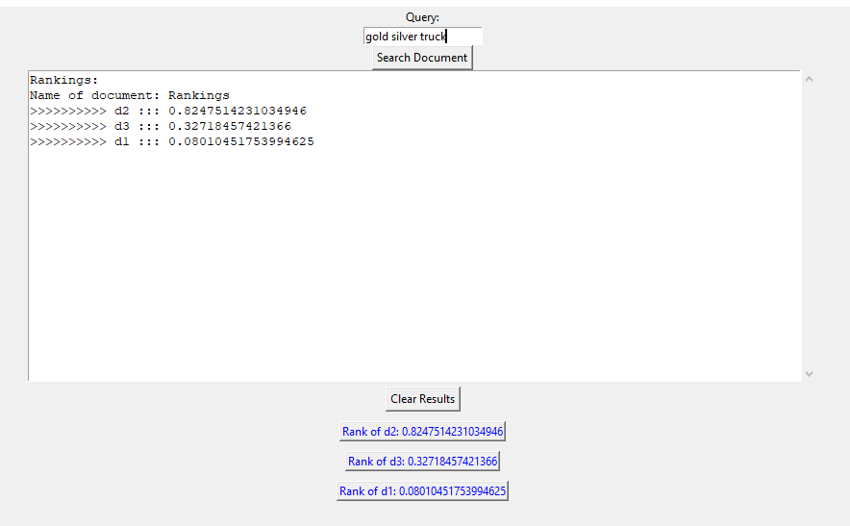

Slide 15
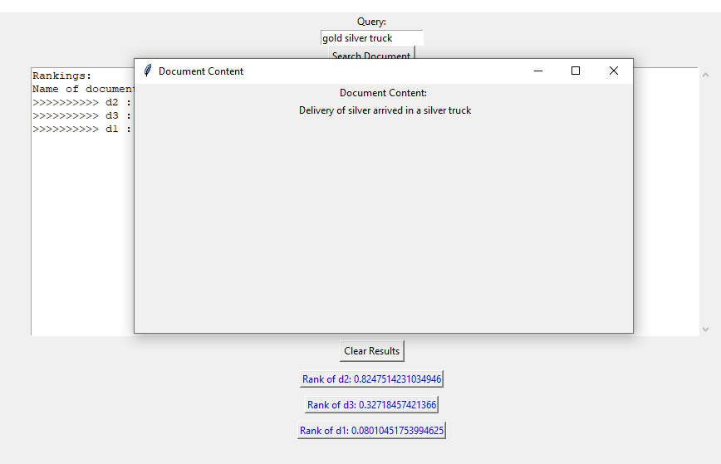

Slide 16
Algorithm Analysis
Time Complexity
O (n * m) + O(n * log(n)) + O(k)
Space Complexity
O(n * k) + O(m) + O(n * m) + O(n)
Limitations

Slide 17

Any Question?

Slide 18


