Slide 1





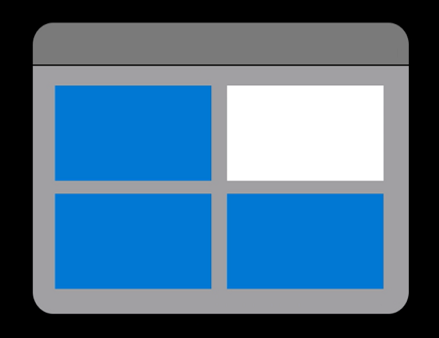


DataFlow
Transformation
ADLS Gen 2
ML models
ECDC Covid19 Data
(HTTP Connector)
Ingestion
Transfer &
Movement
Loading to DB
ADLS Gen 2
Population Data
(Azure Blob Storage)
Azure SQL database

Slide 2
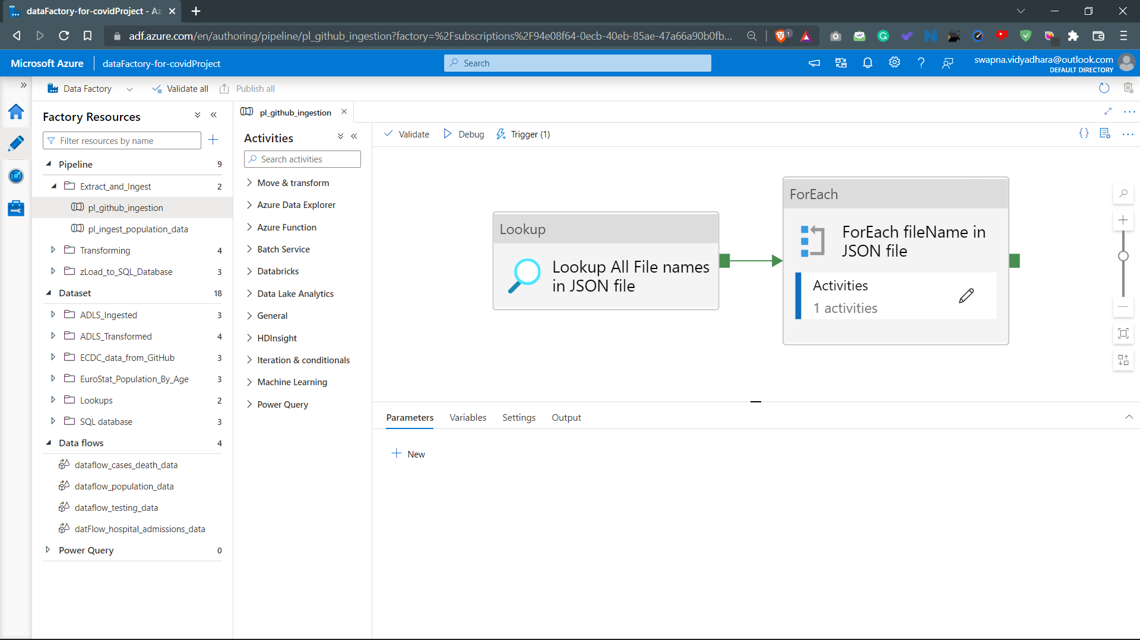

Slide 3
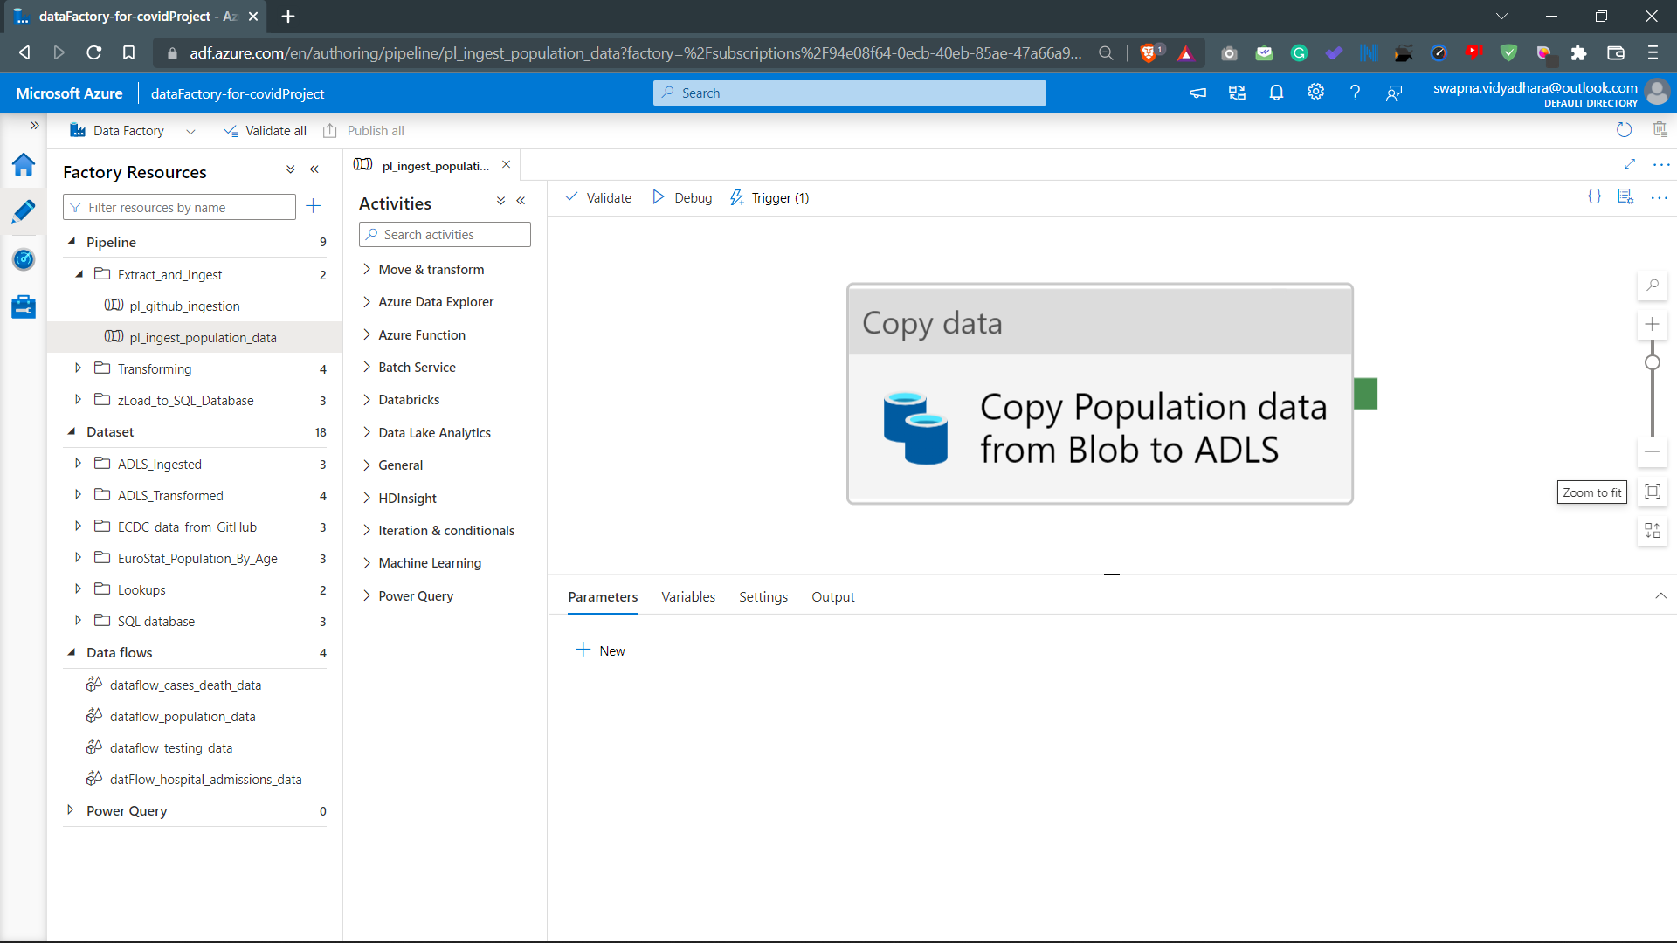

Slide 4
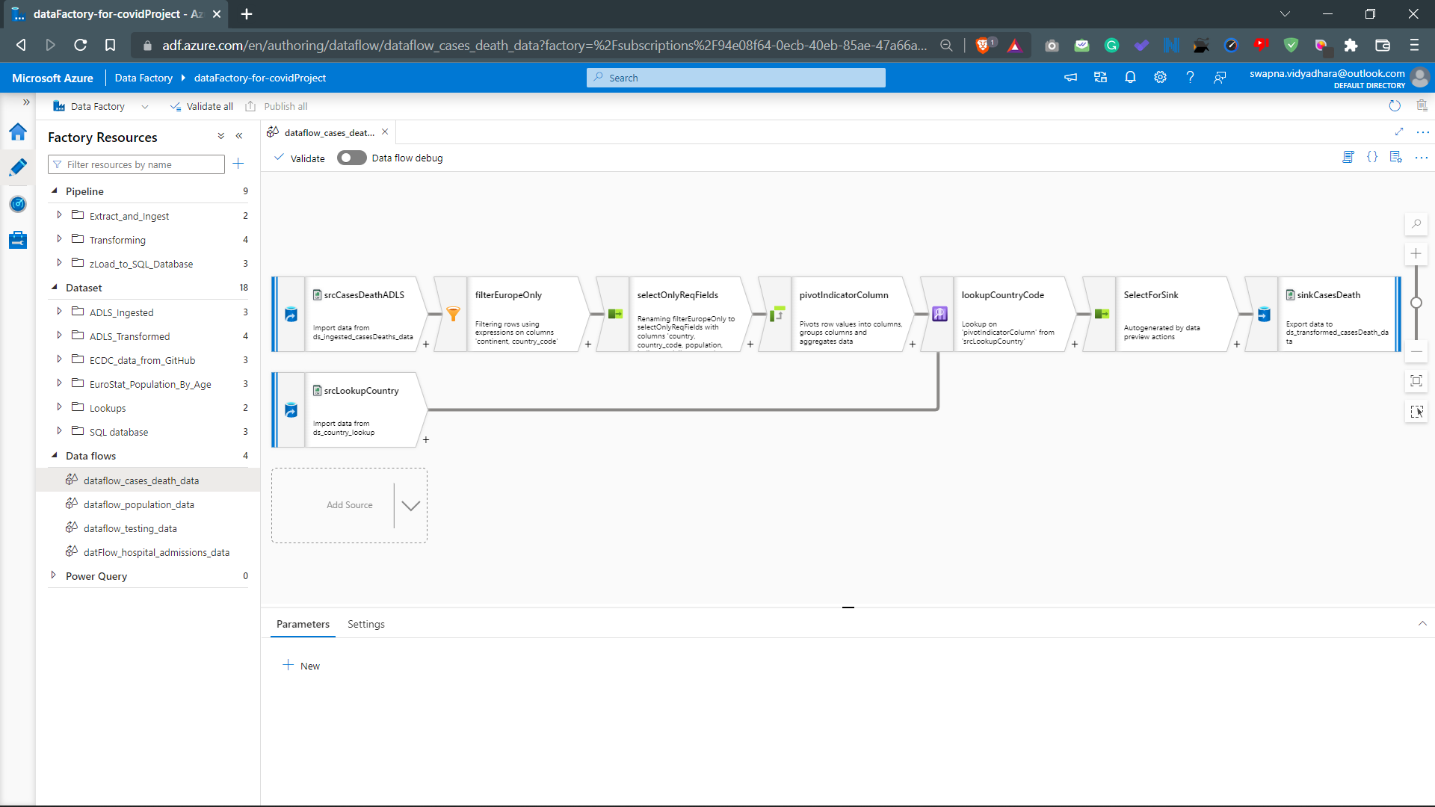

Slide 5
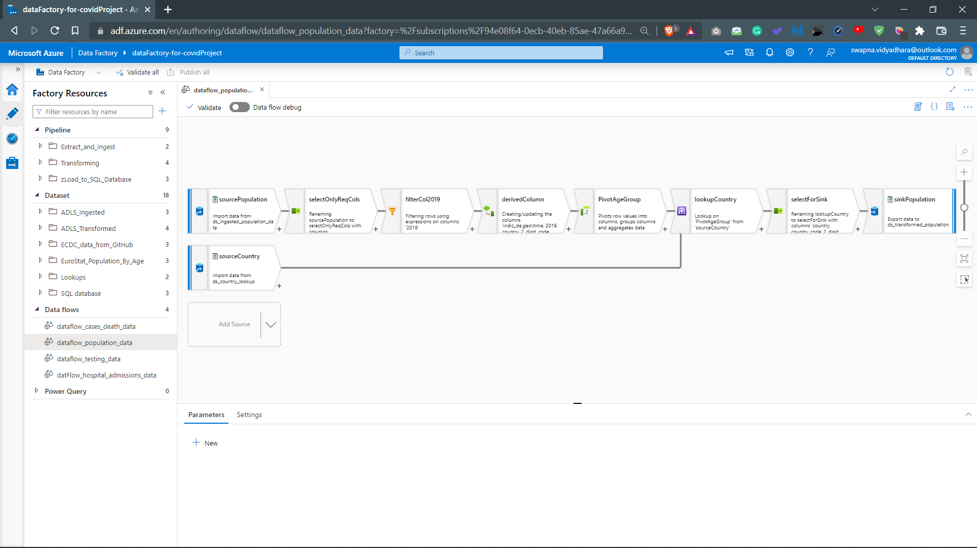

Slide 6
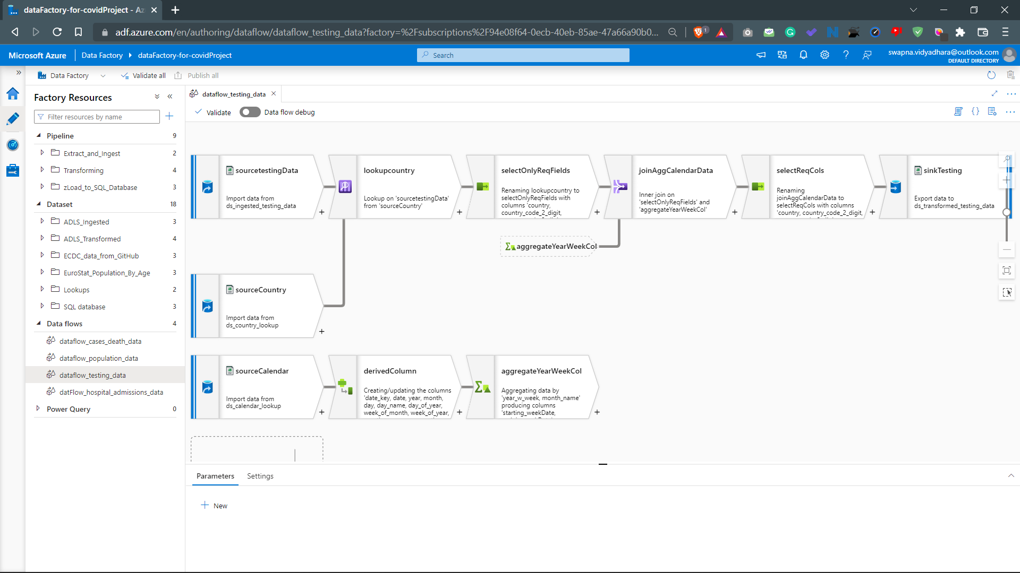

Slide 7
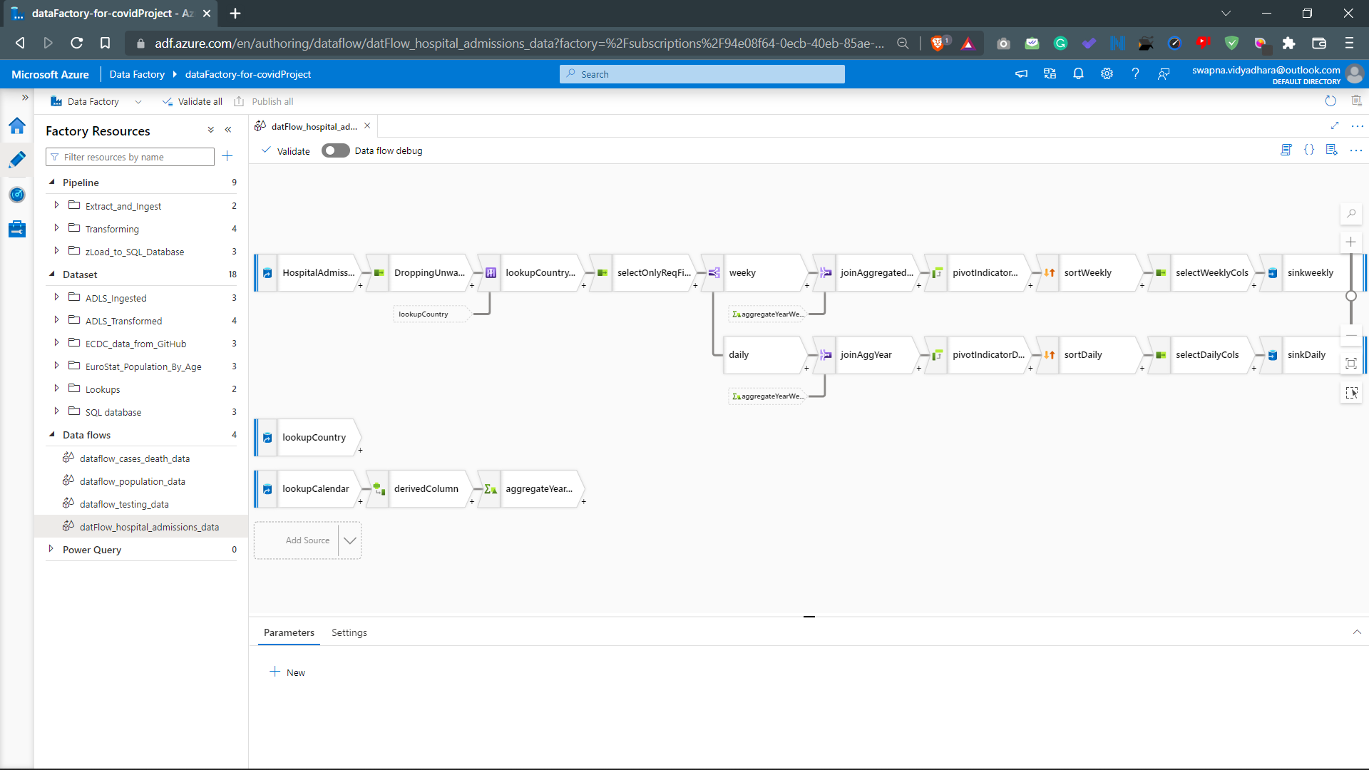

Slide 8
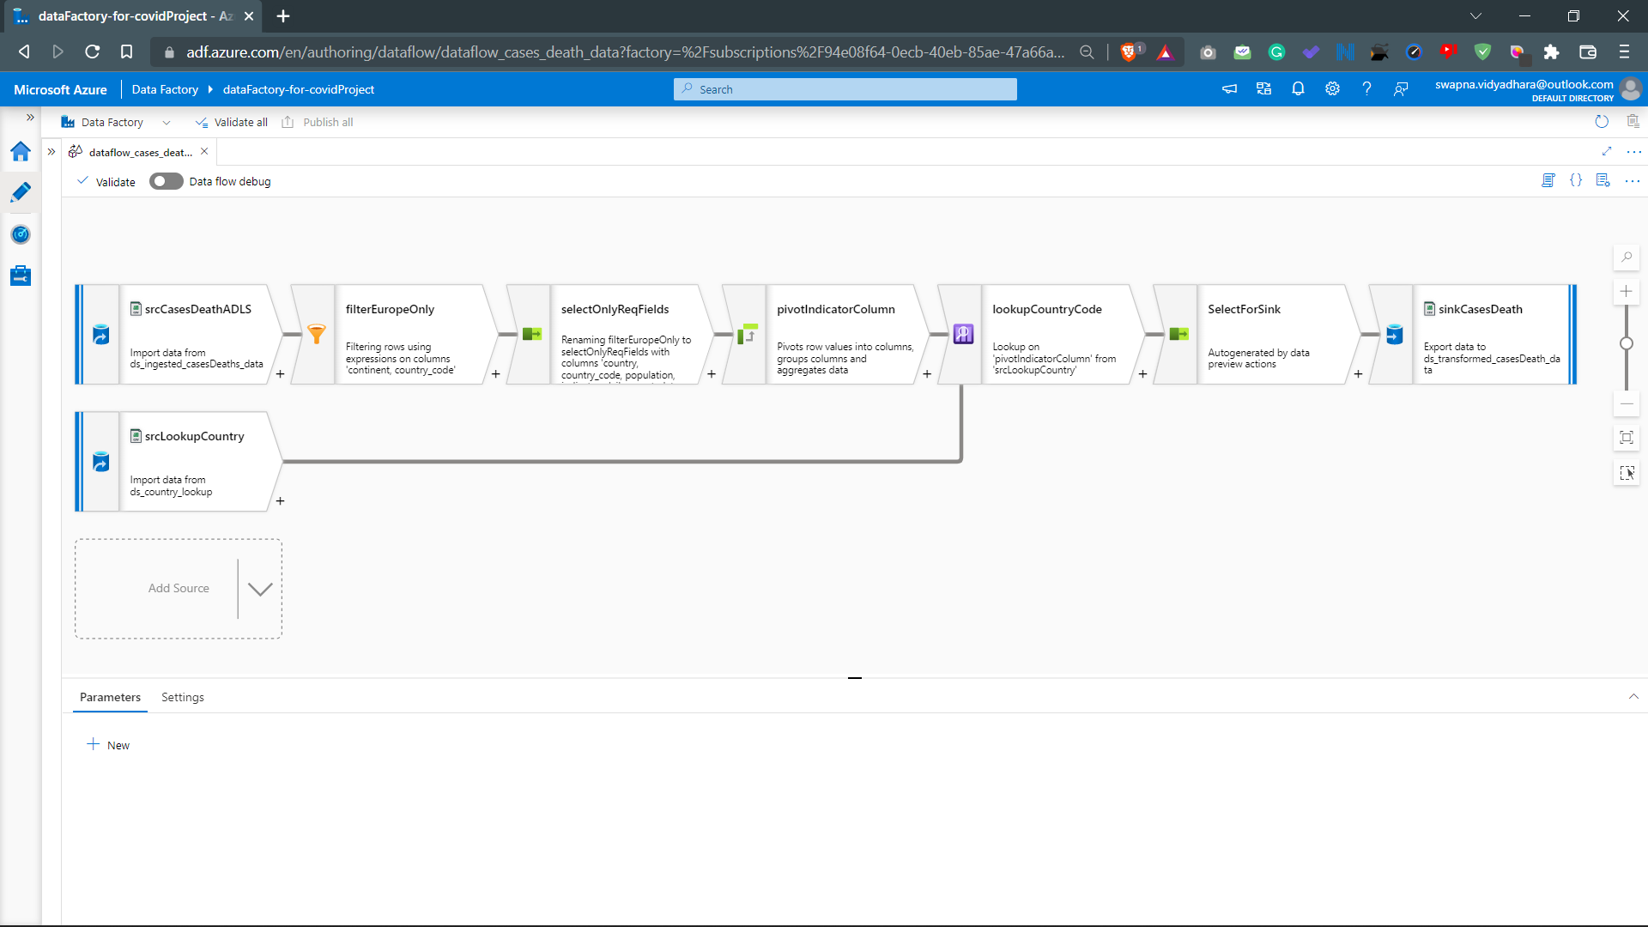

Slide 9
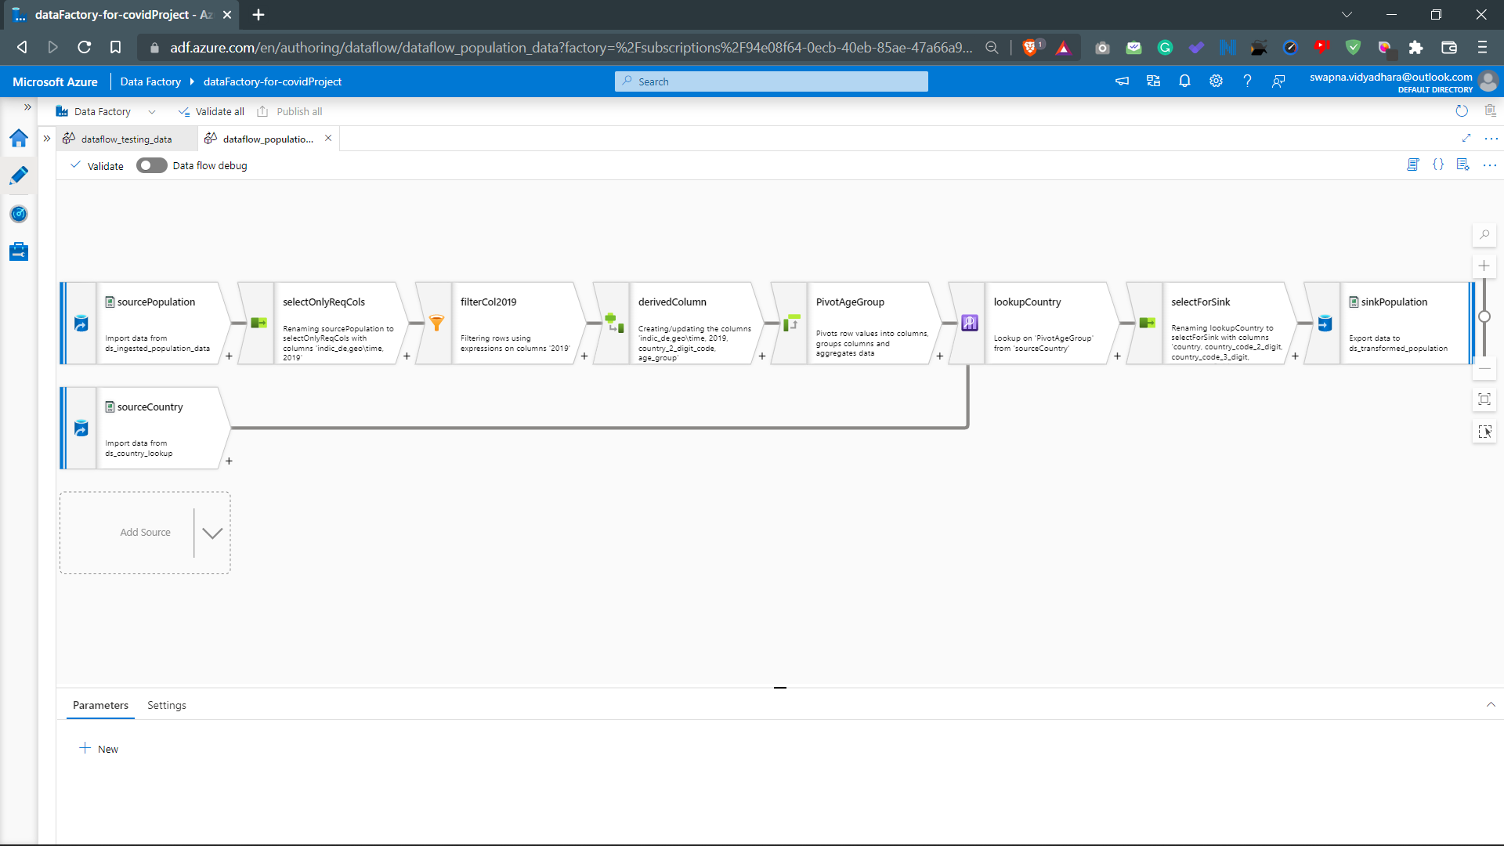

Slide 10
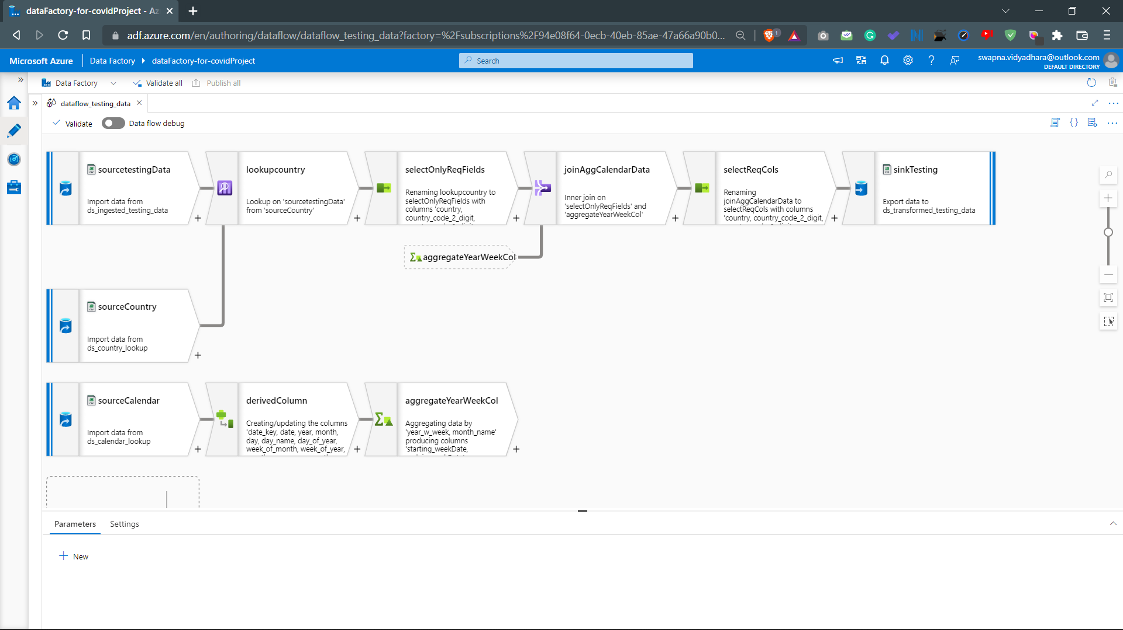

Slide 11
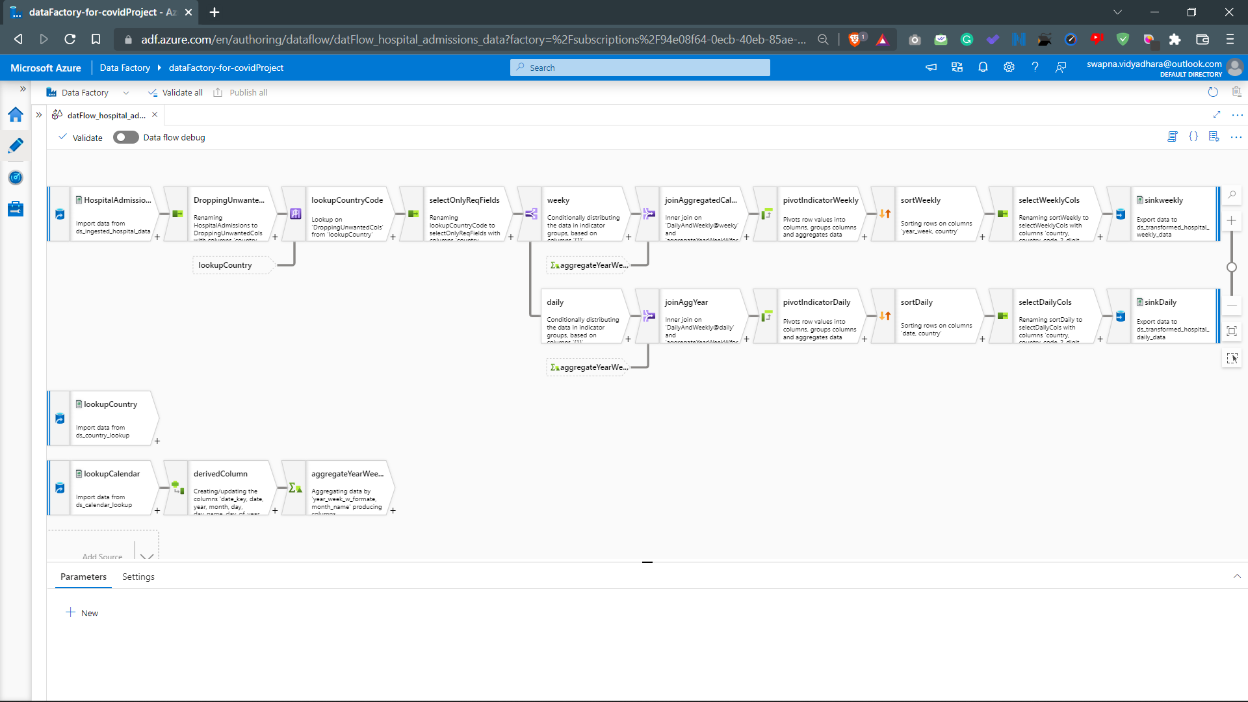

Slide 12
