Slide 1

Department of Computer Science and Engineering

Slide 2
Classification Of Arrhythmia by using deep learning with 2-D ECG spectral Image Representation
Submitted by :
Ch Pradeep Kumar (20Q71A05D8)
P Dileep Reddy (20Q71A0597)
B Sai Kumar (20Q71A05B5)
K Praveen Kumar (20Q71A0579)
M Dhanush (20Q71A0589)
Under the Faculty membership of Mr S Kesava Rao

Slide 3
Project Description
According to the World Health Organization (WHO), cardiovascular diseases (CVDs) are the number one cause of death today.
Over 17.7 million people died from CVDs in the year 2017 all over the world which is about 31% of all deaths, and over 75% of these deaths occur in low and middle-income countries.
Arrhythmia is a representative type of CVD that refers to any irregular change from the normal heart rhythms. There are several types of arrhythmia including atrial fibrillation, premature contraction, ventricular fibrillation, and tachycardia.
In this project, we build an effective electrocardiogram (ECG) arrhythmia classification method using a convolutional neural network (CNN), in which we classify ECG into seven categories, one being normal and the other six being different types of arrhythmia using deep two-dimensional CNN with grayscale ECG images.

Slide 4
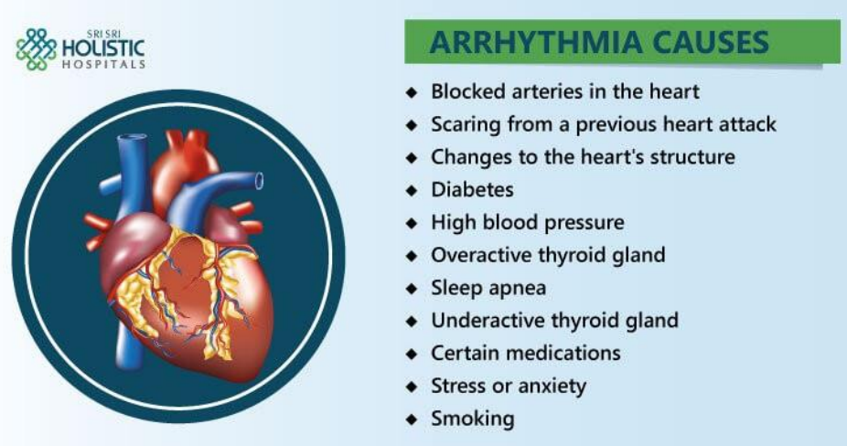
Identified Problem
Cardiovascular diseases (CVDs) are the number one cause of death today.
Over 17.7 million people died from CVDs in the year 2017 all over the world which is about 31% of all deaths, and over 75% of these deaths occur in low and middle-income countries.
Arrhythmia is a representative type of CVD that refers to any irregular change from the normal heart rhythms.
There are several types of arrhythmia including atrial fibrillation, premature contraction, ventricular fibrillation, and tachycardia.

Slide 5
Proposed Solution
An "ambulatory electrocardiogram" ( or an ECG) about the size of a postcard or digital camera that the patient will be using for 1 to 2 days, or up to 2 weeks.
The test measures the movement of electrical signals or waves through the heart.
These signals tell the heart to contract (squeeze) and pump blood.
The patient will have electrodes taped to your skin. It's painless, although some people have mild skin irritation from the tape used to attach the electrodes to the chest.
They can do everything but shower or bathe while wearing the electrodes.
After the test period, patient will go back to see your doctor.

Slide 6
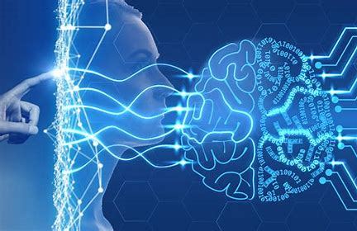
Role of Deep Learning
Deep learning is a branch of machine learning which is completely based on artificial neural networks, as neural network is going to mimic the human brain so deep learning is also a kind of mimic of human brain.
In deep learning, we don’t need to explicitly program everything.
The concept of deep learning is not new. It has been around for a couple of years now. It’s on hype nowadays because earlier we did not have that much processing power and a lot of data.
As in the last 20 years, the processing power increases exponentially, deep learning and machine learning came in the picture.

Slide 7
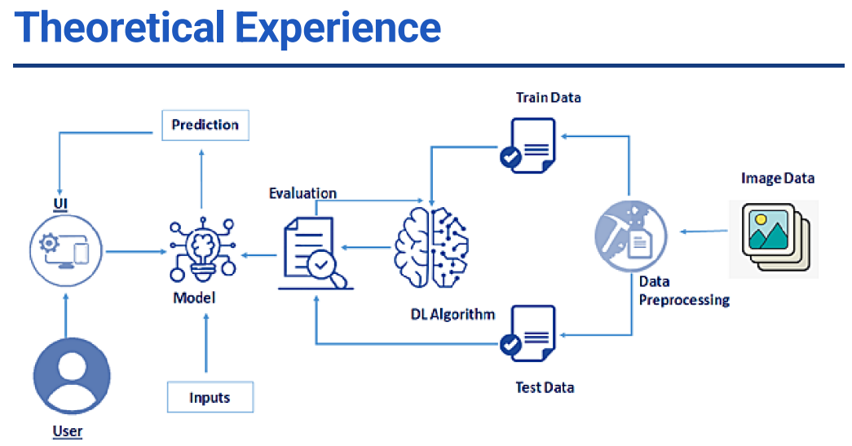

Slide 8
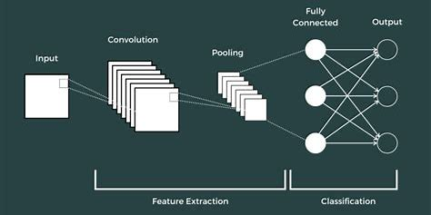
Experimental Investigation
Conventional Neural Network(CNN)
Convolutional Layer 2-D : A 2-D convolutional layer applies sliding convolutional filters to 2-D input.
Pooling Layer : Pooling layers are used to reduce the dimensions of the feature maps.
Fully-Connected layer : After extracting features from multiple convolution layers and pooling layers, the fully-connected layer is used to expand the connection of all features
Dropout Layer : The dropout layer will temporarily disconnect some neurons from the network.

Slide 9
Project Flow
Data Collection
Data Preprocessing
Model Building
Application Building

Slide 10

Project Structure

Slide 11
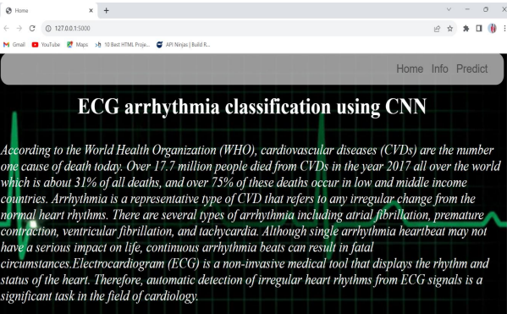

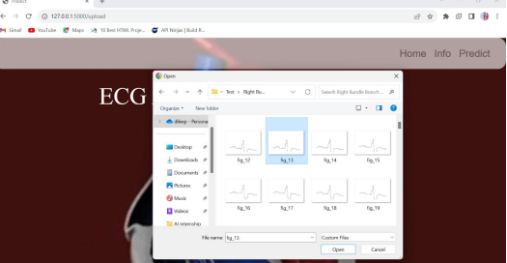
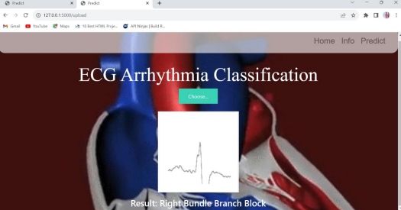
Project Output

Slide 12
Advantages
Disadvantages
The proposed model predicts Arrhythmia in images with a high accuracy rate of nearly 98%.
The early detection of Arrhythmia gives better understanding of disease causes, initiates therapeutic interventions and enables developing appropriate treatments.
Not useful for identifying the different stages of Arrhythmia disease.
Not useful in monitoring motor symptoms.

Slide 13
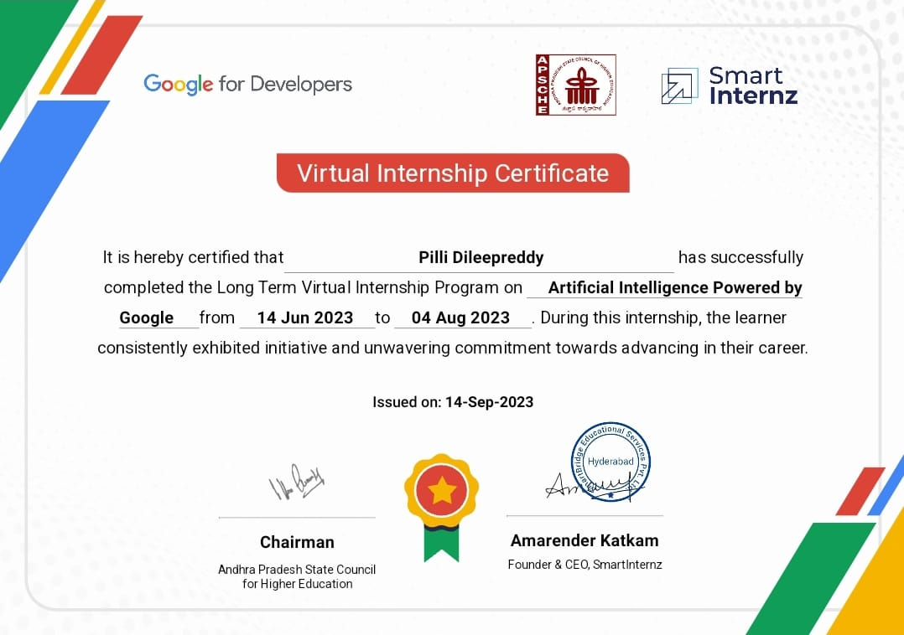
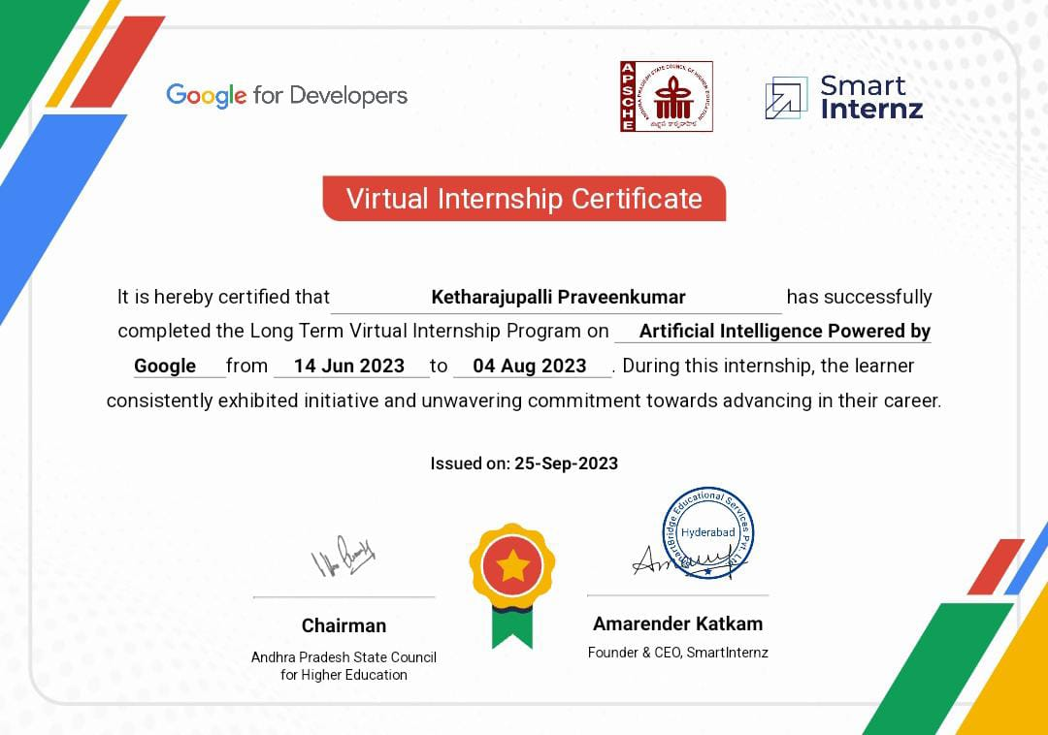

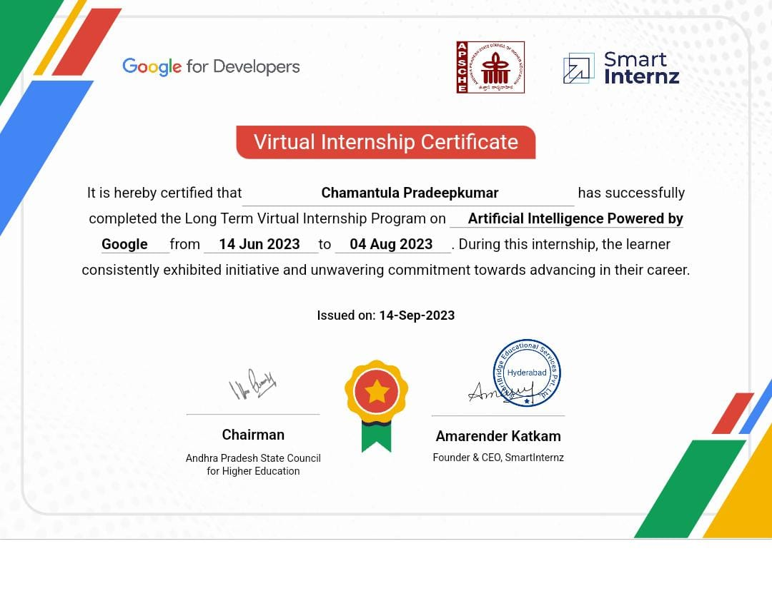
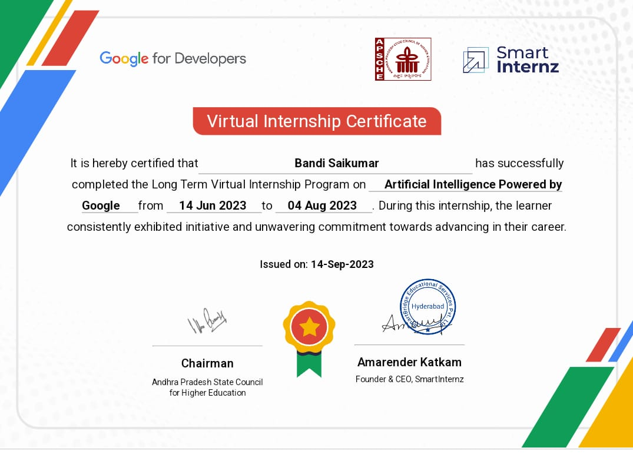
Virtual Internship Certificate

Slide 14
Future Scope
For future work, it would be interesting to explore the use of optimization techniques to find a feasible design and solution. The limitation of our study is that we have yet to apply any optimization techniques to optimize the model parameters and we believe that with the implementation of the optimization, it will be able to further elevate the performance of the proposed solution to the next level.

Slide 15
References
https://www.analyticsvidhya.com/blog/2021/05/convolutional-neural-networks-cnn/ https://www.mathworks.com/help/deeplearning/ref/nnet.cnn.layer.convolution2dlay er.html;jsessionid=0a7e3bc26fabda07a5032030294b
https://smartinternz.com/externship_dyn/1/artificial-intelligence

Slide 16
Project Links
Github Link : https://github.com/Dileep0509/Classification-ofArrhythmia-by-Using-Deep-Learning-with-2-D-ECG-Spectral-ImageRepresentation
Demo Link: https://youtu.be/u8bpsNchyxQ

Slide 17
Conclusion
Cardiovascular disease is a major health problem in today's world. The early diagnosis of cardiac arrhythmia highly relies on the ECG.
Unfortunately, the expert level of medical resources is rare, visually identify the ECG signal is challenging and time-consuming.
The advantages of the proposed CNN network have been put to evidence.
It is endowed with an ability to effectively process the non-filtered dataset with its potential anti-noise features. Besides that, ten-fold cross-validation is implemented in this work to further demonstrate the robustness of the network.

Slide 18
Thank You

