Slide 1

SPEED BREAKER EARLY WARNING SYSTEM
Submitted by
N.Dileep Kumar 14H71A0410
B. Pushpa Latha 14H71A0434
P. Jaya Chandran 14H71A0416
Sk. Ayesha Talath 14H71A0406
UNDER THE GUIDANCE OF
M.GOPALA KRISHNA _{M.Tech., [Ph.D.]}
Assistant Professor, Dept. of E.C.E
DEPARTMENT OF ELECTRONICS AND COMMUNICATION ENGINEERING

Slide 2
CONTENTS
Introduction
Abstract
Existing Technology
Proposed Method
Block Diagram
Components
Advantages
Applications
Results
References

Slide 3
INTRODUCTION
Speed breakers are used in locations where low speeds are desired.
When a vehicle approaches a speed breaker at a speed greater than some threshold velocity, the risk of accident or injury is substantial.
Speed breakers are inconspicuous in low visibility conditions like at night or where there is fog, rain.
Depending on the speed of the vehicle and the distance to speed breaker, an indication should be made to the driver about the speed breaker.
If any case accident occurred message sent through the GSM modem.
Driver taken alcohol message sent through the GSM modem and ignition of vehicle is off.

Slide 4
ABSTRACT
In this project RF Transmitter modules are placed at the speed breakers. RF receiver are used in the vehicles to detect the speed breakers. The RF receiver will detect the RF Transmitter module at about the 100m distance from the speed breaker and alert the driver in the form of audible beeps or tunes. If any accident occurs, then the integrated gsm module sends an alert message to the people of our choice and a alcohol sensor detects the alcohol present in the rider’s breath and accordingly controls the ignition of the vehicle.

Slide 5

EXISTING TECHNOLOGY
Previously sign boards are used with particular colors to represent the speed breakers ahead. But this method is not useful in low visibility conditions and smog areas.

Slide 6
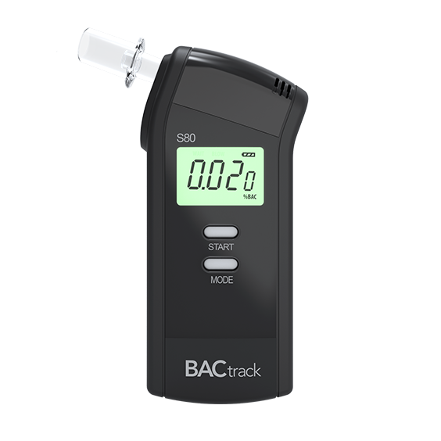
EXISTING TECHNOLOGY
Alcohol detection is done by using a breathe analyzer which is only used by traffic police officers to penalize driver’s who drink and drive. The absence of this check may cause accidents.

Slide 7

EXISTING TECHNOLOGY
Until now, sending an alert message after an accident is always done manually, probably by the victim using different mobile applications.

Slide 8
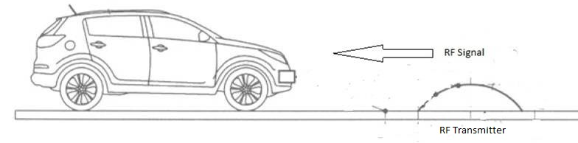
PROPOSED METHOD
Conventional Display boards method is to be replaced by Proposed method, in which RF Tx module is placed at speed breaker and RF Rx module is placed in vehicles. Alert will be given to the driver after RF detection using indicators like buzzers and LCD.And also in this method we are using alcohol sensor to control the ignition of vehicles and message alert in case driver taken alcohol, any accident occurs.

Slide 9
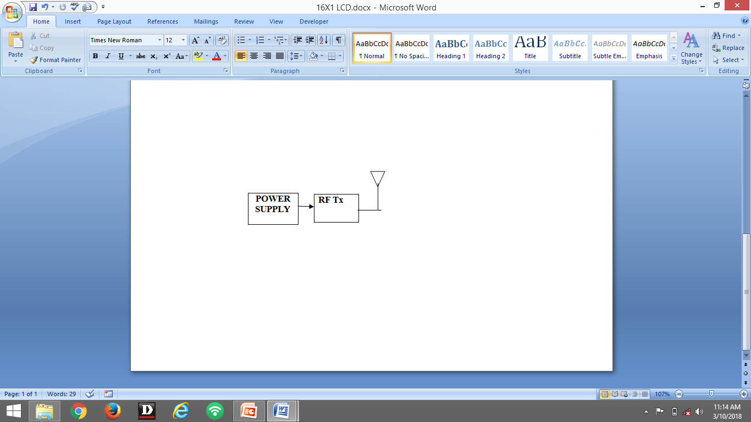
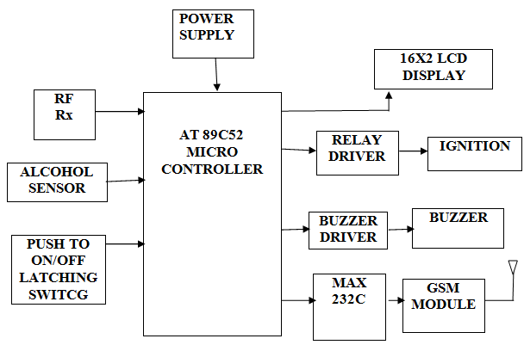
BLOCK DIAGRAM
TRANSMITTER AT RECIEVER AT VEHICLE
SPEED BREAKER

Slide 10
COMPONENTS
AT 89C52 MICRO CONTROLLER
16X2 LCD DISPLAY
GSM MODEM (SIM 900)
BUZZER
MAX 232C
ALCOHOL SENSOR(MQ 135)
PUSH TO ON/OFF LATCHING SWITCH
POWER SUPPLY
RF TRANSMITTER & RECIEVER (433 MHZ)

Slide 11
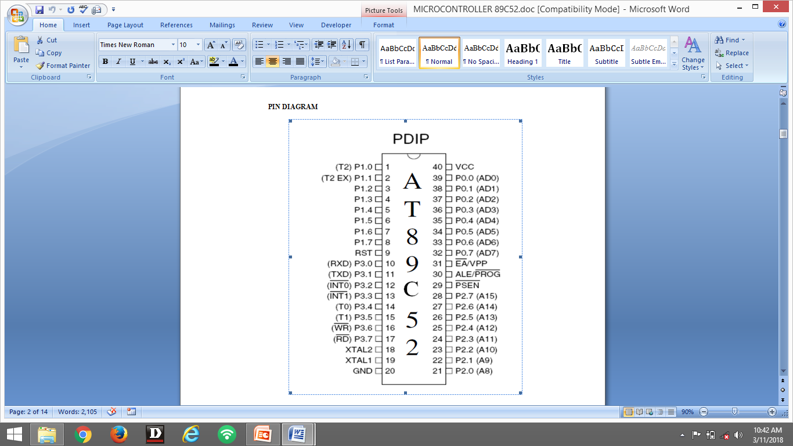
COMPONENTS
AT 89C52 MICRO CONTROLLER
PIN DIAGRAM:

Slide 12
COMPONENTS
FEATURES:
8K Bytes of In-System Reprogrammable Flash Memory.
Endurance: 1,000 Write/Erase Cycles.
Fully Static Operation: 0 Hz to 24 MHz
Three-level Program Memory Lock.
256 x 8-Bit Internal RAM.
32 Programmable I/O Lines.
Three 16-bit Timer/Counters.
Eight Interrupt Sources.
Programmable Serial Channel.
Low Power Idle and Power Down Modes

Slide 13
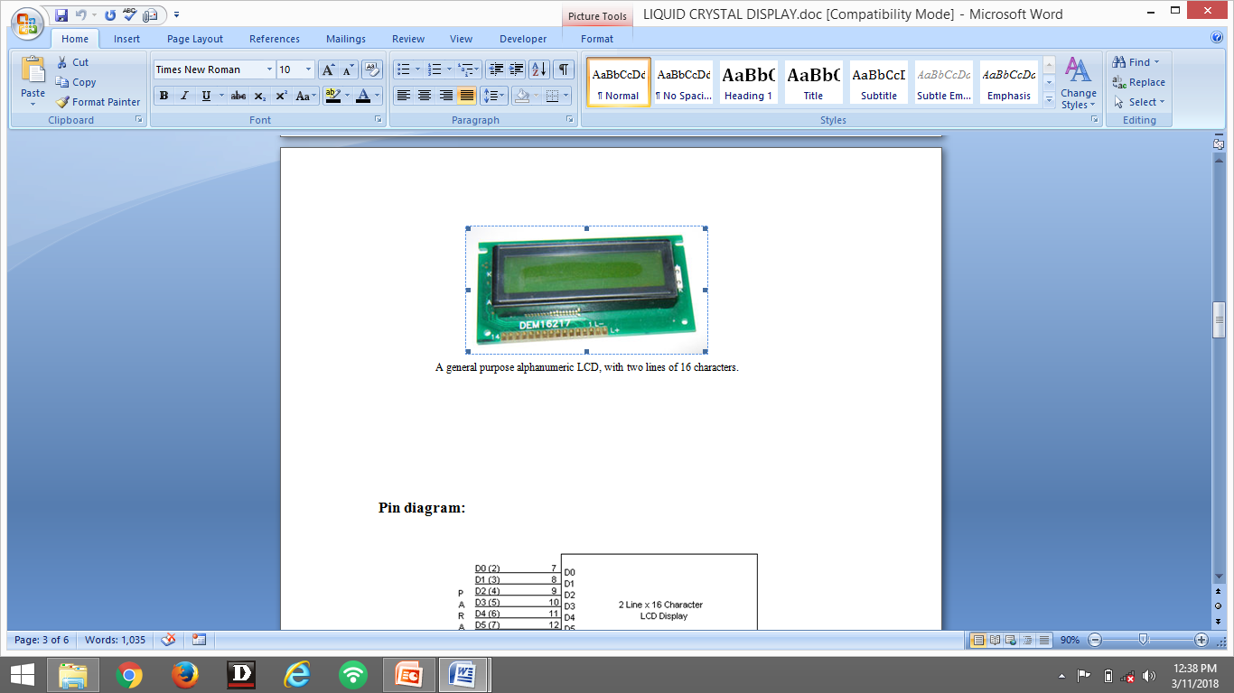
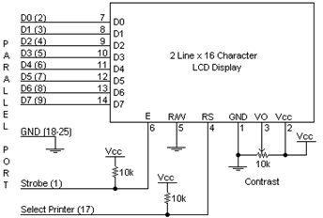
COMPONENTS
LIQUID CRYSTAL DISPLAY:
PIN DIAGRAM:

Slide 14
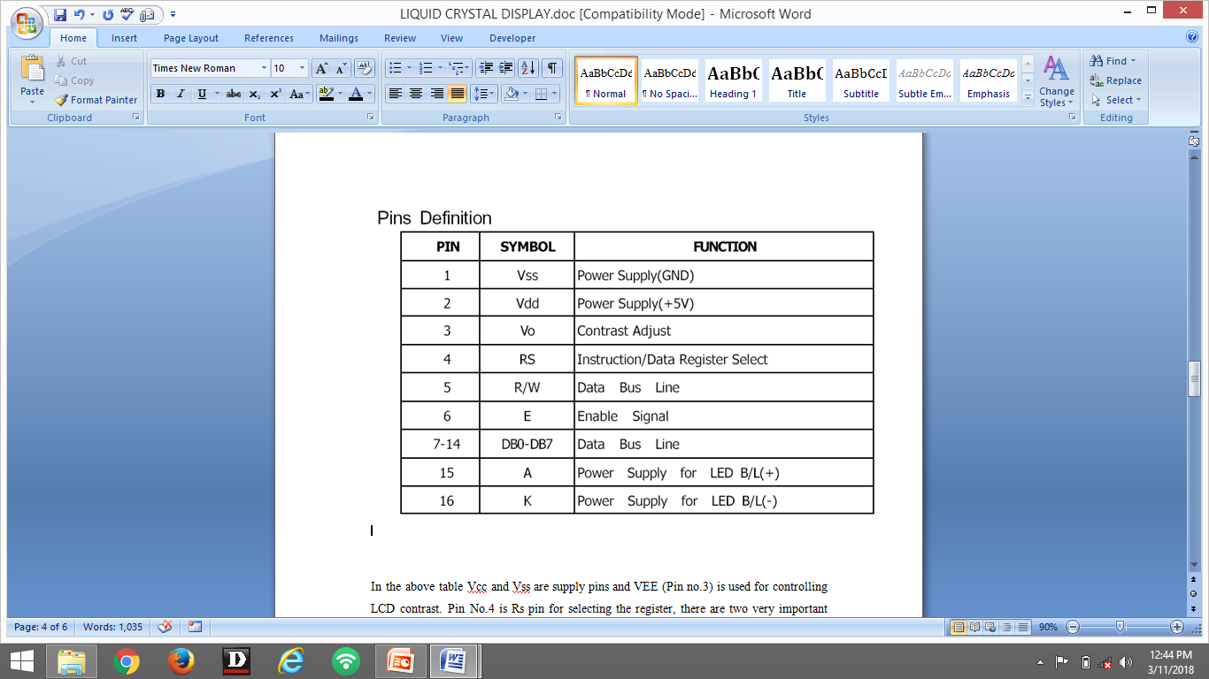
COMPONENTS
FEATURES:
Interface with either 4-bit or 8-bit microprocessor.
accessed by the microprocessor.
Numerous instructions .
ON/OFF, Blink Character, Cursor Shift, Display Shift.
Built-in reset circuit is triggered at power ON.

Slide 15
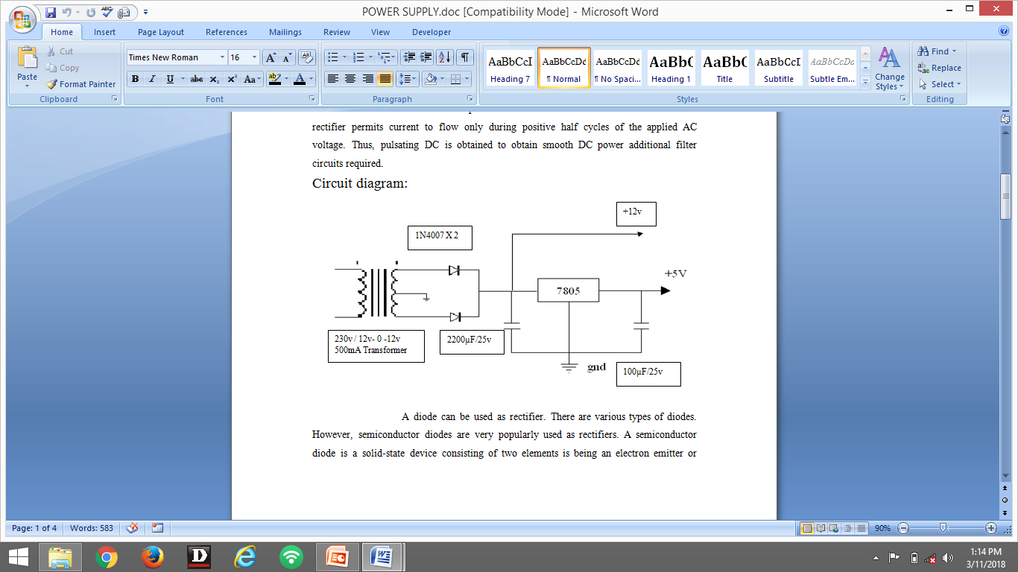
COMPONENTS
POWER SUPPLY:
The Power Supply is a Primary requirement for the project work. The required DC power supply for the base unit as well as for the recharging unit is derived from the mains line. For this purpose center tapped secondary of 12V-0-12V transformer is used. From this transformer we getting 5V power supply. In this +5V output is a regulated output and it is designed using 7805 positive voltage regulator. This is a 3 Pin voltage regulator, can deliver current up to 800 milliamps.
Rectification is a process of rendering an alternating current or voltage into a unidirectional one. The component used for rectification is called ‘Rectifier’. A rectifier permits current to flow only during positive half cycles of the applied AC voltage. Thus, pulsating DC is obtained to obtain smooth DC power additional filter circuits required.
Circuit diagram:

Slide 16
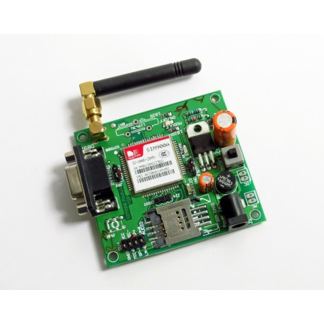
COMPONENTS
GSM MODEM (SIM 900):
GSM (Global System for Mobile Communications) is basically a modem.
Which accepts a SIM card and works in the GSM network provided by the operator just like a mobile phone. The GSM module can be controlled by a computer or a micro controller to do different tasks in the network such as calling , sending mgs.

Slide 17
COMPONENTS
FEATURES:
Quad band 850/900/1800/1900MHZ.
Control via AT commands (GSM 07.07,07.05 and SIMCOM enhanced AT commands).
Low power consumption :1.5mA(sleep mode)
Operation temperature:-40C to 85 C
SPECIFICATIONS:
Indicators:PWR,status LED ,net LED
Power supply :5v
Communication protocol: UART
Baud rate:115200bps

Slide 18
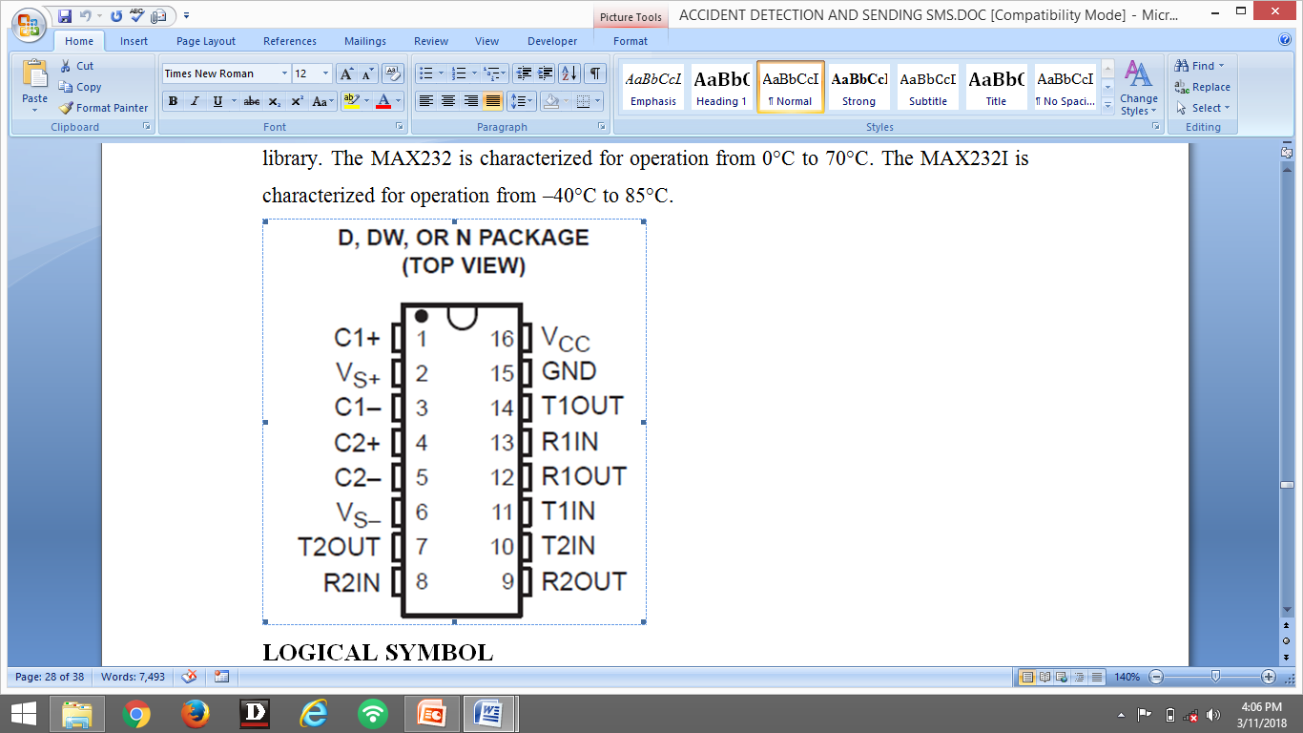
COMPONENTS
MAX 232C:
The MAX232 device is a dual driver/receiver that includes a capacitive voltage generator to supply EIA-232 voltage levels from a single 5-V supply. Each receiver converts EIA-232 inputs to 5-V TTL/CMOS levels. These receivers have a typical threshold of 1.3 V and a typical hysteresis of 0.5 V, and can accept ±30-V inputs. Each driver converts TTL/CMOS input levels into EIA-232 levels The MAX232 is characterized for operation from 0°C to 70°C.

Slide 19
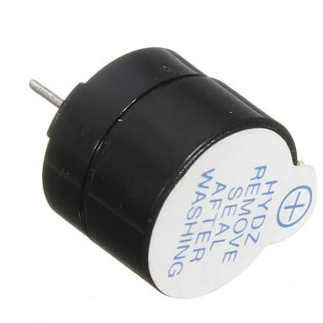
COMPONENTS
SPECIFICATOINS:
Operates With Single 5V Power Supply
Two Drivers and Two Receivers
±30V Input Levels
Low Supply Current . . . 8 mA Typical
BUZZER(5v):
Initially this device was based on an electromechanical system which was identical to an electric bell without the metal gong (which makes the ringing noise).
Usually these were hooked up to driver” circuits which varied the pitch of the sound or pulsed the sound on and off.

Slide 20
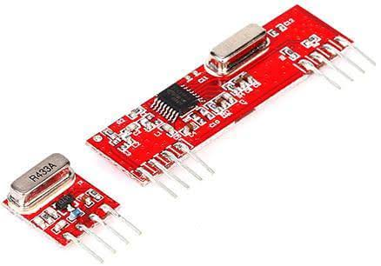
COMPONENTS
RF TRANSMITTER & RECEIVER (R433A):
This is an PLL based ASK Hybrid 433MHZ RF receiver and transmitter
module and is ideal for short range wireless control applications where quality
is primary concern.
The transmitter module employs a SAW stabilized oscillator,
ensuring accurate frequency control for best range performance .

Slide 21
COMPONENTS
RF TRANSMITTER 433MHZ ASK FEATURES:
Frequency range:433.92MHZ.
Supply voltage:3-12v.
Circuit shape: saw
Temperature range :-40degree C-80 degree C
RF RECEIVER 433MHZ ASK (PLL) FEATURES:
Receiver Frequency :433.92MHZ
Typical sensitivity:105dbm
Supply current :2.5mA
IF frequency 500KHZ
Low power consumption
Operating voltage:5volts

Slide 22
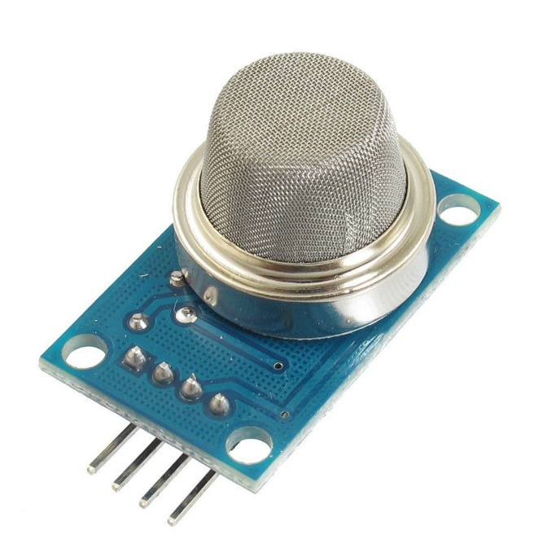
COMPONENTS
ALCOHOL SENSOR(MQ-135):
A gas sensor MQ135 is used to detect the alcohol content in the breath of the rider. The ignition of the vehicle is controlled by the microcontroller, which acts according to the output of gas sensor.
SPECIFICTIONS:
Operating voltage:5v DC
Type:Analog&Digital
Sensitivity to ammonia,sulphide and Benzene steam
Detecting Range:100-1000ppm

Slide 23
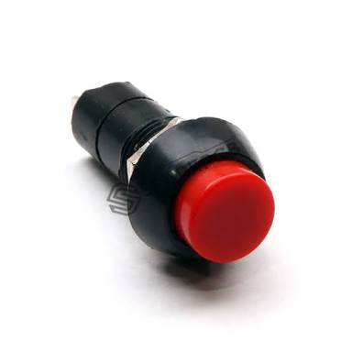
COMPONENTS
PUSH TO ON/OFF LATCHING SWITCH:
It works when mechanical force applied. it converts mechanical energy to electrical energy and it goes to micro controller .In case any accident occurs.
This switch is pushed and with the help of microcontroller, GSM module indicate
accident occurred.
SPECIFICATIONS:
Operating voltage:5v DC or 230vAC
Frequency: 50-60hz
Insulated resistance:0 ohms
continual working:10000times

Slide 24
ADVANTAGES
The risk of accident or injury is reduced by using this system.
It is helpful even in low visibility conditions and smog areas also.
It is helpful for Drivers new to the road.
Commercially Implementable system.
Accidents can be detected and taken care off.
Accidents can be prevented by detecting alcohol content in driver’s breath.

Slide 25
APPLICATIONS
It is used in Automobile Vehicles to avoid accidents.
Usage of sign boards can be replaced with this system.
It is very helpful to police stations and hospitals ,family members know about driver safety in case accident occur.
Alcohol detector can be used in the various vehicles for detecting whether the driver has consumed.

Slide 26


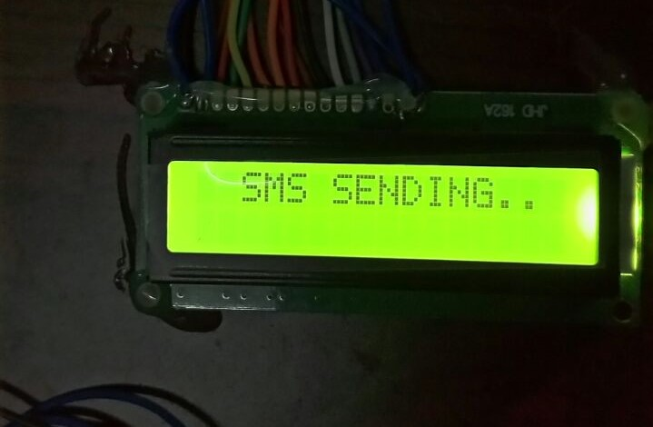
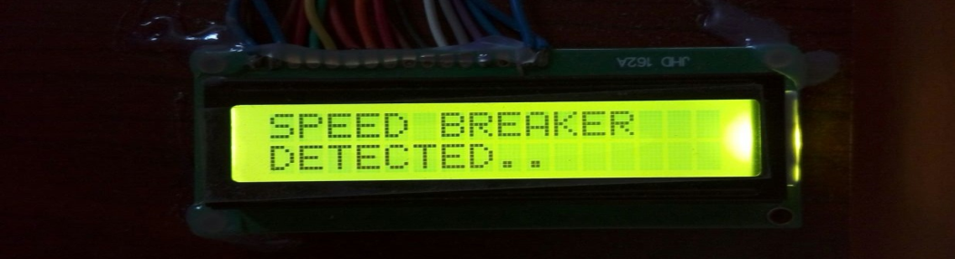
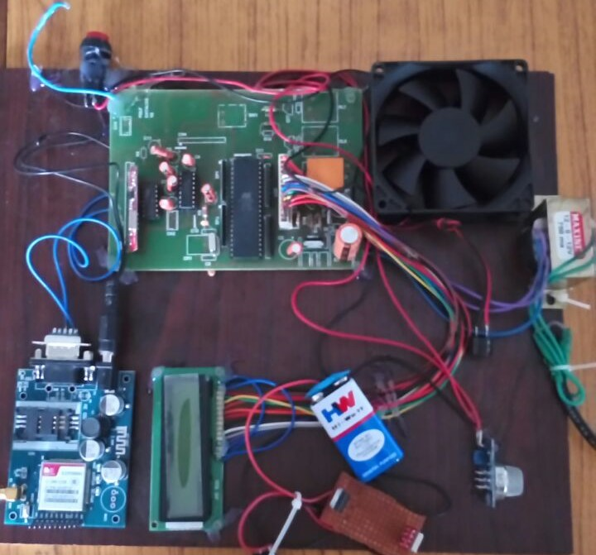
RESULTS

Slide 27
REFERENCES
Rajesh Wari Madli, Santosh Heber, Praveen raj Pattar, and Varprasad Golla, “Automatic Detection and Notifications of Potholes and Humps on Roads to Aid drives”IEEE sensor J.Vol. 15,No.8,August 2015
Gunjan Chug, Divya Bansal and Sanjeev Sofat, “Road condition detection using smartphone sensor: A survey”, International journal of EEE Vol. 7.N0.6,2014.
http://www.atmel.com
http://www.alldatasheets.com
“Automatic Vehicle Accident Detection and Messaging System using GSM and GPS Modem” by C.Prabha, R.Sunitha, R.Anitha,IJAREEIE 7, July 2014.

