Slide 1
MART TRANSACTION

Slide 2
Under the guidance of:
Mrs. S Archana Reddy
(Associate Professor)
Team Members:
PREETHAM SRINIVASACHARY MOTHUKURI – 245319733100
RAJURI ACHITHU VARDHAN BABU – 245319733103
RANGARAJU DILEEP – 245319733104

Slide 3
CONTENTS:
Introduction
Existing System
Disadvantages
Proposed system
Advantages
Hardware & software requirements
Technologies
Design
Project Screenshots
References

Slide 4
INTRODUCTION
ATM stands for Automated Teller Machine.
It is a computerized telecommunications device.
It provides the clients of a financial institution with access to financial transactions in a public space without the need for a cashier, human clerk or bank teller.

Slide 5
EXISTING SYSTEM…
The customer generally needs to insert a plastic ATM card with a magnetic strip into the ATM.
He/she then needs to enter a 4 digit PIN.
If customer chooses withdrawal/deposit they need to enter amount.
The user can check the balance in the balance enquiry option.

Slide 6
DISADVANTAGES:
The existing system lags second stage of security.

Slide 7
PROPOSED SYSTEM
The proposed project is an engineering approach to enhance current transaction (ATM) activities.
It mimics the present ATM system.
The user has to login with their credentials or register using Sign-Up.
The proposed system provides second stage of security on addition to that of present ATM system that is by using One Time Password (OTP) which is sent to customers email-ID for every transaction made by the customer.

Slide 8
ADVANTAGES:
Very Basic and Easy to use as it does not contain complex operations.
This website is made easy for everyone to implement any type of transactions.
This System makes users to complete transactions in a secure way by providing second layer of security through OTP System.

Slide 9
System Requirements:
Hardware Requirements:
CPU Intel Core i5 750.
RAM 2GB.
HDD 256GB.
Good internet connection.
Software Requirements:
Windows 7 and above.
A web browser.

Slide 10
Technologies:
HTML
CSS
Bootstrap
Python
SQL
Flask

Slide 11
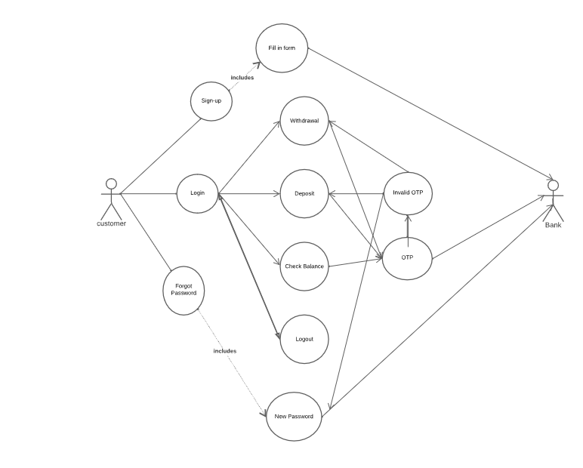
USE CASE DIGRAM:

Slide 12
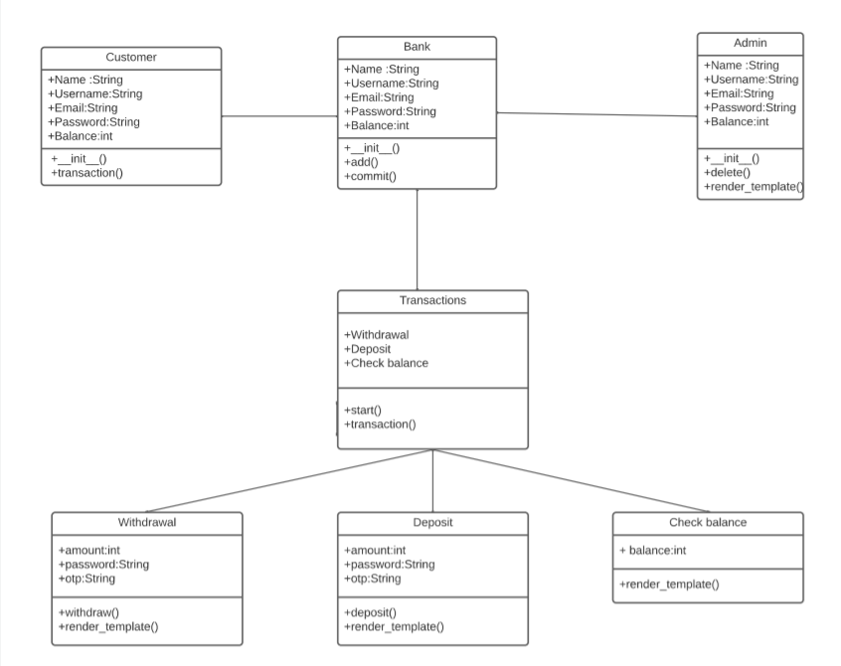
CLASS DIGRAM:
12

Slide 13
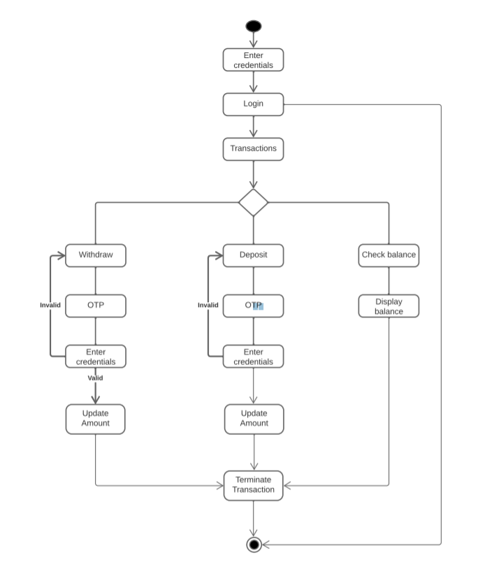
ACTIVITY DIGRAM:
13
13

Slide 14
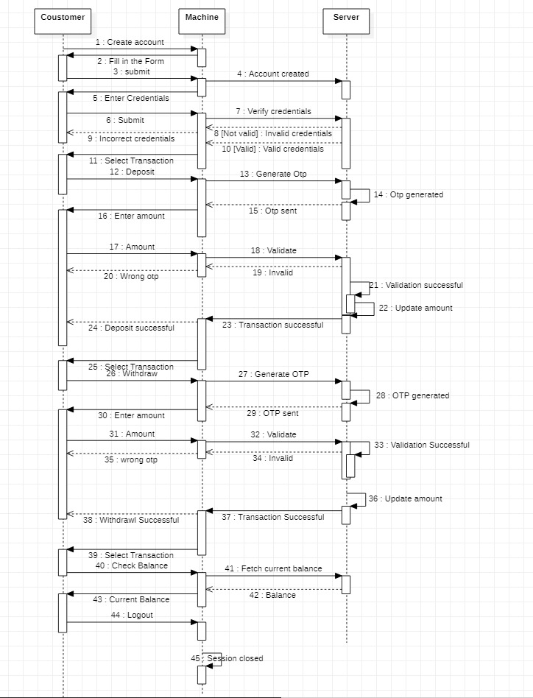
SEQUENCE DIGRAM:
14
14
14

Slide 15
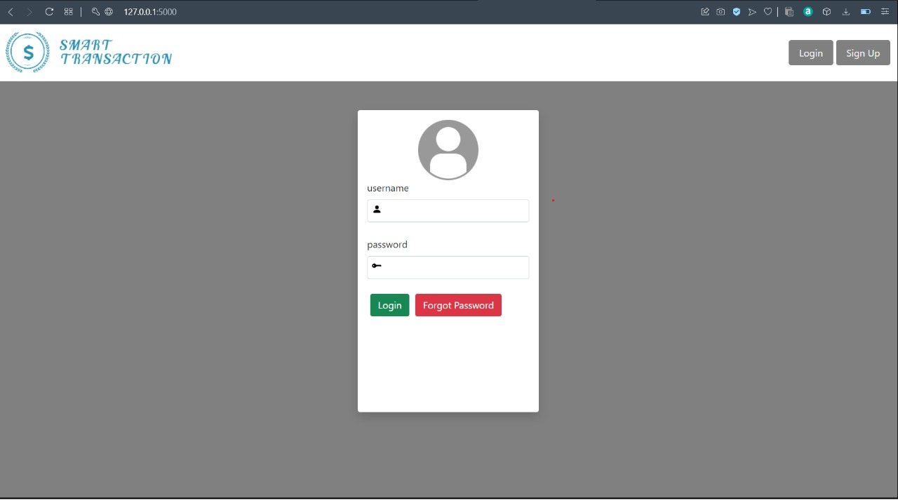
PROJECT
SCREENSHOTS

Slide 16
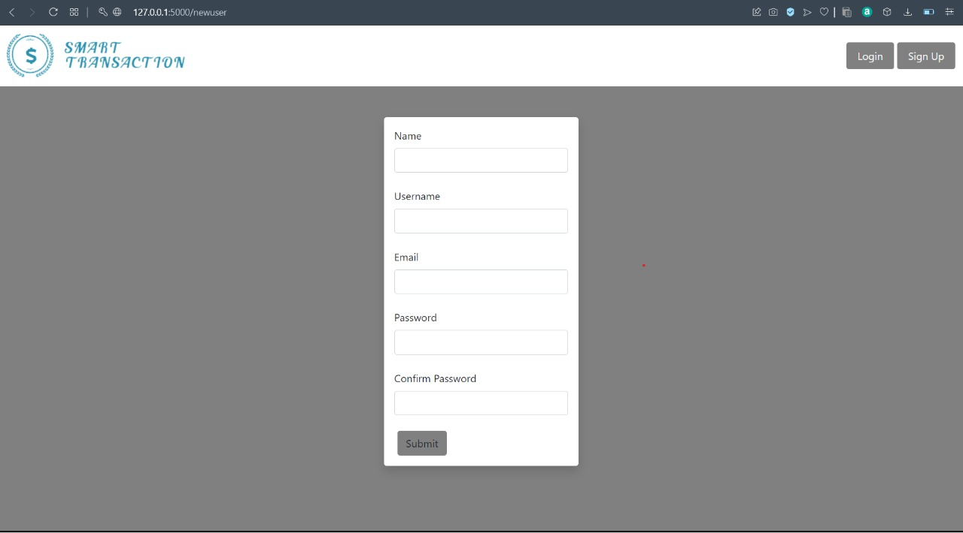

Slide 17
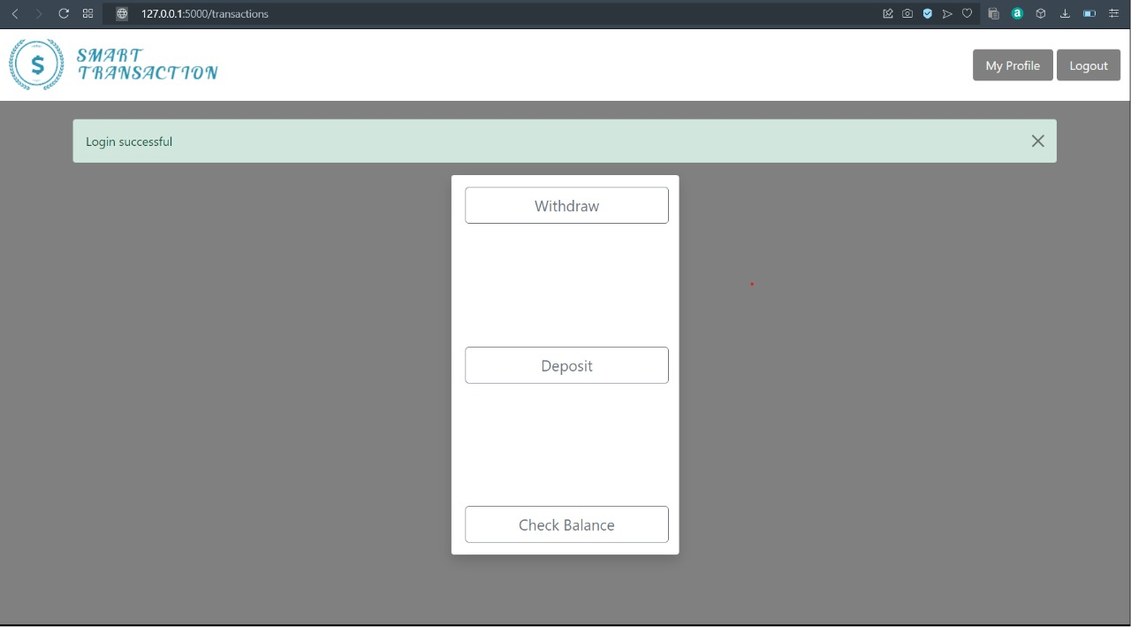

Slide 18
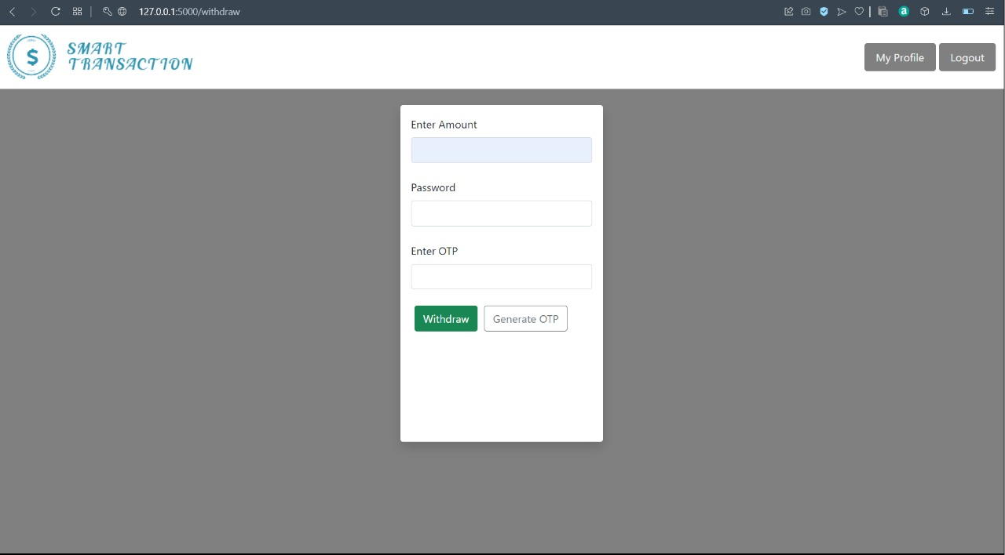

Slide 19


Slide 20
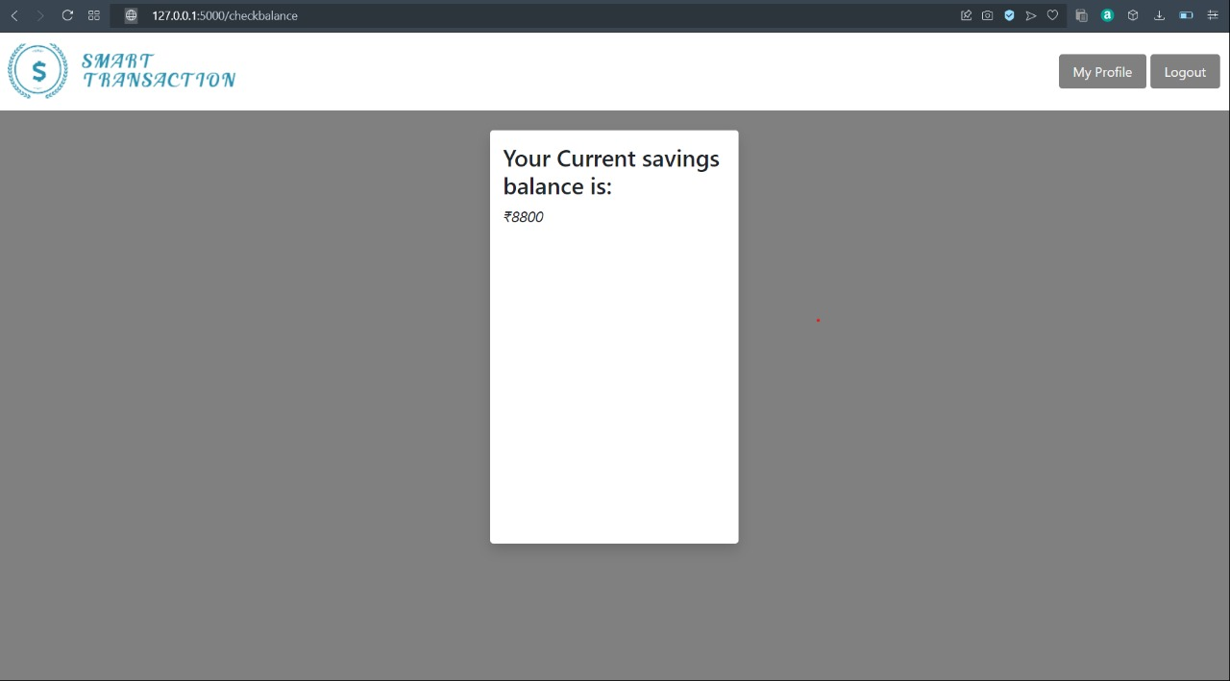

Slide 21
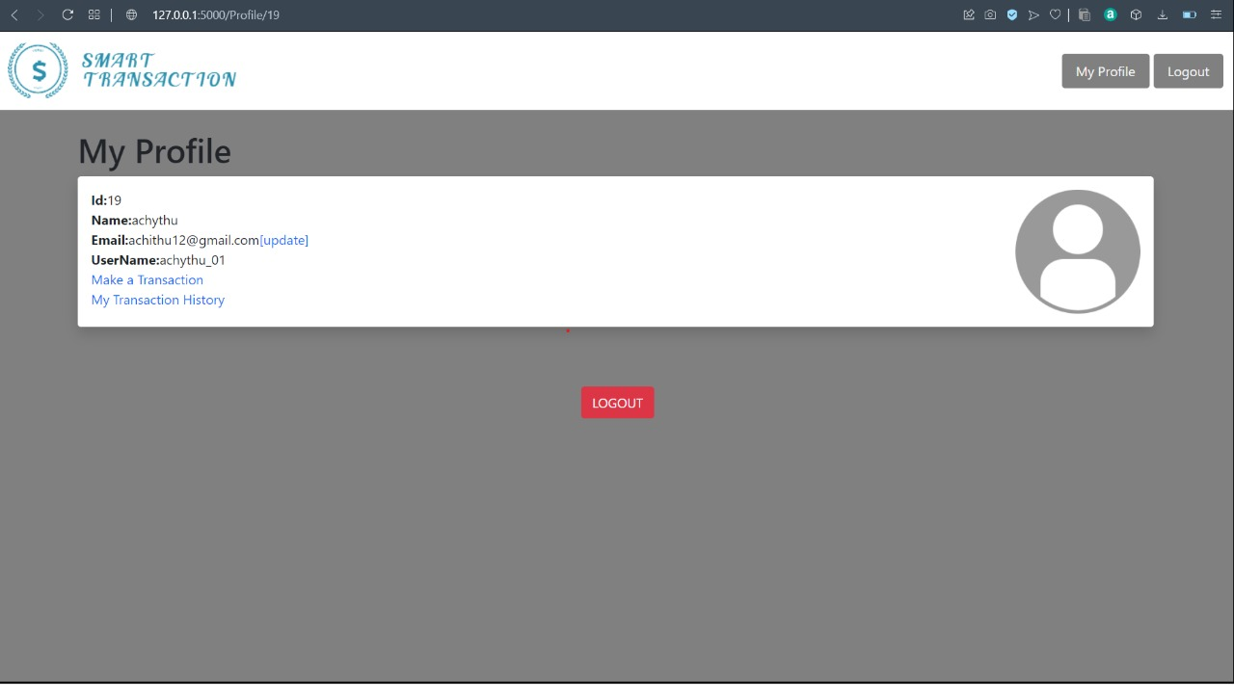

Slide 22
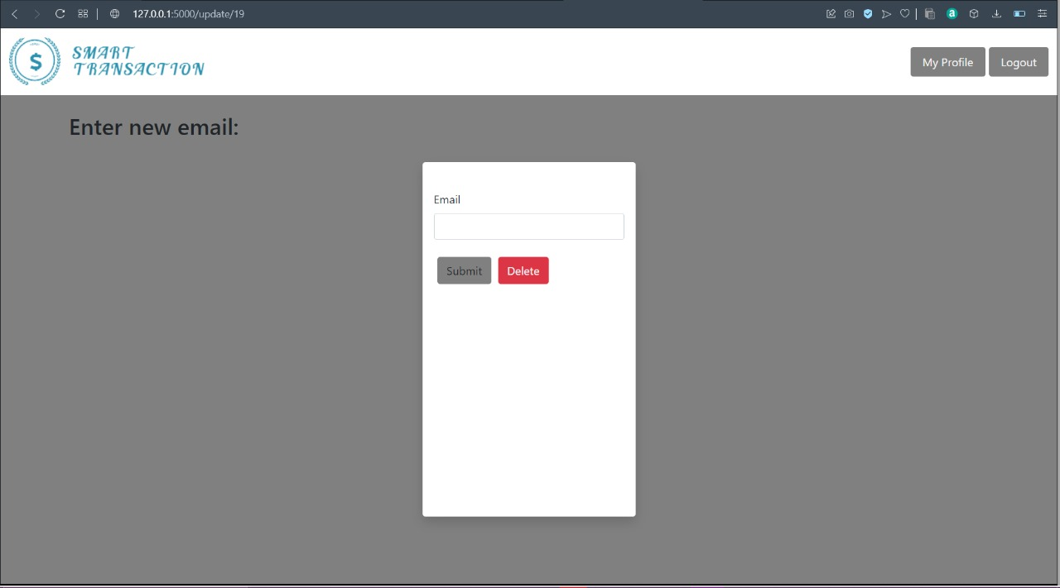

Slide 23
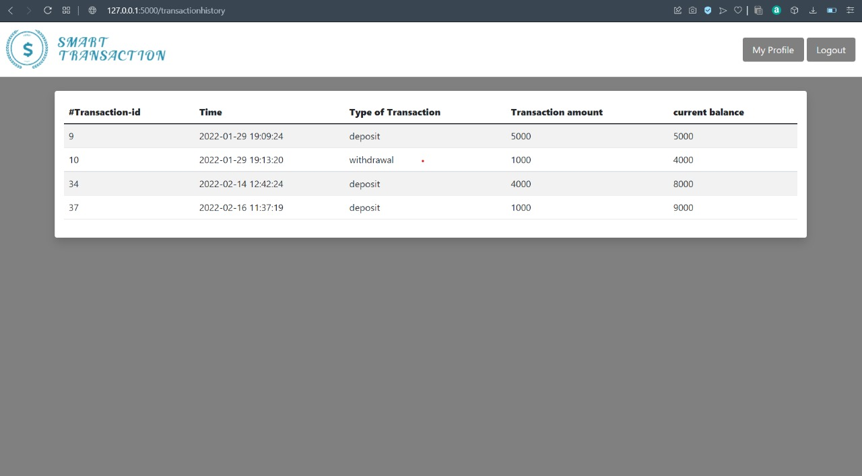

Slide 24
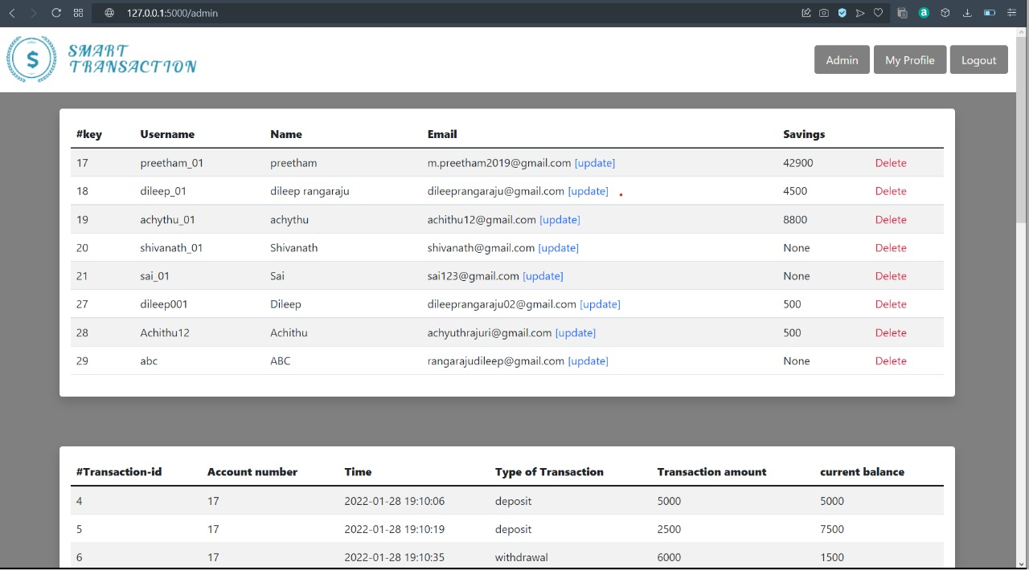

Slide 25
8. REFERENCES :
[1] Python: https://docs.python.org/3/
[2] Flask https://flask.palletsprojects.com/en/2.0.x/, https://www.youtube.com/watch?
v=y62Dvo2Ml7o&list=PLCC34OHNcOtolz2Vd9ZSe
SXWc8Bq23yEz&index=4
[3] wtforms: https://wtforms.readthedocs.io/en/3.0.x/

Slide 26
THANKS!

